Slide 1
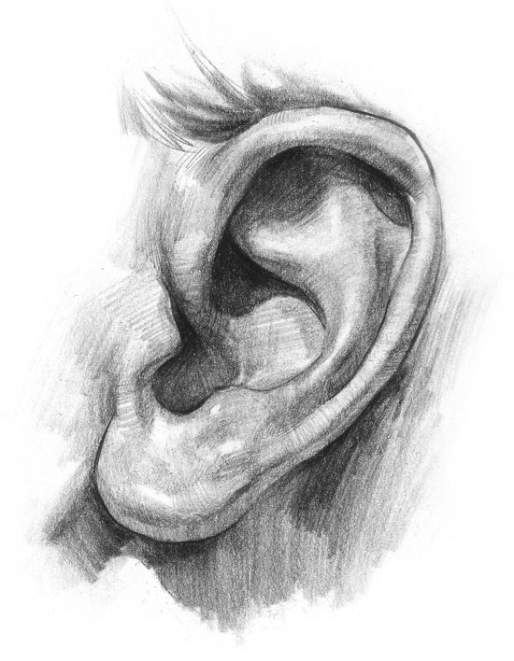
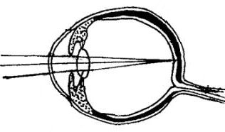
Sensory Acuity
How to become more sharp
in your observations?
How to differentiate between
observation and interpretation?

Slide 2
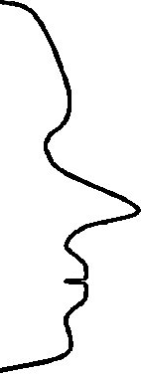
How do we Communicate?
FILTERS
Internal
Representation
Delete
External
signal
State, emotions
Deform
Generalise
Physiology
Behaviour

Slide 3
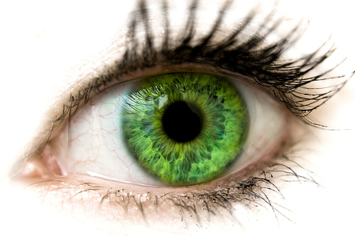
Sensory acuity, 7. What do we observe?
Exercise: What do our senses delete?
Read the following text once carefully and
count how many times the letter F exists in this text.
FINISHED FILES ARE THE RESULTS OF YEARS OF SCIENTIFIC STUDY COMBINED WITH EXPERIENCE OF YEARS OF TRUTHFULL WORK AND OF INTENSIVE REFLECTION IF THEY ARE FILLED WITH FAITHFUL FACTS ABOUT EFFECTIVE SAFETY PERSONS OR FALSE OFFENDERS OF FOUR FANTASTIC AND BEAUTIFUL PEOPLE.

Slide 4
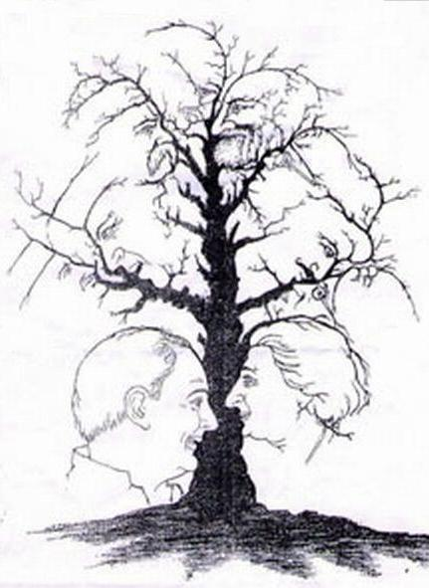
The Head Tree

Slide 5
How sharp are your senses?
Take more time to focus!

Slide 6
Focus with Sensory Acuity!
What did you see?
How many?
Notice how many different observations there are done!

Slide 7
Very much Sensory Acuit!
The answer is 10 heads
Do you want to check another time?
What kind of persons were represented?

Slide 8
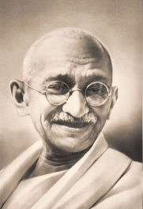
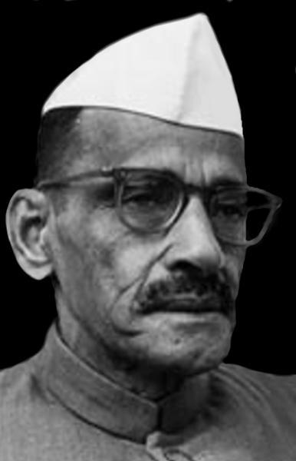
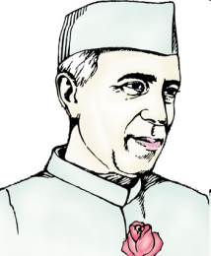
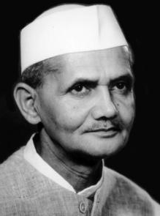
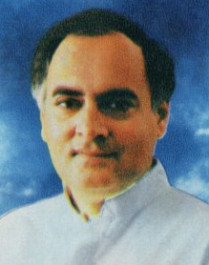
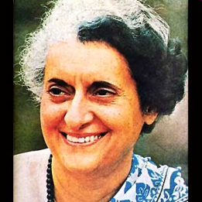
1
2
MahatmaGandhi
1
Gulzarilal Nanda
2
MahatmaGandhi
Nehru
Gulzarilal Nanda
3
3
4
4
Lal Bahadur Shastri
Rajiv Gandhi
5
6
Indira Gandhi
Nehru
Lal Bahadur Shastri
5
6
Rajiv Gandhi
Indira Gandhi

Slide 9
What do we need to get a complete picture?
Attention
Focus on the detail
Focus on the overview
Knowledge about what we can expect
Interest
………

Slide 10
Sometimes it works differently ……..
What do we really need?
Acrocidng to sinefitc rsaerceh at an Eglnhis Uvirntsiey it dseson’t mkae any defenrifce in wchih suqenece the ltreets of a wrod are psiotienod, the olny tnihg whcih is intamropt is taht the fsrit and the lsat lteetr are at the rhgit palce.
The oehetr lttrees may be pealcd on any pacle. You are albe to raed eislaiy waht is wttrien. The rosean is taht we are redinang erevy lteetr saetperlaly but ervey wrod as a wolhe.

Slide 11
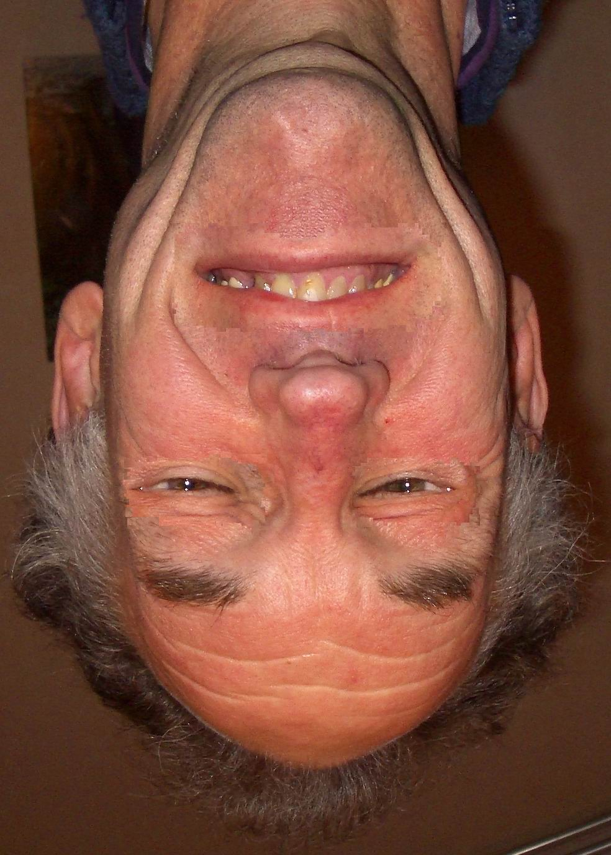
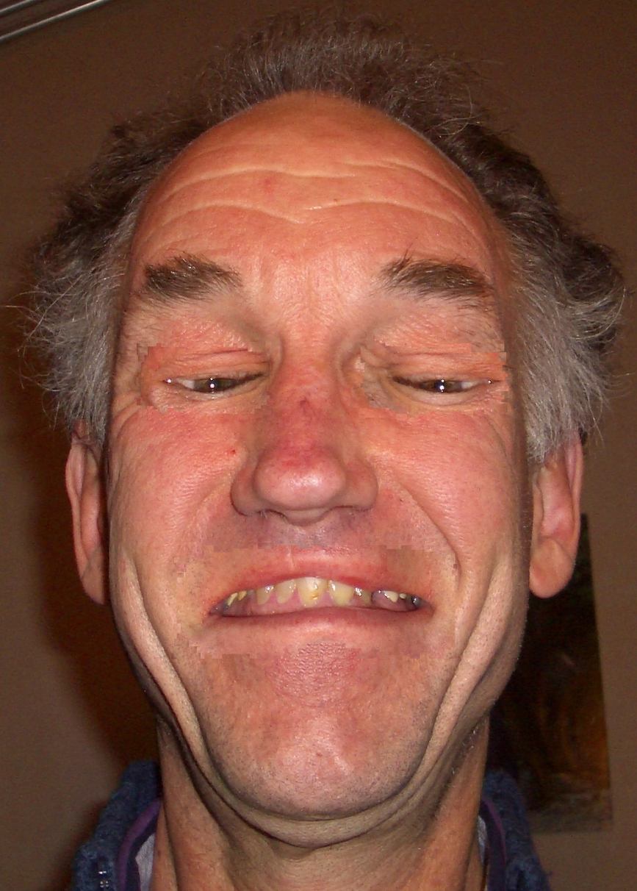
Misleading?
Which emotions following your inerpretations with this person?
What is your interpretation if you turn this photo 180

Slide 12
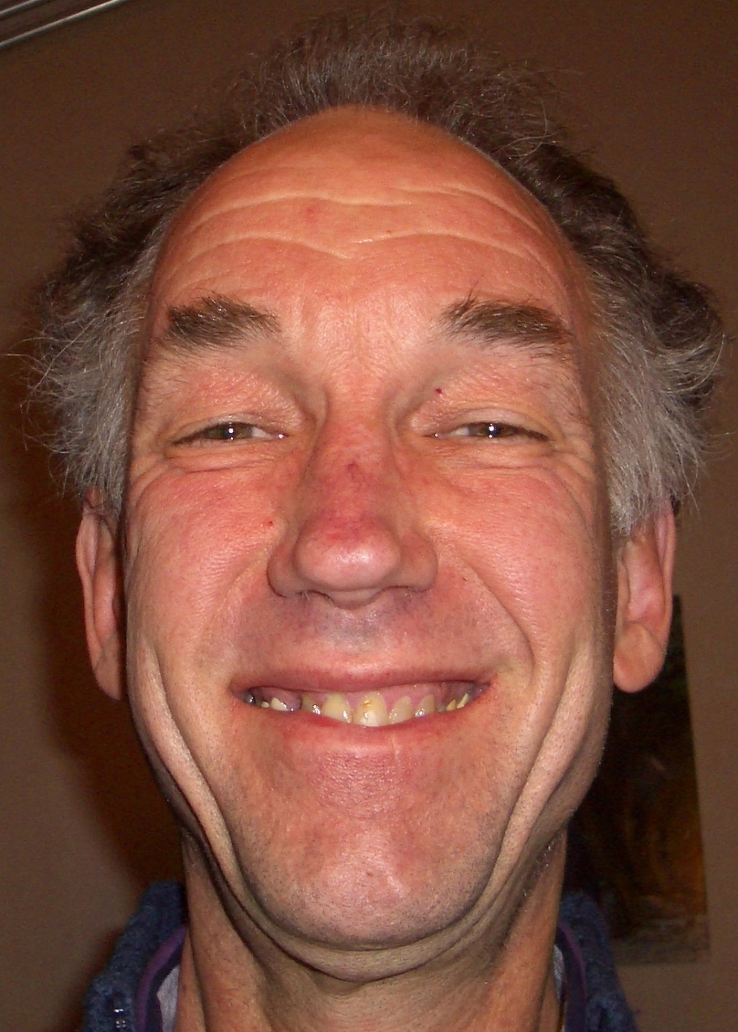
As it was in the original photo

Slide 13
What are the lines doing, you think?

Slide 14
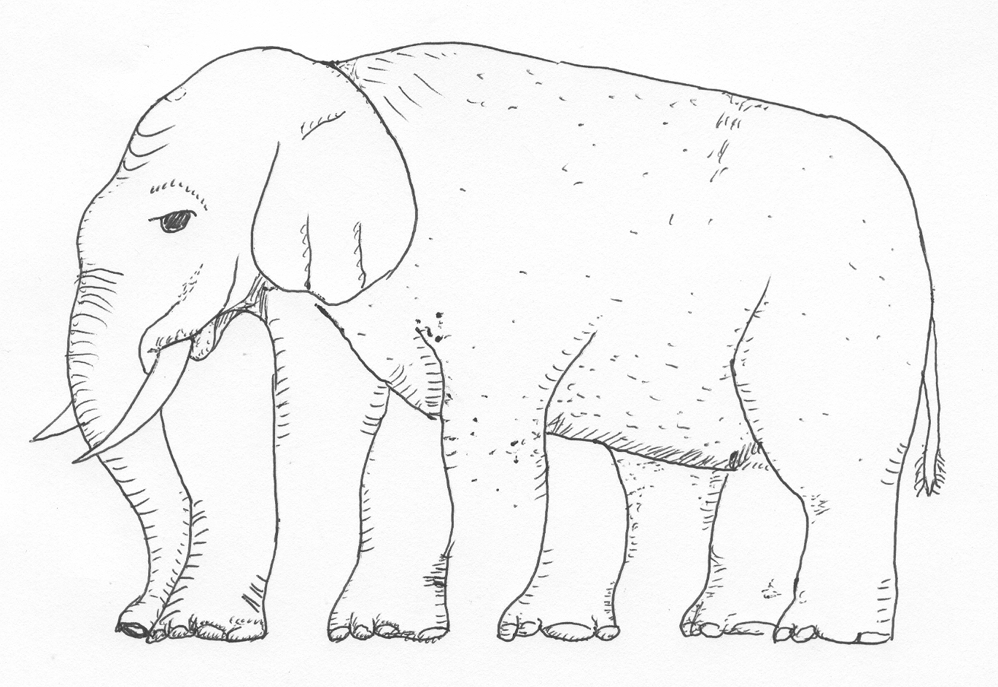
How many legs has this elephant?
And if you cover the lower part?

Slide 15
How many legs has this elephant?
And if you cover the upper part?

Slide 16
Detail or……..

Slide 17
Detail or overview?

Slide 18
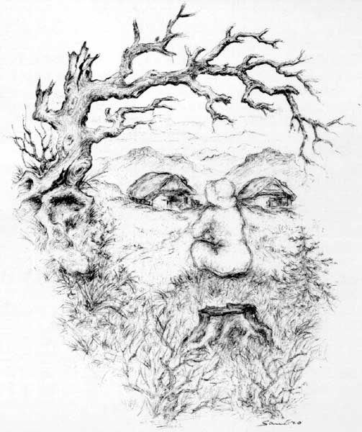
What attracks your attention at first sight? What after that?

Slide 19
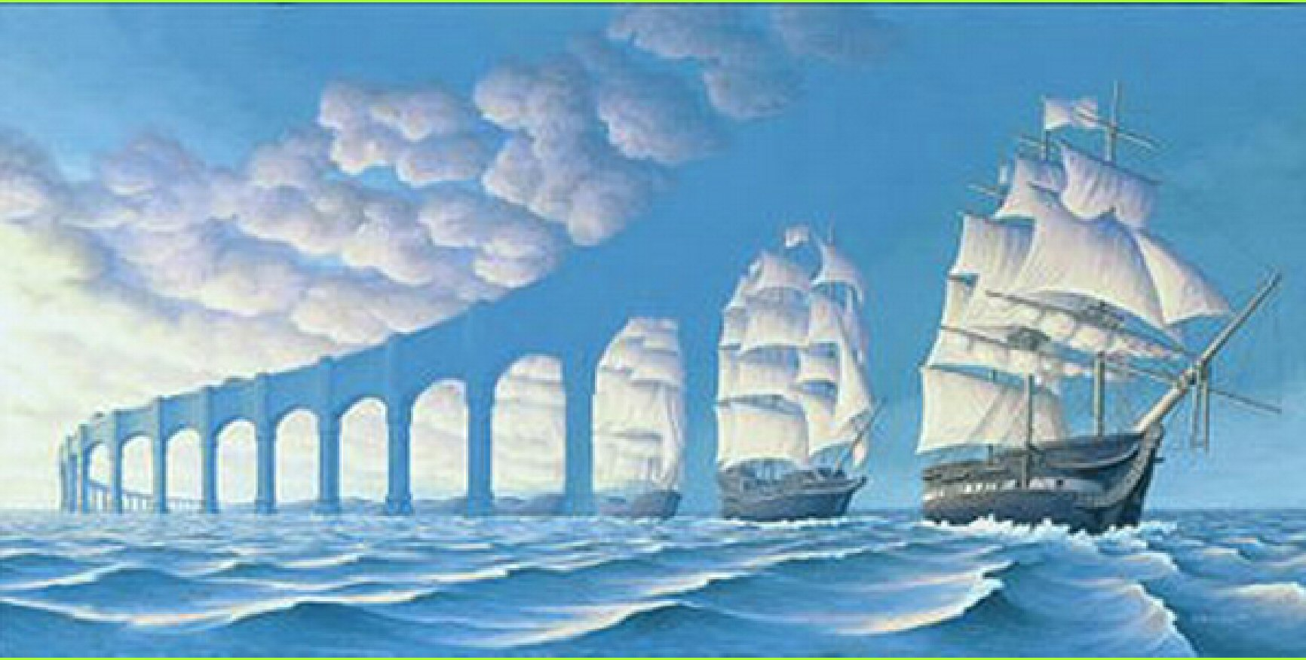
Where does your attention go?

Slide 20
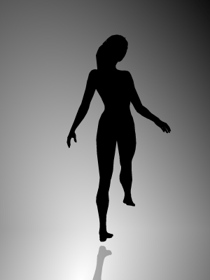
What is your observation?
What is your interpretation?
Does the lady
turn right or left?

Slide 21
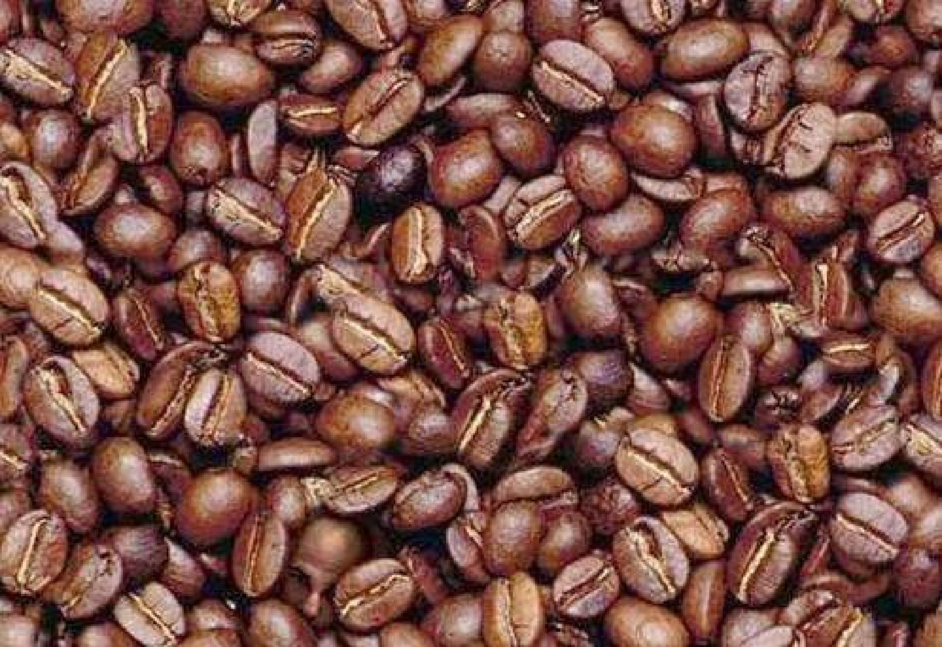
Discover Mr. Bean
What is the function of a search image?

Slide 22
Discover Mr. Bean 2nd time faster? Explain!
What is the function from a search image?

Slide 23
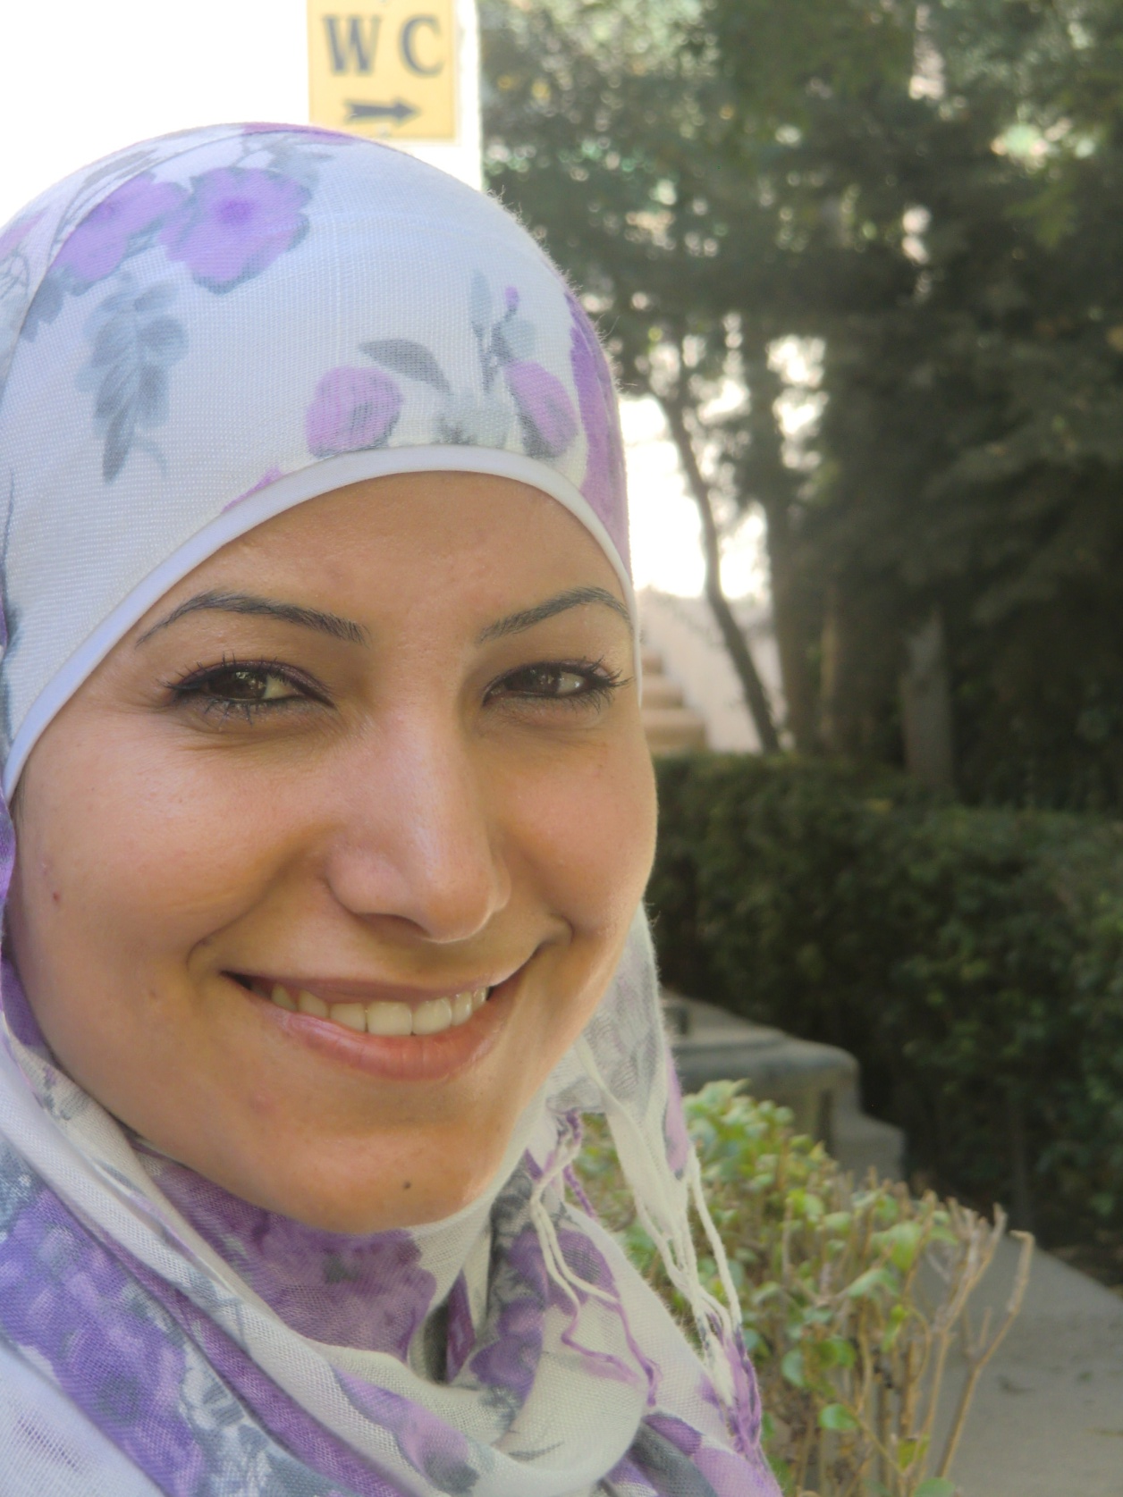
Which caracteristics are changing?
Color of the skin:
Light ………………………………….. Dark
2. Tension of the skin:
Shiny …………………………………. Not shiny
Symmetric ………………………… Asymmetric
Wrinckles in forehead
Flat ……………………………………. Deep
Wrinckles between eyes
Flat ……………………………………..Deep
Wrinckles between eye and ear
Flat ……………………………………..Deep
Wrinckles around the mouth
Flat …………………………………… Deep
3. Breathing
Fast …………………………………….Slow
High …………………………………….Low
4. Size of the underlip, and
position of the mouth corner
Lines …………………………………..No lines
Mouth corner up ……………….Down
5. Eyes
Focus sharp …………………………Not sharp
Pupils …………..…………………… Not enlarged

