Slide 1
Identity and Mission
What is worth to live for?
Online workshop for NLP participants in Ramallah and Gaza

Slide 2
Welcome
Make a difference between behavior and the Person.

Slide 3
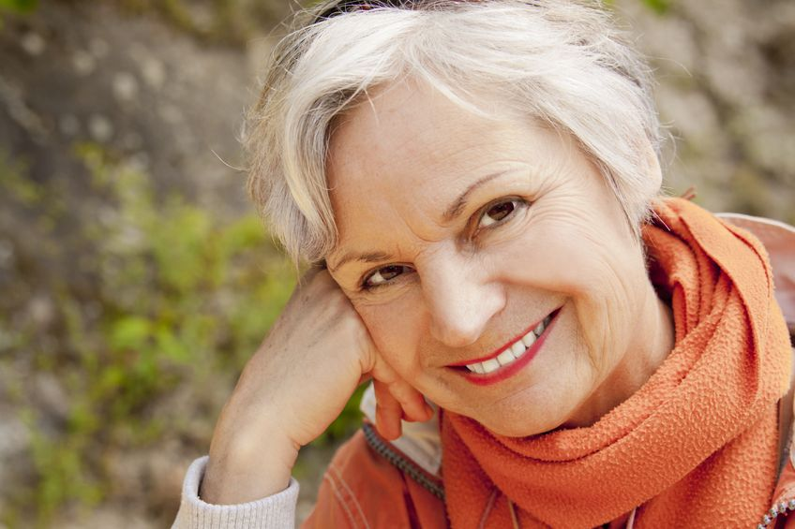
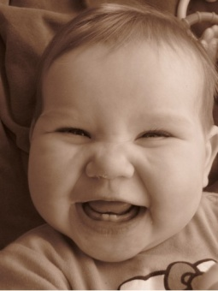
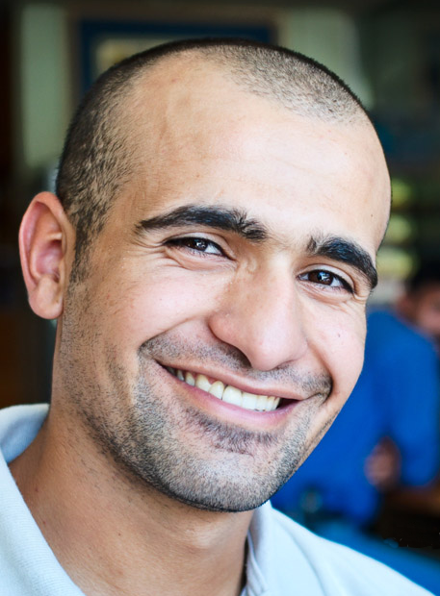
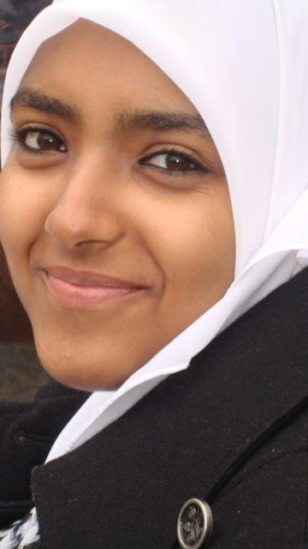
Be a shining person in the world
Focus (2 minutes) on a moment in which
you felt great fulfillment of your life.

Slide 4
Write the title of your experience in the chat.

Slide 5
Neurological levels
Mission
What is the purpose of my life?
Identity
Who am I?
Values
Beliefs
What do I believe?
Capabilities
Skills
What am I able to do?
behavior
What am I doing?
Environment
Where am I?
S

Slide 6
What do you have?
Who are You?
mission
Being
Having

Slide 7
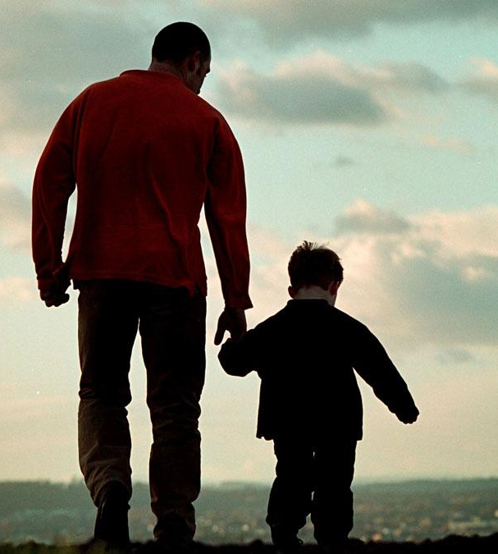
Behavior or Identity?
father
Walking with his child
doctor
carpenter
musician
painter
constructor
office worker
cook
to construct
to work in the office
making music
to paint
to construct
to cook

Slide 8
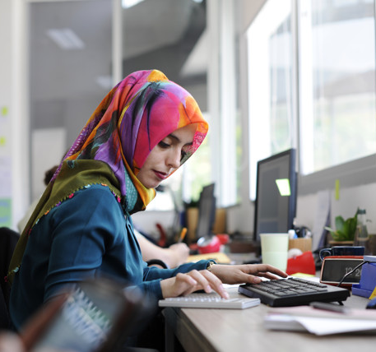
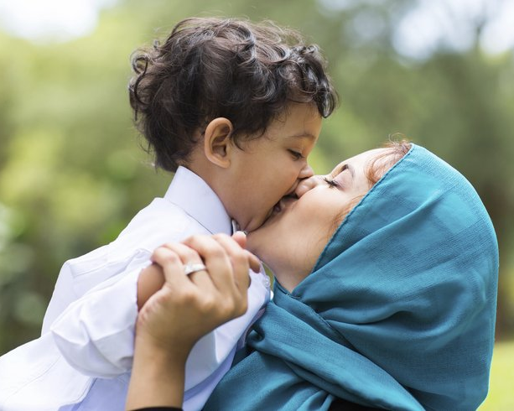
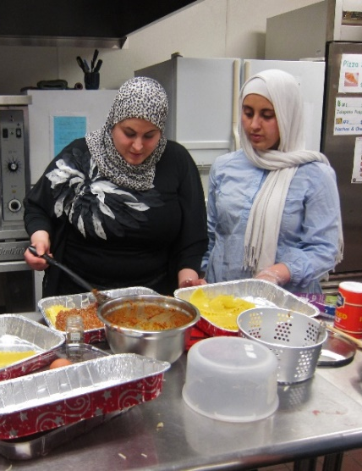
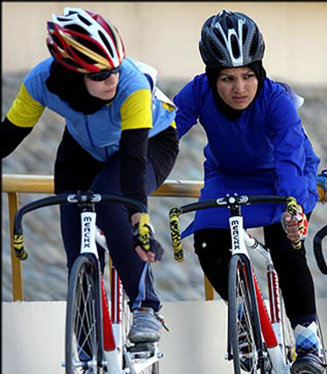
Behavior or Identity?
officeworker
teacher
mother
doctor
Working in an office
Teaching in a school
Kissing her child
Curing people
cook
cyclist
trucdriver
politician
(Hanan Ashrawi)
politician
Cooking
Riding a bicycle
Driving a truck
Speaking to public

Slide 9
To have and to be
At school they were written on the blackboard
the verb to have and the verb to be
with this, time and eternity were given
one reality, the other deceptive.
Having is nothing. Is war. Is not life.
is of the world and of its idols.
Being is raised above those things,
to be filled with the divine.
Having is hard. Is body. Is two red painted lips.
Is hunger and thirst for worldly desires.
Is only empty words, only blunt duty.
Being is the soul, is listening, is allowing.
Is becoming a child and watching the stars,
and being slowly lifted up to the sky.
(After Ed Hoornik)

Slide 10
Who am I? What is my identity?
What is my job? What is my behavior?
my name?
a cook?
a teacher?
a student?
a lawyer?
an office worker?
an Arab speaker?
a Palestinian?
an Arab?
a world citizen?
a part of the universe?
the child of my parents?
a mother/father?
a woman/man?
a human being?
a living creature?
What do you feel that are most important as part of your identity?
Write the numbers in order of decreasing importance to you. (5 min.)

Slide 11
Exercise
1. Make two papers:
One with ‘I have’
The other with ‘I am’
Having:
‘I have’
Being:
‘I am’
2. Put them at the floor with at least one meter distance
3. Step to the side of ‘Having’ and think of all the things, and capacities which you have.
4. After 2 minutes step to the side of ‘Being’ and think of all the qualities which are part of your being, who you are deep in your heart.

Slide 12
Compliment on behavior level or on identity level?
To strengthen the identity of someone else,
it is positive to say:
“You are OK!” or
“You are wonderful!”
Try the effect of staying close to the facts, on behavior level.
The person might belief you more easily:
“What you did yesterday was very adequate, because …………..“.
Or “What I did this morning was with love and attention.”
Write a compliment for yourself on identity level
And a compliment on behavior level.
Put them in the chat.

Slide 13
Identity and Ego
“When the ego dies, the soul awakes.”
Mahatma Gandhi
“The Ego is a veil between humans and God. In prayer we all are equal.”
Rumi
Ego is defined as your idea or opinion of yourself, especially your feeling of your own importance and ability.

Slide 14
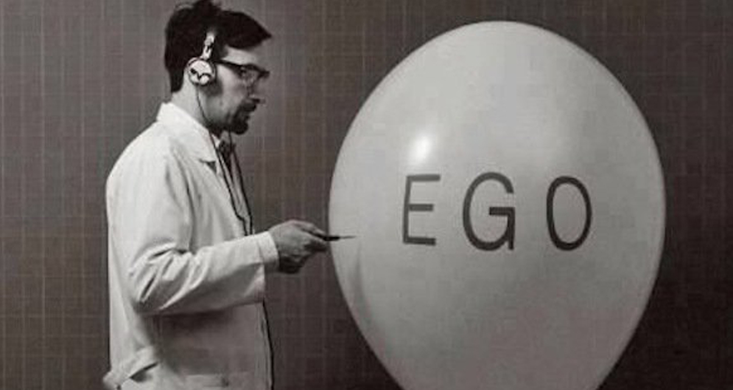
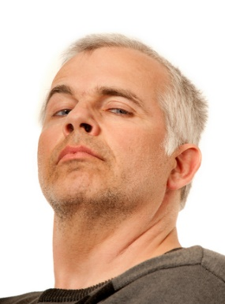
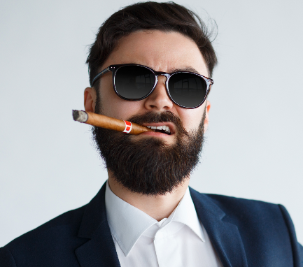
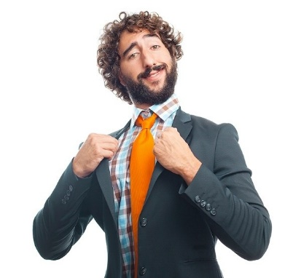
Ego to big:
you are selfish, arrogant, judgmental to others, egoistic.

Slide 15
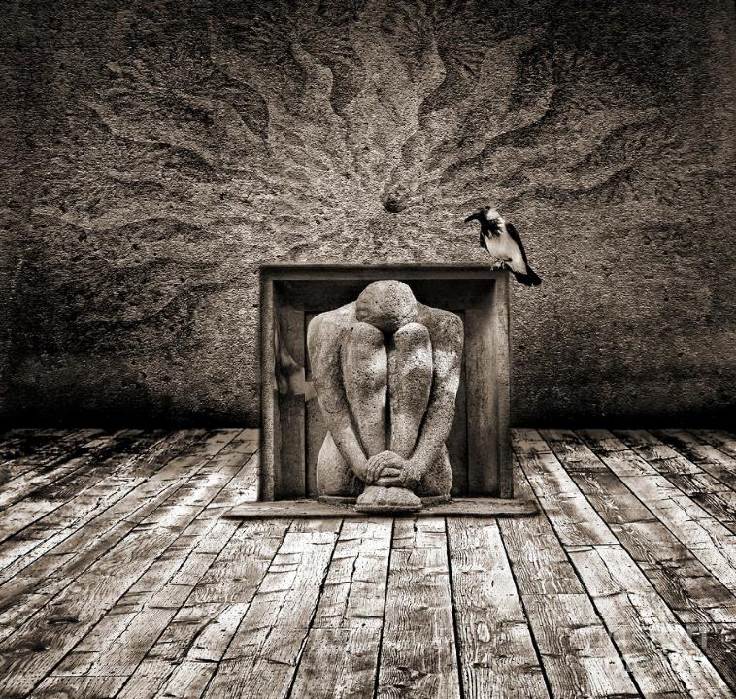
Ego too small:
you let others walk over you, you hide yourself, others are more important than you, you don’t say what you want.

Slide 16
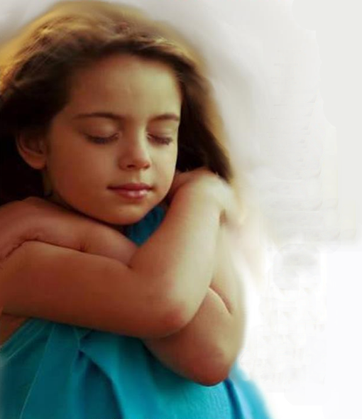
Love yourself
Your ego is ok!

Slide 17
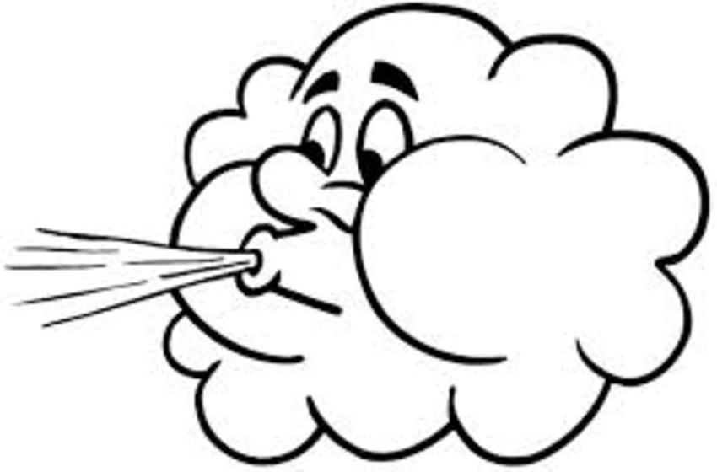
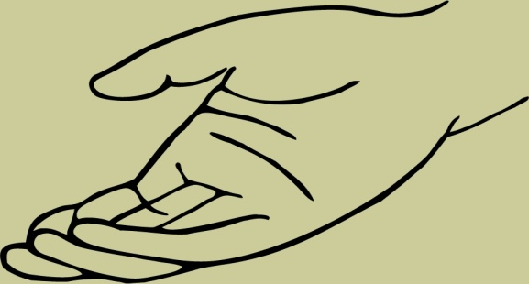
Exercise: blow away a negative ego
S W I S H

Slide 18
How to change my too big/small ego?
Close your eyes and look at the image of yourself with an ego too big or too small.
Change bright colors into grey.
If it is moving stop the moving.
Make the image smaller with your hands
Push it at more distance from you.
Blow it in the sky, let it disappear behind the horizon.
PFFFFFFFFFFFFFFFFFFFFFFFFFFFFFFFFFFFFFFFFFFFFFFFFFFF

Slide 19
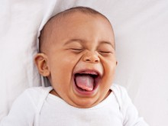
Making a positive memory still stronger
more contrast
bigger
S W I S H

Slide 20
Positive intention comes from your identity
What is your positive intention on identity level?
to feed,
to sleep,
to feel safe
to be acknowledged
to love and
to be loved

Slide 21
Every behavior has a positive intention…….
Think of a behavior you don’t like of someone close to you.
Take a moment to go in his or her shoes.
What could be the positive intention to fulfill his or her basic needs?
Write the name of the behavior and the positive intention in the chat.
What could you do if you are aware of the positive behavior, instead of becoming angry?

Slide 22
Reframing
3 Perceptual
positions
3rd position
Observer
I
2nd position
1st position

Slide 23
How do you see
your own identity?
What is your mission?
3
Third Position
How do you see yourself if you take distance and look from a helicopter position to your self?.
Exercise:
Take 2 minutes in position 1
How do you see your identity
And how your mission?
and 2 minutes in position 3
How do you see your identity
And how your mission?
Write the differences in the chat.
1
First Position
How do you see your self?

Slide 24
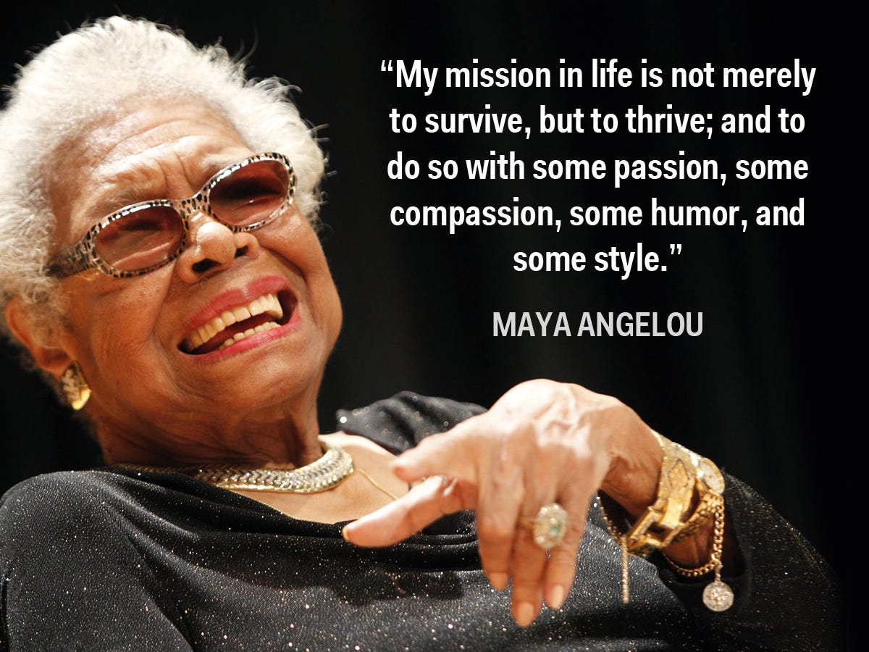
From your Identity to your Mission

Slide 25
Write in the chat what you take with you from this workshop.

