Slide 1
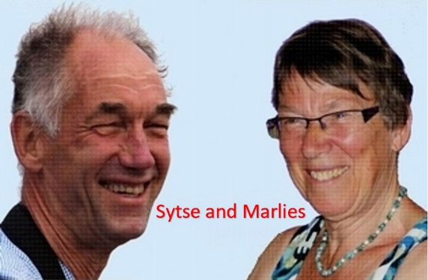
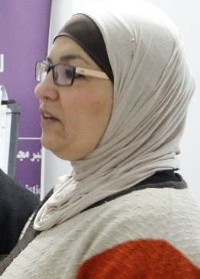
“Create more choices with NLP”
Every behavior has a positive intention
Creating Choices
Palestine Online workshop 7 Oct 2020, 20.30 – 22.00
organizer, translator and co-trainer: Hekmat Bessiso

Slide 2
If you think
that there is only one choice..
you will not look for other choices

Slide 3
NLP Presupposition
The more choices,
the more success
The person with the greatest number of choices
is likely to get the best outcome.

Slide 4
Presupposition about Corona
If you say: ‘Corona is bad’.
What will you probably focus on?
(write one in the chat)
If you say: ‘Corona may have good sides’.
What will you probably focus on?
(write them all in the chat)

Slide 5
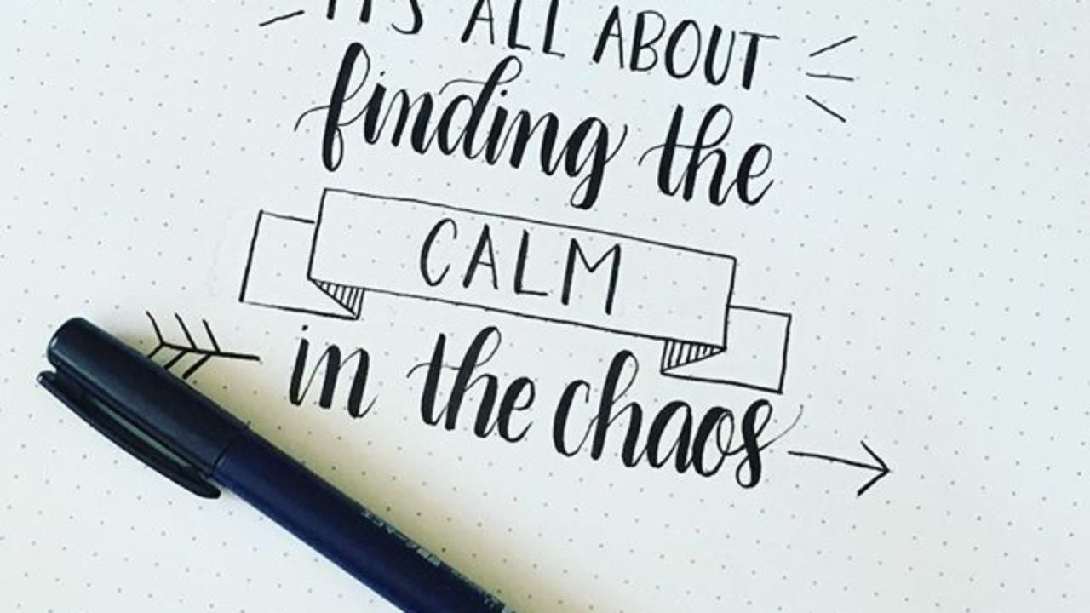
Have you more?
more time for myself,
more time for my family,
pay more attention to solidarity to less privileged people
more time for praying
more time for thinking about the meaning of life
I learned to study online NLP
I take the opportunity to read
……

Slide 6
‘Be realistic, think (choose for) the impossible’
quote from the German philosopher Ernst Bloch.

Slide 7
Is the world dark?

Slide 8
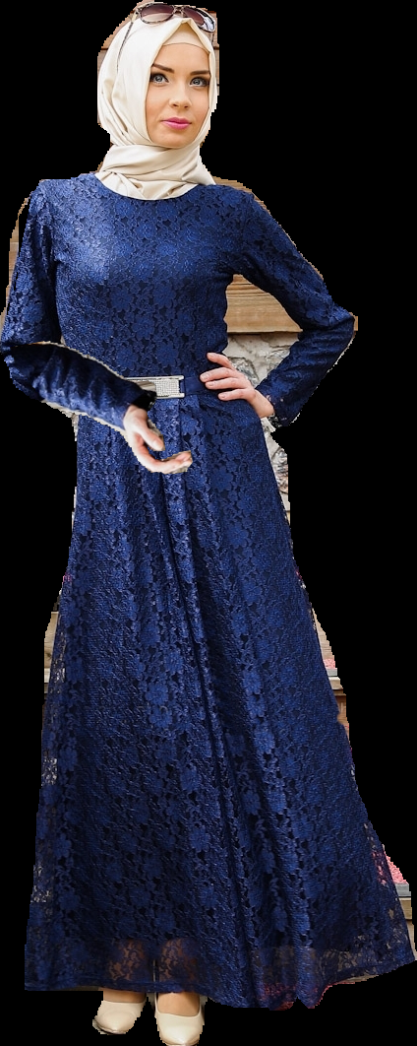
NLP presupposition: You can change your world!

Slide 9
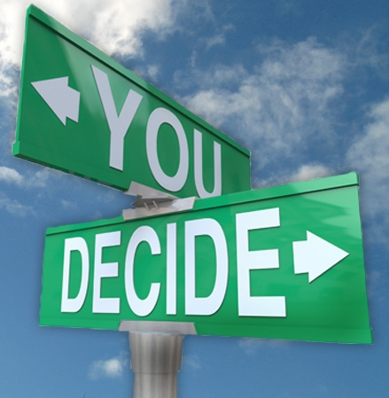
Presuppositions (الافتراض الضمني)
Is an ’implicit assumption’:
If you take it as a fact it works for you.
Example:
If you say: ‘There is no choice in this situation’, then you will not look for possibilities.
But if you say: ‘There is always a choice’, then you will look for all kind of possibilities.

Slide 10
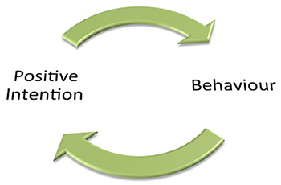
More NLP presuppositions:
7. Every behaviour has a positive intention.

Slide 11
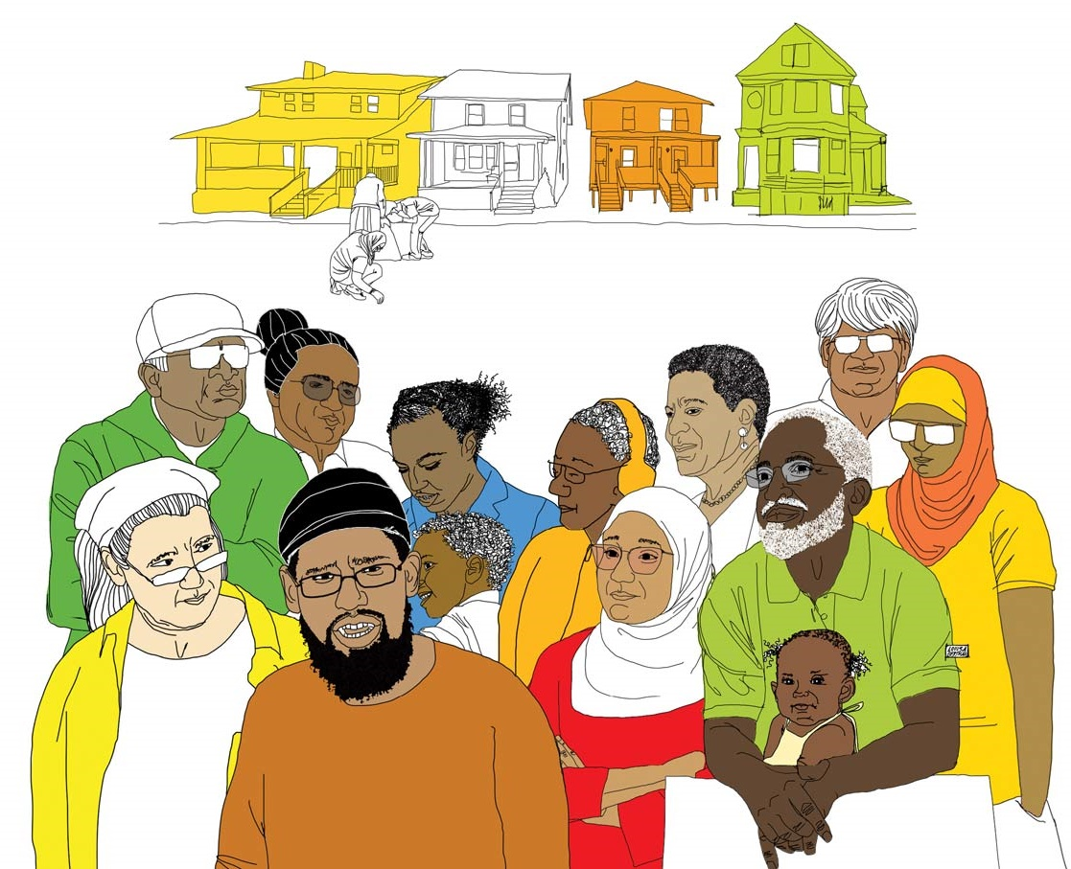
More NLP presuppositions:
9. Everyone has all the resources s/he needs.
Resources in the community
Resources in yourself

Slide 12
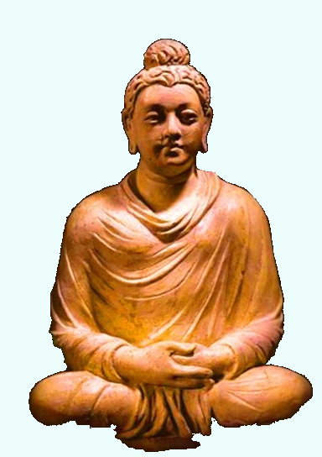
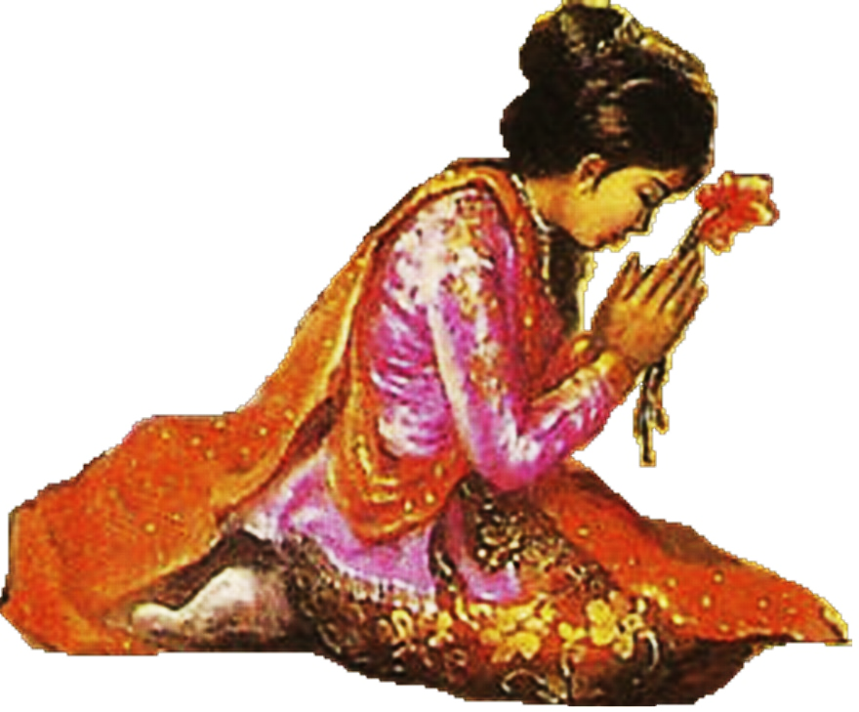
The ‘impossible’ choice
Once upon a time there was a mother who lost her child. She went to Buddha and ask to revive her child.
What do you think the Buddha said to her to make the impossible choice?

Slide 13
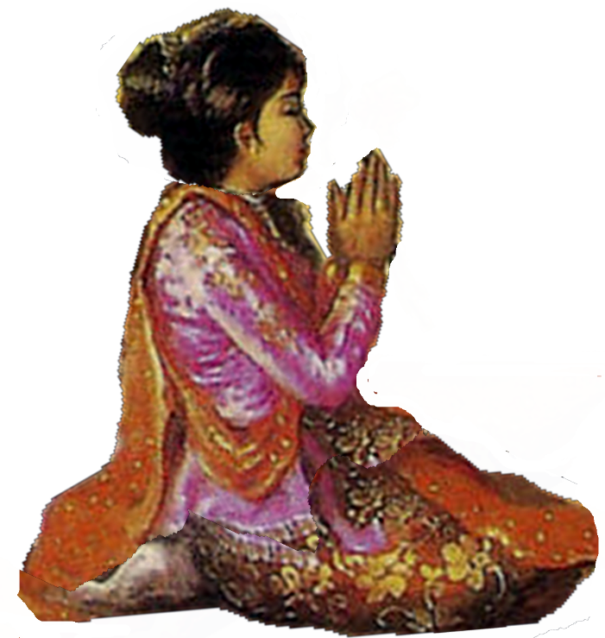
the Buddha said:
“I ask you to find only one family who never had such a tragedy.”
The women went through the entire city and asked all the families this question.
Then she came back to the Buddha and said:
“All the people I met, gave me compassion.
Now I can endure my grief”

Slide 14
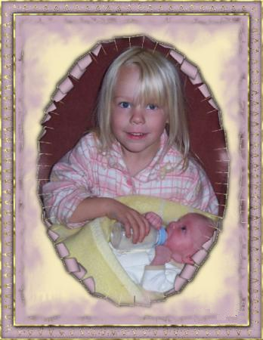
What is your choice to think about the bigger picture?

Slide 15
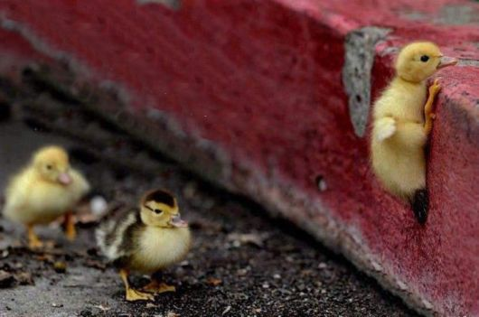
I choose to ask the impossible,
I asked to be able to fly ...
And life gave me obstacles to overcome.

Slide 16
Make a choice about what you see.

Slide 17
Making more choices

Slide 18
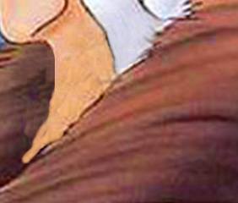
Reframing: Look at it from another side.

Slide 19
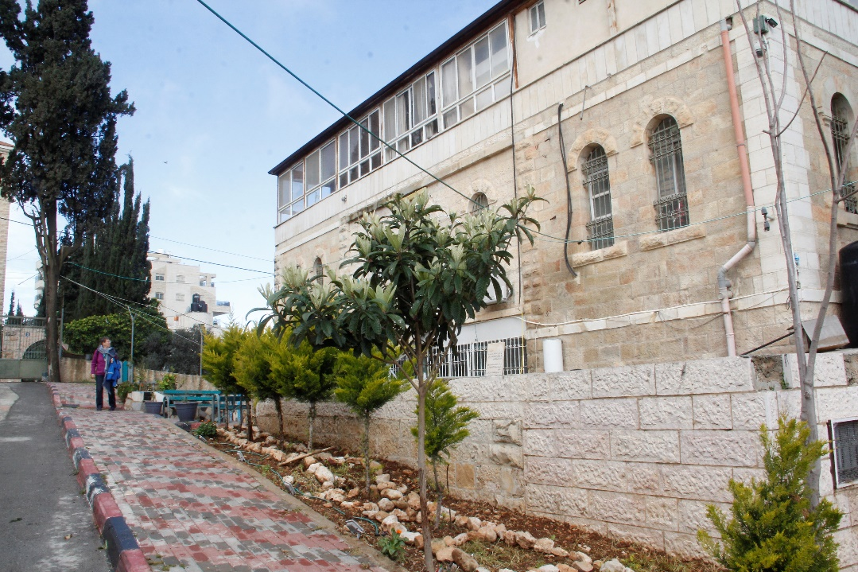
Making more choices:
1 Failed for an exam?
Punishment of the examinator?
Chance to learn better.
2 Dar Al Amal, Ramallah
Youth prison, to punish for what they did
Youth prison to protect the society
Home for young boys to give them a chance,
to create a better life for themselves
and to contribute for the society.

Slide 20
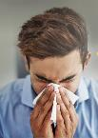
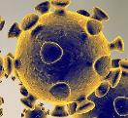
How do we Communicate?
B r a i n
Map
Territory
Internal
Representation
External
signal
State, emotions
FILTERS
Delete
Generalise
Deform
Observe
Physiology
Behaviour

Slide 21
More choices: choose an other filter
Information from outside
Presupposition 2
FILTER 2
FILTER 1
Presupposition 1

Slide 22
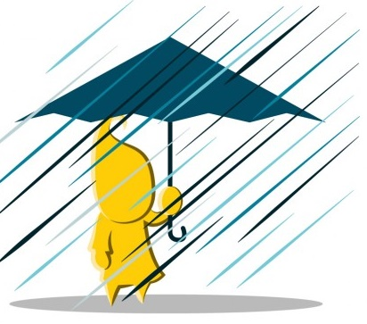
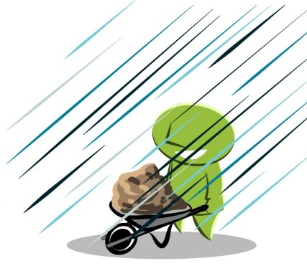
Choosing to change the context
Awful it rains
Wonderful for the garden

Slide 23
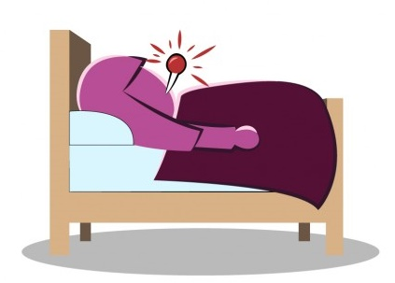
Choosing to change the Meaning
Separate behaviour and intention: ‘what do you really want?’
Separate behaviour and identity: ‘what do you do? ≠ who are you really??’
Choose to look at the benefits in stead of the disadvantages:
‘I am ill, so I can not work’
‘I am ill, so this a perfect moment
to give my body some rest’

Slide 24
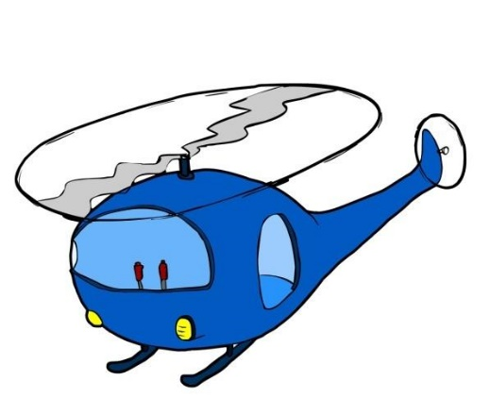
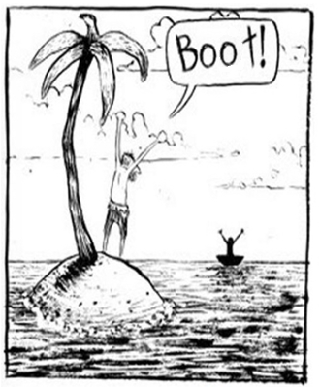
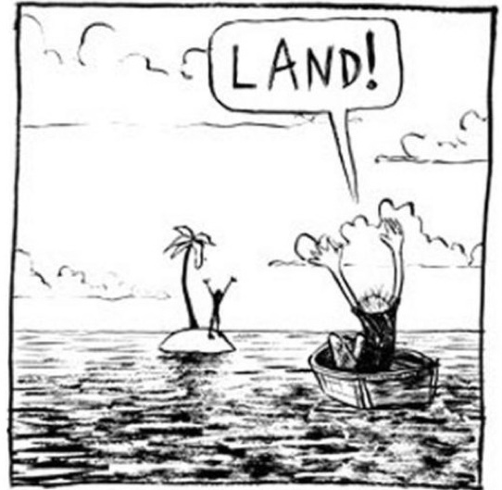
Making other choices:
From the helicopter
position
Looking from the position of the other
May be they can support each other.
They need a third person to save them

Slide 25
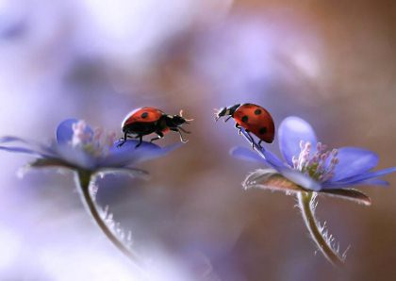
Relation too much distance?
What can they do at this distance?

Slide 26
What do I choose?
Being a victim, complain and blame
I feel powerless because the corona crisis ….
or
do I take initiatives, create possibilities?
I feel good because I …..
study online,
clean the house, write to people,
phone beloved friends
take a course in NLP

Slide 27
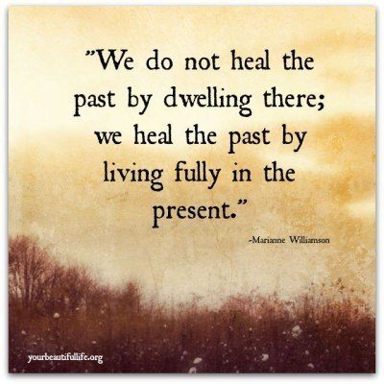
Even in corona-time: Choose to live fully

