Slide 1
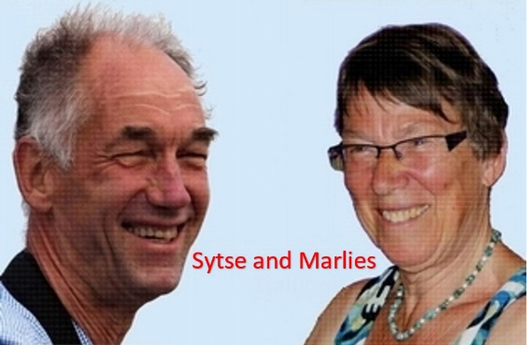
“Surviving Coronavirus Powerfully with NLP”
To a valuable model of your world
Welcome!
Palestine Online workshop 30 September 2020,
organizer, translator and co-trainer: Hekmat Bessiso

Slide 2
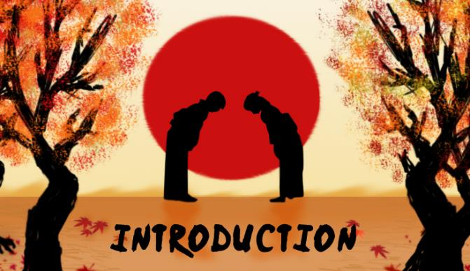
Short
Introduction
Please say:
your name,
work,
place where you live
is NLP new for you?

Slide 3
Internal
Representation
What are the individual differences in the internal representations?
Practice
Write for yourself at least 5 words which come up when you hear the word “Coronavirus”.
What do you think?
How many of these words, which you wrote down are written by everybody?
Write them in the chat.

Slide 4
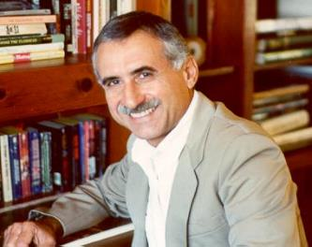
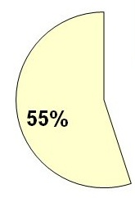
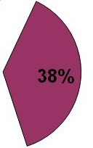
What is communication about?
words
physiology
Zoom
Professor Albert Mehrabian
tonality

Slide 5
Modern Communication
What is the percentage of the
whole Communication ?
Telephone call
Email

Slide 6
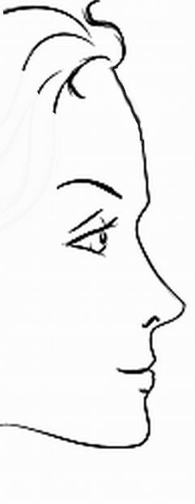
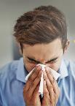
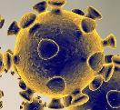
How do we Communicate?
B r a i n
Map
Territory
Internal
Representation
External
signal
State, emotions
FILTERS
Delete
Generalise
Deform
Observe
Physiology
Behaviour

Slide 7
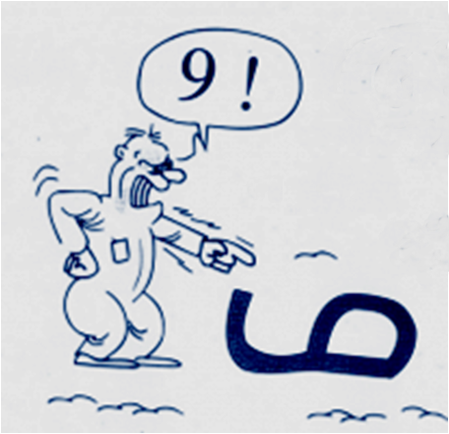
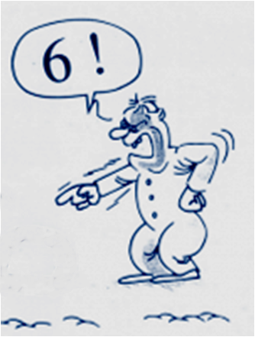
Perception
=
Projection
Look from a different perspective

Slide 8
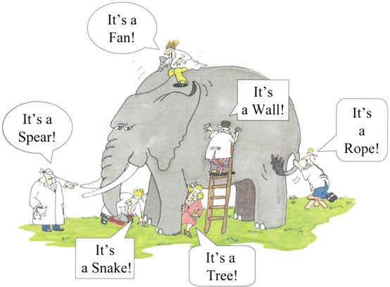
The six blinds: The map is not the territory

Slide 9
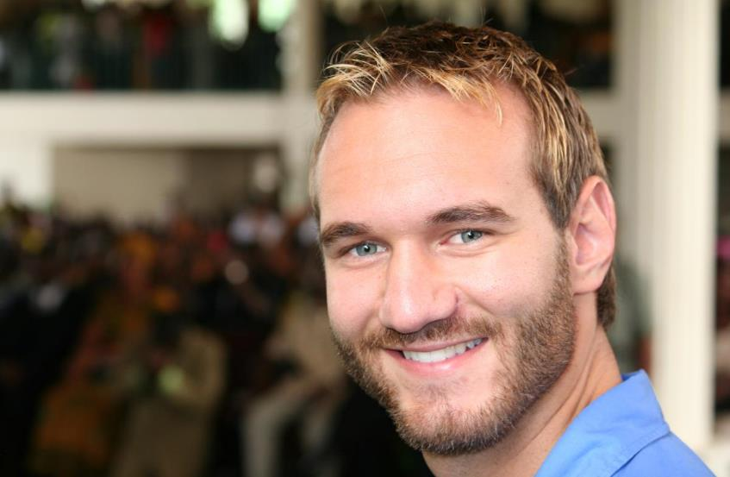
How much can you focus at what you have?
Instead of focussing at what you miss?

Slide 10
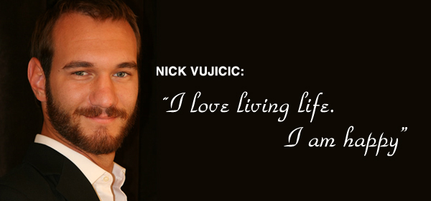
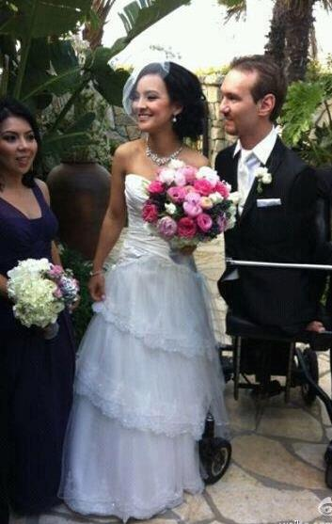
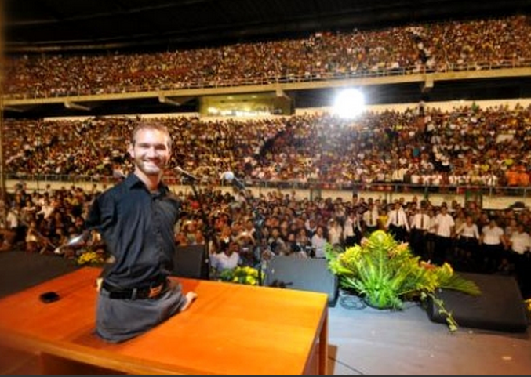
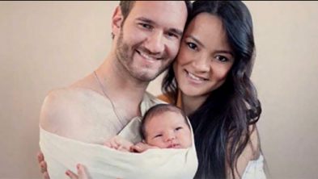
What is he focusing on?

Slide 11
The three life questions أسئلة الحياة الثلاثة
1 What do I focus on?
2 What meaning do I give it?
3 What do I do?
ما الذي تركز عليه ؟
.2ي معنى تعطيه ؟
.3ماذا تفعل ؟

Slide 12
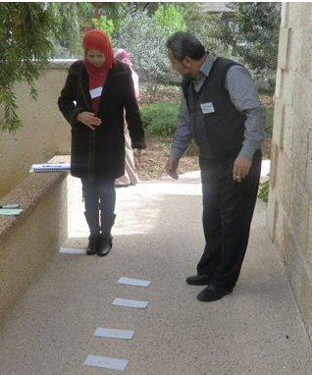
NLP in Ramallah
1. What are they focusing on?
ما الذي تركز عليه ؟
2. What meaning do they give it?
.2أي معنى تعطيه ؟
3. What are they going to do?
.3ماذا تفعل ؟

Slide 13
Practice Three Life Questions
We work in break-out-rooms, 15 minutes, fill in the positive frame.
Take an actual situation in your personal life
If you are able to focus on empowering thoughts, you might become more successful.
1 My focus on the negative side
2 The meaning I give it
3 The action I want to take
1 My focus on the positive side
2 The meaning I give it
3 The action I want to take

Slide 14
What do I choose?
I feel a victim, I complain, and I blame
I feel powerless because the corona crisis ….
or
I take initiatives, I create possibilities?
I feel good because I …..
go study online,
clean the house, write to people,
phone beloved friends
take a course in NLP

Slide 15
How do I enlarge my circle of influence?
Victim
Actor
Stephen Covey
Circle of concern
Circle of concern
Circle of influence
Circle of influence
Stay at the side of the result!
Go stand at the side of the cause!
Passive:
I blame the others,
I blame the corona
I can’t do anything
Why I?
Pro-active:
I take initiatives
I look for possibilities
I can do different things
I take responsibility.

Slide 16
“Surviving Coronavirus Powerfully and with Courage”

Slide 17
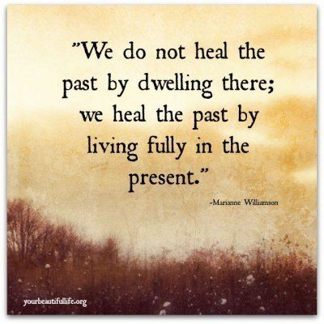
Choose to live fully even in corona-time

