Slide 1
to the NLP-course “Getting to know your Unlimited Powers even better”
مرحبا
إمكانيات غير محدودة
Welcome!
دورة في البرمجة اللغوية العصبية
Dar al Amal, Ramallah, Palestine
fifth day Thursday 26 October 2016
Trainers: Sytse and Marlies Tjallingii

Slide 2
Good and New
Energy
Joy
In pairs, 2 minutes each.
Focus at a recent situation which has given you a good/or new feeling. In which you felt energy, happiness or joy.
Share in the whole group the title of your experience and show your feelings at your face.

Slide 3
Open Frame
Questions
Experiences
Short stories
Share a real life-experience to reflect on what NLP can mean to it.
Goal: apply NLP in your own reality.

Slide 4
Healing Metaphors

Slide 5
At the foot end of the (own) children’s’ bed
Objective of this exercise:
Healing a painful situation in the past.
This can be in early childhood, but also in adolescence.
The principle is:
You make all situations in the past more bearable
and healing those by looking at it lovingly
and to give love to your younger self in these situations.

Slide 6
What does these metaphors mean to you?

Slide 7
What does this metaphor mean to you?

Slide 8
What does this metaphor mean to you?

Slide 9
Milton Model
Hypnotic Stimulating Language

Slide 10
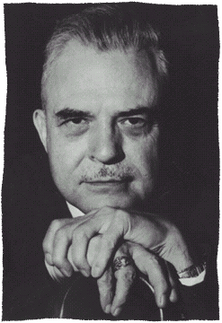
Milton Model: Language paterns motivational language to fill the listener with own positive thoughts
Richard Bandler
By modelling
John Grinder

Slide 11
Milton Erickson

Slide 12
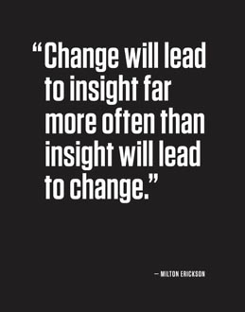

Slide 13
Examples of Milton language:
This is easy, isn’t it? (Tag question)
What is interesting is, when did you last learn so easily? (embedded commands)
Would you like to order it in blue or in green? (double binds)
Some day, we’ll all be free.
Things can go only better.
I have a dream.

Slide 14
Milton patterns
1. Distortions in the Milton model
Distortions are language constructions which are far from the reality, or you may say easily to reframe to a more realistic version.

Slide 15
Milton Distortions (1)
Mind reading
You guess what could be the thoughts in the other’s mind, and of course it’s a guess.

Slide 16
Milton Distortions (1)
Mind reading
Examples:
"You are curious what you will get out of this learning”.
This suggestion creates curiosity, even if it was not there before.
“You don't know yet, what the next minute will bring”
This creates openness
“At the same time you know, that you are still going to learn more."
This suggests that you are coming into a learning state.
"You know what I mean."
This suggests that you understand everything I said.

Slide 17
Milton Distortions (1)
2. Cause and effect
You make a causal relation between two phenomenon’s which is not proved, but seems likely.
A causes B.

Slide 18
Milton pattern Cause and Effect (2)
Examples:
"While you are sitting here you can already imagine how this will change the way you are working”
Suggestion is: Sitting here causes change in working
“While you practice the new skills with your colleagues, you can get an idea of how that translates into your reality."
Suggestion is: Practice causes translation in your reality.

Slide 19
Milton language (3) Deletions
Deleting information is the most useful for hypnotic purpose
Process words
Unspecified verbs
Simple deletions
Object is absent
Tag questions
Comparisons
Untruth

Slide 20
Milton language (3) Deletions
I see that you are ready to listen (simple deletion)
As you may have attention you will learn more and more (unspecified verbs)
There are people who are learning fast (unspecified subject)
You are feeling more and more curious (comparing)
Remember that you have been through some tough times and survived them well (judgements)
You are gaining new insights, building new friendships (nominalisations)

Slide 21
Milton Language (4) Generalisation
You become more successful, you will be able to discover new ways. (possibility)
You must take this forward where it has to go (necessity)
Every time you feel like this you will remember how important this is for you. (universals)
All the skills you need are easy for you to learn (universal)

Slide 22
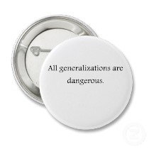

Slide 23
Rapport
Body language
Milton Language
Tonality matching

Slide 24
Pacing and leading
A coach
B client
pacing
leading
Unused resources

Slide 25
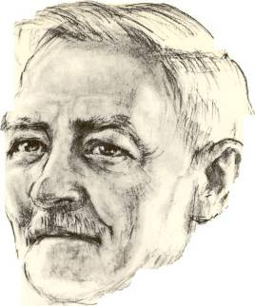
1
I observe that you came to this place. (a)
I notice that you are looking at me which means that you have attention for this (b)
2
3
I can imagine that you ask yourself how much this conversation can give you. (c)
4
Everything is pointing in the direction of success (d)
Milton patterns
Factual observation
Cause→ Result
Mind reading
Universal truth
Possibility
Presupposition
5
There may happen beautiful things. (e)
How would you approach this case?

Slide 26
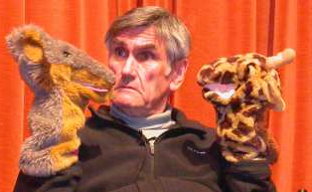
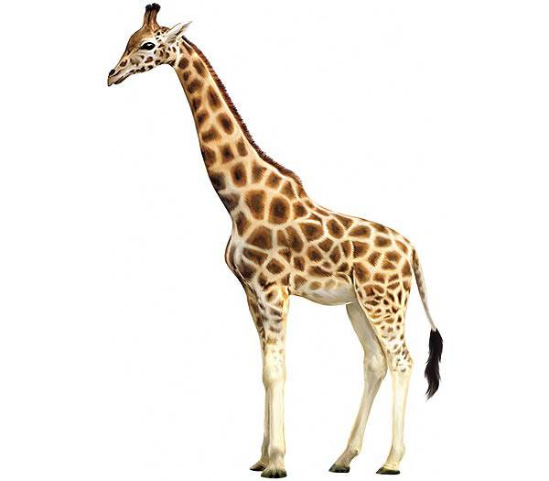
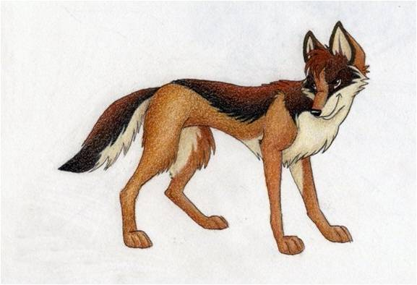
Non- Violent Communication
´You´ messages
´I´ messages
Giraf
Jackal

Slide 27
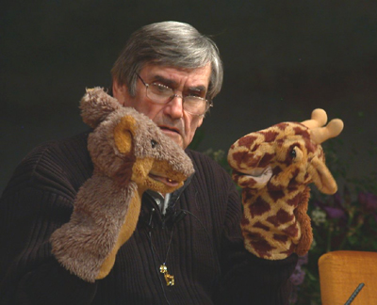
Marshall Rosenberg:
Non-Violent Communication
OPTIONS
4. Which possibilities do you have to fulfill your needs?

Slide 28
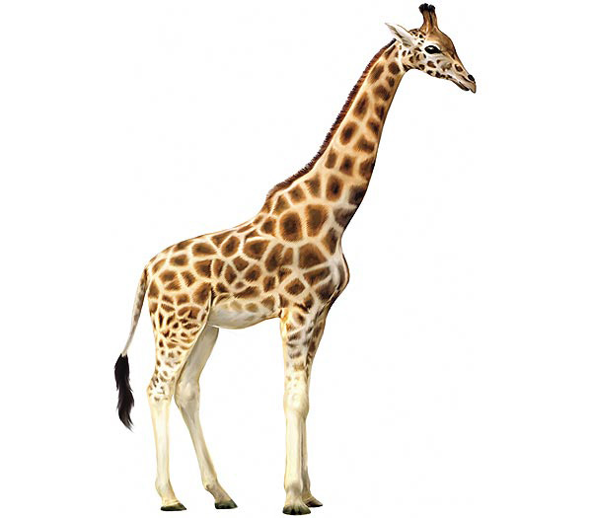
Non-violent Communication

Slide 29
Nonviolent Communication
Giraf Language
1. Observe Without judgment or interpretation “I see…” “I hear…”
2. Feel Recognize your feelings Acknowledge your feelings “This makes me feel …”
3. Acknowledge needs Connect your feelings with your needs “I feel … because I need …”
4. Options Which different options do you have to meet your needs?
5. Do a request or do something “Could you do … ?” “I am going to do ..”

Slide 30
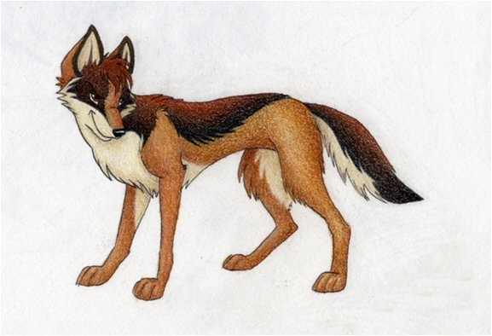
Violent Communication

Slide 31
Nonviolent Communication
Giraf Language
Pitfalls of the Jackal
1. Observe Without judgment or interpretation “I see…” “I hear…”
1. Observe with own judgments Pasting your own judgment on something “you never do it right!”
2. Feel Recognize your feelings Acknowledge your feelings “This makes me feel …”
2. Mix feelings with thoughts Read minds “I see/feel that you don’t feel like it”
3. Acknowledge needs Connect your feelings with your needs “I feel … because I need …”
3. Make the other person responsible for my needs “I want that you don’t make me angry”
4. Options Which different options do you have to meet your needs?
4. There is one option only Only you can …, I can’ “t do anything”
5. Do a request or do something “Could you do … ?” “I am going to do ..”
5. Mix request with a demand “I want you to do this now” “You have to do this now and in my way”

Slide 32
Video mother and child:
..\video's\NVC\Compassionate Communication with Kids.flv

Slide 33
Giraffe language
Look for at least 3 different needs which are basic in your life.
What are your feelings when these needs are not fulfilled?
What are your feelings when these needs are fulfilled?
What are your options to fulfill these needs?
What are you going to do or what is your request?

Slide 34
1. Observe
Without judgement
“I see............... “
“I hear............ “

Slide 35
2. Feelings
Acknowledge
Your feelings
“I feel me with this...............”

Slide 36
3. Acknowledge Needs
Connect your feelings with your needs.
“I feel ....., because I have a need to ...............”

Slide 37
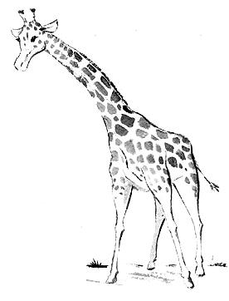
Needs
I have a need at a deep level and I take resposability to fulfill this need
CONNECTION acceptance affection appreciation belonging cooperation communication closeness community companionship compassion consideration consistency empathy inclusion intimacy love mutuality nurturing respect/self-respect | CONNECTION continued safety security stability support to know and be known to see and be seen to understand and be understood trust warmth PHYSICAL WELL-BEING air food movement/exercise rest/sleep sexual expression safety shelter touch water | HONESTY authenticity integrity presence PLAY joy humor PEACE beauty communion ease equality harmony inspiration order AUTONOMY choice freedom independence space spontaneity | MEANING awareness celebration of life challenge clarity competence consciousness contribution creativity discovery efficacy effectiveness growth hope learning mourning participation purpose self-expression stimulation to matter understanding

Slide 38
4. Options
Which different possibilities do you have to fulfill your authentic needs?

Slide 39
5. Request or action
Would you like to do .......?
I’m going to do ...........

Slide 40
The world needs our love!

