Slide 1
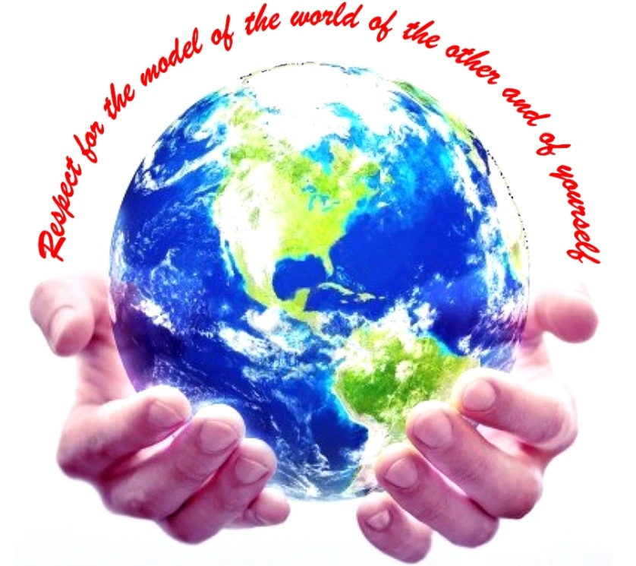
to the NLP-course “Getting to know your Unlimited Powers even better”
مرحبا
إمكانيات غير محدودة
Welcome!
دورة في البرمجة اللغوية العصبية
Dar al Amal, Ramallah, Palestine
fourth day Wednesday 26 October 2016
Trainers: Sytse and Marlies Tjallingii

Slide 2
Good and New
Energy
Joy
In pairs, 2 minutes each.
Focus at a recent situation which has given you a good/or new feeling. In which you felt energy, happiness or joy.
Share in the whole group the title of your experience and show your feelings at your face.

Slide 3
Open Frame
Questions
Experiences
Short stories
Share a real life-experience to reflect on what NLP can mean to it.
Goal: apply NLP in your own reality.

Slide 4
Presupposition no 1:
Respect for somebody else’s model of the world
and of your own model of the world
Respect

Slide 5
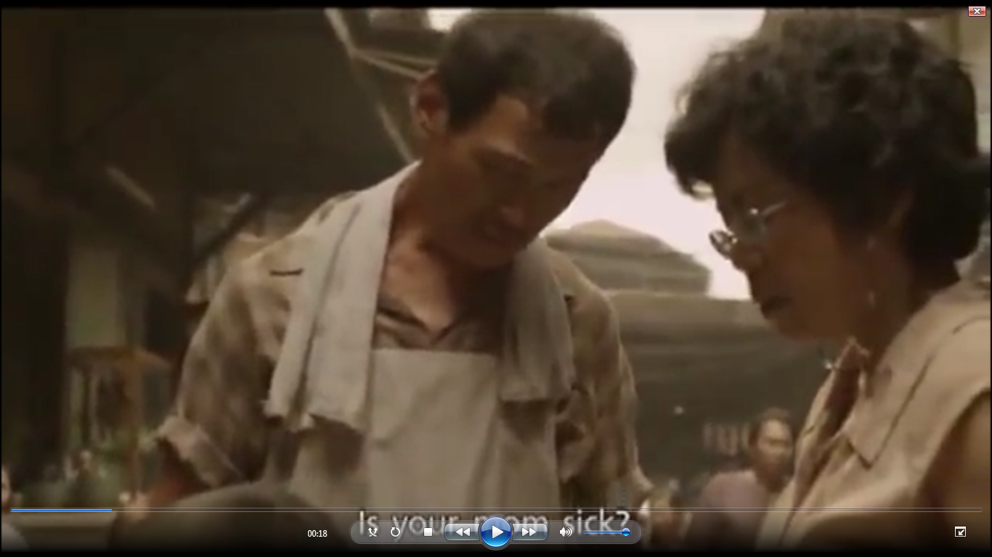
Giving and receiving , gratefulness

Slide 6
V = Value
Respect, Health, Love, Harmony, Freedom, Safety
Values and Beliefs
B
B
B
B
V
B
B
B
B
B
B
V
B
B
B
V
B
B
B
B- = Beliefs:
I can respect….. neighbors
B
B
I can respect ….. colleagues
B
V
B
V
B
B
B
B
B
B
V
B
B
B
B
B
B
B
V
B
V
B
B
B

Slide 7
Values and Beliefs of Dar al Amal
B
B
B
B
V
V = Value of Dar al Amal
B
B
B
Hope
B
B
B- = Beliefs to realize hope
1. We can build a community, with respect for each others model of the world
2. We can respect each other as colleagues
3. We can …………………………………….

Slide 8
Totally conscious
How are Values
organized in
our system?
Attitudes
Beliefs
Values
Core values
Meta Programmes
Totally unconscious

Slide 9
Sources of Values
Family
Friends
Religion
Sport
School
Music
Health
Living environment
Economy
Media
Nature
Community

Slide 10
Example of an important value:
Community
Game: the big wind blows

Slide 11
42 Exercise: Becoming aware of your values
A
Approach
B
Avoid

Slide 12
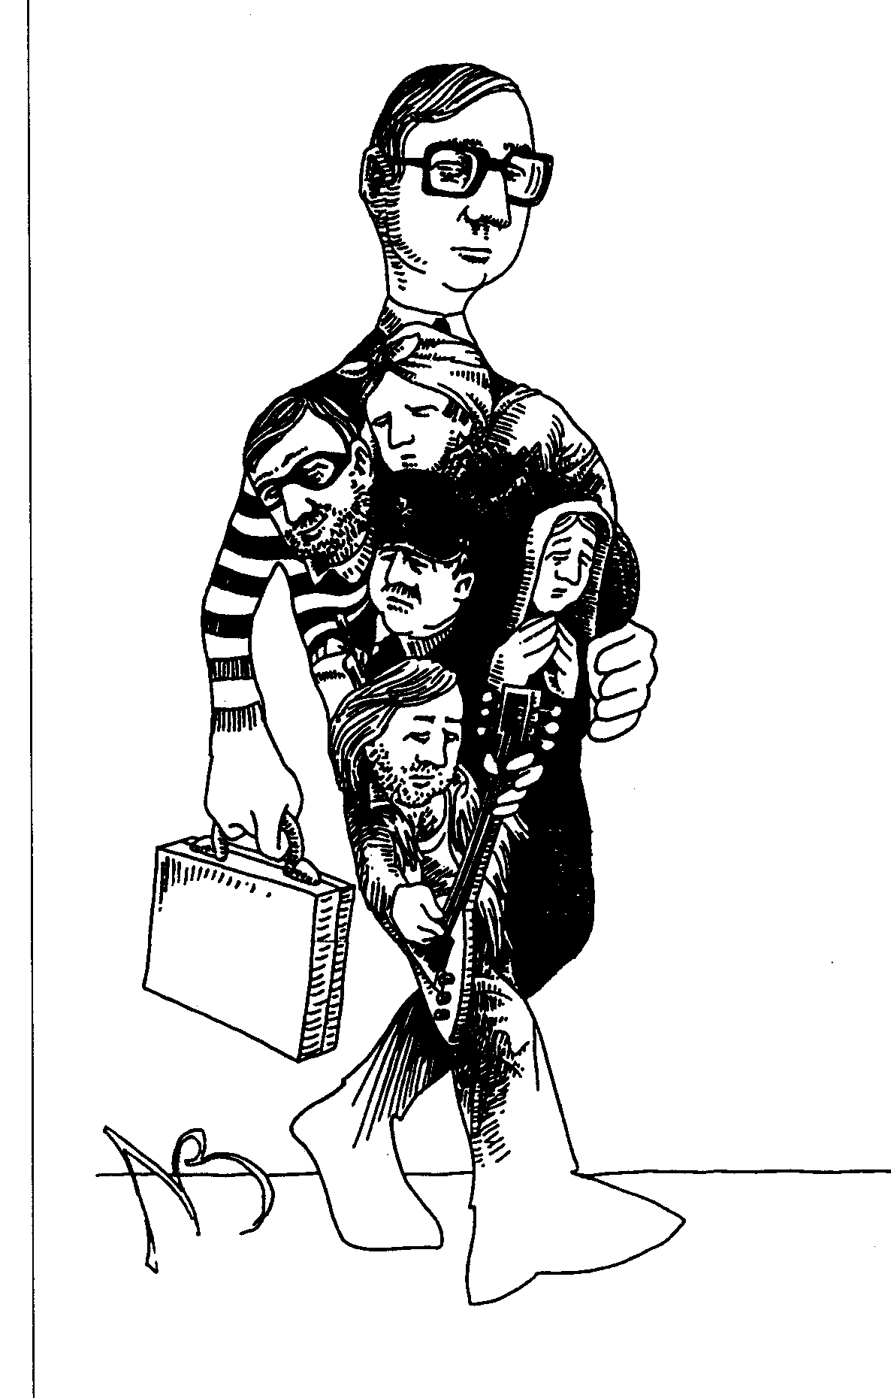
Parts
Working with “parts” of your unconscious
Communicating with parts:
Parts are like people
Parts can also communicate with each other

Slide 13
Assumptions about parts.
A part........
is intelligent
has positive intentions
is responsible for a certain behaviour
assumes the best choice that it has
should be treated with respect and...
is able to communicate with another part / other parts

Slide 14
Steps of the Visual Squash
45. Exercise:
Steps in the work with parts
Identify one part, put it on one of your hands and give it a name.
Thank this part.
Ask what is the opposite of this part.
Let the second part come out and put it on the other hand.
Separate the positive intention and the behaviour of the second part.
Chunk up asking to the highest positive intention.
Continue with the other part (the first).
Also chunk up to the highest positive intention.
If both parts arrived at the same highest intention, suggest that both could come together and form again one whole.
Put slowly the hands together and move them to your heart.

Slide 15
Working with metaphors
Game
Crocodiles and frogs

Slide 16
Healing Metaphors
They both listened to an old story,
wonderful things came flowing to them
M. Vasalis: Fairytale
A metaphor is a kind of image or story
in which two or more unequal significations are being connected
into one new meaning.
A healing metaphor helps you to give you insights.
In each story someone tells,
the pattern of himself is hidden
and for those who want to grow,
connection with his own narrative is necessary

Slide 17
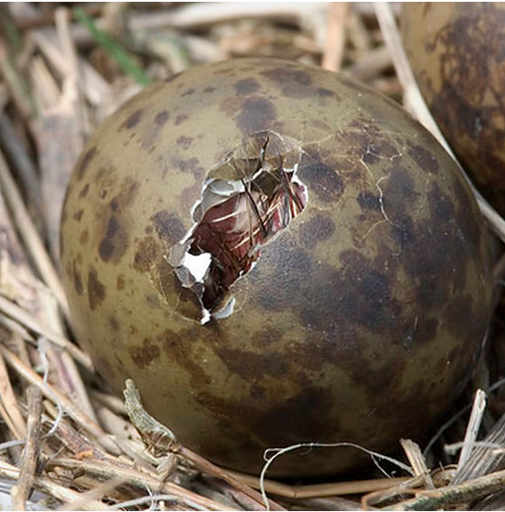
Protruding Egg
This could be a metaphor for:
The emergence of new ideas.
The transition to a new phase in your life.
The escape from the narrowness of life, to liberate yourself, to breathe freely.
A new world.
Discovering who are your parents.
Dreams about growing, flying out, getting freedom.
Whatever comes to your mind when seeing and imagining what this young bird is doing and what he is accessing.

Slide 18
On his way.
The man walked roaming along the beach.
As he wandered, his thoughts wandered.
Thinking about origin and desire he walked around.
Suddenly his eye fell on footprints in the sand.
.................................................

Slide 19
At the foot end of the (own) children’s’ bed
Objective of this exercise:
Healing a painful situation in the past.
This can be in early childhood, but also in adolescence.
The principle is:
You make all situations in the past more bearable
and healing those by looking at it lovingly
and to give love to your younger self in these situations.

Slide 20
What does these metaphors mean to you?

Slide 21
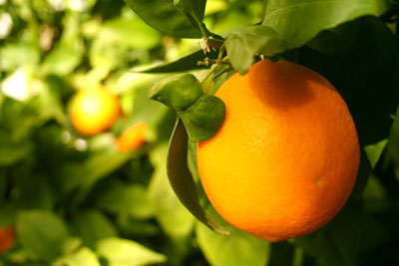
What does this metaphor mean to you?

Slide 22
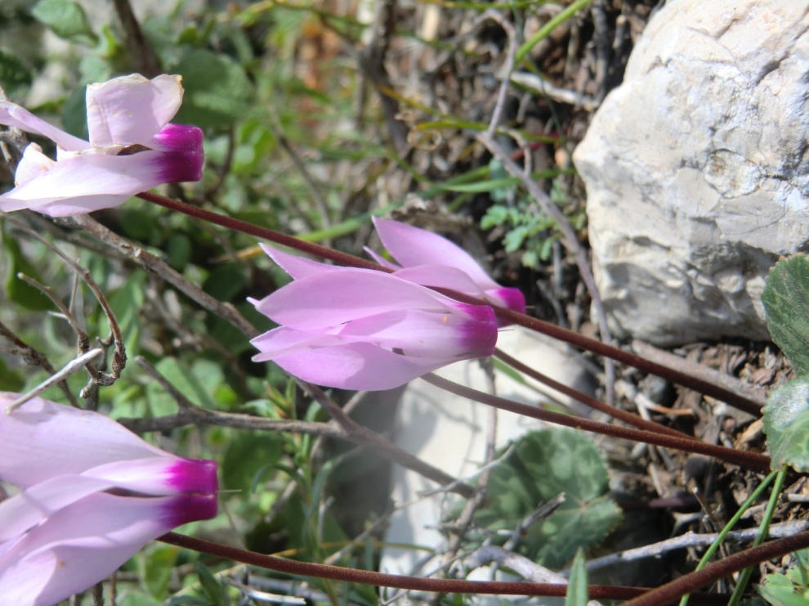
What does this metaphor mean to you?

Slide 23
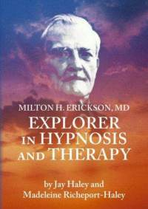
Milton Model
Hypnotic Stimulating Language

Slide 24
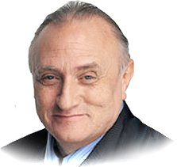
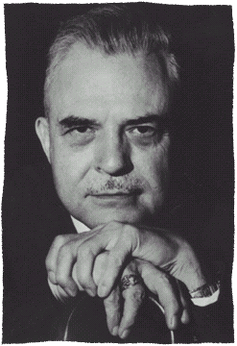
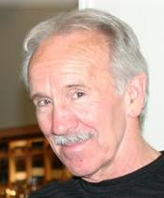
Milton Model: Language paterns motivational language to fill the listener with own positive thoughts
Richard Bandler
By modelling
John Grinder

Slide 25
Milton Erickson

Slide 26
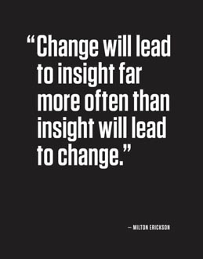

Slide 27
Examples of Milton language:
This is easy, isn’t it? (Tag question)
What is interesting is, when did you last learn so easily? (embedded commands)
Would you like to order it in blue or in green? (double binds)
Some day, we’ll all be free.
Things can go only better.
I have a dream.

Slide 28
Pacing and leading
A coach
B client
pacing
leading
Unused resources

Slide 29
Milton patterns (1)
Distortions in the Milton model
Distortions are language constructions which are far from the reality, or you may say easily to reframe to a more realistic version.
Mind reading
You guess what could be the thoughts in the other’s mind, and of course it’s a guess.
Examples:
"You are curious what you will get out of this learning”.
This suggestion creates curiosity, even if it was not there before.
“You don't know yet, what the next minute will bring”
This creates openness
“At the same time you know, that you are still going to learn more."
This suggests that you are coming into a learning state.
"You know what I mean."
This suggests that you understand everything I said.

Slide 30
Milton patterns (2)
Cause and effect
You make a causal relation between two phenomenon’s which is not proved, but seems likely.
A causes B.
Examples:
"While you are sitting here you can already imagine how this will change the way you are working”
Suggestion is: Sitting causes change in working
“While you practice the new skills with your colleagues, you can get an idea of how that translates into your reality."
Suggestion is: Practice causes translation in your reality.

Slide 31
Milton language (3) Deletions
I see that you are ready to listen (simple deletion)
As may have attention you will learn more and more (unspecified verbs)
There are people who are learning fast (unspecified subject)
You are feeling more and more curious (comparing)
Remember that you have been through some tough times and survived them well (judgements)
You are gaining new insights, building new friendships (nominalisations)

Slide 32
Milton Language (4) Generalisation
You become more successfull, you will be able to discover new ways. (possibility)
You must take this forward where it has to go (necessity)
Every time you feel like this you will remember how important this is for you. (universals)
All the skills you need are easy for you to learn (universal)

Slide 33
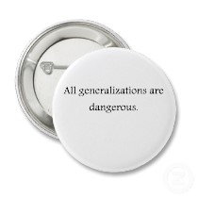

Slide 34
Milton Language (5) Distortion
This means that you are getting all the help you need (equivalence)
I know that you think with more and more interest (mind reading)
On each breath, you can relax even more (cause and result)

Slide 35
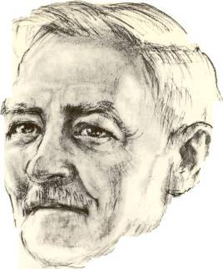
1
I observe that you came to this place. (a)
I notice that you are looking at me which means that you have attention for this (b)
2
3
I can imagine that you ask yourself how much this conversation can give you. (c)
4
Everything is pointing in the direction of success (d)
Milton patterns
Factual observation
Cause→ Result
Mind reading
Universal truth
Possibility
Presupposition
5
There may happen beautiful things. (e)
How would you approach this case?

Slide 36
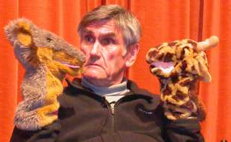
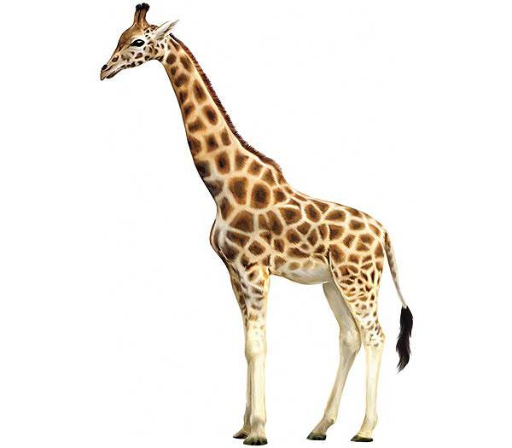
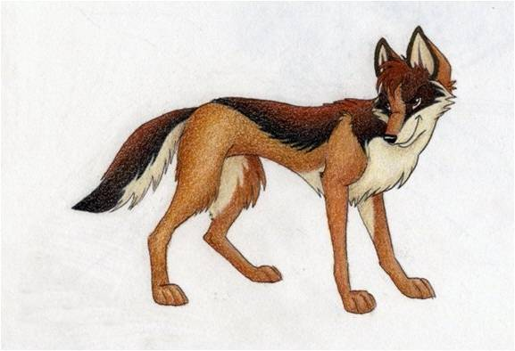
Non- Violent Communication
´You´ messages
´I´ messages
Giraf
Jackal

Slide 37
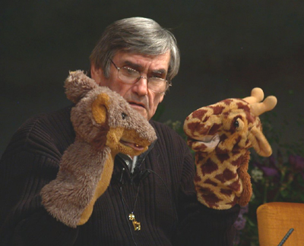
Marshall Rosenberg:
Non-Violent Communication
OPTIONS
4. Which possibilities do you have to fulfill your needs?

Slide 38
Nonviolent Communication
Giraf Language
1. Observe Without judgment or interpretation “I see…” “I hear…”
2. Feel Recognize your feelings Acknowledge your feelings “This makes me feel …”
3. Acknowledge needs Connect your feelings with your needs “I feel … because I need …”
4. Options Which different options do you have to meet your needs?
5. Do a request or do something “Could you do … ?” “I am going to do ..”

Slide 39
Nonviolent Communication
Giraf Language
Pitfalls of the Jackal
1. Observe Without judgment or interpretation “I see…” “I hear…”
1. Observe with own judgments Pasting your own judgment on something “you never do it right!”
2. Feel Recognize your feelings Acknowledge your feelings “This makes me feel …”
2. Mix feelings with thoughts Read minds “I see/feel that you don’t feel like it”
3. Acknowledge needs Connect your feelings with your needs “I feel … because I need …”
3. Make the other person responsible for my needs “I want that you don’t make me angry”
4. Options Which different options do you have to meet your needs?
4. There is one option only Only you can …, I can’ “t do anything”
5. Do a request or do something “Could you do … ?” “I am going to do ..”
5. Mix request with a demand “I want you to do this now” “You have to do this now and in my way”

Slide 40
Video mother and child:
..\video's\NVC\Compassionate Communication with Kids.flv

Slide 41
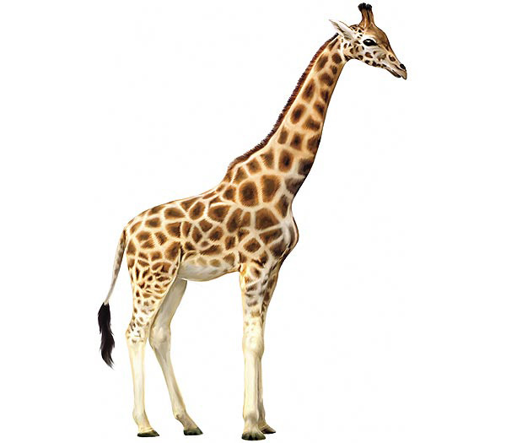
Non-violent Communication

Slide 42
Giraffe language
Look for at least 3 different needs which are basic in your life.
What are your feelings when these needs are not fulfilled?
What are your feelings when these needs are fulfilled?
What are your options to fulfill these needs?
What are you going to do or what is your request?

Slide 43
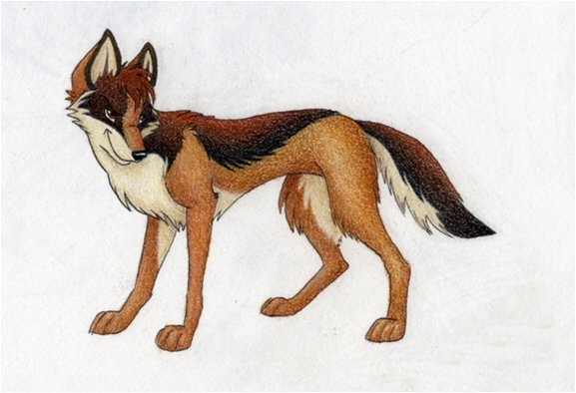
Violent Communication

Slide 44
1. Observe
Without judgement
“I see............... “
“I hear............ “

Slide 45
2. Feelings
Acknowledge
Your feelings
“I feel me with this...............”

Slide 46
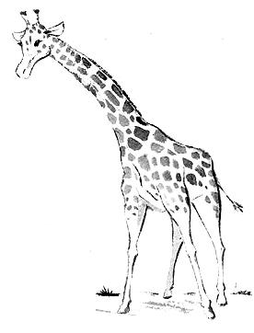
Needs
I have a need at a deep level and I take resposability to fulfill this need
CONNECTION acceptance affection appreciation belonging cooperation communication closeness community companionship compassion consideration consistency empathy inclusion intimacy love mutuality nurturing respect/self-respect | CONNECTION continued safety security stability support to know and be known to see and be seen to understand and be understood trust warmth PHYSICAL WELL-BEING air food movement/exercise rest/sleep sexual expression safety shelter touch water | HONESTY authenticity integrity presence PLAY joy humor PEACE beauty communion ease equality harmony inspiration order AUTONOMY choice freedom independence space spontaneity | MEANING awareness celebration of life challenge clarity competence consciousness contribution creativity discovery efficacy effectiveness growth hope learning mourning participation purpose self-expression stimulation to matter understanding

Slide 47
4. Options
Which different possibilities do you have to fulfill your authentic needs?

Slide 48
5. Request or action
Would you like to do .......?
I’m going to do ...........

Slide 49
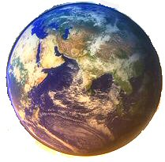
The world needs our love!

