Slide 1

to the NLP-course “Getting to know your Unlimited Powers even better”
مرحبا
إمكانيات غير محدودةك
Welcome!
دورة في البرمجة اللغوية العصبية
Dar al Amal, Ramallah, Palestine
second day Monday 24 October 2016
Trainers: Sytse and Marlies Tjallingii

Slide 2



Good and New
Energy
Joy
In pairs, 2 minutes each.
Focus at a recent situation which has given you a good/or new feeling. In which you felt energy, happiness or joy.
Share in the whole group the title of your experience and show your feelings at your face.

Slide 3

Open Frame
Questions
Experiences
Short stories
Share a real life-experience to reflect on what NLP can mean to it.
Goal: apply NLP in your own reality.

Slide 4
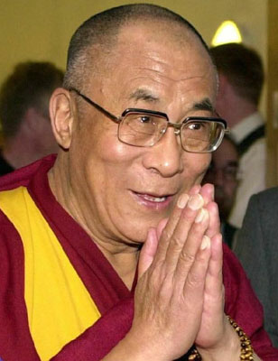
Dalai Lama
The three R’s:
Respect for self
Respect for others
Responsibility for all actions

Slide 5
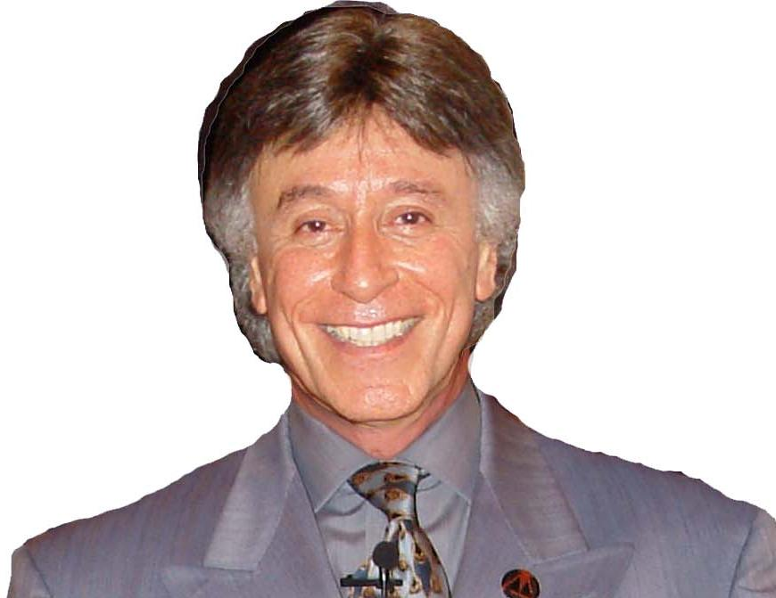
Observing facial expression
Look at the following picture.
Describe the facial expression.

Slide 6
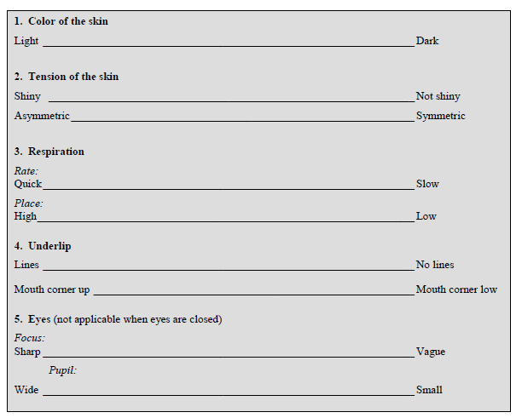

Slide 7
Observing facial expression
Look at the picture again.
What did you see more?

Slide 8
Observing facial expression
What is your interpretation of
the emotion of Ibrahim El Fiky?

Slide 9
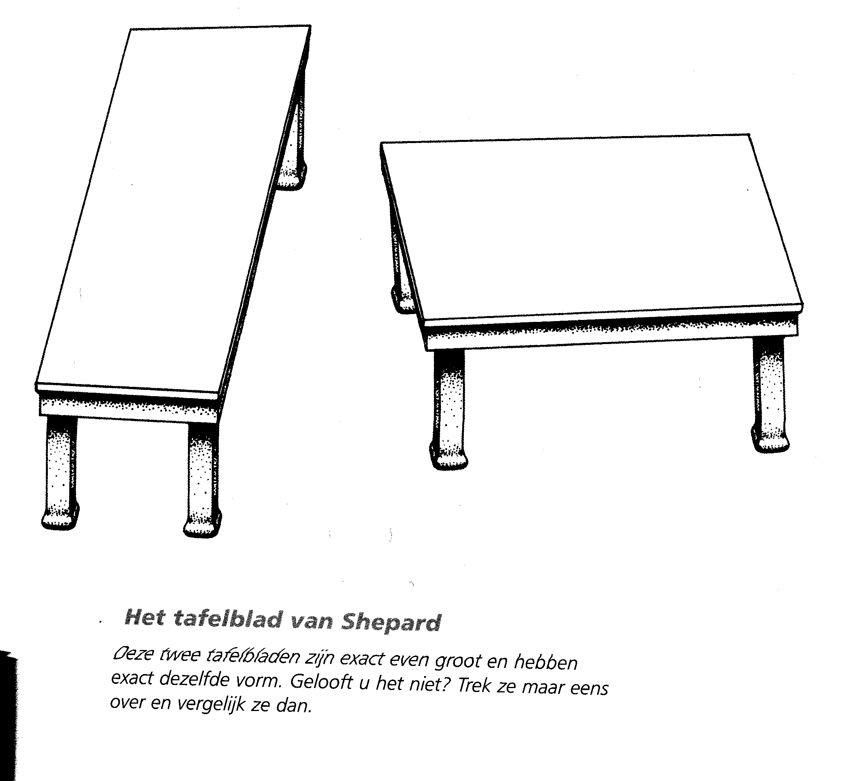
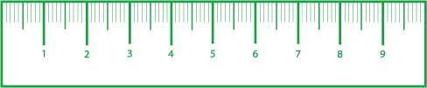
How accurate can you observe?

Slide 10
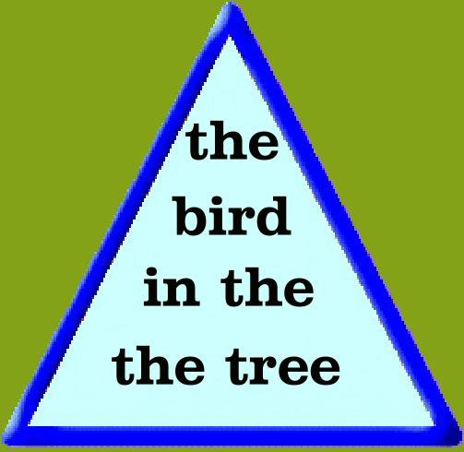

Slide 11

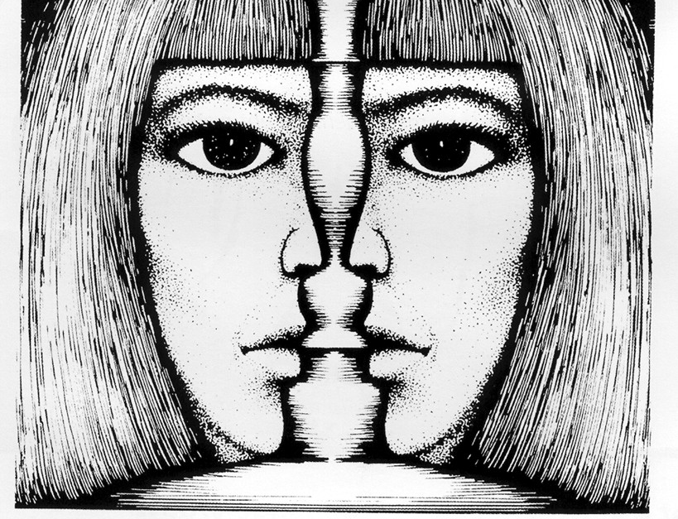
What do I focus on?
One or
two faces?
Or a candle?
One or
two faces?

Slide 12
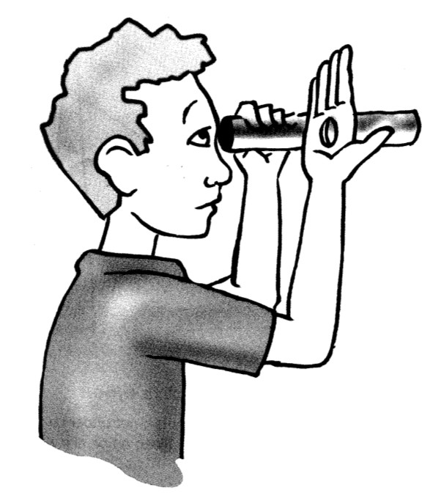


A hole in your hand?
Focus at the tree

Slide 13
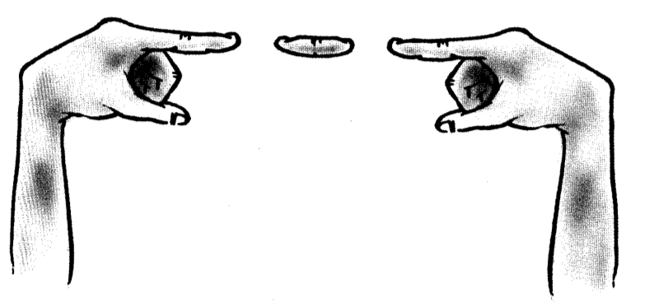
Focus at the tree

Slide 14



Slide 15


Slide 16
How accurate are your observations of emotions?
Angry
Afraid
Sad
Happy
Surprised

Slide 17
Why going back to the observation?
Creates more success
to many different possibilities
Possibility 1
Possibility 2
Possibility 3
Possibility 4
back to the observation
From one judgment

Slide 18
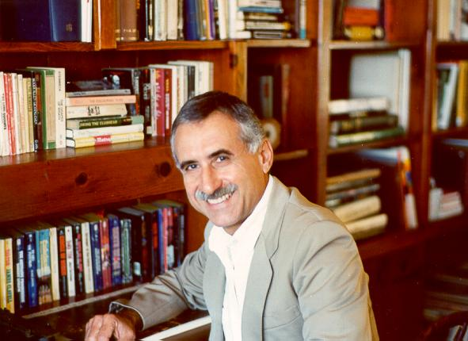

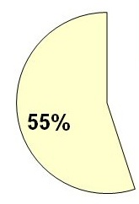
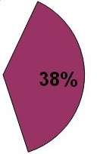
What is communication about?
words
physiology
Professor
Albert Mehrabian
tonality

Slide 19

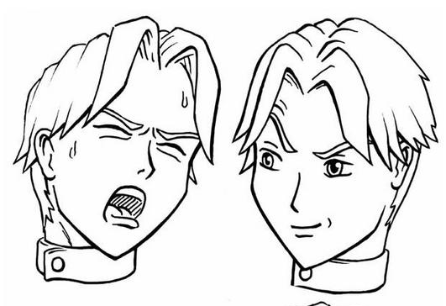
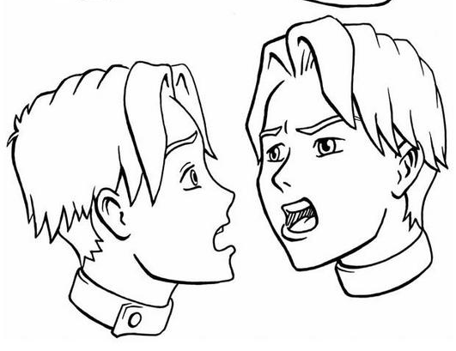
Tonality as non-verbal message
tempo
rhythm
loudness
timbre
inflections

Slide 20
What is the influence of auditory submodalities?
Write these emotions on 6 different papers.
Person A takes one by one the papers and expresses the emotion by saying:
“You’ve done this well”
Angry
Surprised
Afraid
Happy
Sad
Ashamed
Person B closes his eyes while listening, and describes the auditory submodalities
And adds the interpreted emotion

Slide 21
The three life questions
1 What do I focus on?
2 What meaning do I give it?
3 What do I do?

Slide 22
Exercise 28
Apply the 3 life questions
Person A tells the ‘incident’ of page 4 (Arab version)
A and B analyze the three life questions with at least 3 possible meanings

Slide 23
Song: Man dare to live

Slide 24
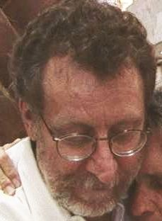
Change on identity level
Love is an expression
of the willingness
to create space
in which something
is allowed to change.
Harry Palmer
(An exercise from Avatar)

Slide 25
The 4-Step Learning Process
1. Unconscious incompetent
Becoming conscious
2. Conscious incompetent
Exercise
3. Conscious competent
Getting routine
4. Unconscious competent
Unlearn: from step 4 to 2 and again to 4
Once more learn: from 2 to 4.

Slide 26
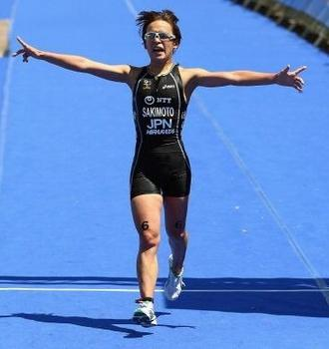

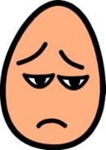
Feelings in the 4 steps learning process
4 succes experience
4
3 feeling better
1 neutral
2b challenge
feelings
1
2b
3
2a fear
2a
Stop disappointed
time

Slide 27
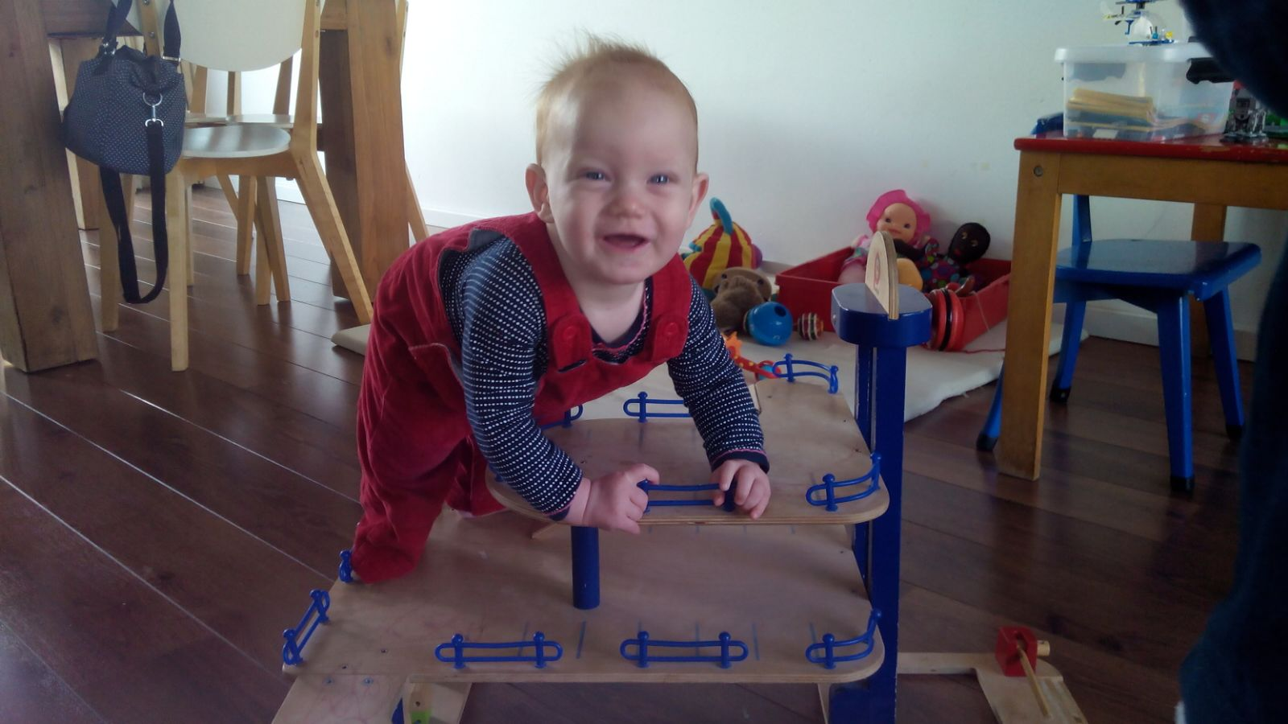

Slide 28
Presupposition no 12:
Failure doesn’t exist, only feedback
If what I do doesn’t give the desired result, then I do something different
If I always do what I always did,
then I get what I always got.

Slide 29
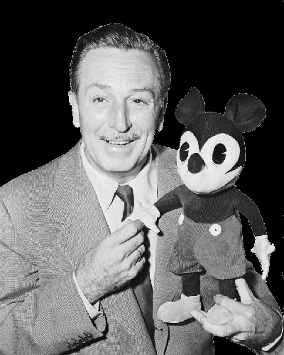
Exercise:
Learning to use
the Disney Strategy
Walt Disney
dreamer
coach
doer

Slide 30
Disney strategy
dreamer
coach
doer

Slide 31
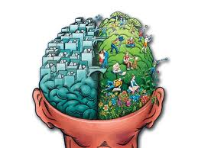
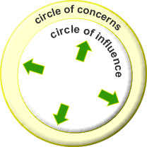

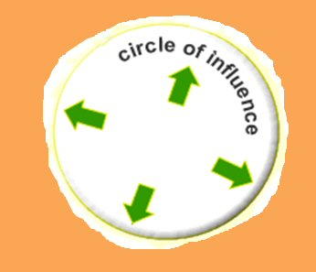
Cause and Effect
Cause
Effect
Standing at the side of the cause or the effect?

Slide 32
Exercise: Cause-Effect test
Aspect of communication | Mark every question with the answer that appeals most to you. | Score
What do you focus on? | Usually I am more focused on approaching.’ I often want to avoid problems. | 1A 1B
2. What do you think of? | First I think of the solution of a problem. First I think of the cause of a problem. | 2A 2B
3, Against or together? | I feel the other is against me and I think ‘they, you and everyone takes care of him/herself. I think in ‘we and together.’ | 3A 3B
4. Dealing with each other | There is talking about others, often blaming, the other does not need to be there. There is talking with each other, daring to confront each other (with respect). | 4A 4B
5. Helping or attacking? | The other will usually help me. It feels like others often want to attack me. | 5A 5B
6. Concept of humanity | People are interchangeable: "for you another." Each person has a unique contribution , | 6A 6B
7. Missing? | People will miss me and address me. No one will miss me. | 7A 7B

Slide 33

Anchoring
Anchor: Any stimulus that is associated with a specific response.
The short way to your resources
Resources:
  MOTIVATION
  HUMOUR / LAUGHING
  ENERGY
  LOVE
  POWER
  SELFCONFEDENCE

Slide 34

Chaining Anchoring
Knuckels
1 2 3 4
1 = UPS
2 = IS1
3 = IS2
4 = DFS

Slide 35
To set an anchor
Anchoring
start
end
intensity
feelings
time
The keys to anchoring
The make anchors working properly, they have to meet four criteria. We call these the four keys to anchoring:
The intensity of the experience - must be totally associated; see, hear, feel it as it was;
The timing of the anchor (see graphic above);
The unique properties of the stimulus (don’t take the inside of your hand, but take the touch of a knuckle or step in a circle);
Repeating of the stimulus (the incentive must be able to be repeated).

Slide 36
Anchoring
start
end
intensity
feelings
time
The four steps to anchoring
Remember a vivid positive experience from the past with one valuable resource as: Motivation; humour / laughing; energy; love; power; self confidence.
Step in the circle of excellence at the highest point (see graphic below). Repeat this several times.
Change your state (break state).
3 Repeat with the same or different resources with different memories.
4 Set the anchor in action to perform the test.

Slide 37
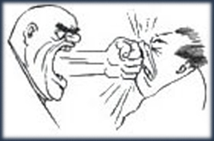

Swish pattern
Changing Submodalities
Changing
size,
clearness, contrast

Slide 38
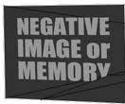


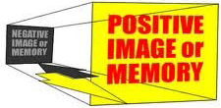


Slide 39
UPS = Undesired Present Situation
DFS = Desired Future Situation

Slide 40
Swish pattern
Step 1
Write a belief which you don’t want any more.
UPS
Step 5
New belief which you want.
DSF

Slide 41
Totally conscious
How are Values
organized in
our system?
Attitudes
Beliefs
Values
Core values
Meta Programmes
Totally unconscious

Slide 42
Sources of Values
Family
Friends
Religion
Sport
School
Health
Living environment
Economy
Media
Nature

Slide 43
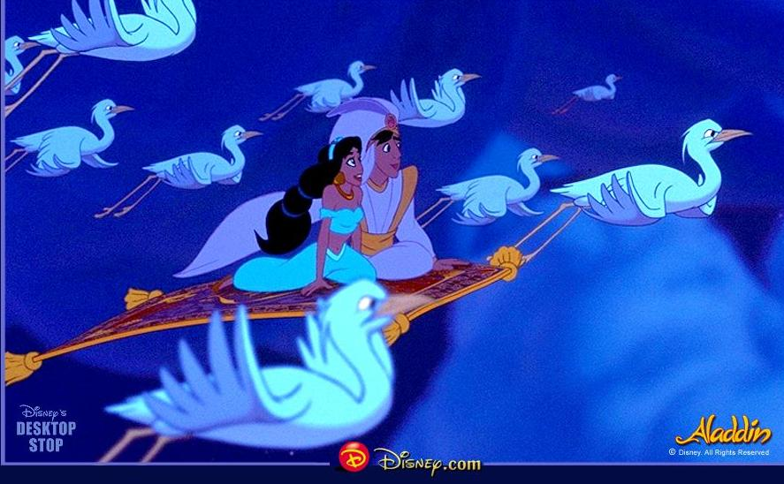
Healing metaphors

