Slide 1

to the NLP-course “Getting to know your Unlimited Powers even better”
مرحبا
Welcome!
دورة في البرمجة اللغوية العصبية
Dar al Amal, Ramallah, Palestine
one day Sunday 23 October 2016
Trainers: Sytse and Marlies Tjallingii

Slide 2

Getting to know each other
2 x 2 minutes, talk to each other, taking turns.
Introduce the other

Slide 3



Good and New
Energy
Joy
In pairs, 2 minutes each.
Focus at a recent situation which has given you a good/or new feeling. In which you felt energy, happiness or joy.
Share in the whole group the title of your experience and show your feelings at your face.

Slide 4

Listening skills: One speaks……. the other listens only.

Slide 5

Open Frame
Questions
Experiences
Short stories
Share a real life-experience to reflect on what NLP can mean to it.
Goal: apply NLP in your own reality.

Slide 6
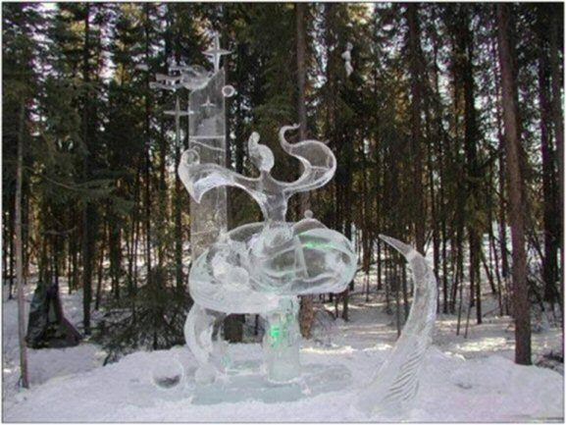
Recognise the unlimited powers in your thoughts
Observe them
Change them
Reframe them
Accept them
Let them go
Anchor your thoughts
Empower your thoughts

Slide 7

The ‘incident’
blabla
????
You have already experience in NLP!
And you are ambitious, because you want to do this second level course!
Remember a recent situation in which you would have liked to communicate better.
Do this individually

Slide 8

Your Life areas
relations
work/ main activity
family
My perspective for the future
Church/ mosque/
clubs
Friends
hobby’s
Sleeping
Free time/ relaxatio
Health
Spending money
My energy
Food
Sports/ fitness
Mobility

Slide 9
Your Life areas
Food
Friends
family
hobby’s
Sleeping
Free time/ relaxation
Health
Mobility
My perspective for the future
My energy
relations
Church/ mosque
clubs
Sports/ fitness
work/ main activity
Spending money
In which area of your life are you fully satisfied?
In which areas of your life you would like to have more satisfaction?
Choose some areas and indicate how satisfied you are and how much you would like to improve them.
2x 5 min. Work in pairs.
Life area: | Actual rate | To improve/reduce: to which rate?

Slide 10
Which skills would you like to improve?
determine your borders
convincing
making new friends
stand for myself
Have empathy
Keep friendships
show selfconfidence
learn to relax
Speak in public
connect
To show feelings
Control myself better
Present myself better
Evaluate
Choose 3 most important skills.
In which life area are they most important?
How much you can do already?
How much you want to improve?
Skill | Most important for Life area: | Actual mark | Mark you wish
1 learn to relax | Free time | 3 | 8
2
3

Slide 11
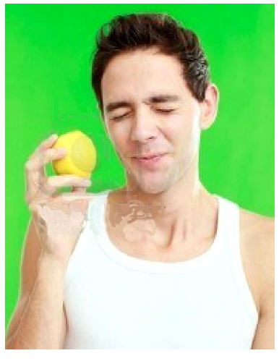
The NLP communication model
Exercise changing your internal representation

Slide 12


The toolkit of NLP:Neuro Linguistic Programming
Anchoring
1 Focusing
Positive language, Milton and Metamodel, hierarchy in language: chunking
2 Meaning giving Interpretation
3 Doing
Reframing
4 steps learning proces motivating in 2nd step
Integrate presuppositions
Respect
Accept
Neurological levels
Mission building
The map is not the territory
Changes on identity level
toolkit
Sensory acuity
Building empowering beliefs
Internal representation
Using your inner resources

Slide 13
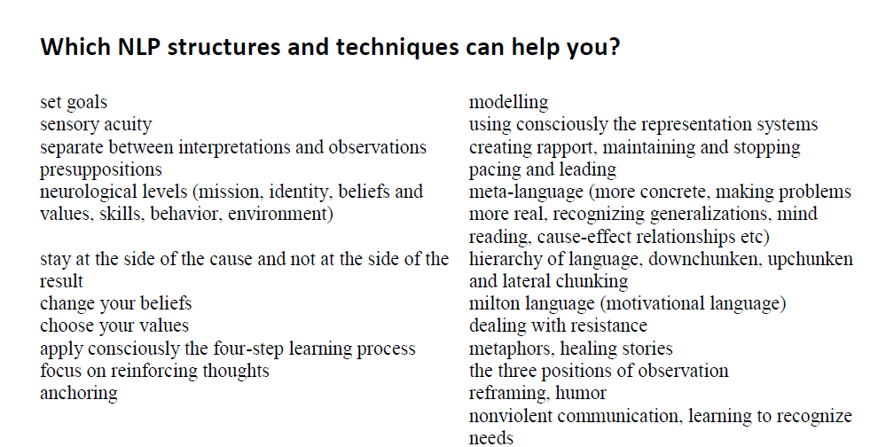
NLP techniques
three life questions

Slide 14
Which NLP Models and Techniques can help you?
Exercise: (page 9 English version) In pairs 2 x 5 minutes
Which theme?
Which NLP technique could help you with this theme?
Select a few.

Slide 15
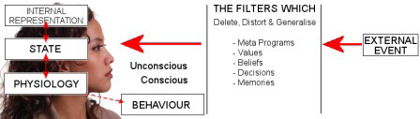
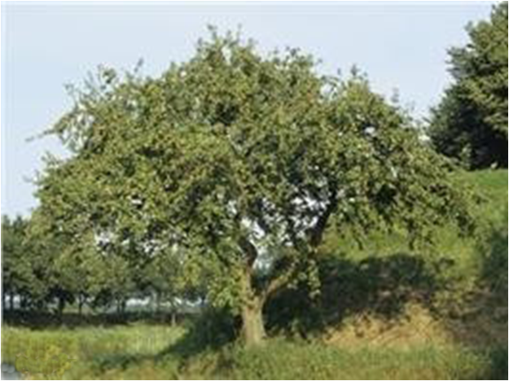

The Map is not the territory
Alfred Korzibsky
map territory

Slide 16
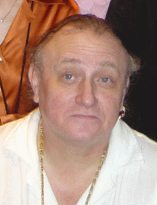
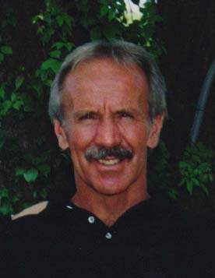
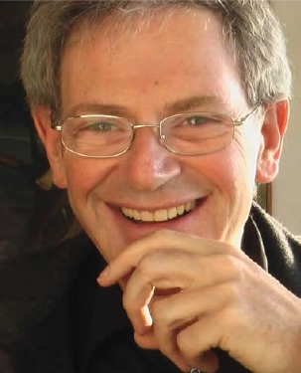
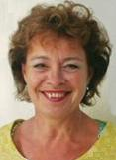
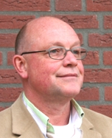
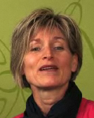
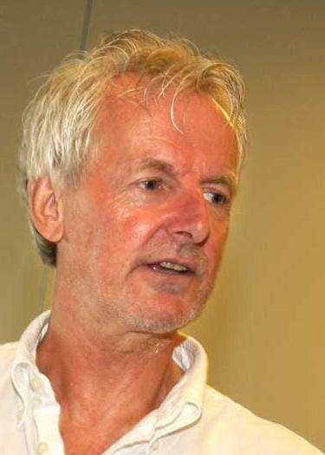

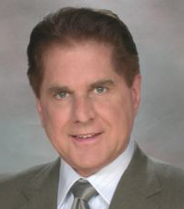
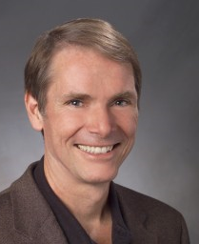
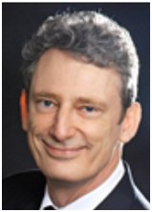
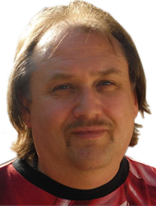
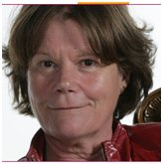
Who is who in NLP?
Dr Richard Bandler
Prof. Dr John Grinder

Slide 17
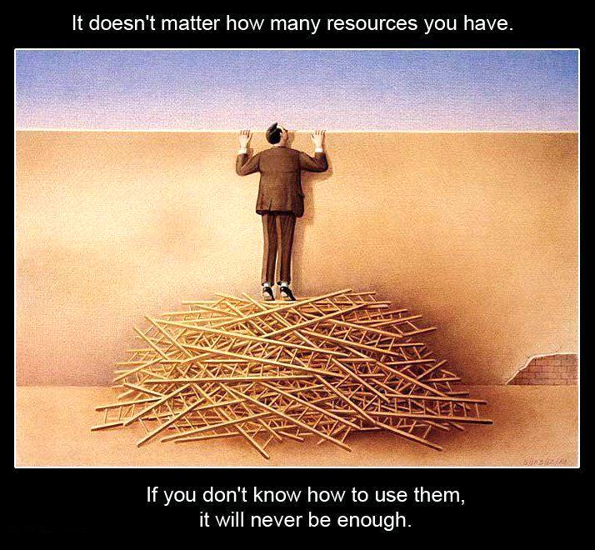

Resources, how do you use them?
Presupposition 9: Everyone has all the resources s/he needs.

Slide 18
What is NLP?
Neuro(logical) =
Linguistic =
Programming =

Slide 19
From Judgement to Respect
Release
Pay attention
Respect
Look at it
Embrace
Accept
Judge negative
Judge negative
Release
Look at it
Understand
Accept
Pay attention
Respect
Embrace

Slide 20

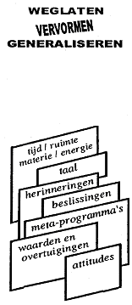
NLP Communication model
FILTERS
Internal
Representation
Delete
Destort
Generalise
External
signal
State, emotions
time/space matter/energy
time/space matter/energy
language
memories
decisions
metaprograms
values
and beliefs
attitudes
Physiology
Behaviour

Slide 21
Neurological levels
Mission
Identity
Beliefs, Values
Skills
Behavior
Environment

Slide 22
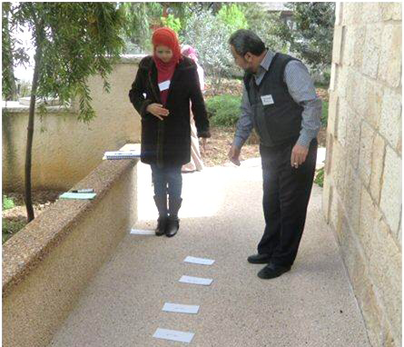

Slide 24
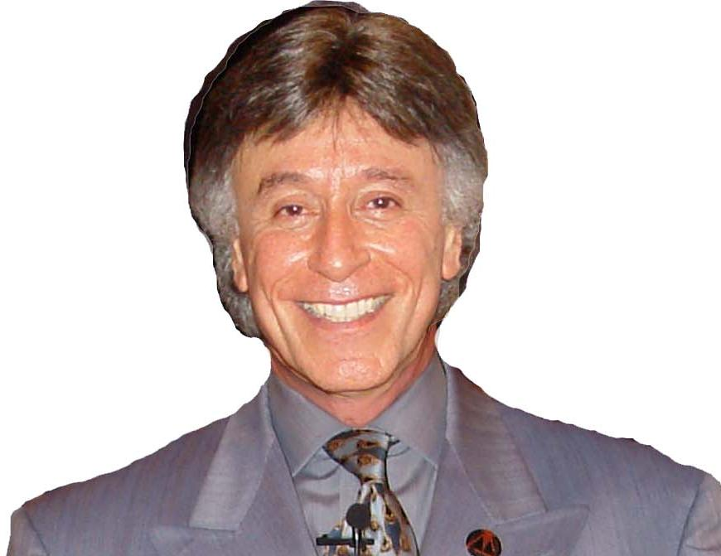

Slide 25
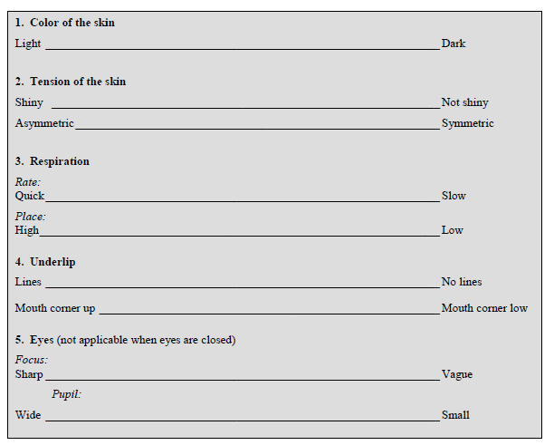

Slide 26
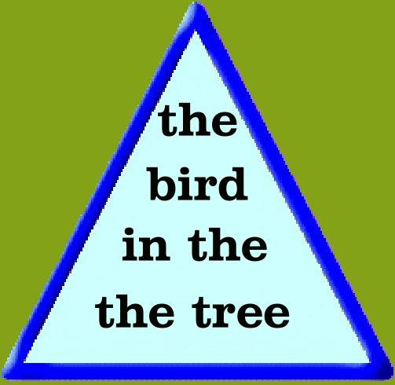

Slide 27


What do I focus on?
One or
two faces?
Or a candle?
One or
two faces?

Slide 28


Slide 29
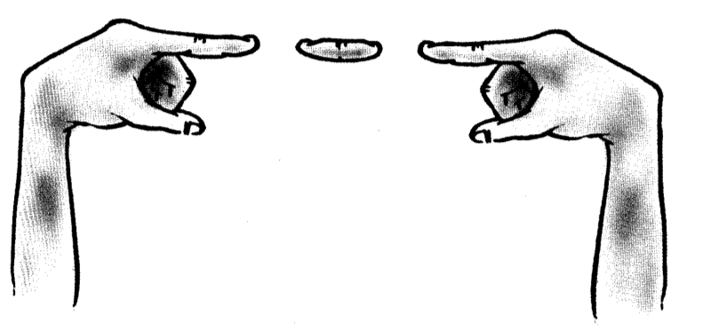

Slide 30

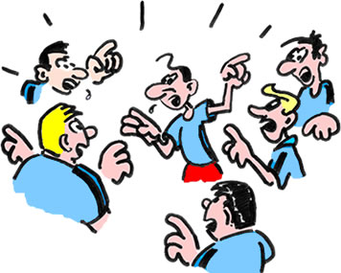
Discussion? Express opinions?

Slide 31
Reframing

Slide 32
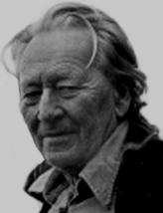
3
Three
Perceptual
Positions
Third Position
Dissociated of yourself and from the other
Also called: the meta position, the observer or helicopter view.
1
2
Professor
Gregory Bateson
First Position
Associated in your self
Second Position Associated in the other

Slide 33
Change on identity level
Just like me …………………………..

Slide 34
4 step learning:
1 unconscious incompetent
2 conscious competent
3 conscious competent
4 unconscious competent

Slide 35
Feelings in the 4 steps learning process
4
feelings
1
2
3
2
time

Slide 36
If what I do doesn’t give the desired result,
then do something different
If I always do what I always did,
then I get what I always got.

Slide 37
Why going back to the observation?
Creates more success
to many different possibilities
Possibility 1
Possibility 2
Possibility 3
Possibility 4
back to the observation
From one judgment

Slide 38

Anchoring
Anchor: Any stimulus that is associated with a specific response.
The short way to your resources
Resources:
  MOTIVATION
  HUMOUR / LAUGHING
  ENERGY
  LOVE
  POWER
  SELFCONFEDENCE

Slide 39

Chaining Anchoring
Knuckels
1 2 3 4
1 = UPS
2 = IS1
3 = IS2
4 = DFS

Slide 40
To set an anchor
Anchoring
start
end
intensity
feelings
time
The keys to anchoring
The make anchors working properly, they have to meet four criteria. We call these the four keys to anchoring:
The intensity of the experience - must be totally associated; see, hear, feel it as it was;
The timing of the anchor (see graphic above);
The unique properties of the stimulus (don’t take the inside of your hand, but take the touch of a knuckle or step in a circle);
Repeating of the stimulus (the incentive must be able to be repeated).

Slide 41
Anchoring
start
end
intensity
feelings
time
The four steps to anchoring
Remember a vivid positive experience from the past with one valuable resource as: Motivation; humour / laughing; energy; love; power; self confidence.
Step in the circle of excellence at the highest point (see graphic below). Repeat this several times.
Change your state (break state).
3 Repeat with the same or different resources with different memories.
4 Set the anchor in action to perform the test.

Slide 42
Disney strategy
dreamer
coach
doer

Slide 43
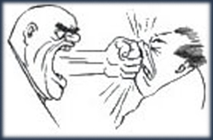

Changing Submodalities
Changing Submodalities
Changing
size,
clearness, contrast

Slide 44
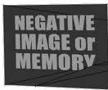


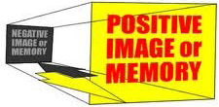


Slide 45
UPS = Undesired Present Situation
DFS = Desired Future Situation

Slide 46
Swish pattern
Step 1
Write a belief which you don’t want any more.
UPS
Step 5
New belief which you want.
DSF

Slide 47
Totally conscious
How are Values
organized in
our system?
Attitudes
Beliefs
Values
Core values
Meta Programmes
Totally unconscious

Slide 48
Sources of Values
Family
Friends
Religion
Sport
School
Health
Living environment
Economy
Media
Nature

Slide 49

Healing metaphors

