Slide 1
Welcome to the NLP-course “Achieve more success with Your Unlimited Powers”
"حقق نجاحا أكثر مع طاقاتك اللامحدودة"
دورة البرمجة اللغوية العصبية التابعة
ترحيب
مرحبا
Success!
5th day Ramallah, October 28, 2017

Slide 2
Program for today
Good and New
Open Frame
Meta model
Working with parts
Collapsing Anchors
The source of your resources
Reflection
Certificates

Slide 3
Good and New
In pairs 2 minutes each.
Focus at a recent situation which has given you a good/or new feeling. In which you felt energy, happiness or joy.
Share in the whole group the title of your experience and show your feelings at your face.

Slide 4
Open Frame
Questions
Experiences
Short stories
Share a real life-experience to reflect on what NLP can mean to it.
Goal: apply NLP in your own reality.

Slide 5
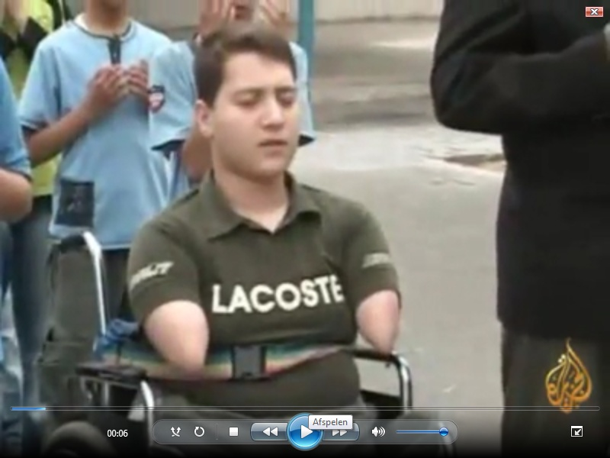
Success without limbs in Gaza

Slide 6
chunking
More general
More general
More specific
Milton-model
Meta-model
down-chunking
up-chunking
More specific

Slide 7
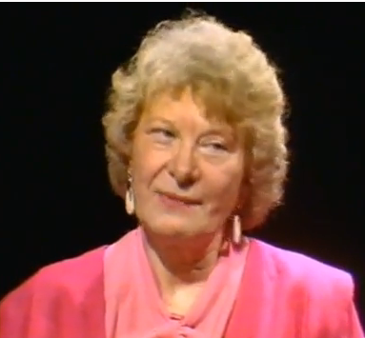
Meta-Model
Virginia Satir, Family therapist
Probleem
Big Problem
With generalizations,
distortions and deletions
Metamodel-question 1
Always?
Never?
Metamodel-question 2
Who says that?
How exactly goes that?
Metamodel-question 3
Or? Because?

Slide 8
Distortions: Mind Reading

Slide 9
Generalizations: Must, have to, need

Slide 10
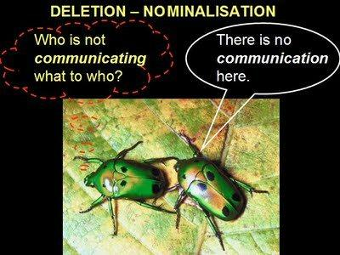
Deletions: Nominalisations

Slide 11
Metamodel 1
Meta-model expression:
He dislikes me.
Meta-model question:
How do you know that he dislikes you?

Slide 12
Metamodel 2
Meta-model expression:
You make me angry
Meta-model question:
What makes you think that my behavior causes your anger?

Slide 13
Metamodel 3
Meta-model expression:
I feel hurt by her.
Meta-model question:
What does make you choose (unconsciously) for being hurt?

Slide 14
Metamodel 4
Meta-model expression:
He does not look at me,
so he does not like me.
Meta-model question:
Did you ever not look at someone, while you liked the person?

Slide 15
Mini-Meta-Model 1
Exercise 1
A says with high volume and high tone:
You must …………………………………………………
You have to …………………………………………..
You should ……………………………………………
B: listens
Exercise 2
A says: You must …………………………………….
B asks: What happens when I don’t do that?
A and B feel what the question does to them.

Slide 16
Mini-Meta-Model 2
Exercise 3
A says a negative expression with
Always
Never
Everybody
Nobody
B asks: Always?
or B asks: Was there ever a situation were it did not happen? (exception)

Slide 17
Communication
In all communication between people there will always be some distortion, deletion and generalization

Slide 18
Exercise
If you pass a message in a circle from person to person what is happening with the message?
Start message: Song text.
End message: ………..
Conclusion of the exercise: By passing a message from person to person you get a multiplication of distortions, deletions and generalizations

Slide 19
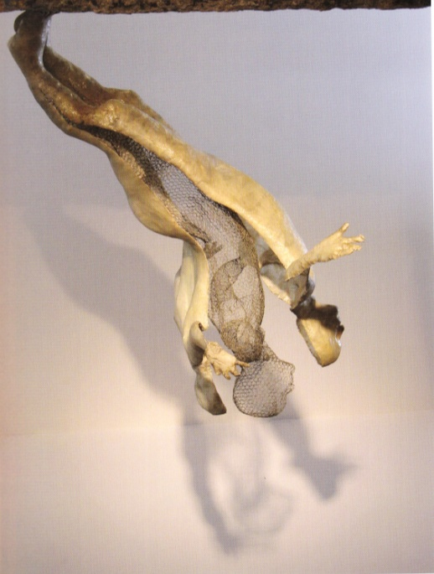
Work with parts
Bring harmony in your onconscious mind
From which parts do you existt

Slide 20
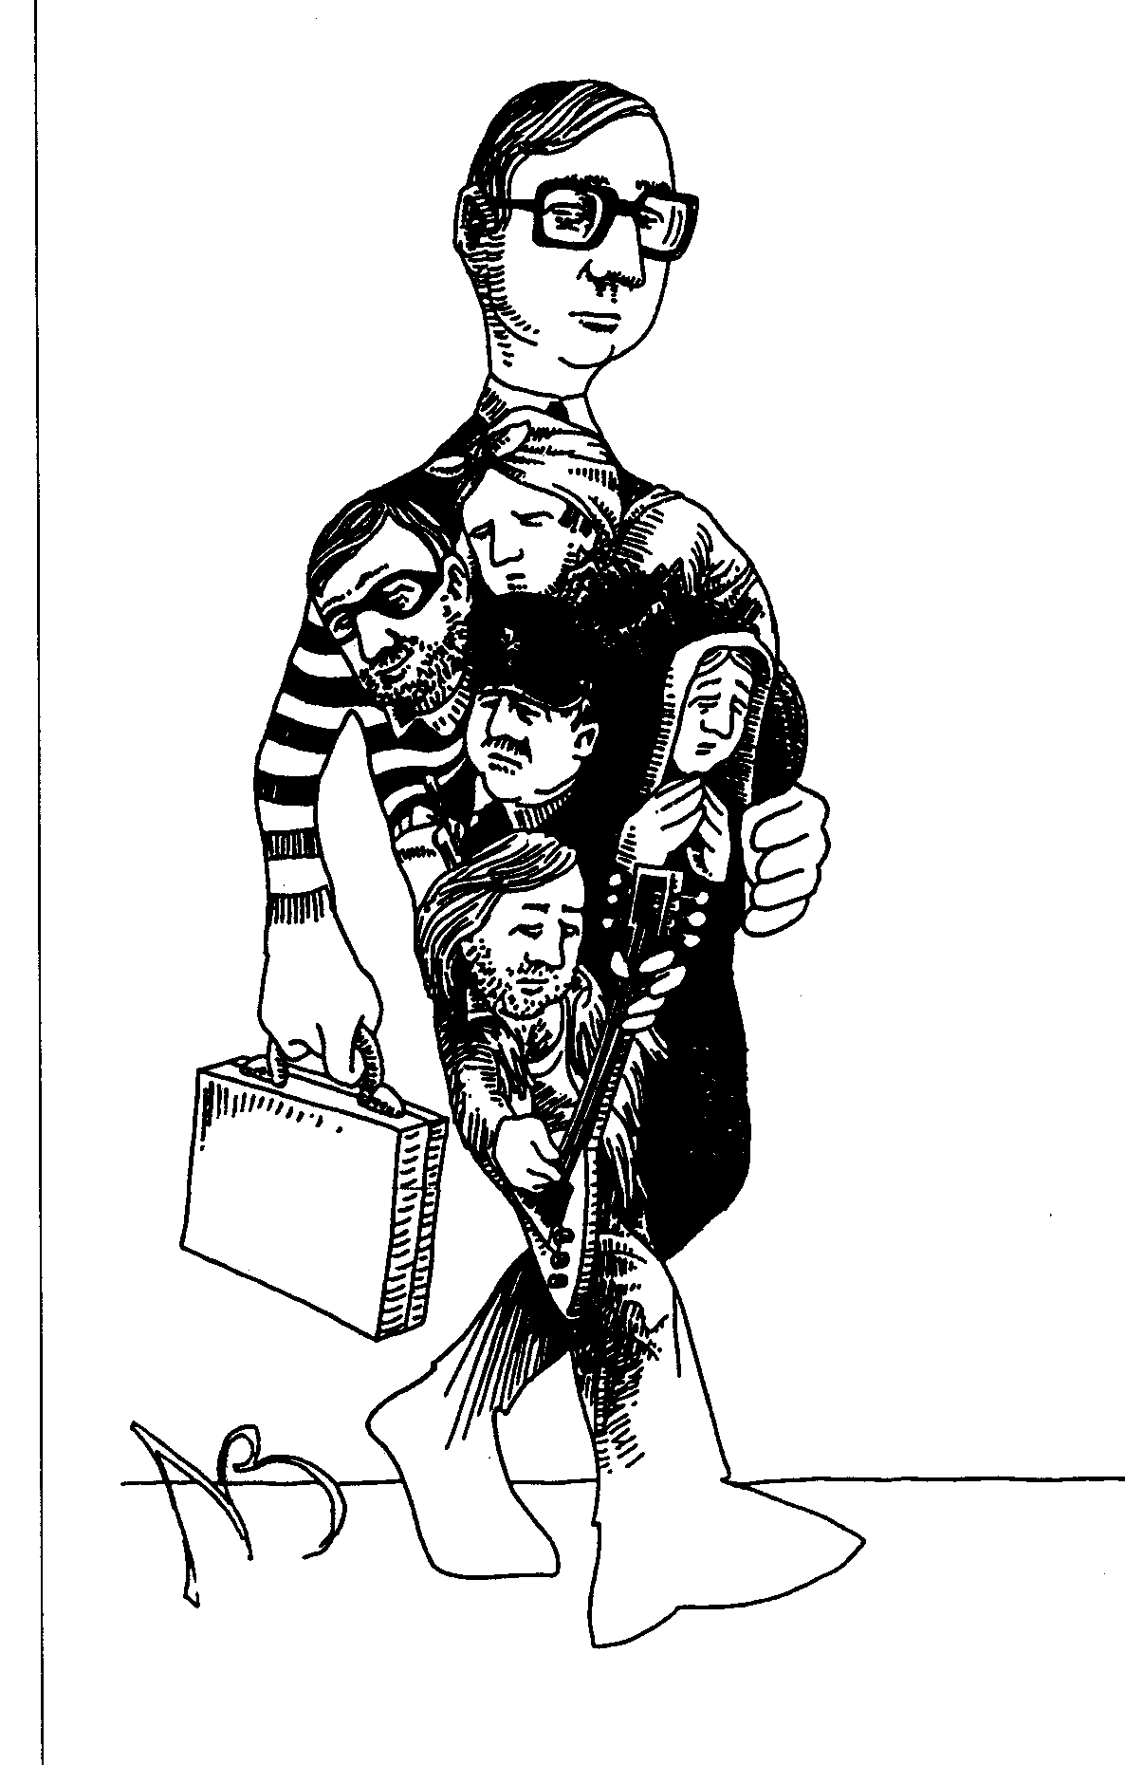
Unconscious Parts
Parts ………
are Unconscious.
have an intention and a behavior.
emerge from a Significant Emotional Event (SEE).
protect and continue not-integrated behavior.
are a source of incongruency.
two parts have the same highest intention.
in the past they have been part of a bigger whole.
reintegration of parts is possible.

Slide 21
Gestalt

Slide 22
Gestalt

Slide 23
Examples of unconscious parts
On one side I want to stop smoking ….
But on the other side I continue to smoke.
Did you know?
Globally, tobacco killed 100 million people in the 20th century, much more than all deaths in World Wars I and II.

Slide 24
Exercise working with parts
What are opposite parts which you recognize in yourself.
Write them down.
Use the neurologic levels
5 minutes per person.
This is a preparation for the next step.

Slide 25
You communicate with parts when ……
1. you talk about something you want, but you keep not doing it.
2. you talk about something you don’t want, but you keep doing it.
3. you dissociate yourself severely – for example because of psycho-somatic issues.
4. you want to discover why you do, feel or think certain things.
5. you want to do something even better than you already can.

Slide 26
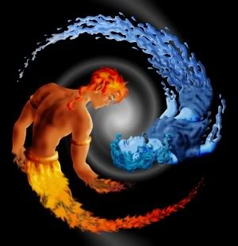
Visual Squash:
Integration of parts
Yin and yang are opposite parts
Water and fire are opposite parts
Bringing Harmony in opposite parts

Slide 27
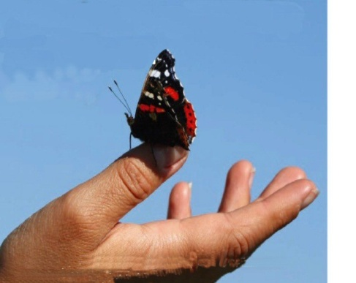
Visual Squash:
integrate parts
example
Melt together to one metaphor i.e. for peace
Chunk up to the highest positive
intention
Metaphor
i.e. for freedom
The opposite of this part
Metaphor
i.e. for safety

Slide 28
Visual Squash
Peace
Peace
Self-fulfill-ment
Chunk up to the highest positive
intention
Love
Satis-faction
Care
Enjoy
Protec-tion
Freedom on one hand
Safety on the other hand
Opposite of this part
"What is the positive intention of this part ?”
“To reach what?”
“To get where?”
“What does it bring you?”
(Chunk up till the highest positive intention) .
I want to do what I like
I only do if I am not scared
Right hand
Left hand

Slide 29
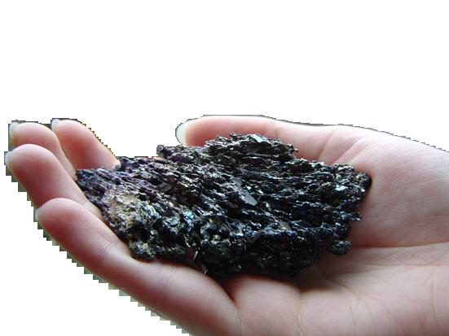
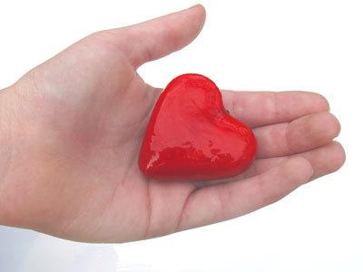
Let both metaphors melt together

Slide 30
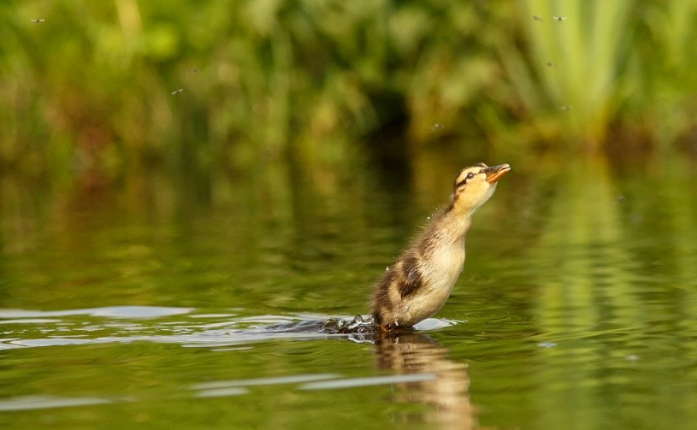
Use your resourses
Open your uncounscious resourses
Which resourses do you have?

Slide 31
You raise me up
Celine Tam 5 year old Chinese girl

Slide 32
Resourses
Happiness

Slide 33
Resourses
Geluk
Relaxing

Slide 34
Resourses
Ontspanning
Geluk
Love

Slide 35
Hulpbronnen
Liefde
Ontspanning
Geluk
Power

Slide 36
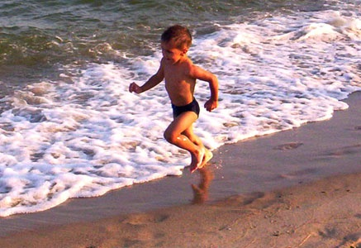
Resourses
Kracht
Liefde
Ontspanning
Geluk
Energy

Slide 37
Resourses
Motivation
Energie
Kracht
Liefde
Ontspanning
Geluk

Slide 38
Hulpbronnen
Energie
Kracht
Motivatie
Liefde
Ontspanning
Geluk
Humor

Slide 39
Resourses
Energie
Kracht
Motivatie
Liefde
Humor
Ontspanning
Geluk
Vrede

Slide 40
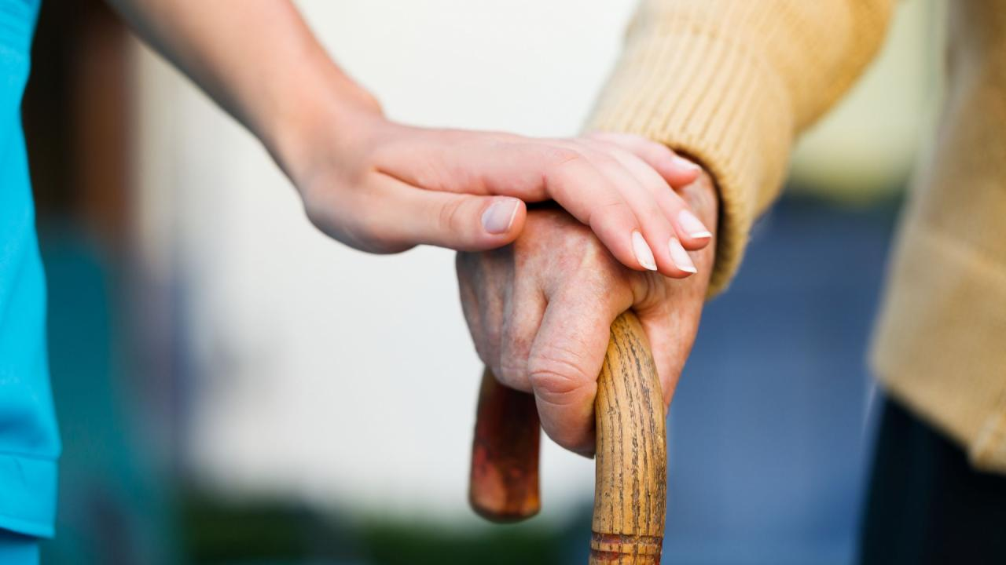
Resourses
Energie
Kracht
Motivatie
Liefde
Humor
Ontspanning
Vrede
Geluk
Respect

Slide 41
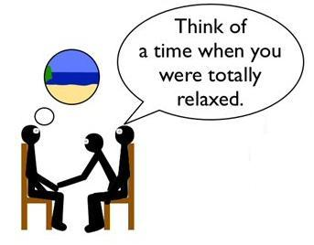
Collapsing Anchors
Anchor your Resources
Energy
Power
Motivation
Love
Humor
Relaxation
Peace
Happiness
Respect

Slide 42
Anchoring when Intensity is high
State
Time

Slide 43
Anchoring: Timing
Seconds
State
Time

Slide 44
Install the anchors
1 place of the negative anchor
Negative anchor
positive
2 place of the positive anchor
Fire both anchors, lift the negative anchor 5 sec before the positive anchor

Slide 45
Neurological levels compared with the 7 chakra’s
Mission
Crown of the head
Between your eyebrows
Identity
Values and Beliefs
Throat
Right of the heart
Skills
Navel
Behavior
Above de genitals
Environment
Just above the anus

Slide 46
Achieve more success with your Unlimited possibilities!
Go for your success!

Slide 47
If light is in your heart,
You will find your way home.
- Jalāl al-Dīn Rūmī-

Slide 48
Achieve more Success with your unlimited powers!
Go for your success!

Slide 49
Reflection of the day
Look back on what we did today.
Where and how can you use the different exercises?

