Slide 1
Welcome to the NLP-course “Your Unlimited Powers”
Welcome!
مرحبا
Ministry of social affairs, Dar Al Amal, Ramallah, Palestine
5th day Wednesday 4 May 2016
Trainers: Sytse and Marlies Tjallingii

Slide 2
Program of today
9.00 – 10.30 Welcome
Good and New
Open Frame
Circle of Excellence Exercise
10.45 – 12.00 Language
Power of Language
Chunking
12.15 – 13.15 From Specific to Generalised
Exercise Chunking
13.30 – 14.30 Metamodel
Milton Model
Reframing
Conclusion
Closing ceremony

Slide 3
Good and new
Joy
Energy
In two's 2 minutes each.
Focus at a recent situation which had given you a good/or new feeling. In which you felt energy, happiness or joy.
Share in the whole group the title of your experience and show your feelings at your face.

Slide 4
Open Frame
Questions
Experiences
Short stories
Share a real life-experience to reflect on what NLP can mean to it.
Goal: apply NLP in your own reality.

Slide 7
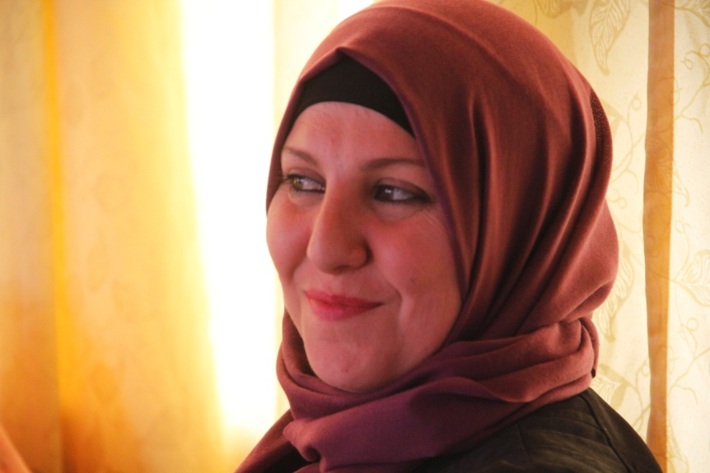

Slide 8
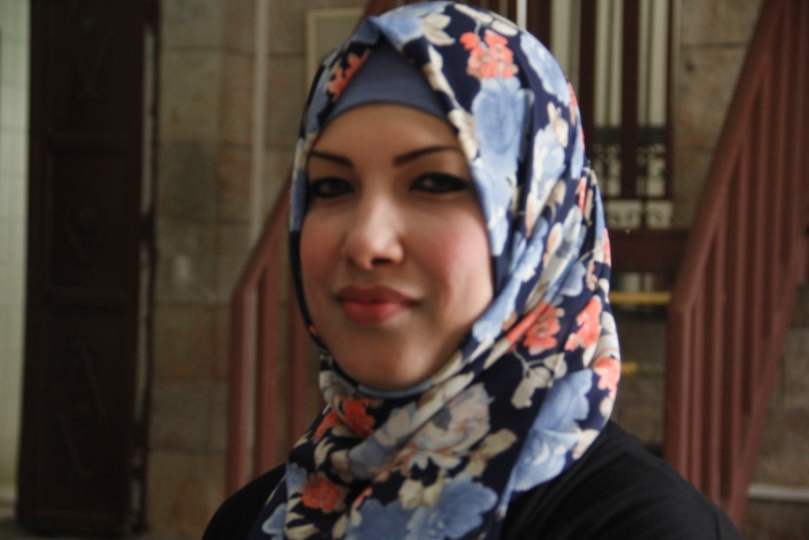

Slide 11
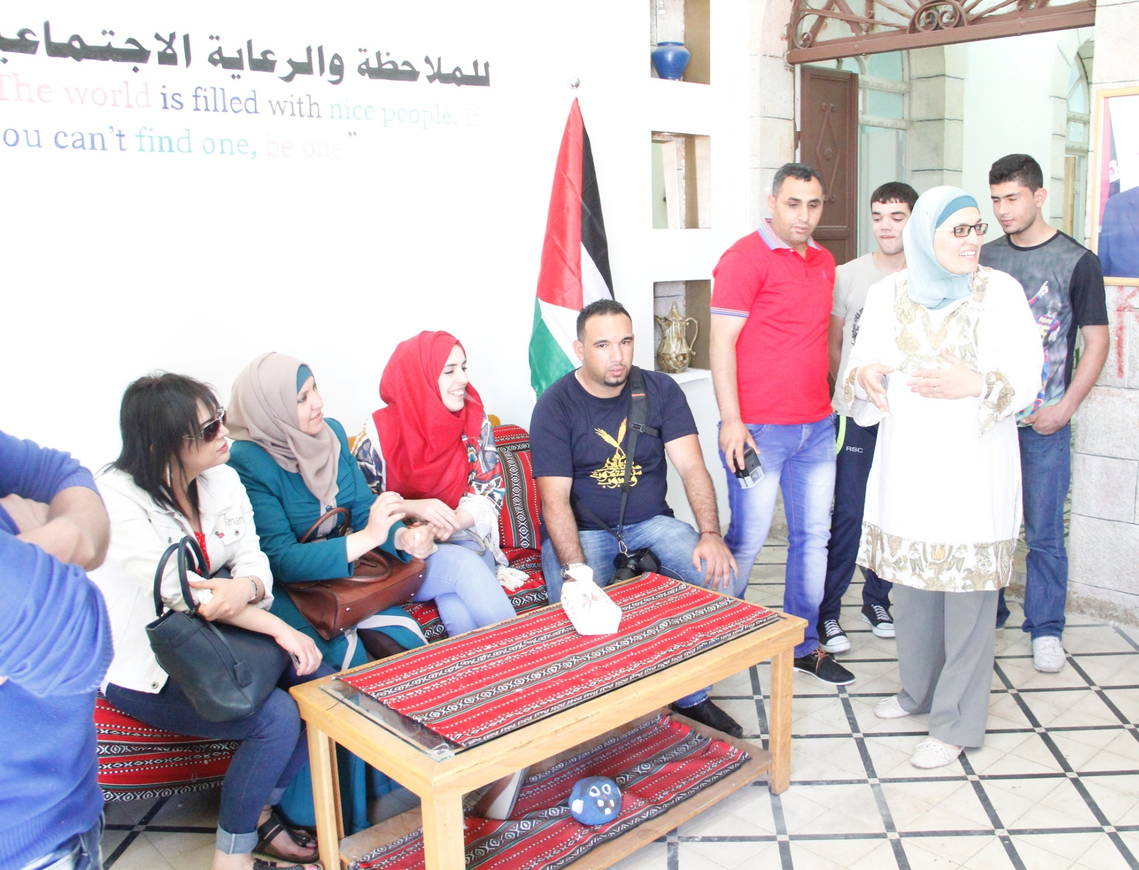
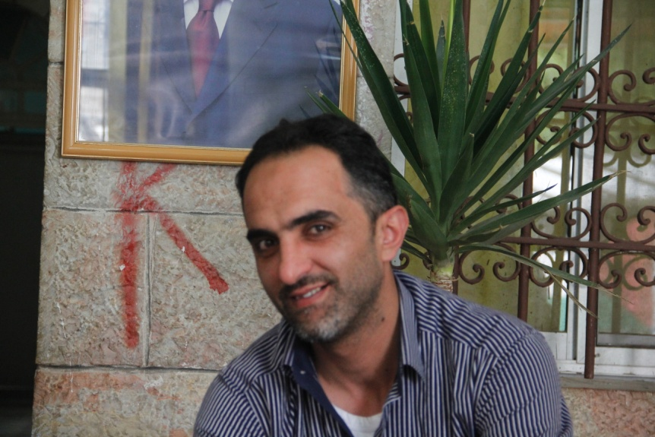

Slide 12
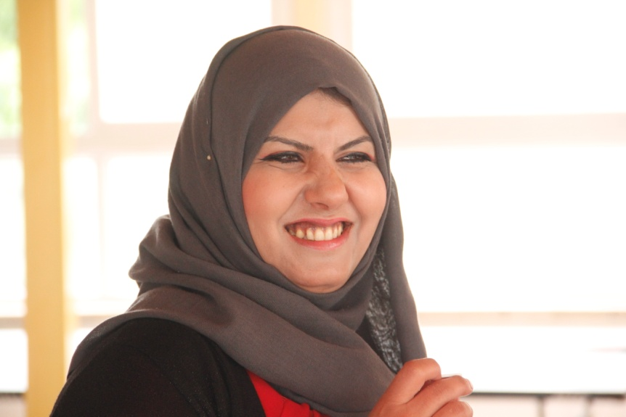

Slide 14
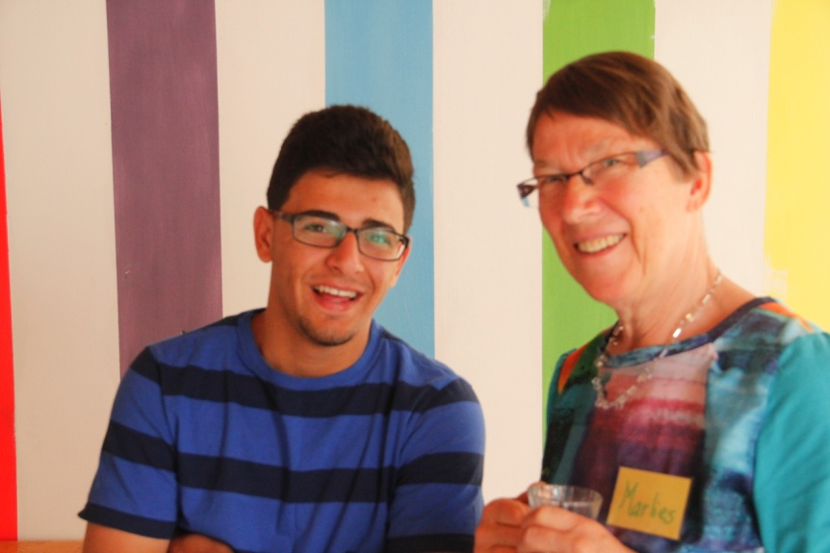

Slide 15
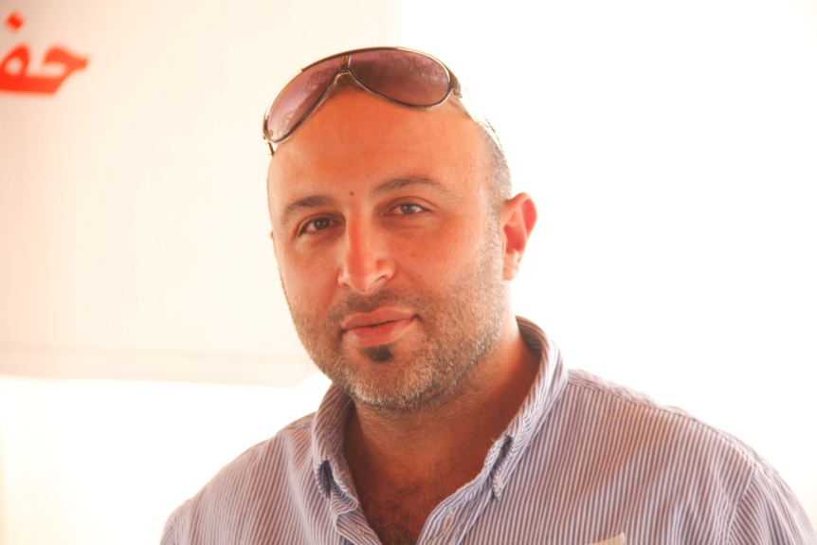

Slide 17
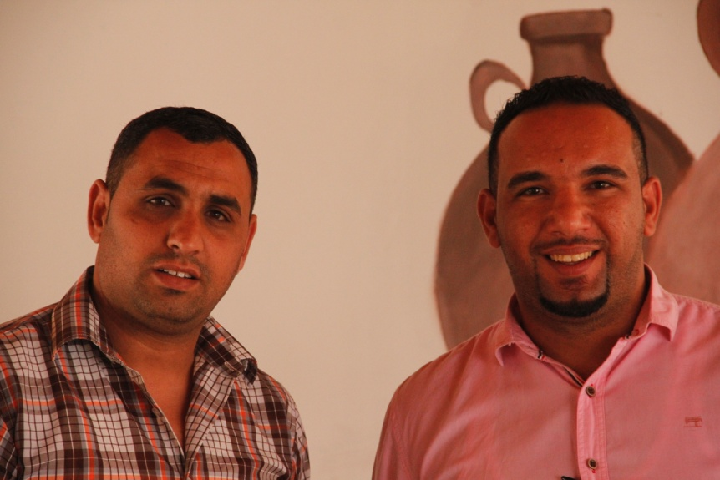

Slide 18
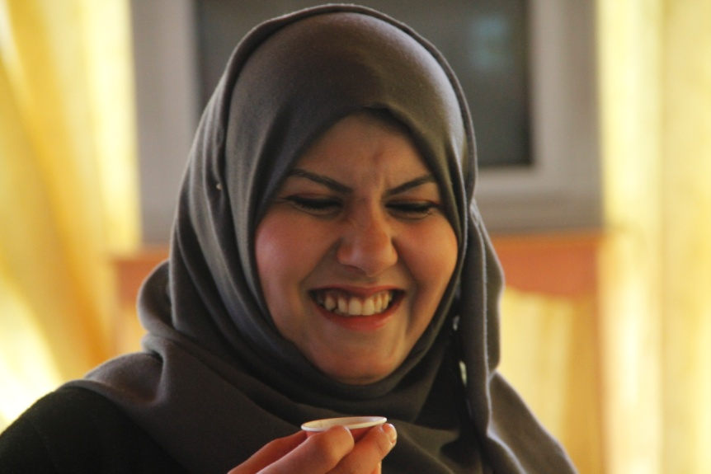

Slide 20
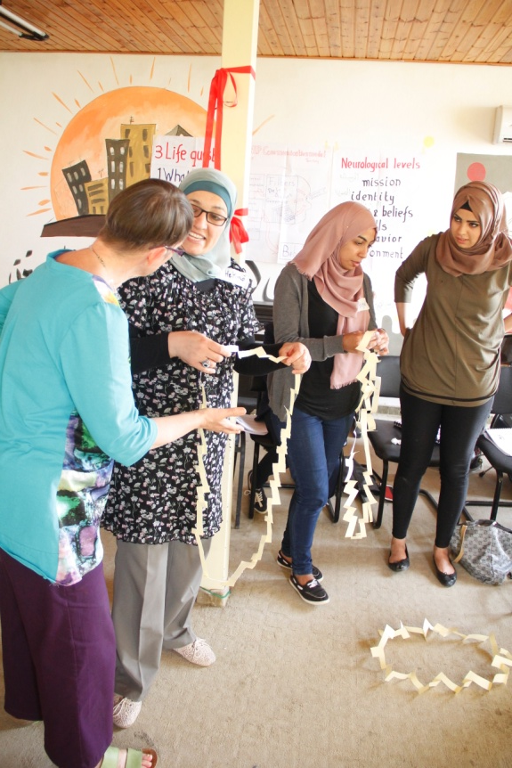

Slide 21
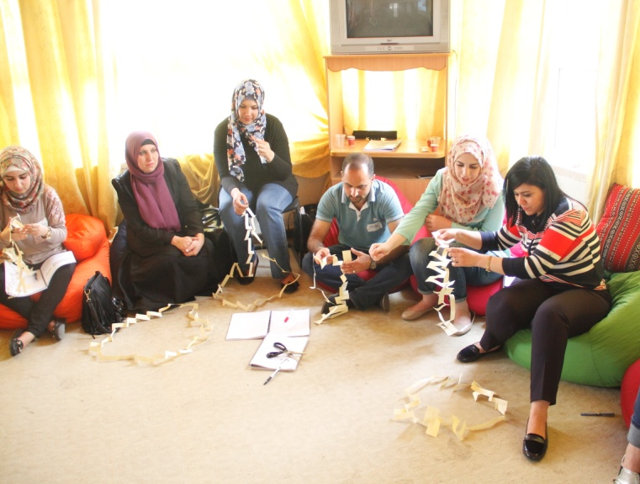

Slide 22
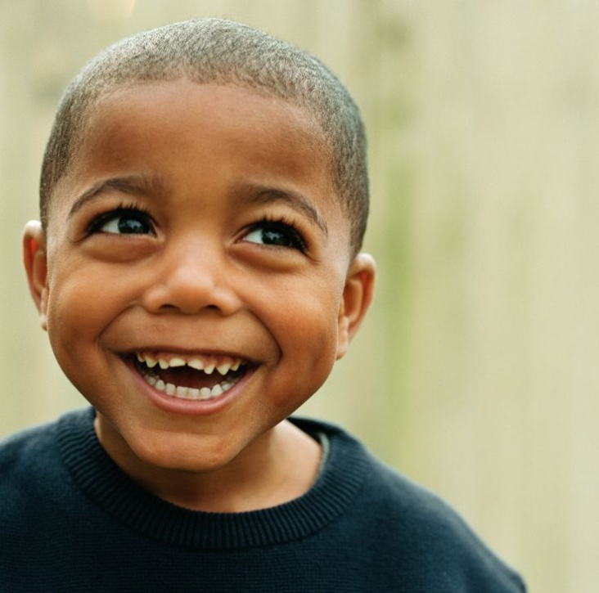
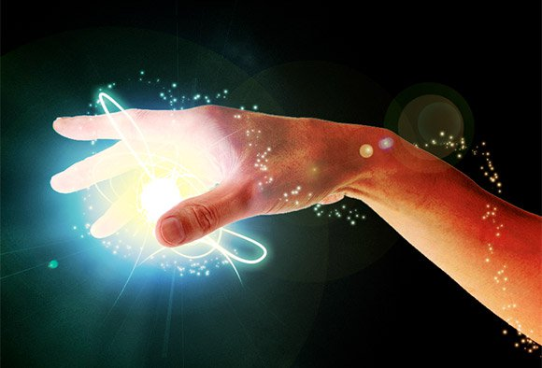
Anchoring
Anchor: Any stimulus that is associated with a specific response.
MOTIVATION
HUMOUR / LAUGHING
ENERGY

Slide 23
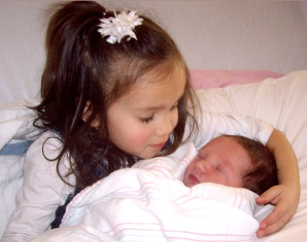
The short way to your resources
LOVE
POWER
SELFCONFIDENCE

Slide 24
4 steps to Anchoring
start
end
intensity
feelings
time
Remember an experience with one valuable resource as: Motivation; humour / laughing; energy; love; power; self confidence.
Step in the circle of excellence when the feeling is getting stronger
Step out at the highest point (see graphic below).
Break state
3 Repeat with the same or different resources with different memories.
4 Set the anchor in action to perform the test.

Slide 25
Language
Hierarchy (chunking)
Meta-Model (problem reducing)
Milton-Model (motivating)
Non-violent communication

Slide 26
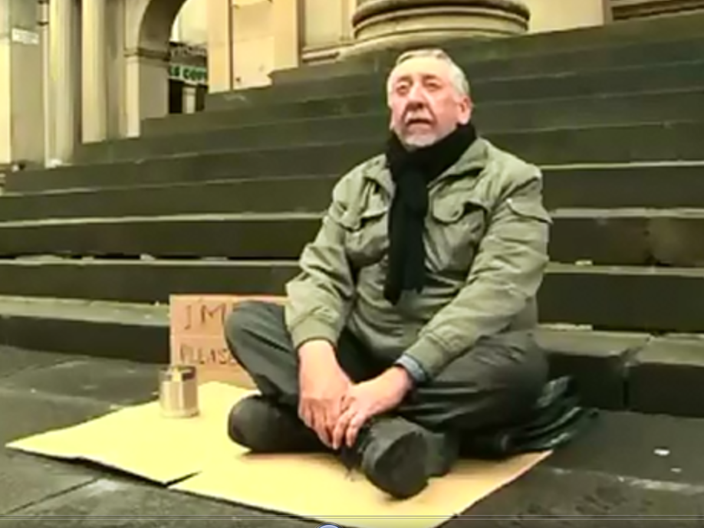
I am blind please help me.

Slide 27
Necessity or Possibility?
I should ……..
I ought to …….
I’ve got to ……
I have to …….
I must ……….
I’d like to ……..
I might …….
I may ……
I could …….
I will ……….
I want …….

Slide 28
More general
More general
chunking
More specific
More examples at the same level
down-chunking
lateraal
chunken
up-chunking
More specific

Slide 29
Chunking
Up-chunking: From specific to abstract.
Questions:
With which meaning?
Where is this an example from?
Down-chunking: From abstract to specific.
Questions:
What is specific?
Can you give an example ..?
Lateral chunking: At the same level, more of the same (see bus, car, train, etc.).
Questions:
With what can you compare this?

Slide 30
GENERALISED
up chunk
I
ng
EXISTANCE
down chunk
I
ng
MOVING
TRANSPORT
lateral chunking
CAR, PLANE, BUS, BOAT, TRAIN
CLASS
SPARE PARTS
VW, BMW, OPEL
WHEELS
GOLF
WHEEL COVER
GTI
CHROME
SPECIFIC

Slide 31
chunking
Once upon a time
B
C
A
B points with tumb up (chunking up) or down (chunking) or sideway (lateral chunking)
C listens and guesses duim
A tells and changes the story in more or less abstract or with examples at the same level

Slide 32
Compare Meta- and Milton model
Milton Model | Meta Model
Makes language more general | Makes language more specific
Moves from surface to deep structure | Moves from deep structure to surface
Looks for general understanding | Looks for precise examples
Aims to access unconscious | Aims to bring experience to conscious
Keeps client internally focused | Keeps client externally focused

Slide 33
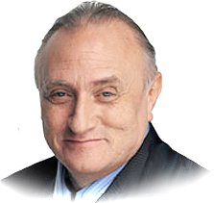
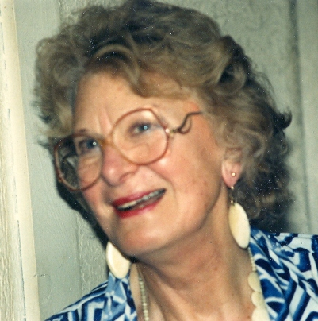
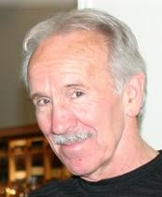
Meta-Model
Gathering Specific information: Chunking down
Reducing the problem
From Virginia Satir to …..
Richard Bandler
By modelling
The Structure of Magic
John Grinder

Slide 34
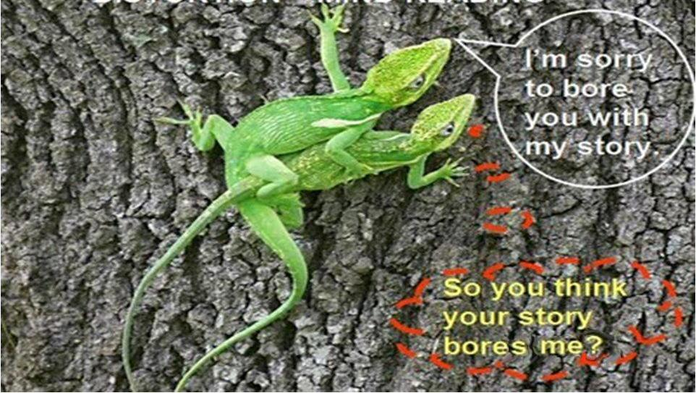
Distort: Mind reading

Slide 35
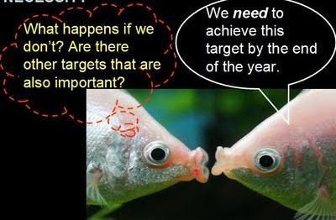
Generalisations: Must, have to

Slide 36
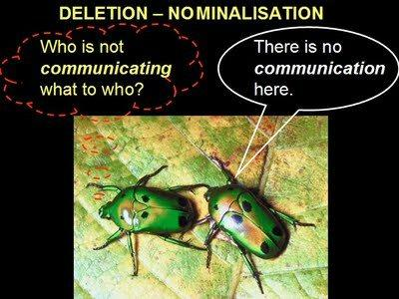
Deletions: Nominalisations

Slide 37
Metamodel 1
Meta-model expression:
You dislike me.
Meta-model question:
How do you know that I dislike you?

Slide 38
Metamodel 2
Meta-model expression:
You make me angry
Meta-model question:
What makes you think that my behavior causes your anger?

Slide 39
Metamodel 3
Meta-model expression:
I feel hurt by you.
Meta-model question:
What does make you choose (unconsciously) for being hurt?

Slide 40
Metamodel 4
Meta-model expression:
You do not look at me,
so you do not like me.
Meta-model question:
What does not looking at you tell about me?
Do you ever not look at someone, while you like the person?

Slide 41
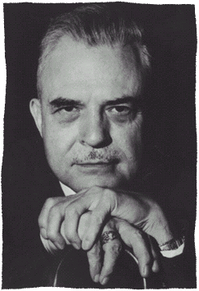
Milton Model: Language paterns motivational language / chunking up let the listener fill with his/her own thought
Richard Bandler
By modelling
John Grinder

Slide 42
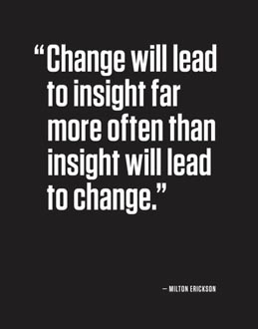

Slide 43
Examples of Milton language:
This is easy, isn’t it? (Tag question)
What is interesting is, when did you last learn so easily? (embedded commands)
Would you like to order it in blue or in green? (double binds)
Some day, we’ll all be free.
Things can go only better.
I have a dream.

Slide 44
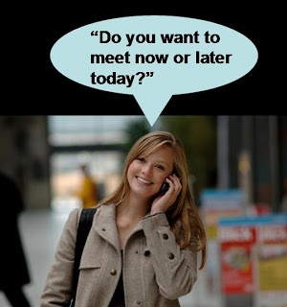

Slide 46
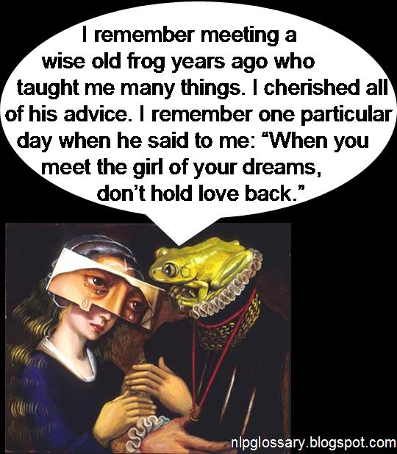

Slide 47
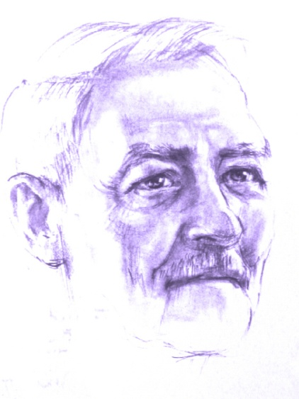
Milton language
Deletions
I see that you are ready to listen (simple deletion)
As you may have attention you will learn more and more (unspecified verbs)
There are people who are learning fast (unspecified subject)
You are feeling more and more curious (comparisons)
Remember that you have been through some tough times and survived them well (judgements)
You are gaining new insights, building new friendships (nominalisations)

Slide 48
Milton language
Generalizations
You become more successful, you will be able to discover new ways. (possibility)
You must take this forward where it has to go (necessity)
Every time you feel like this you will remember how important this is for you. (universals)
All the skills you need are easy for you to learn (universal)

Slide 49
Milton language
Distortions
This means that you are getting all the help you need (equivalence)
I know that you think with more and more interest (mind reading)
On each breath, you can relax even more (cause and result)

Slide 50
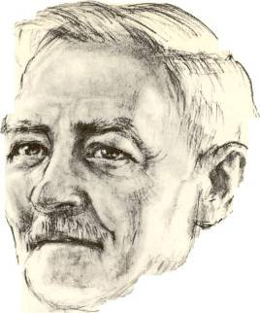
1
I observe that you came to this place. (a)
I notice that you are looking at me which means that you have attention for this (b)
2
3
I can imagine that you ask yourself how much this conversation can give you. (c)
4
Everything is pointing in the direction of success (d)
Milton patterns
Factual observation
Cause→ Result
Mind reading
Universal truth
Possibility
Presupposition
5
There may happen beautiful things. (e)
How would you approach this case?

Slide 51
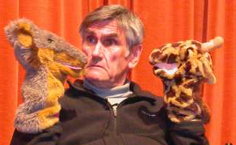
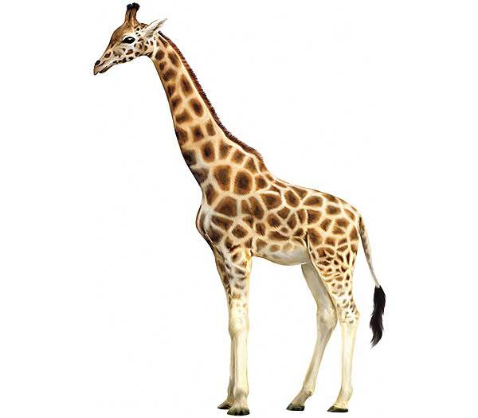
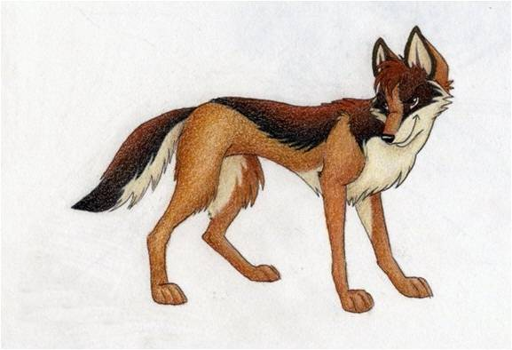
Non- Violent Communication
´You´ messages
´I´ messages
Giraf
Jackal

Slide 52
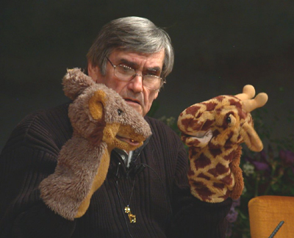
Marshall Rosenberg:
Non-Violent Communication
OPTIONS
4. Which possibilities do you have to fulfill your needs?

Slide 53
Nonviolent Communication
Giraf Language
Pitfalls of the Jackal
1. Observe Without judgment or interpretation “I see…” “I hear…”
1. Observe with own judgments Pasting your own judgment on something “you never do it right!”
2. Feel Recognize your feelings Acknowledge your feelings “This makes me feel …”
2. Mix feelings with thoughts Read minds “I see/feel that you don’t feel like it”
3. Acknowledge needs Connect your feelings with your needs “I feel … because I need …”
3. Make the other person responsible for my needs “I want that you don’t make me angry”
4. Options Which different options do you have to meet your needs?
4. There is one option only Only you can …, I can’ “t do anything”
5. Do a request or do something “Could you do … ?” “I am going to do ..”
5. Mix request with a demand “I want you to do this now” “You have to do this now and in my way”

Slide 54
Video mother and child:
..\video's\NVC\Compassionate Communication with Kids.flv

Slide 55
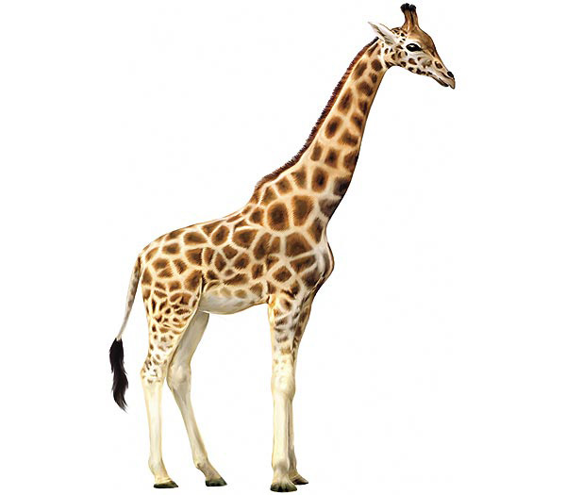
Non-violent Communication

Slide 56
Giraffe language
Look for at least 3 different needs which are basic in your life.
What are your feelings when these needs are not fulfilled?
What are your feelings when these needs are fulfilled?
What are your options to fulfill these needs?
What are you going to do or what is your request?

Slide 57
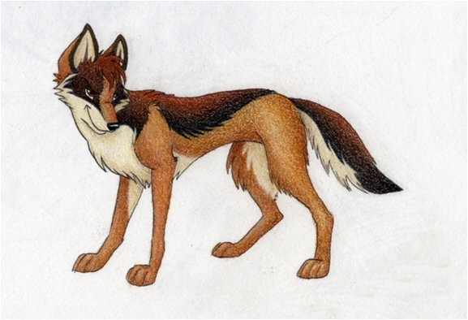
Violent Communication

Slide 58
1. Observe
Without judgement
“I see............... “
“I hear............ “

Slide 59
2. Feelings
Acknowledge
Your feelings
“I feel me with this...............”

Slide 60
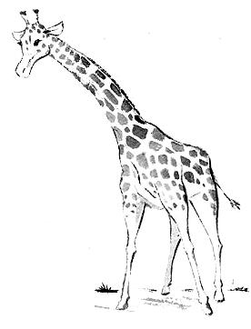
Authentic Feelings
I take reponsability for my own felings
AFFECTIONATE compassionate friendly loving open hearted sympathetic tender warm ENGAGED absorbed alert curious engrossed enchanted entranced fascinated interested intrigued involved spellbound stimulated | CONFIDENT empowered open proud safe secure EXCITED amazed animated ardent aroused astonished dazzled eager energetic enthusiastic giddy invigorated lively passionate surprised vibrant | GRATEFUL appreciative moved thankful touched INSPIRED amazed awed wonder JOYFUL amused delighted glad happy jubilant pleased tickled | PEACEFUL calm clear headed comfortable centered content equanimous fulfilled mellow quiet relaxed relieved satisfied serene still tranquil trusting | EXHILARATED blissful ecstatic elated enthralled exuberant radiant rapturous thrilled HOPEFUL expectant encouraged optimistic REFRESHED enlivened rejuvenated renewed rested restored revived

Slide 61
3. Acknowledge Needs
Connect your feelings with your needs.
“I feel ....., because I have a need to ...............”

Slide 62
Needs
I have a need at a deep level and I take resposability to fulfill this need
CONNECTION acceptance affection appreciation belonging cooperation communication closeness community companionship compassion consideration consistency empathy inclusion intimacy love mutuality nurturing respect/self-respect | CONNECTION continued safety security stability support to know and be known to see and be seen to understand and be understood trust warmth PHYSICAL WELL-BEING air food movement/exercise rest/sleep sexual expression safety shelter touch water | HONESTY authenticity integrity presence PLAY joy humor PEACE beauty communion ease equality harmony inspiration order AUTONOMY choice freedom independence space spontaneity | MEANING awareness celebration of life challenge clarity competence consciousness contribution creativity discovery efficacy effectiveness growth hope learning mourning participation purpose self-expression stimulation to matter understanding

Slide 63
4. Options
Which different possibilities do you have to fulfill your authentic needs?

Slide 64
5. Request or action
Would you like to do .......?
I’m going to do ...........

Slide 65
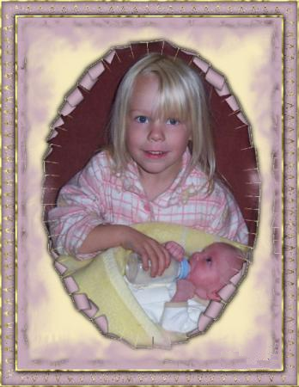
Reframing

Slide 66
What I asked life
I asked for strength...
And life gave me difficulties to make me strong.
I asked for wisdom...
And life gave me problems to resolve.
I asked for prosperity...
And life gave me brains and muscles to work with.
I asked to be able to fly ...
And life gave me obstacles to overcome.
I asked for love ...
And life gave me people who needed help.
I asked for favours ...
And life gave me possibilities
I did not receive anything of what I asked for...
And.......
I received everything I needed!

Slide 68
Reframing with
3 Perceptual positions
3
Third Position
Dissociated of yourself
and from the other
Also called: The meta position, the observer or helicopter view.
1
2
First Position
Associated in your self
Second Position Associated in the other

Slide 69
The gift of peace on earth lies in our hands.
What could be your first step?
Thank you for your important step
in improving your life with NLP !

