Slide 1
Welcome to the NLP-course “Achieve more success with Your Unlimited Powers”
"حقق نجاحا أكثر مع طاقاتك اللامحدودة"
دورة البرمجة اللغوية العصبية التابعة
ترحيب
مرحبا
Success!
4^{hd} day Ramallah, October 26, 2017

Slide 2
Program for today
Good and New
Open Frame
Dead-end street
Non-Violent Communication
Needs
Solution focused work
Reflection

Slide 3
Good and New
In pairs 2 minutes each.
Focus at a recent situation which has given you a good/or new feeling. In which you felt energy, happiness or joy.
Share in the whole group the title of your experience and show your feelings at your face.

Slide 4
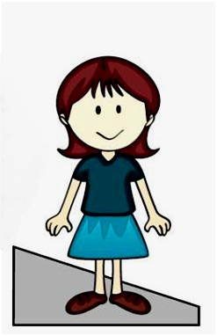
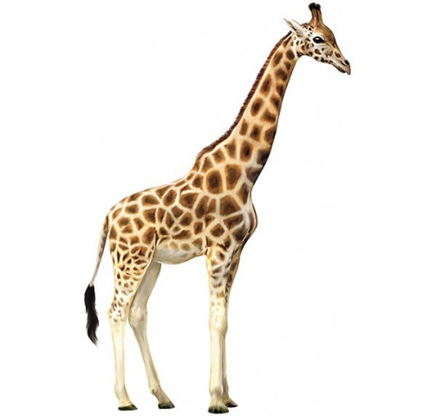
In the box
Out the box
Intensity of the emotion
Giraffe - language

Slide 5
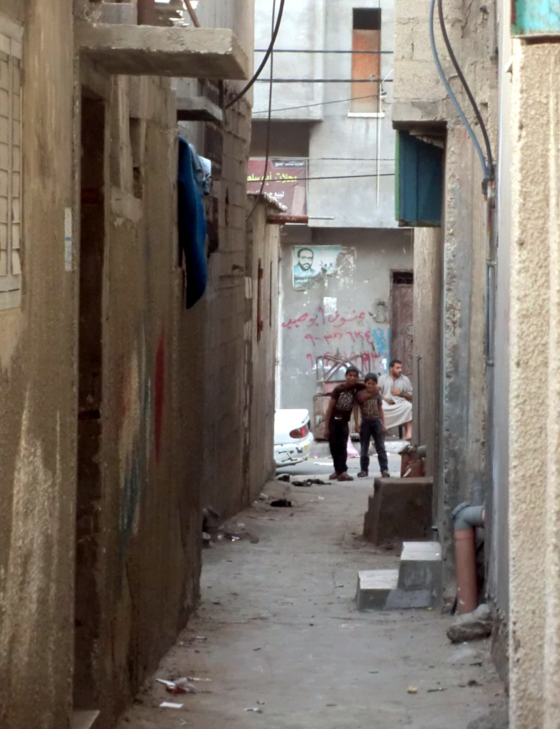
Street with dead end
Separate behavior and intention

Slide 6
Dead End Street
In pairs A and B.
A tells B about a conflict A has with another person.
(i.e. an unpleasant conversation).
A plays himself and B responds playing the role of the other person of the conflict.

Slide 7
Steps of the dead end street
Escalating, attacking, judgments
Step 1
Blocked
Deadend
Step 2
Turn 180º , take a new perspective
De-escalating, positive intention, needs
Step 3
Step 4
Negotiate, coming out the street

Slide 8
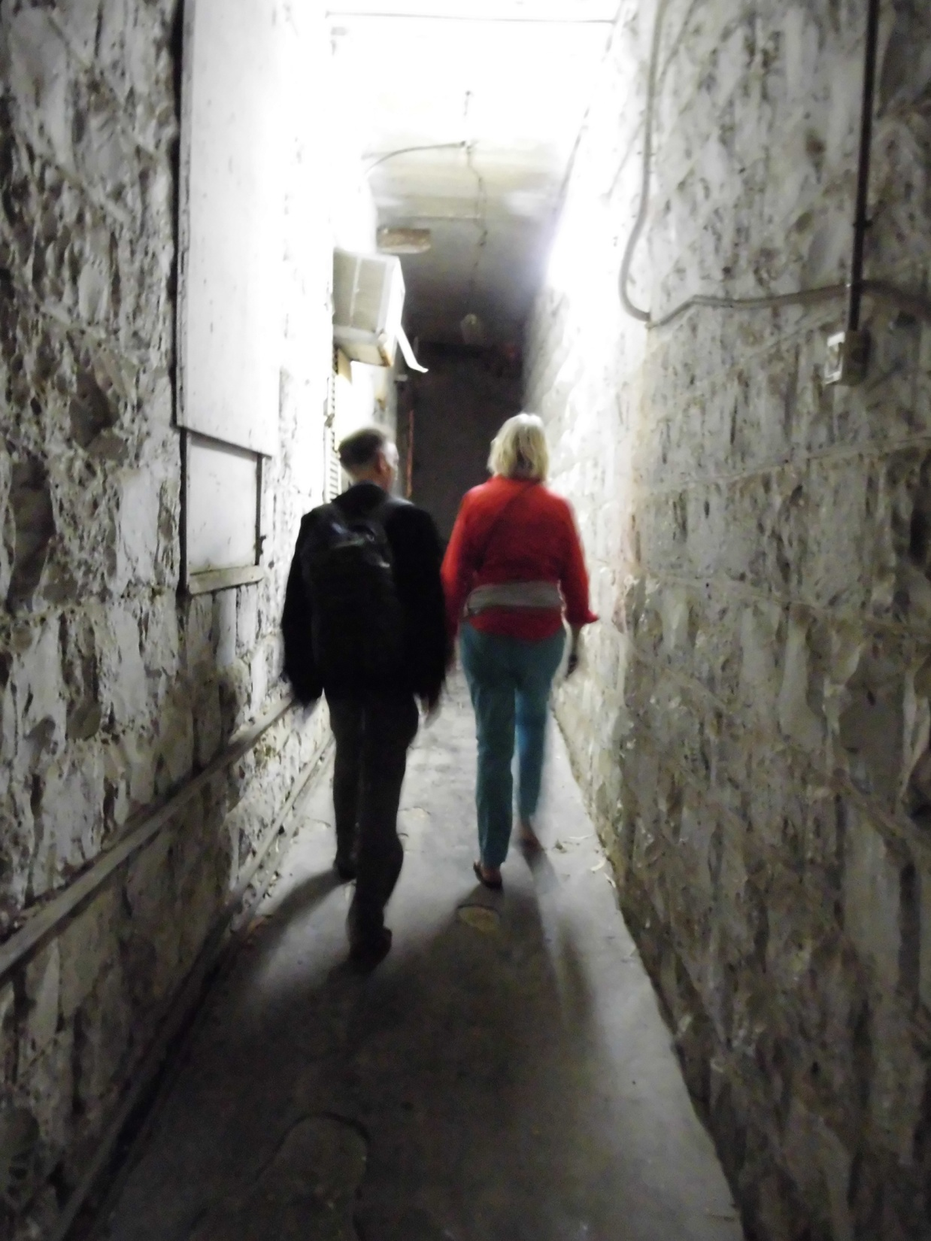
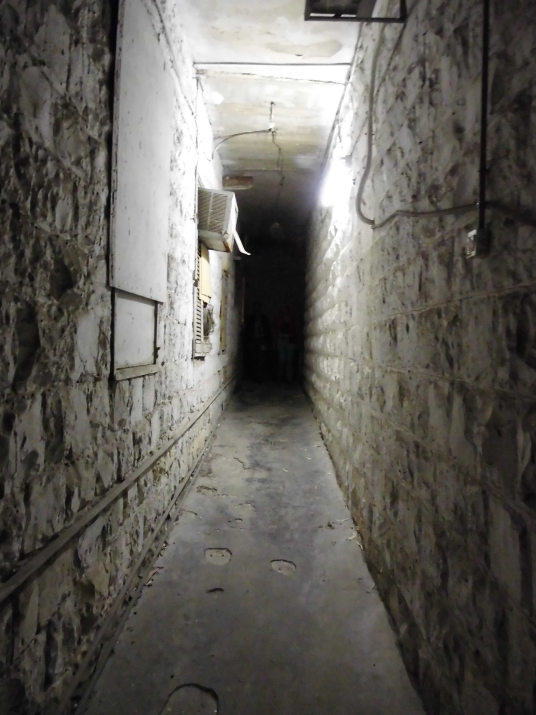
Dead-end street conflict-resolution with NLP
Walking to the dead-end
Escalating:
Negative judgments
attacking

Slide 9
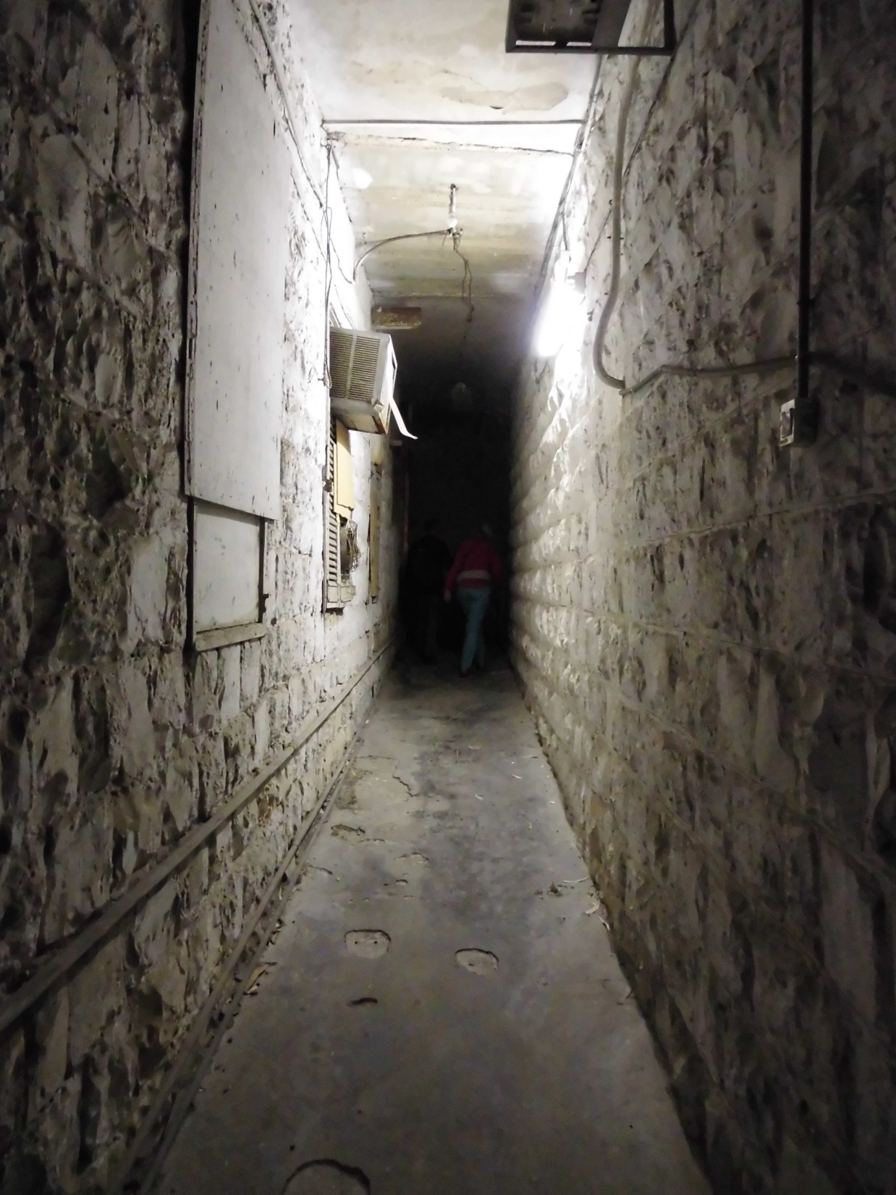
The dead-end
Changing the direction, because there is no way to continue.
A: So if I understand it correctly, you think/say ………
(using the same words),
B: Yes!

Slide 10
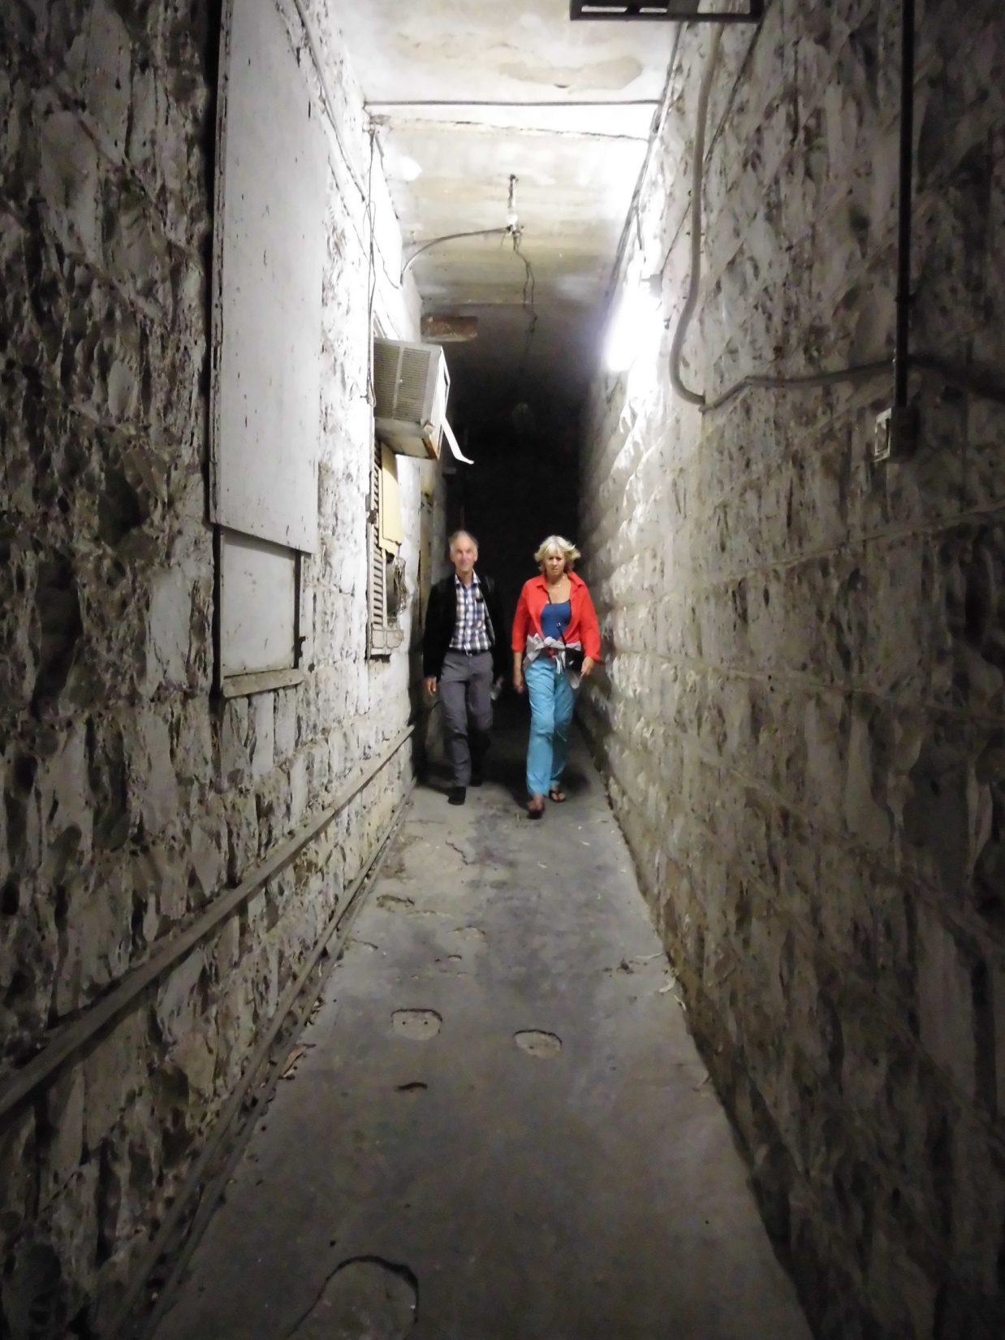
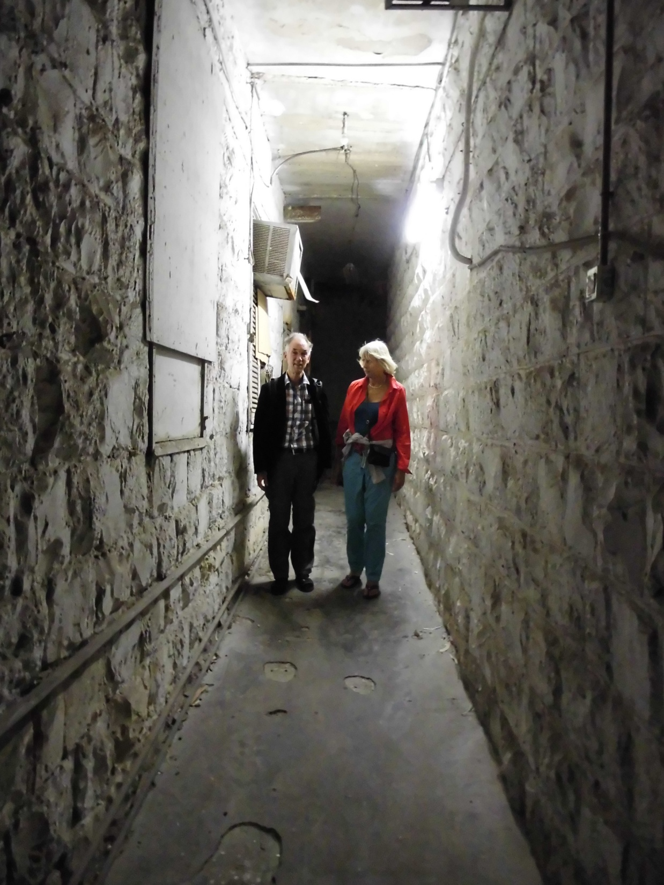
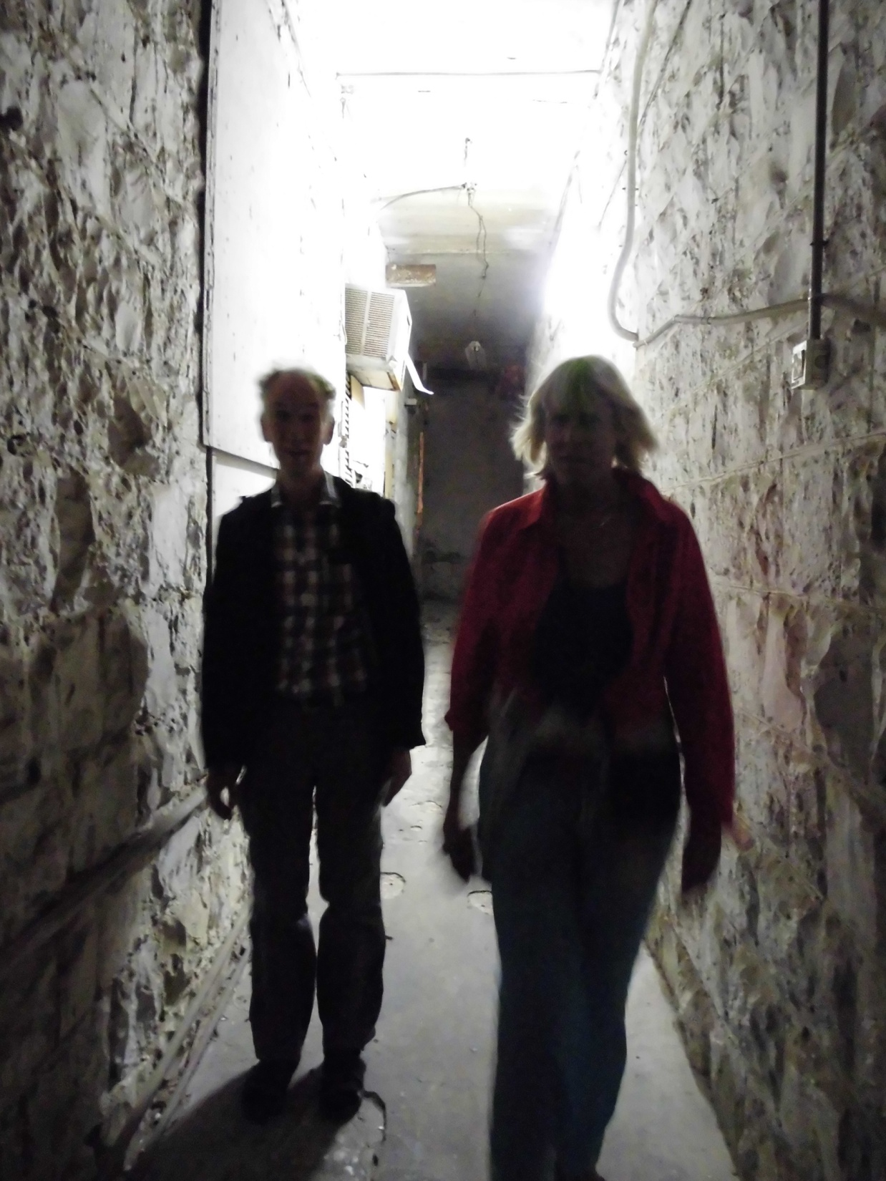
Coming out of the dead-end
Walking the way out: de-escalating
I know you have a positive intention tell me about it….
So this is very important to you….
Negotiate

Slide 11
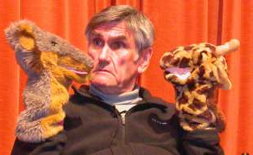
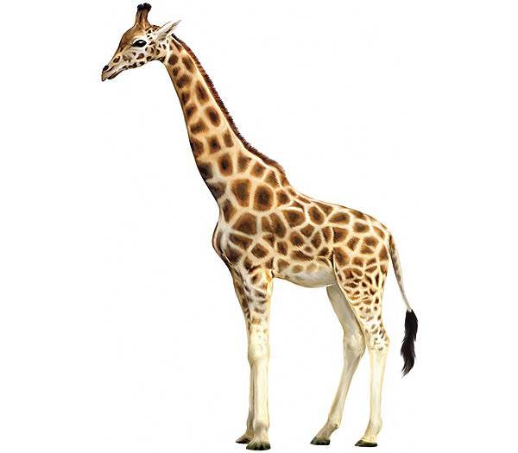
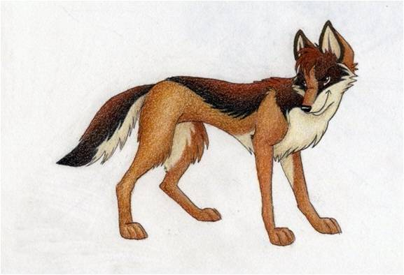
Non- Violent Communication
Marshall Rosenberg:
´You´ messages
´I´ messages
Giraf
Jackal

Slide 12
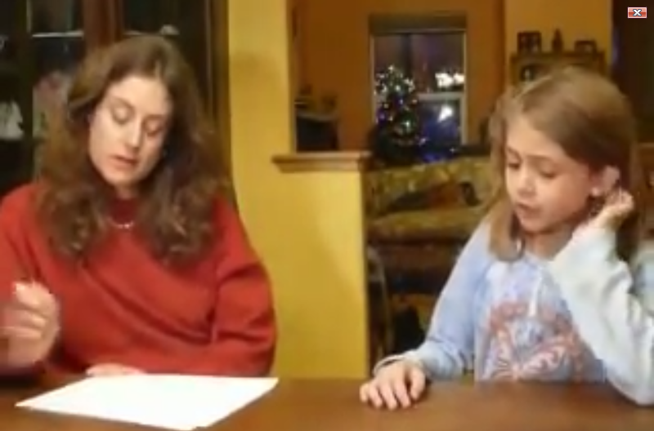
Video mother and child, Compassion in communication 2

Slide 13
The 5 steps of the Giraf
1. OBSERVATIONS
“I see (hear) ……..
2. FEELINGS
“I feel ……”
3. NEEDS
My need is ……
Love , Acknowledgement, Safety
4. OPTIONS
My possibilities to fulfill my needs are: ….
Non-Violent
Communication
5. REQUESTS
Request: Would you be willing to ……?

Slide 14
Non-violent Communication

Slide 15
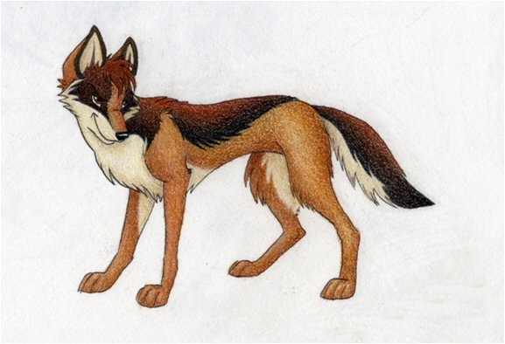
Violent Communication

Slide 16
1. Observe
Without judgement
“I see............... “
“I hear............ “

Slide 17
2. Feelings
Acknowledge
Your feelings
“I feel me with this...............”

Slide 18
3. Acknowledge Needs
Connect your feelings with your needs.
“I feel ....., because I have a need to ...............”

Slide 19
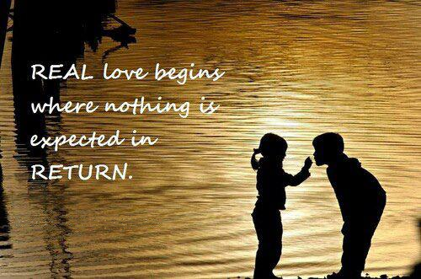
Basic Needs
1 Love
2 Safety
3 Acknowledgement

Slide 20
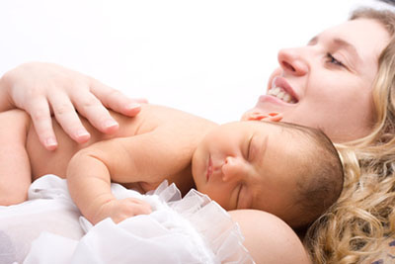
Basic Needs
1 Love
2 Safety
3 Acknowledgment

Slide 21
Basic Needs
1 Love
2 Safety
3 Acknowledgement

Slide 22
Communicating with judgments
The pitfalls of the jackal
1. Observing with judgments
“ I see that you never do the right thing!”
2. Mix feelings with thinking
Mind reading: “I see that you don’t like to do it.”
3. The other is responsible for my needs
“I want that you don’t make me angry.”
4. There is only one option
“Only you can do it ........................, I am not able to do it.”
5. A demand not a request
“I want that you do it immediately and in my way!

Slide 23
Giraffe language
Look for at least 3 different needs which are basic in your life.
What are your feelings when these needs are not fulfilled?
What are your feelings when these needs are fulfilled?
What are your options to fulfill these needs?
What are you going to do or what is your request?

Slide 24
4. Options
Which different possibilities do you have to fulfill your authentic needs?

Slide 25
5. Request or action
Would you like to do .......?
I’m going to do ...........

Slide 26
From Jackal to Giraffe
I’m furious,
because you ……………..
Do you feel furious because your need to ……….. is not fulfilled?

Slide 27
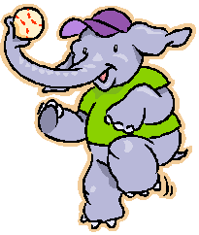
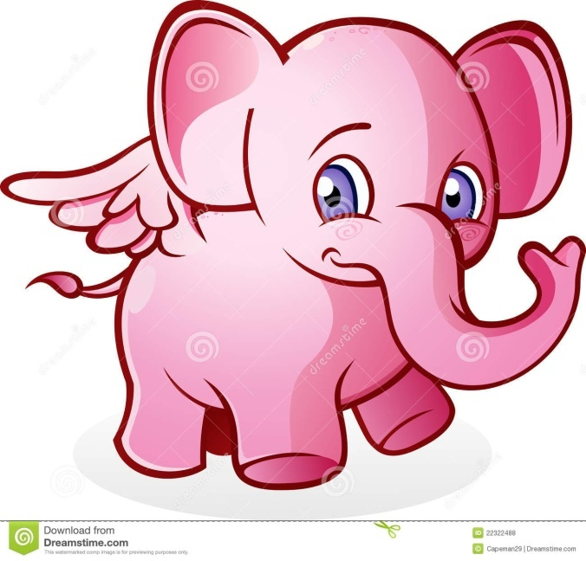
NLP: The central nervous system is not able to store a denial.
Use as few denials as possible like not and no.
Our brains cannot keep a denial
Do not think of a blew elephant
This only possible if you think
of a grey elephant

Slide 28
What says NLP ? Yes, but ……
Use in stead of “Yes but …..” the words “Yes, and …..”
You don’t deny the word of the last speaker.
You put your own experience besides the other’s.
…… yes but ……… → Yes, and ……
Marshall Rosenberg:
“Never say a ‘but’ in an angry face”

Slide 29
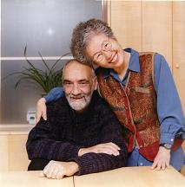
Solution focused work
Steve de Shazer
And Insoo Kim Berg

Slide 30
If you focus on problems, what happens?

Slide 31
If you focus on solutions, what happens?

Slide 32
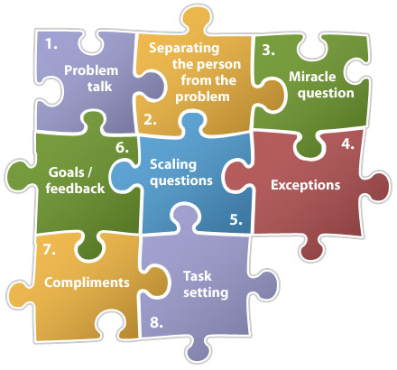
Solution focused work
Coping
questions

Slide 33
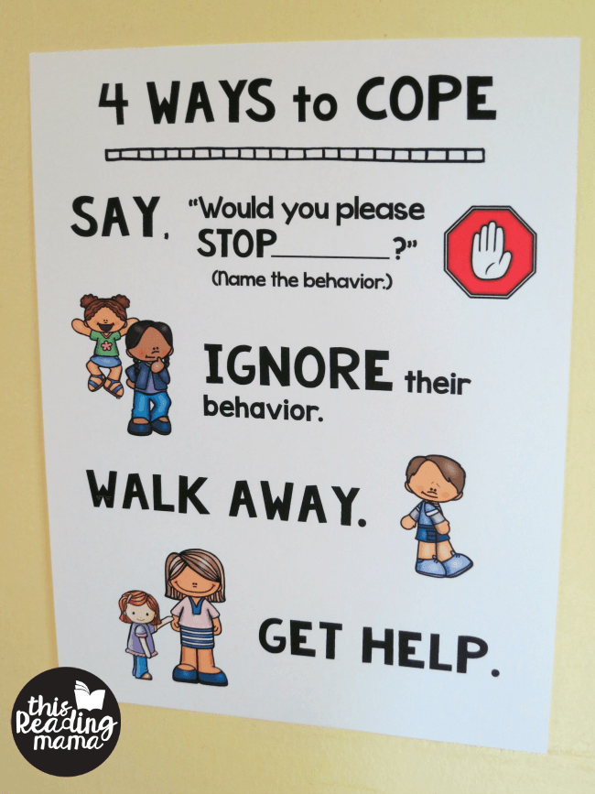
Coping questions
These help to think of what you do to survive with the problem.
And they help to think about your own resources.
They help to feel your own qualities and skills.

Slide 34
Coping questions:
What keeps you going under such difficult circumstances?
How can you explain to yourself how you have been able to do so well while the circumstances were so hard?
It is admirable how you have been able to keep on going under such difficult circumstances.... how did you do that?

Slide 35
Miracle Question
Suppose you wake up tomorrow morning and by some miracle
everything you ever wanted,
everything good you could ever imagine for yourself,
has actually happened !
Your life has turned out exactly the way you want it.
You don’t know how this happened but you know it has happened.

Slide 36
Miracle questions:
Think about it now.
What will you notice around you what lets you know that the miracle had happened?
What will you see?
What will you hear?
What will you feel inside yourself?
How would you be different?
How will other people see that the miracle has happened?

Slide 37
chunking
More general
More general
More specific
Milton-model
Meta-model
down-chunking
up-chunking
More specific

Slide 38
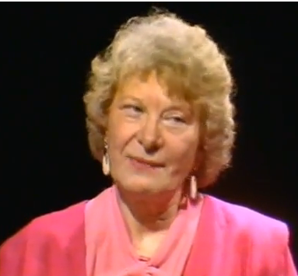
Meta-Model
Probleem
Big Problem
With generalizations
Metamodelquestion 1
Metamodelquestion 2
Metamodel-question 3

Slide 39
Metamodel 1
Meta-model expression:
He dislikes me.
Meta-model question:
How do you know that he dislikes you?

Slide 40
Metamodel 2
Meta-model expression:
You make me angry
Meta-model question:
What makes you think that my behavior causes your anger?

Slide 41
Metamodel 3
Meta-model expression:
I feel hurt by her.
Meta-model question:
What does make you choose (unconsciously) for being hurt?

Slide 42
Metamodel 4
Meta-model expression:
He does not look at me,
so he does not like me.
Meta-model question:
Did you ever not look at someone, while you liked the person?

Slide 43
Reflection of the day
Look back on what we did today.
Where and how can you use the different exercises?

