Slide 1
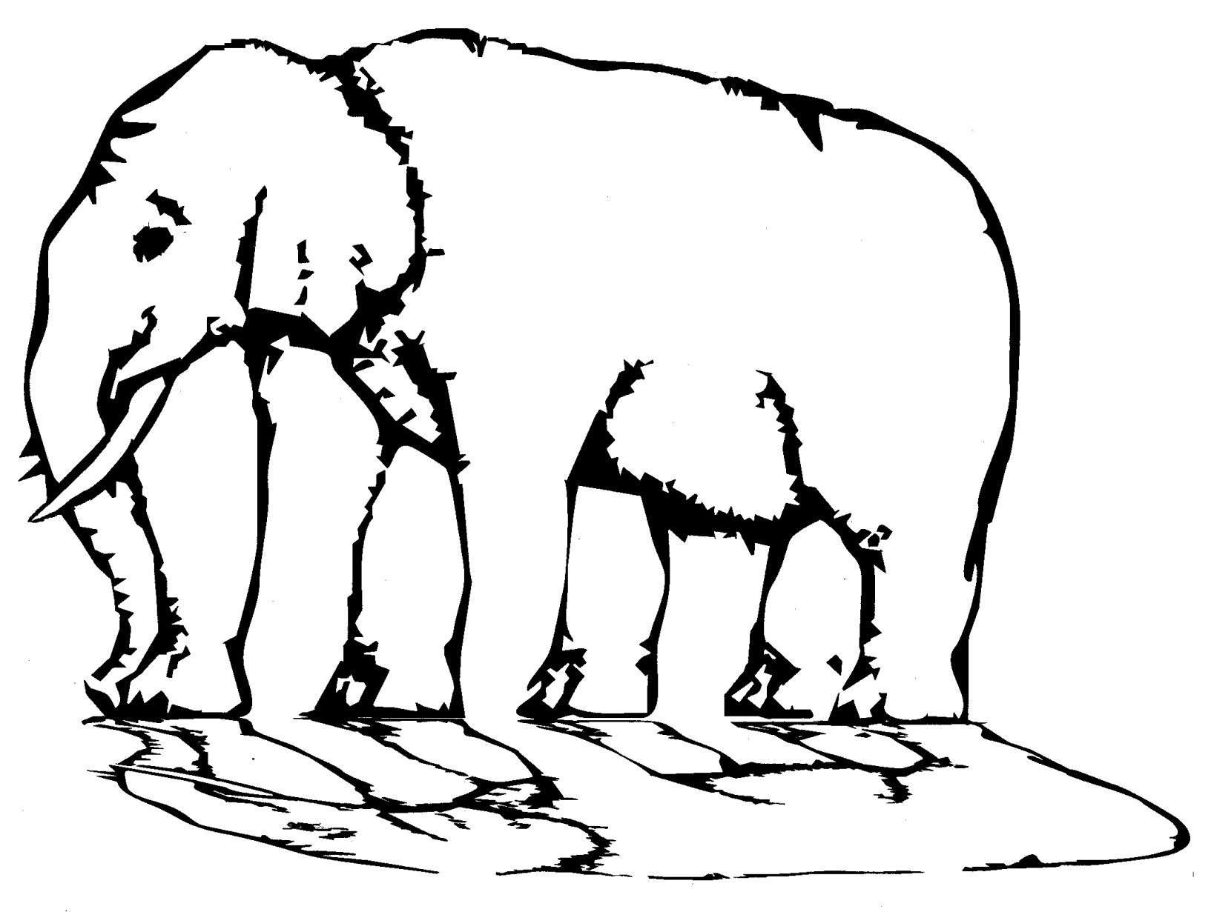
Welcome to the NLP-course “Your Unlimited Powers”
Welcome!
مرحبا
Ministry of social affairs, Ramallah, Palestine
4th day Tuesday 3 May 2016
Trainers: Sytse and Marlies Tjallingii

Slide 2
Program of today
9.00 – 10.30 Welcome
Good and New
Open Frame
The central nervous system is not able to store a denial
10.45 – 12.00 Sandwich feedback
Rapport
Pacing and Leading
12.15 – 13.15 Rapport with yourself
Representation systems
13.30 – 14.30 Predicates
Representation system typology
Anchoring
Circle of excellence

Slide 3
Good and new
Joy
Energy
In two's 2 minutes each.
Focus at a recent situation which had given you a good/or new feeling. In which you felt energy, happiness or joy.
Share in the whole group the title of your experience and show your feelings at your face.

Slide 4
Open Frame
Questions
Experiences
Short stories
Share a real life-experience to reflect on what NLP can mean to it.
Goal: apply NLP in your own reality.

Slide 5
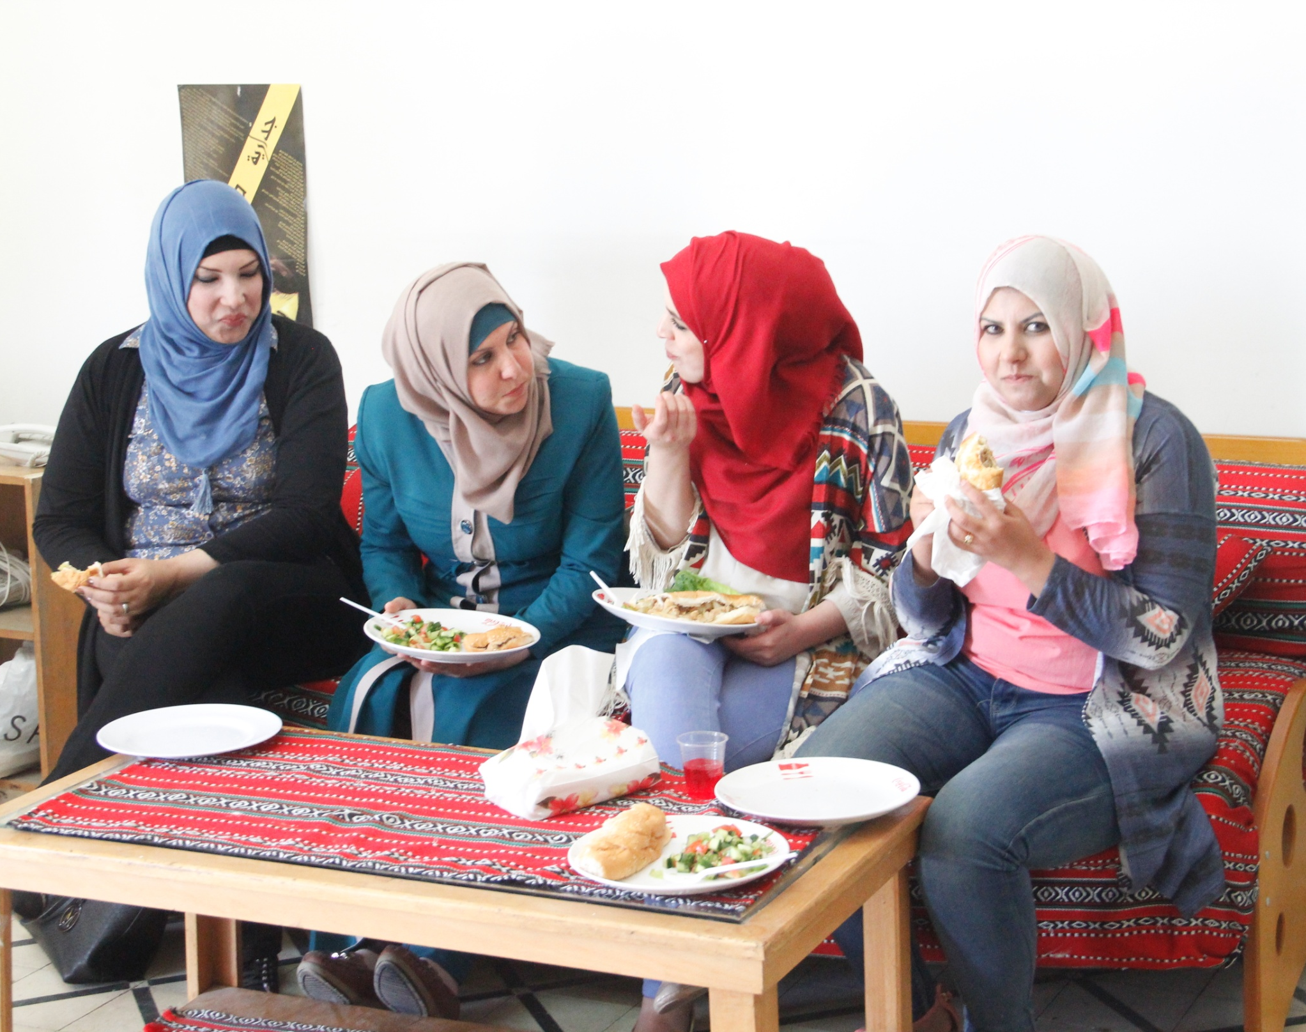
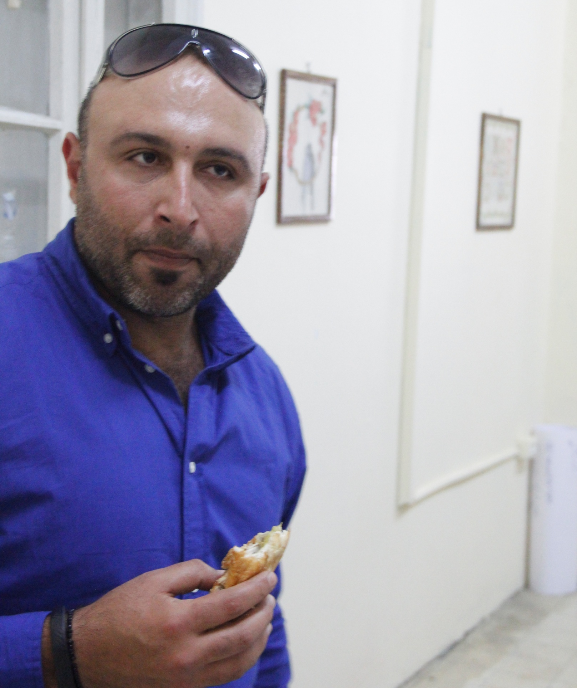

Slide 6
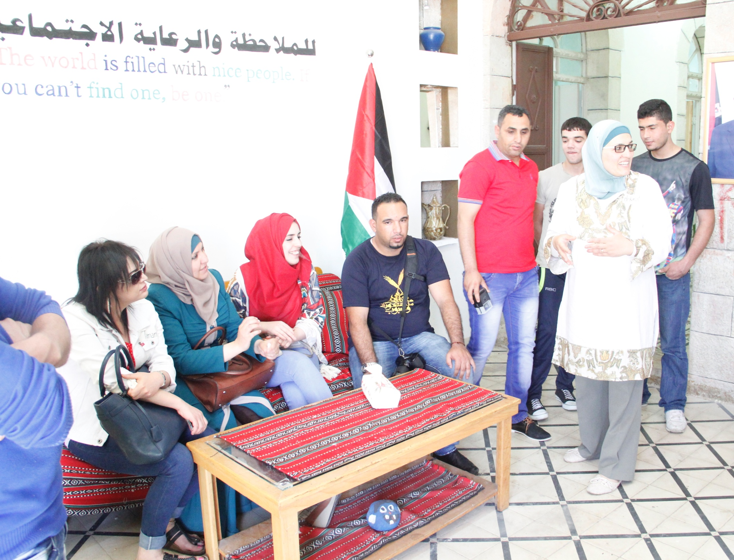

Slide 9
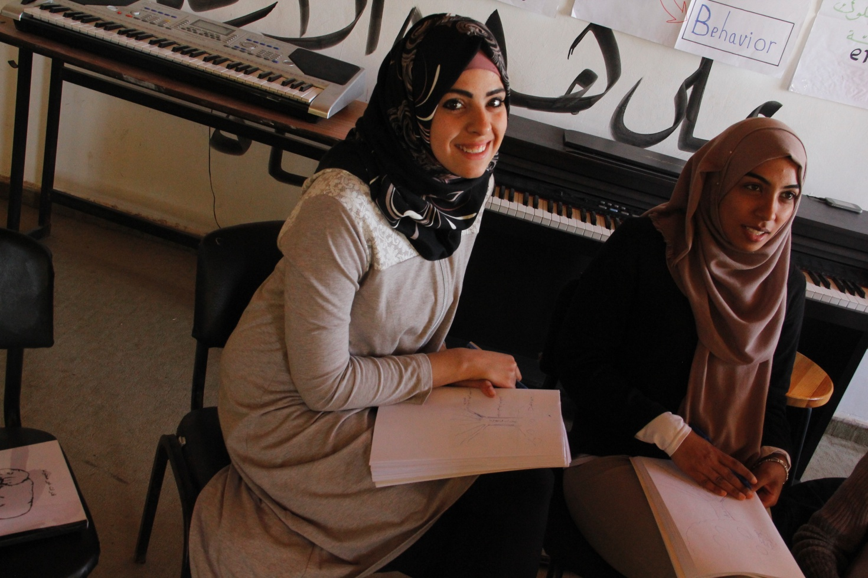

Slide 10
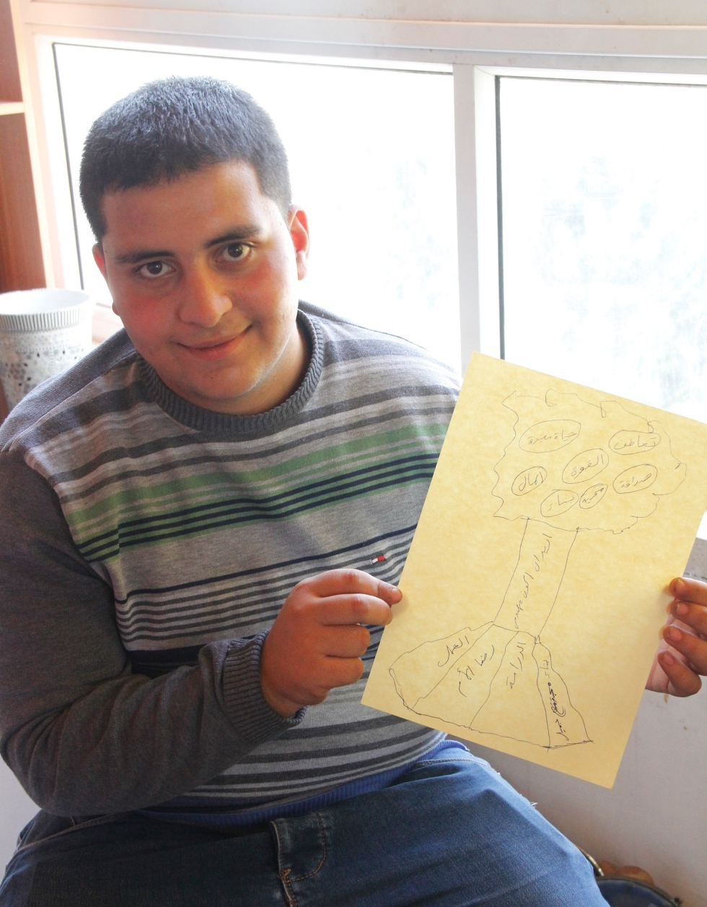

Slide 12
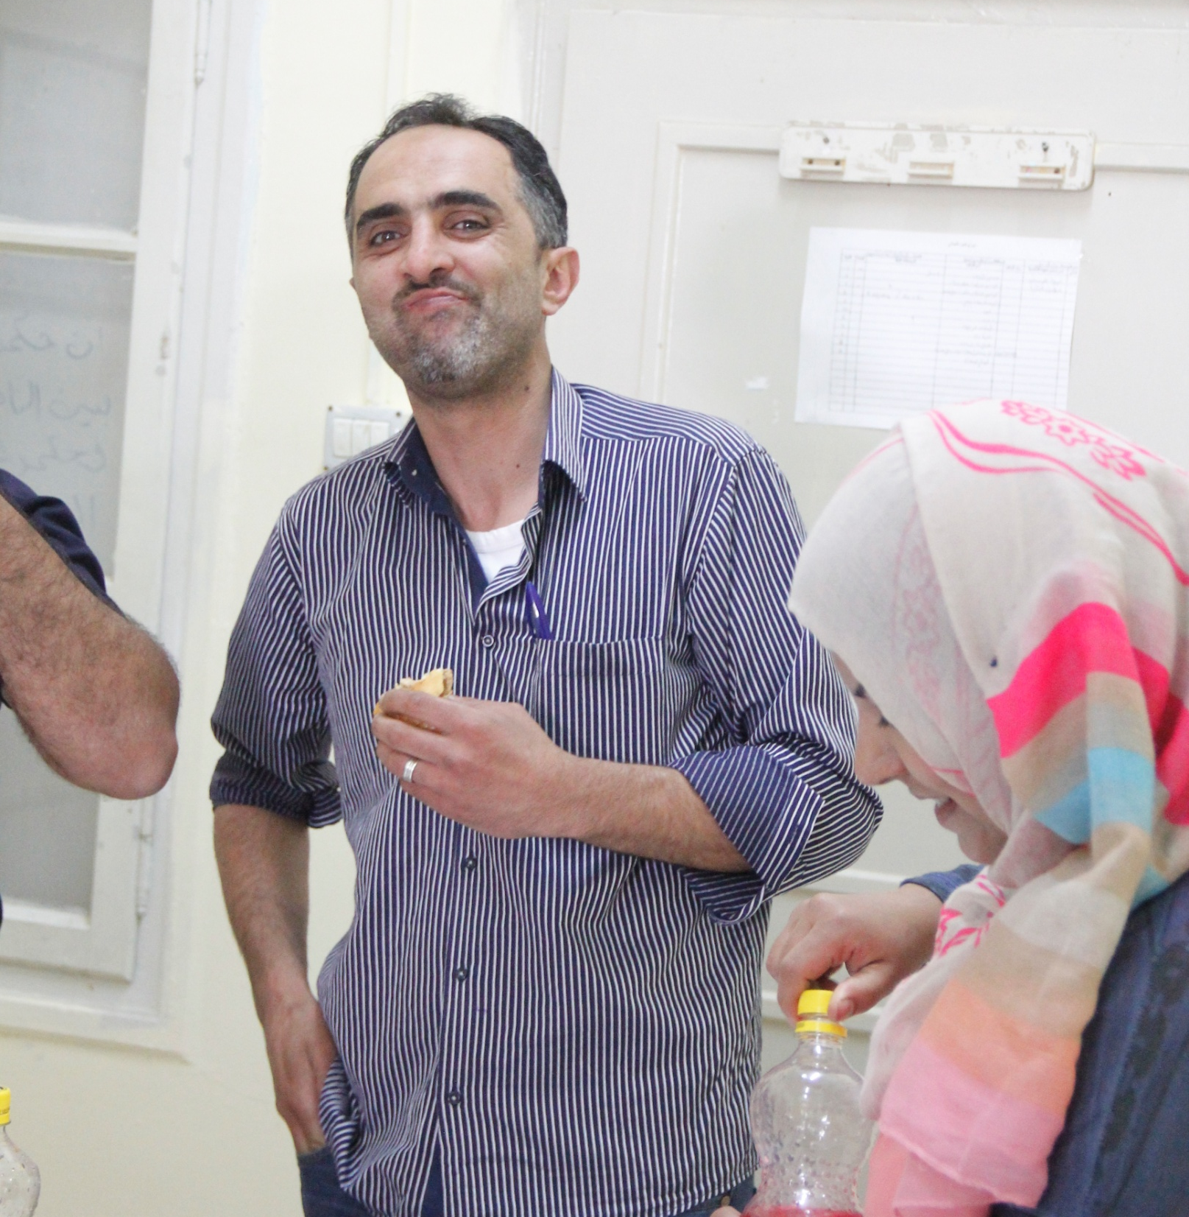

Slide 13
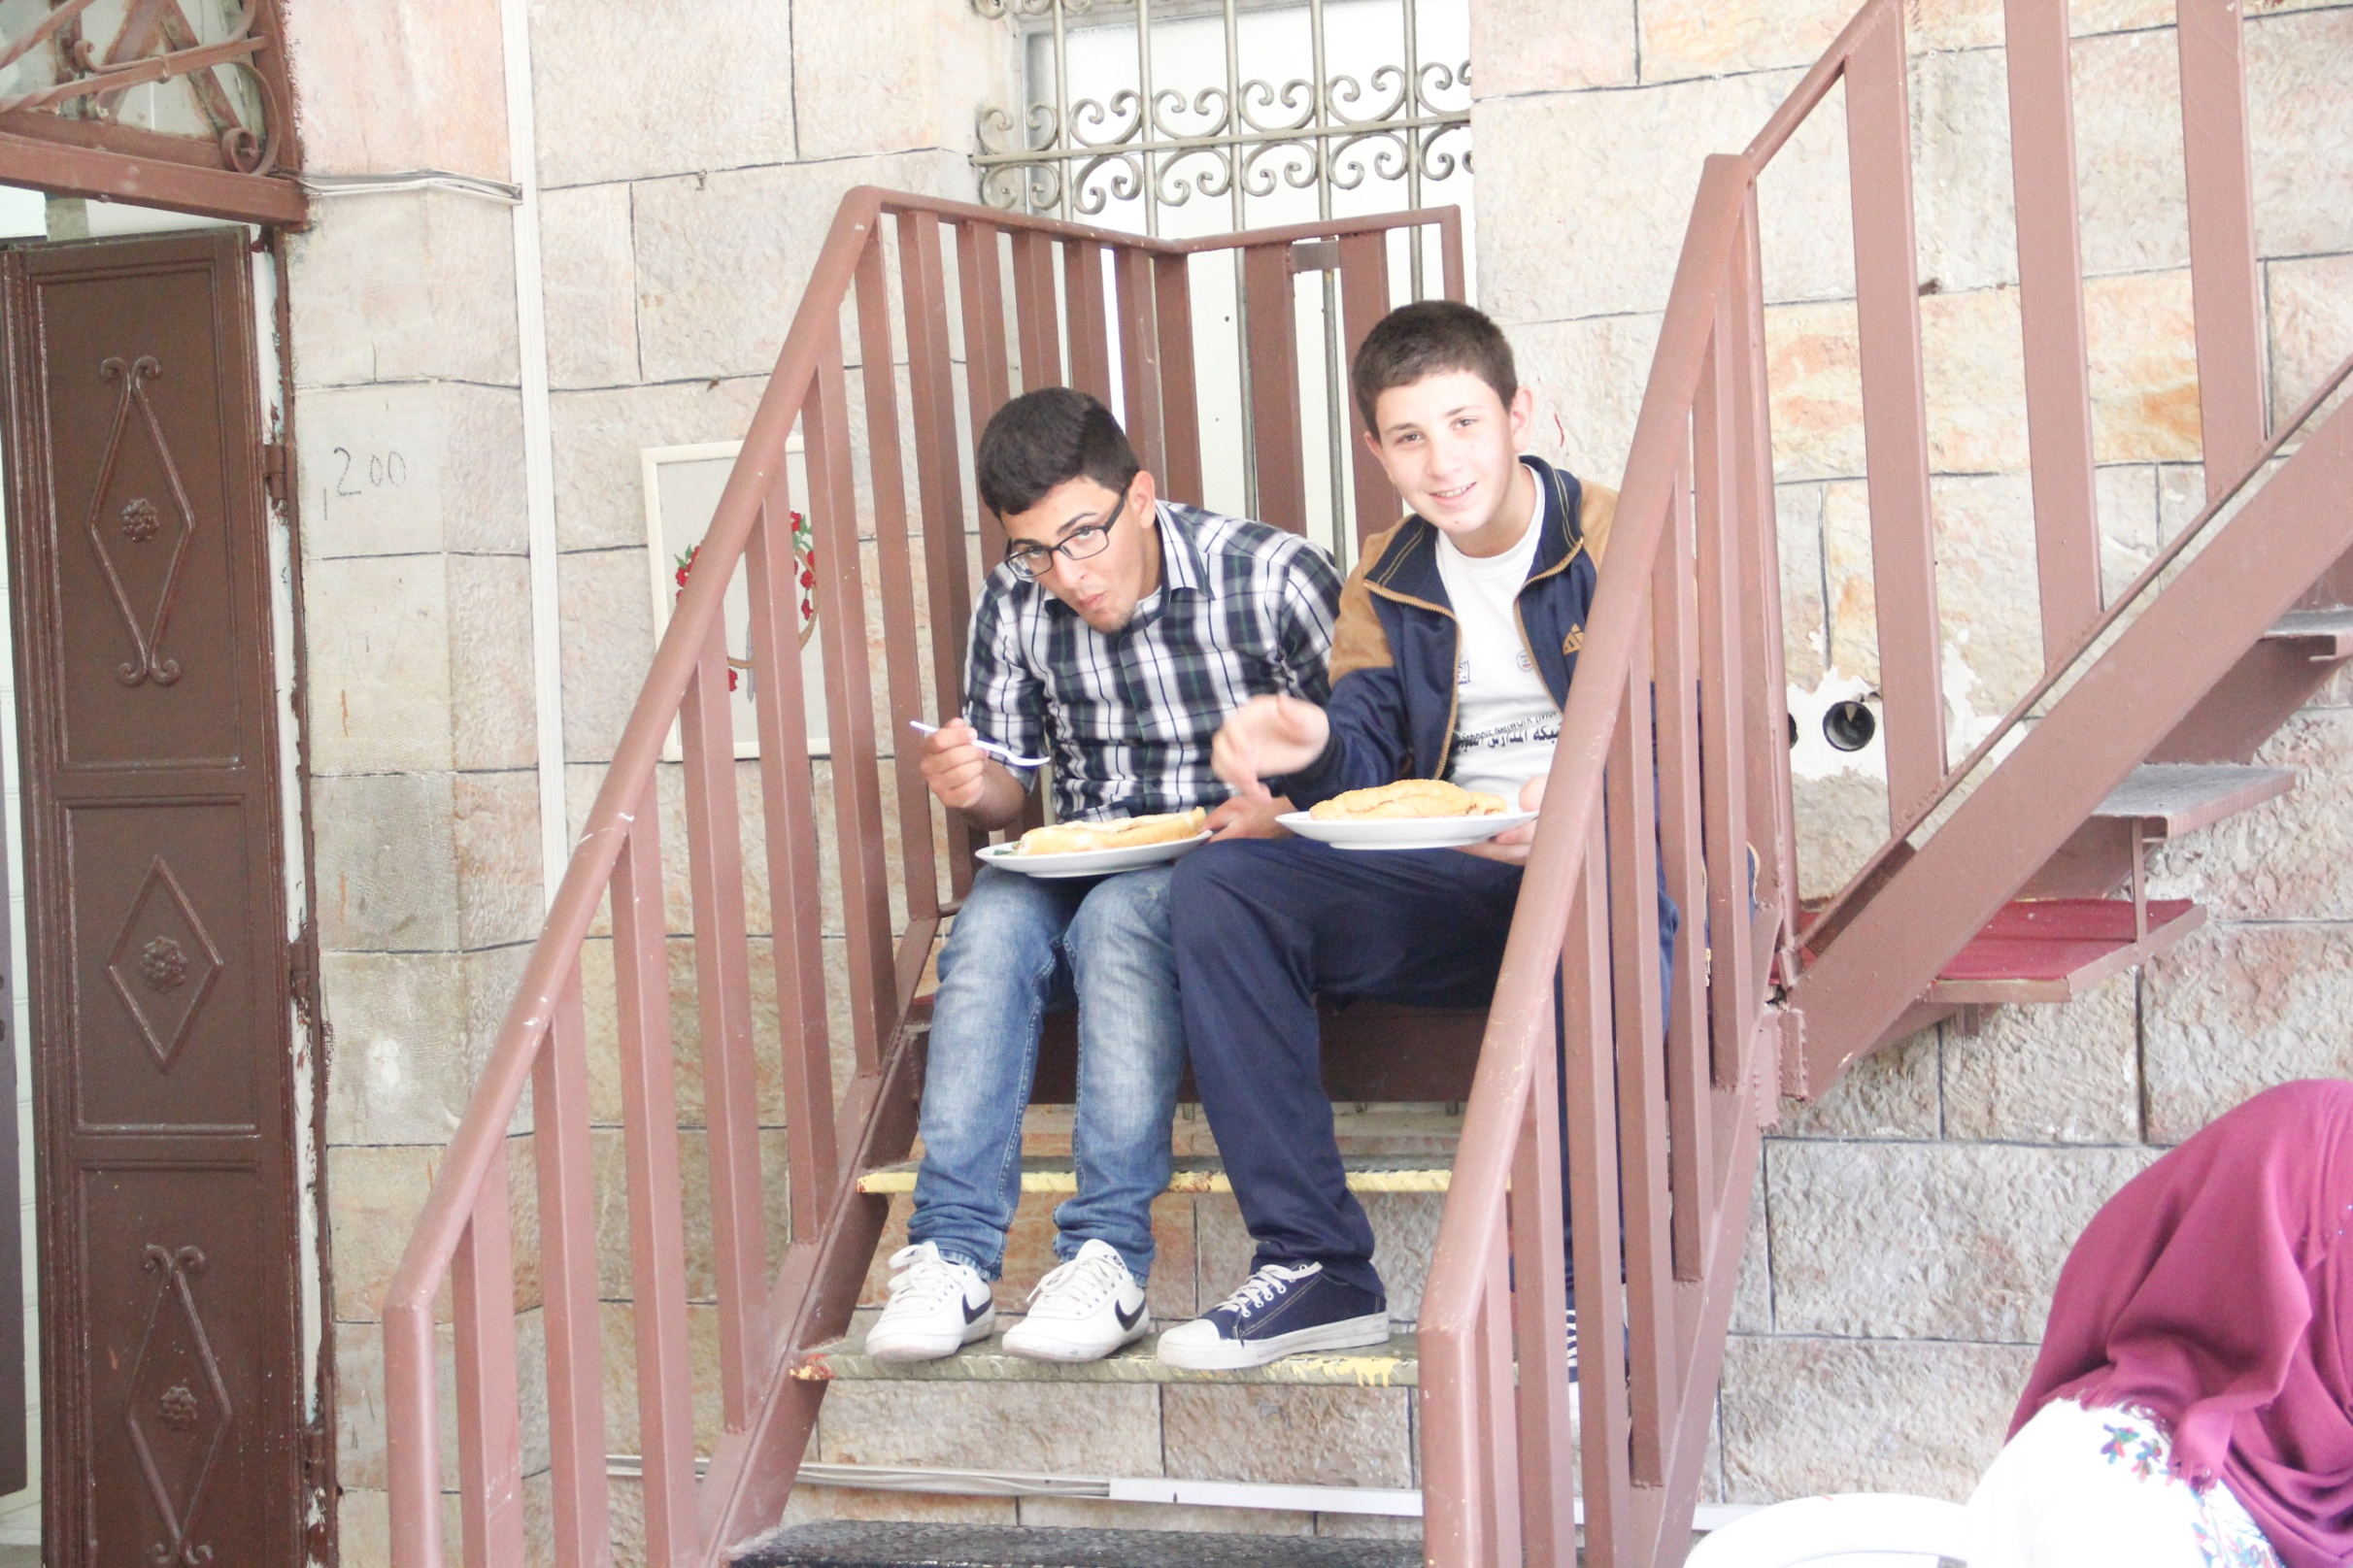

Slide 14
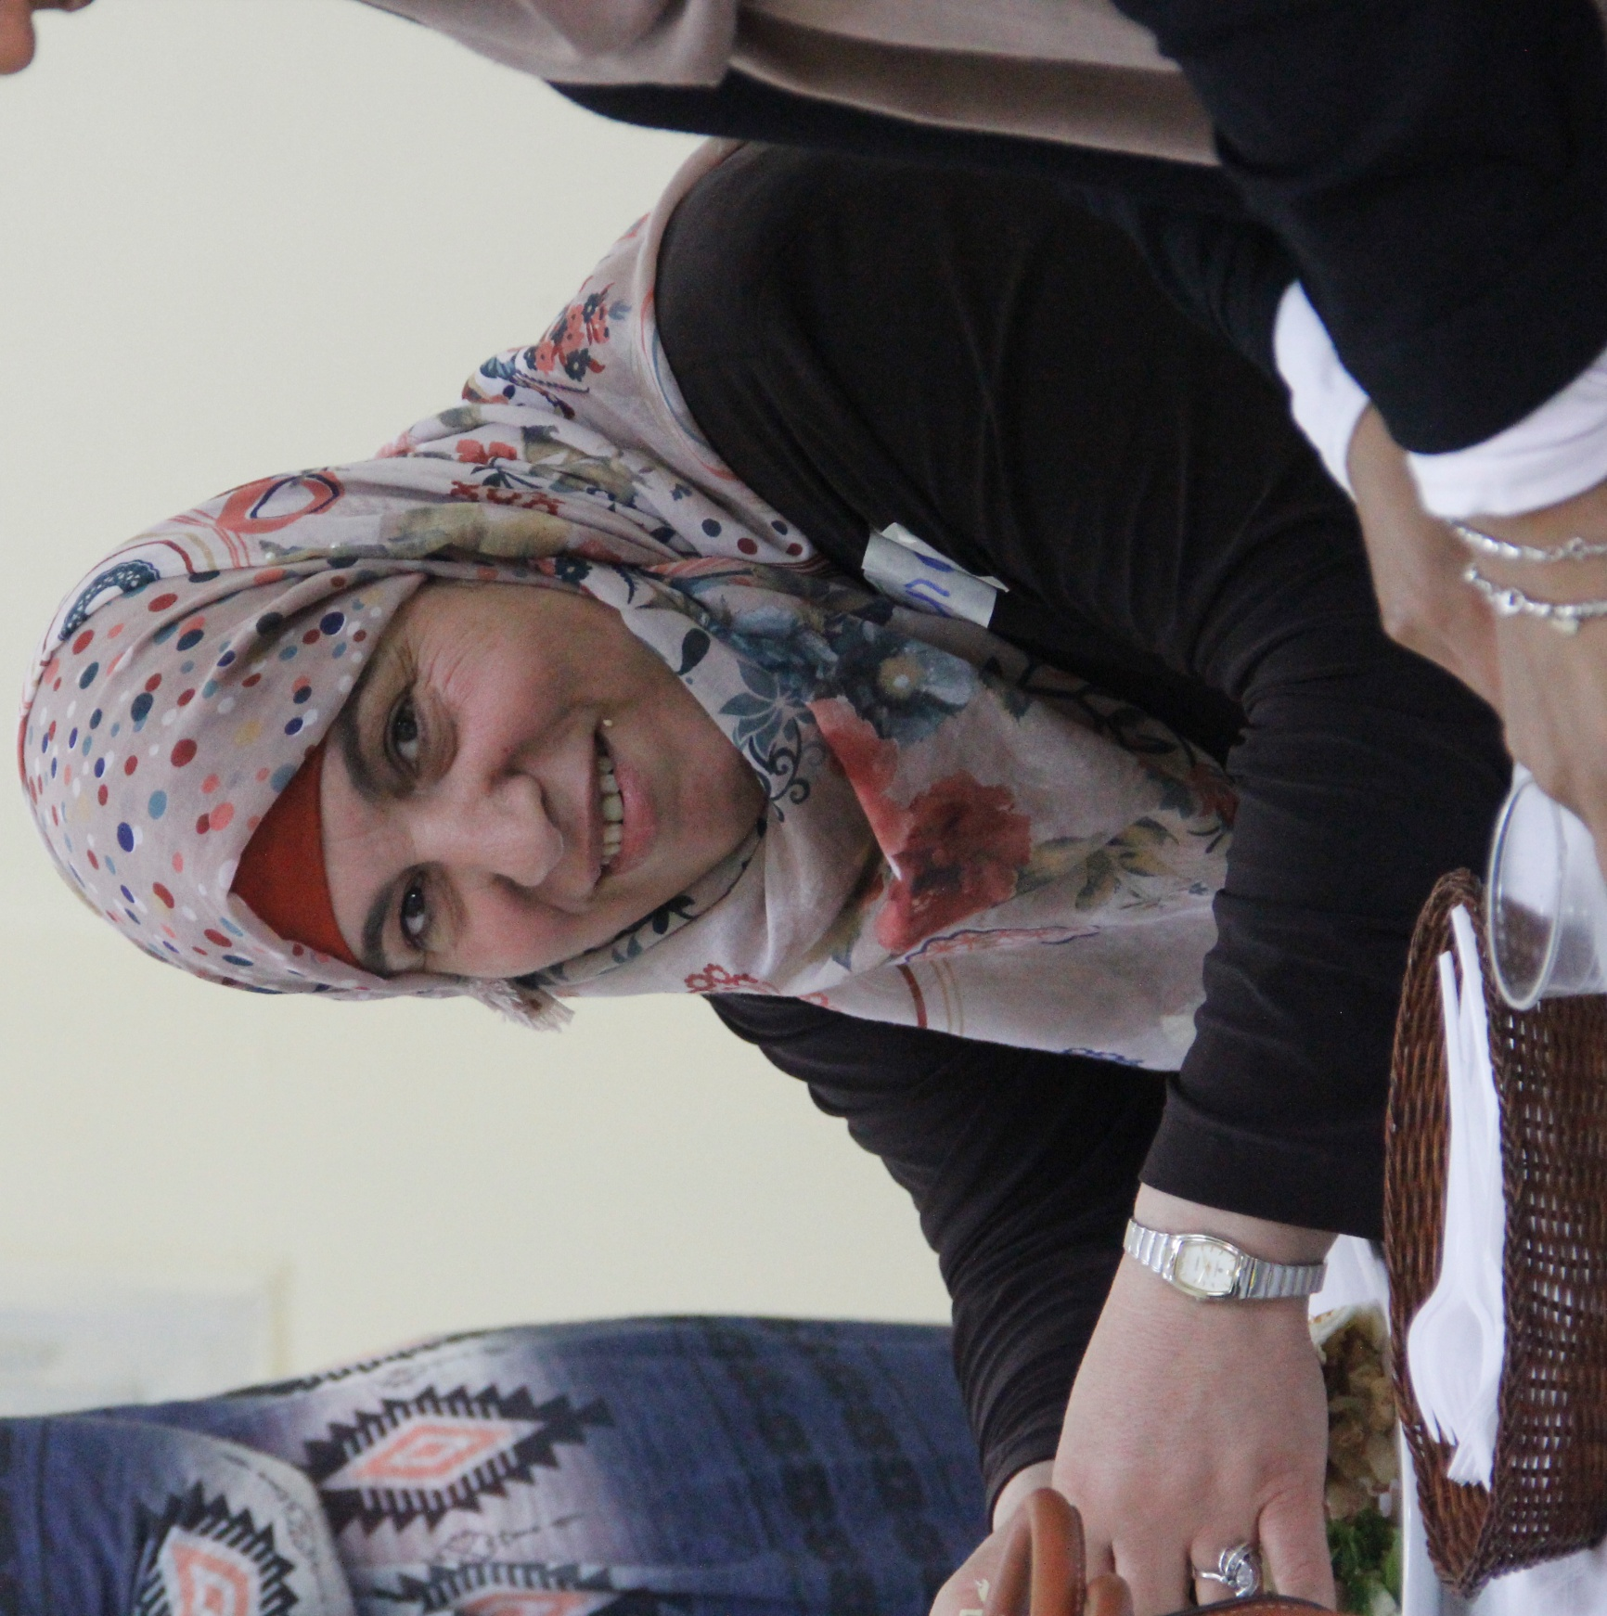

Slide 15
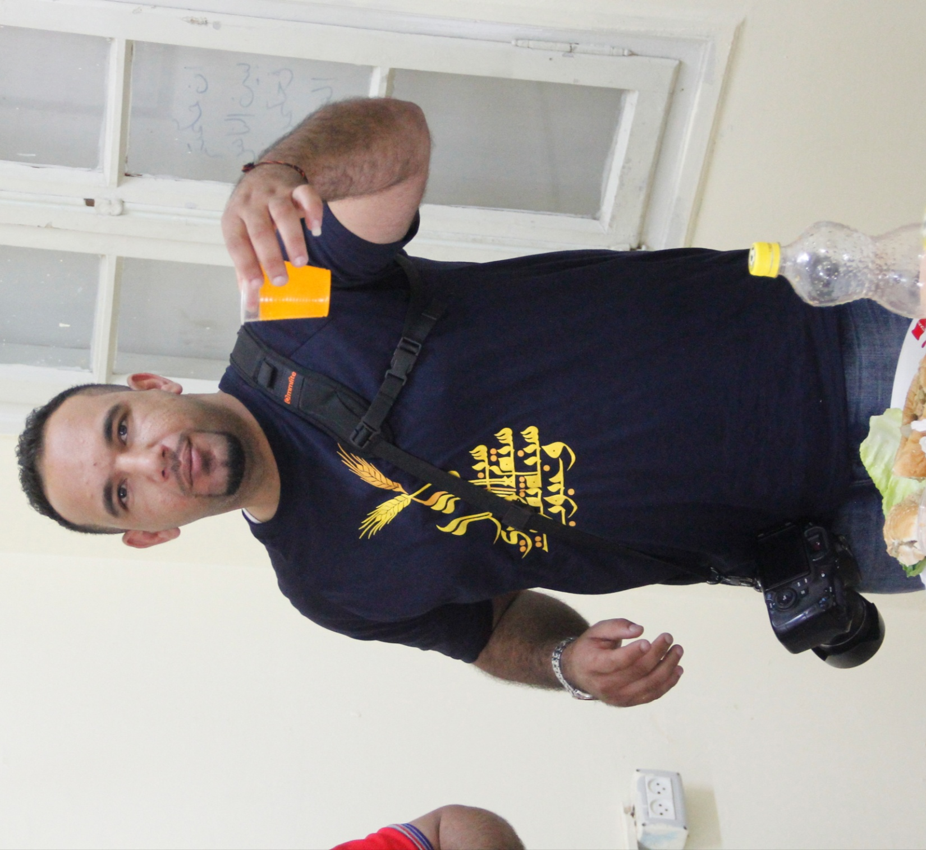

Slide 16
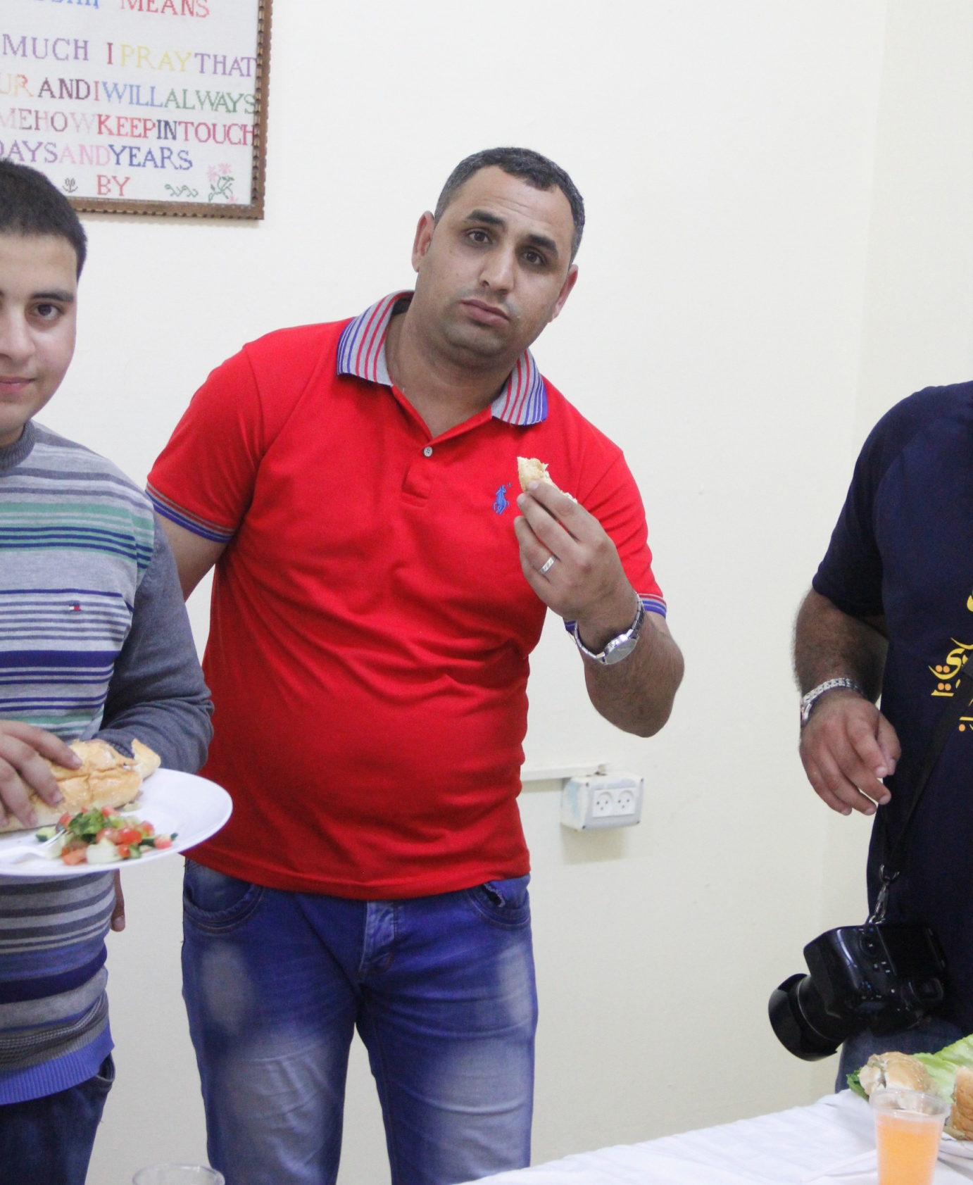
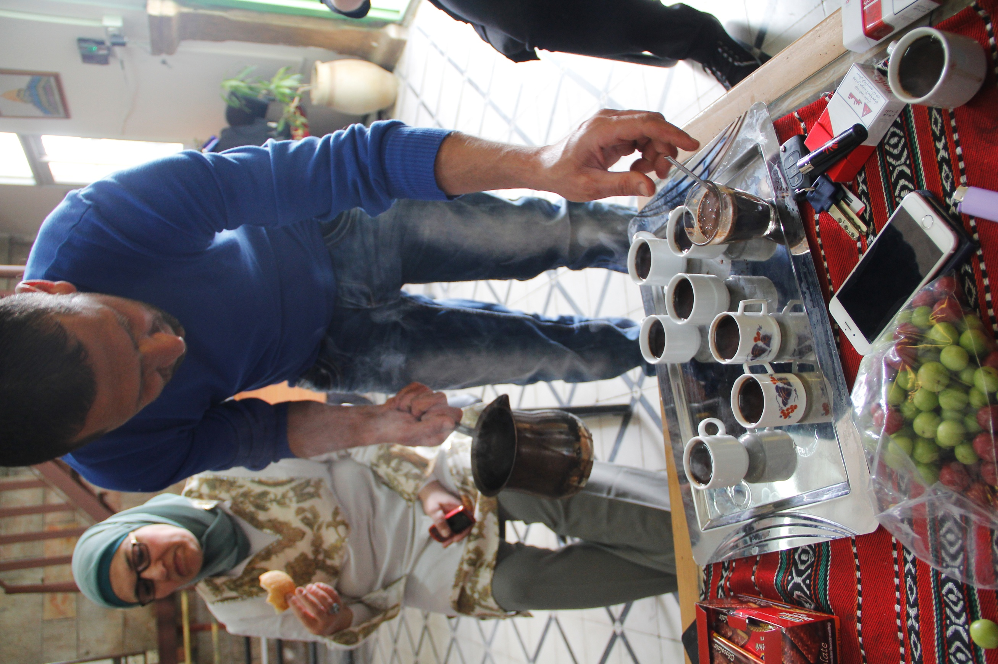
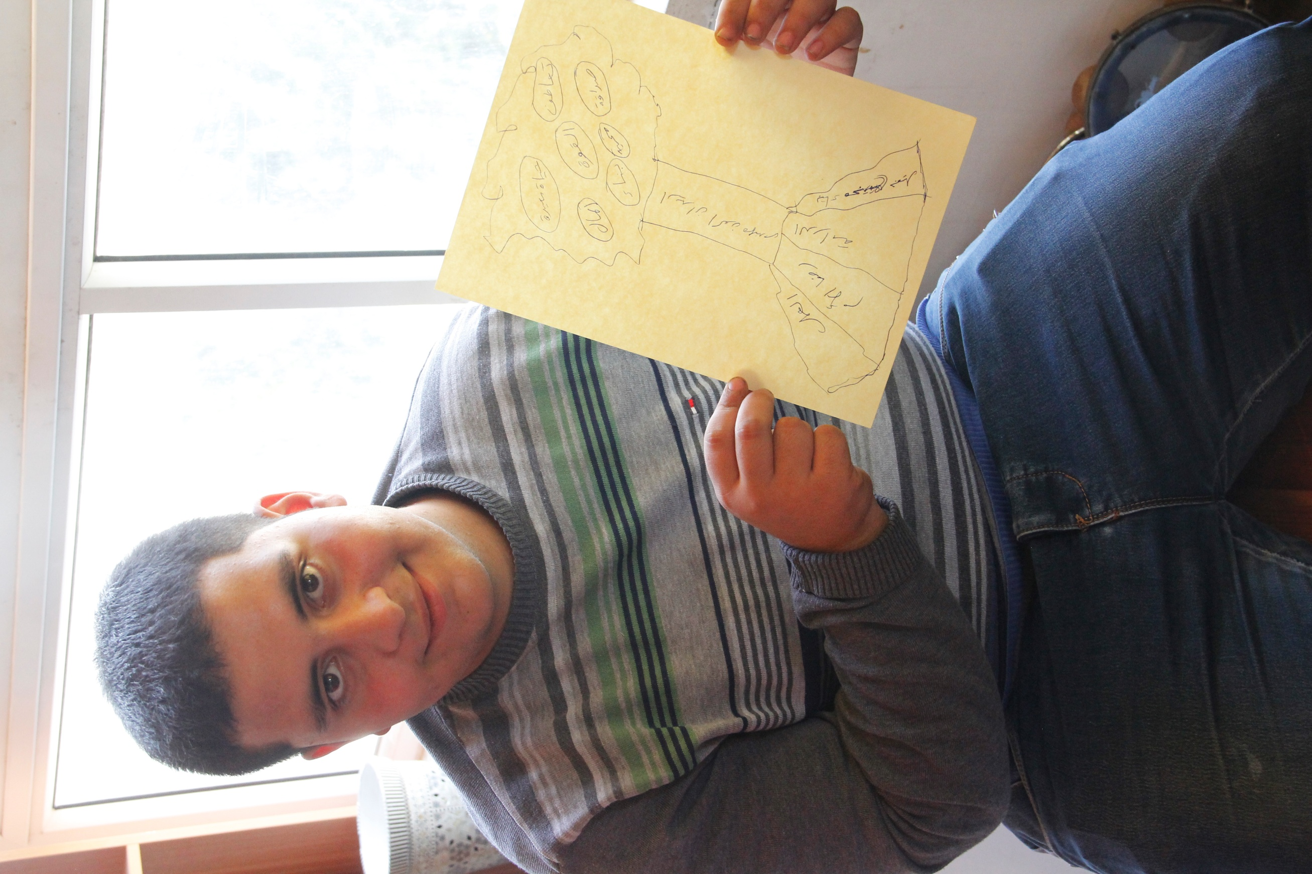
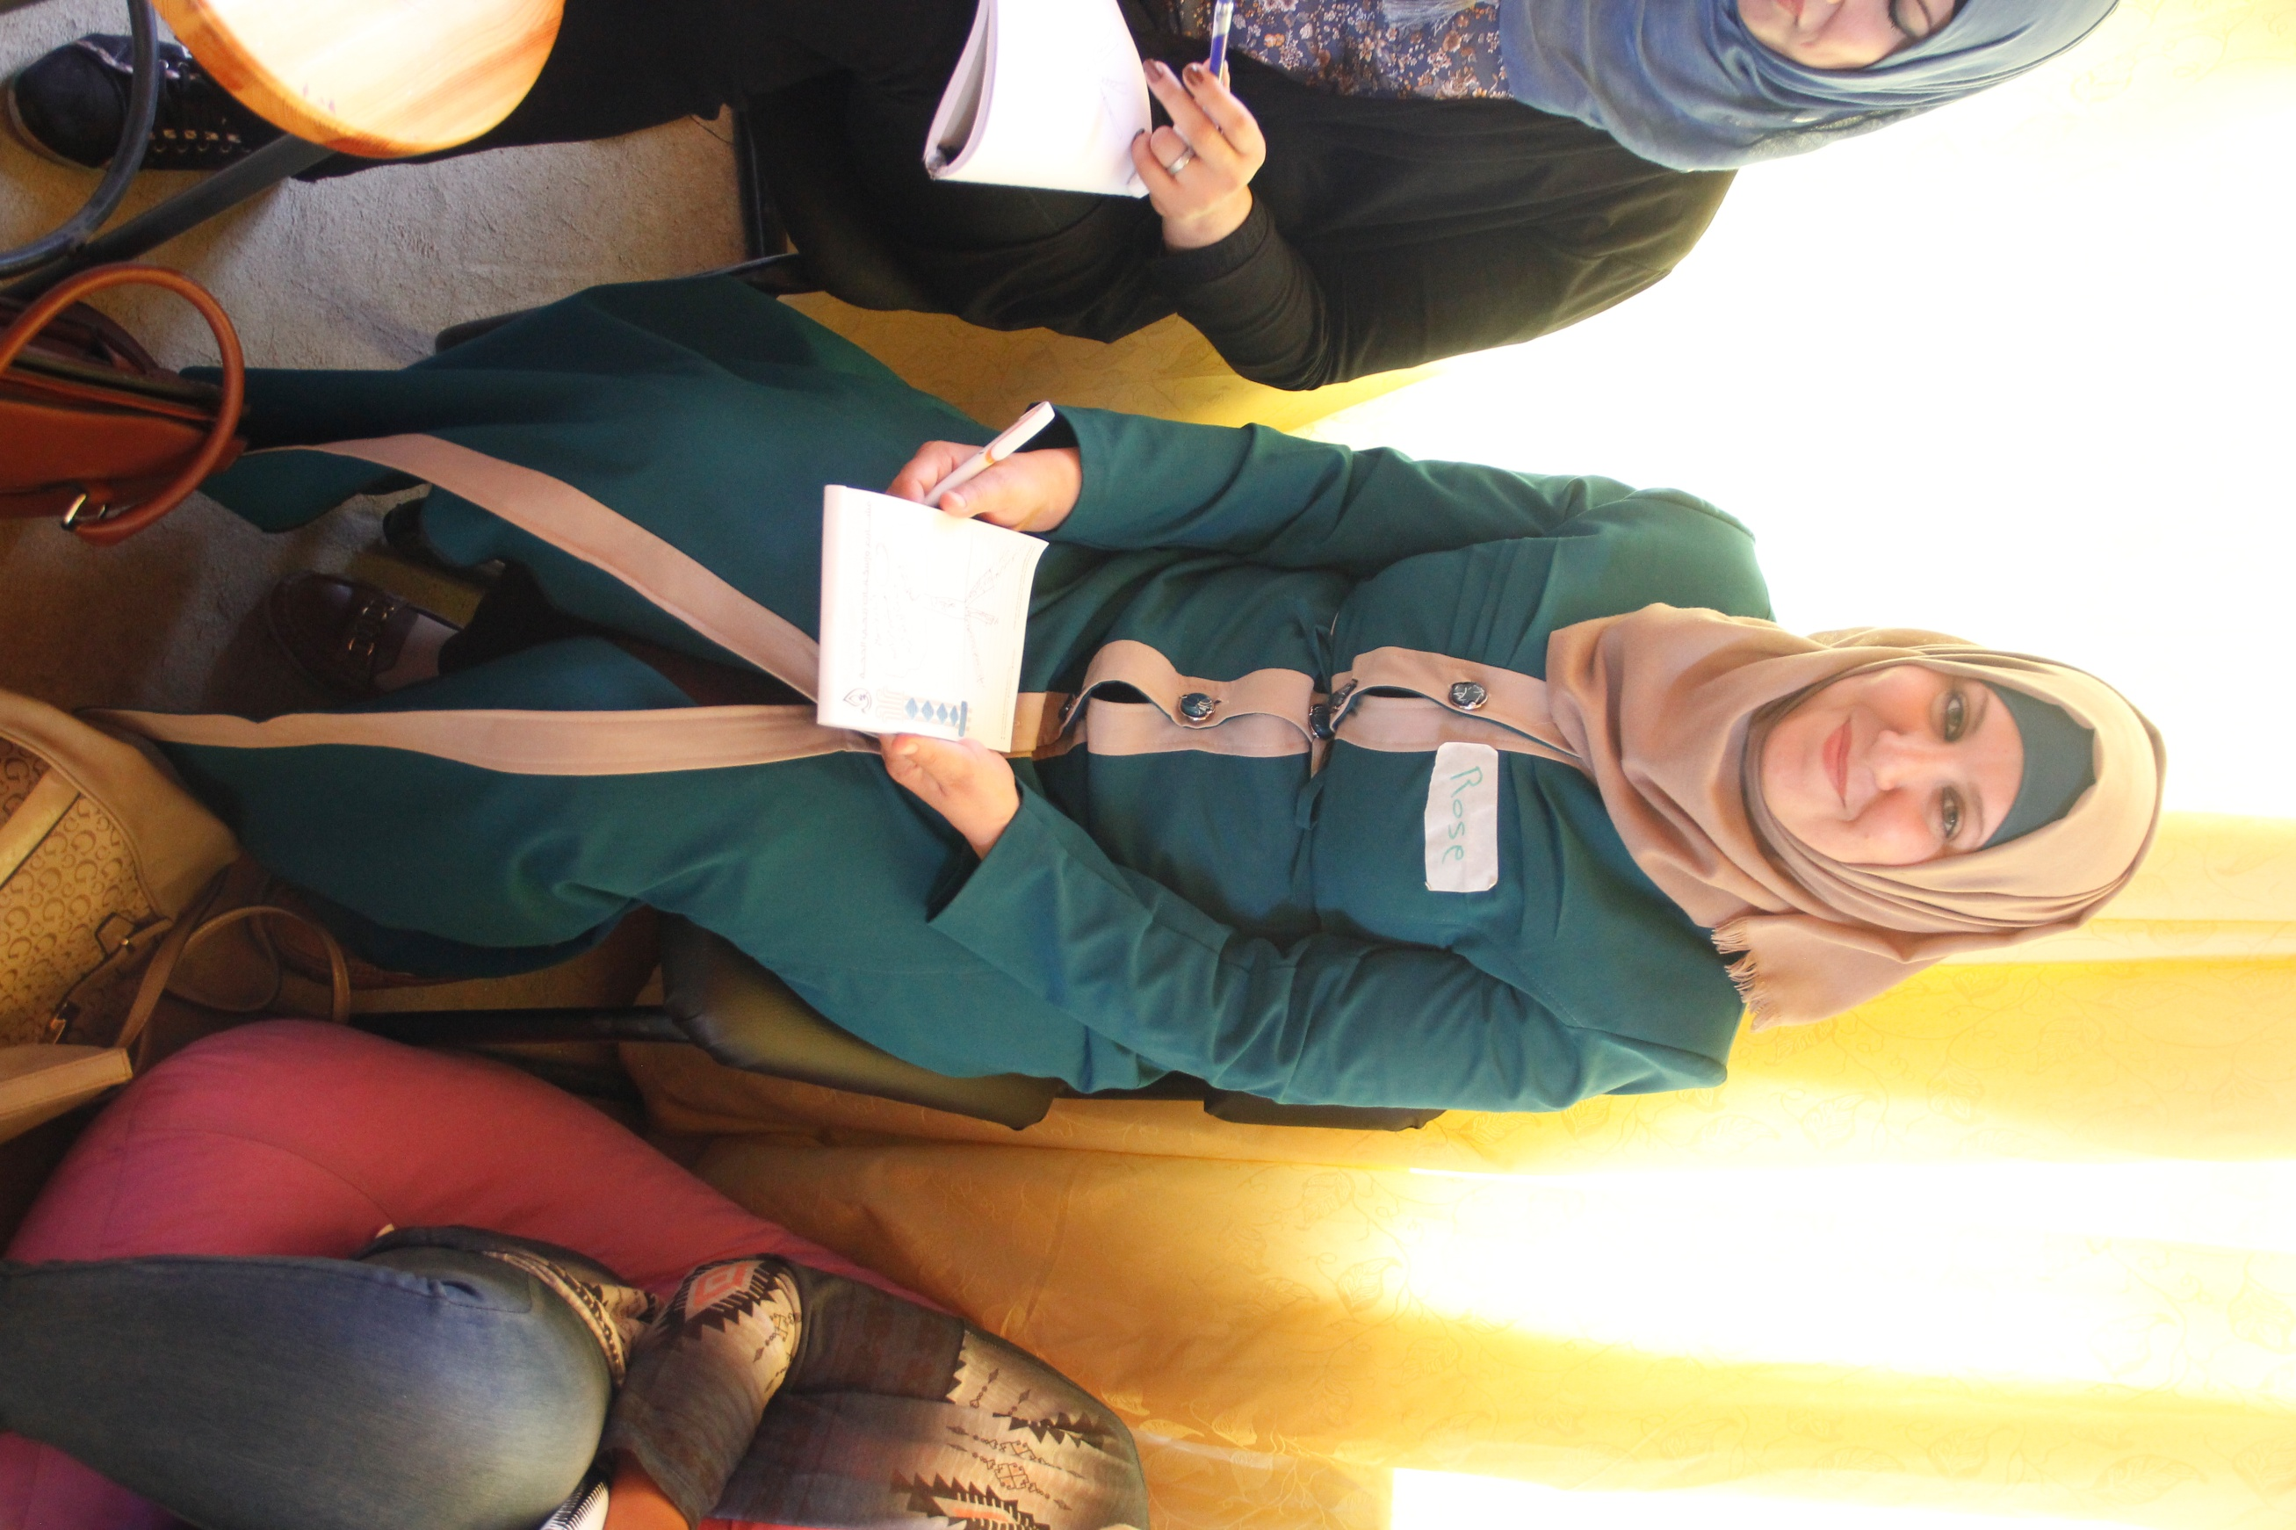
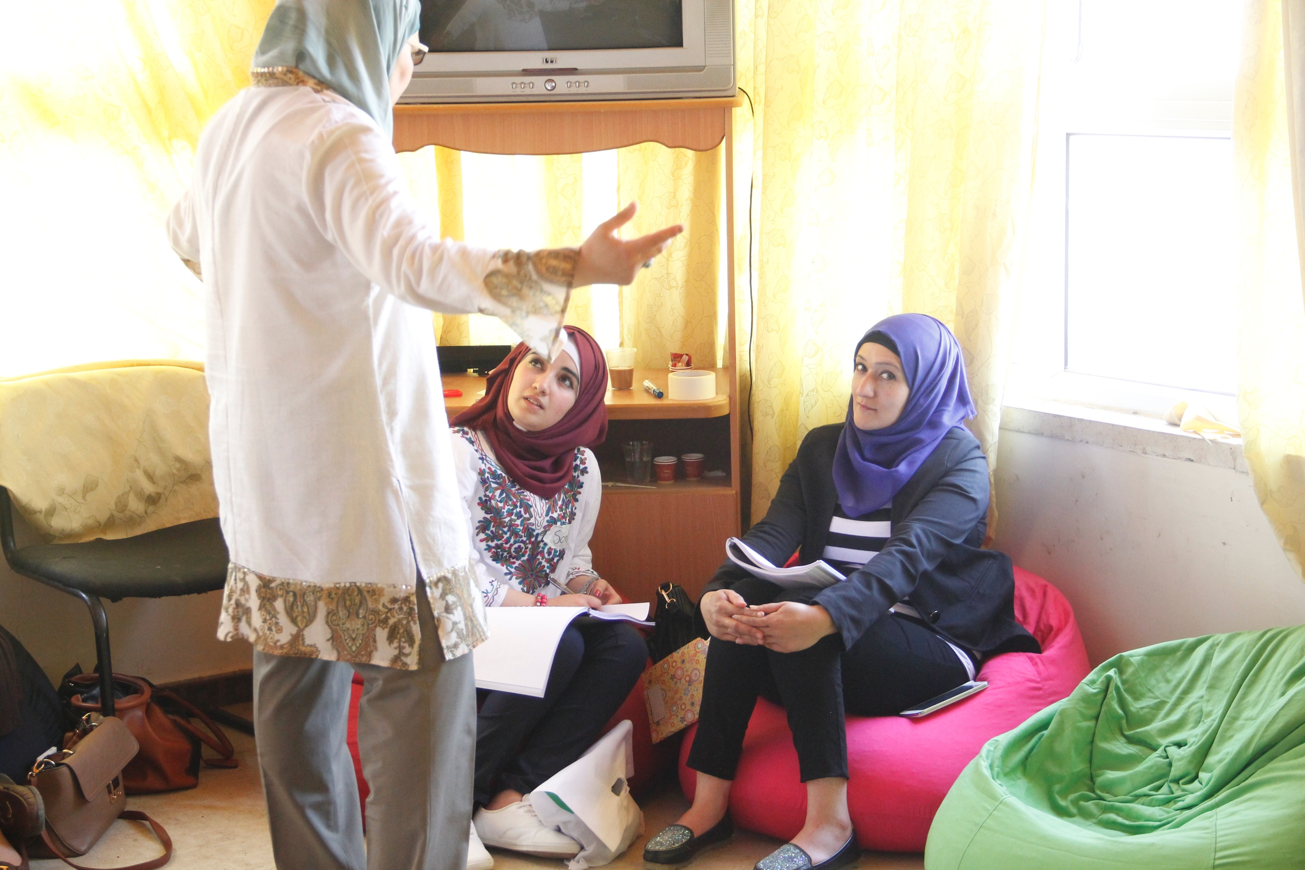
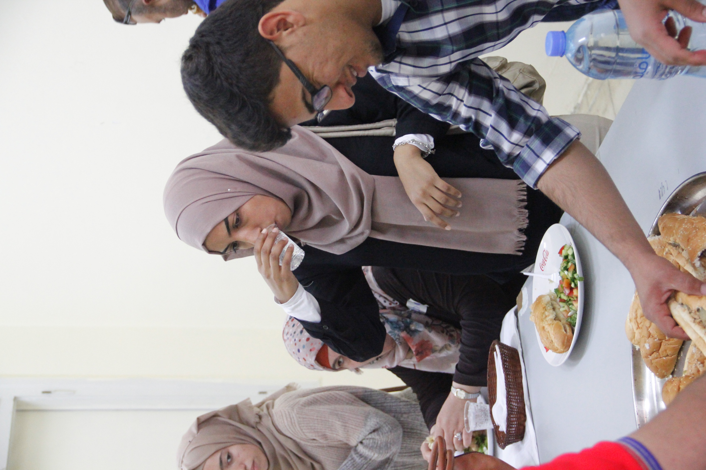

Slide 17
The central nervous system is
not able to store a denial
Do not think of a pink elephant
Do not think of how you came
to the course today
Do not think of how you are going
home after the course
Do think of a blue elephant!

Slide 18
Learn to give compliments
with the sandwich feedback model
What I specific like of what you deed ….(about the behavior)
What you probably could still do better in the future is ……
What I like, is your effort, motivation.

Slide 19
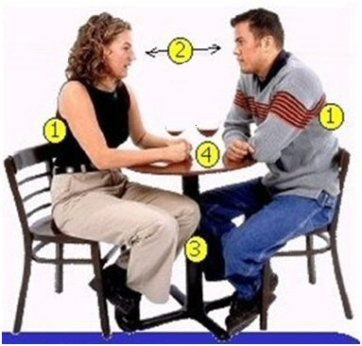
Rapport
1 = back in same position
2 = eye contact
3 = legs and feet in same position
4 = arms and hands slightly different.
Being on the same wavelength,
Feeling contact,
Synchronic
Feeling that you both are willing to listen and willing to accept suggestions
Example of unconscious human interaction.

Slide 20
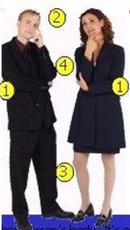
Rapport
1 = back in same position
2 = eye contact
3 = legs and feet in same position
4 = arms and hands slightly different.

Slide 21
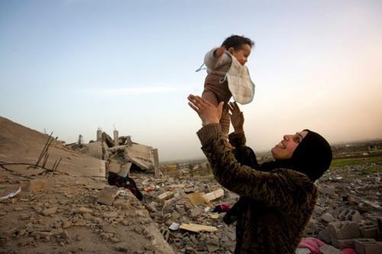
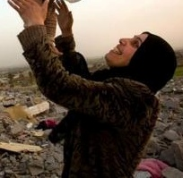
Rapport
Palestinian woman in rapport with her child
near their destroyed house
show respect for the other’s model of the world
eye contact
matching
adjust to each other
give attention to each other
willingness to follow
build trust
create emotional connection
use the same representation system

Slide 22
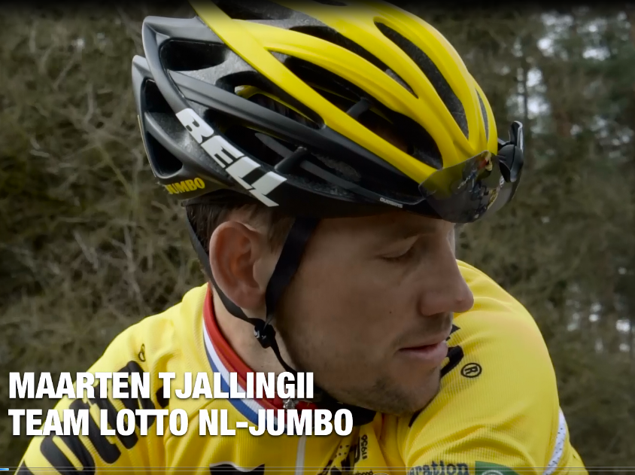

Slide 23
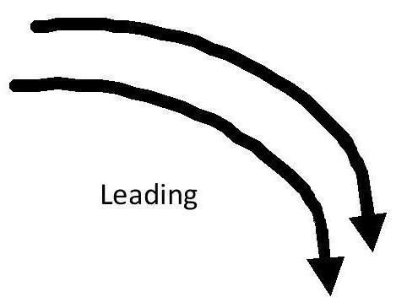
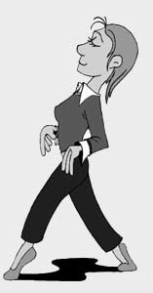
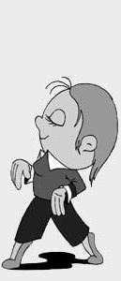
Pacing and Leading
Building up Rapport

Slide 24
The three houses

Slide 25
Representation systems test
4 most close to your own description
3 next best to your own description
2 next best to your own description
1 the least suited description
Example:
1. I take important decisions based on:
….. my intuitive feelings
….. what sounds best for me
….. what looks the best for me
….. exact research and study of the subject
2
3
1
4

Slide 26
Representation systems
primary
V | Visual
At | Auditive tonal
K | Kinesthetic
O | Olfactory
G | Gustative
Secondary Ad | Auditive digital
Seeing
Hearing
Feeling
Smelling
Tasting
Thinking
V
A
K
O
G
sec
Auditive-digital
insight
conscious
analyse
thought
understand
know
decide
Visual
look
picture
bright
outlook
focus
vision
perspective
Auditive-tonal
say
accent
question
click
rhythm
language
speech
Kinaesthetic
touch
move
pressure
handle
loose
insensitive
rough
Olfactory
scent
stink
whiff
reek
fishy
air
nostril
Gustatory
flavour
sweet
appetite
sour
feed
juicy
spicy

Slide 27
Practice Predicates 2
Indicate with V = visual, At = Auditive tonal, K = Kinesthetic, Ad = Auditive digital
1 I see your point
V
2 I want you to get a grasp on this
K
3 It appears rather clear to me
V
4 I ask myself
At
5 I saw a twinkling in your eyes
V
6 Are you able to get a handle on this?
K
7 I understand you
Ad
8 That doesn’t realy ring a bell
At
9 I want you to take a look at it
V
10 What you are doing doesn’t feel right to me
K
11 I hear what you are saying
At
12 Life feels warm and wonderful
K
13 I think you will understand me
Ad
14 Am I painting a clear picture?
V
15 That information is solid as a rock
K

Slide 28
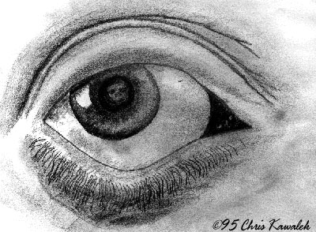
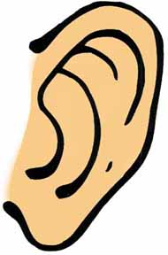
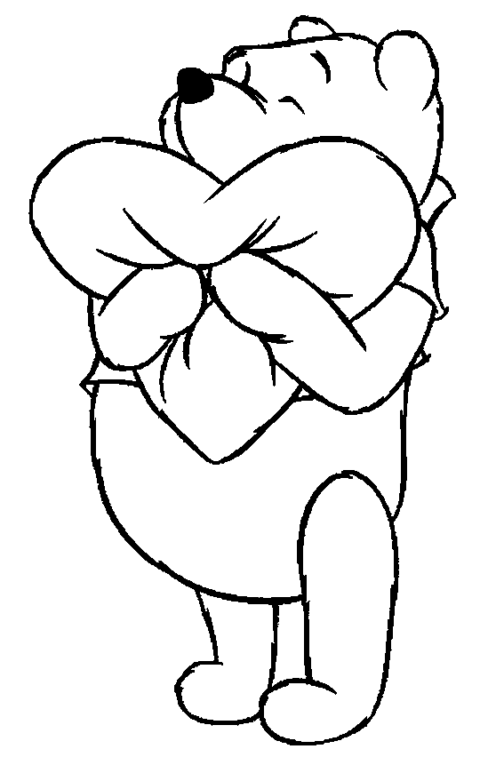
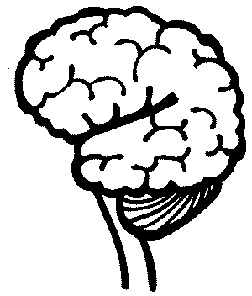
Representation system typology
V: Visual
with their eyes upward. They breath from the top of their lungs, often sitting forward in their seats.
At: Auditive
They breath from the middle of the chest. they are talking to themselves .
They love music and talking on the phone. They remember by using steps, procedures and sequences.
K: Kinesthetic
Breathing from the bottom of their lungs. They often move slowly. They may speak slowly and with a low tune. They are standing close to people, touch the other person.
Ad: Auditive digital
They love ANALYZING the worlds around them. Thinking in themselves and becoming conscious about something

Slide 29
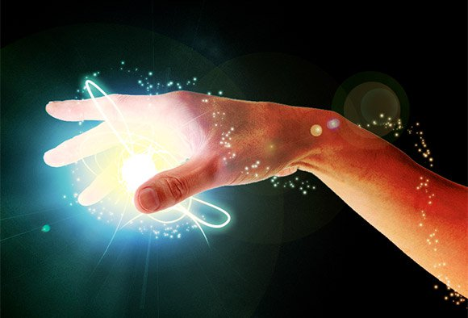
Anchoring
Anchor: Any stimulus that is associated with a specific response.
MOTIVATION
HUMOUR / LAUGHING
ENERGY

Slide 30
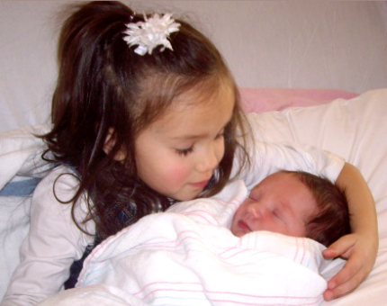
The short way to your resources
LOVE
POWER
SELFCONFIDENCE

Slide 31
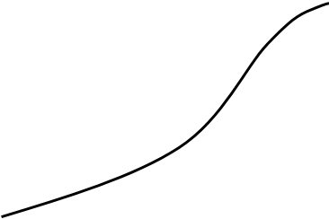
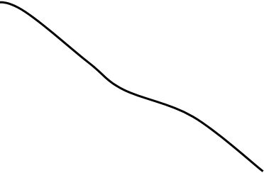
4 steps to Anchoring
start
end
intensity
feelings
time
Remember an experience with one valuable resource as: Motivation; humour / laughing; energy; love; power; self confidence.
Step in the circle of excellence when the feeling is getting stronger
Step out at the highest point (see graphic below).
Break state
3 Repeat with the same or different resources with different memories.
4 Set the anchor in action to perform the test.

Slide 32
Language
Hierarchy
Meta-Model
Milton-Model
Non-violent communication

Slide 33
More general
More general
chunking
More specific
More examples at the same level
down-chunking
lateraal
chunken
up-chunking
More specific

Slide 34
Video mother and child:
..\video's\NVC\Compassionate Communication with Kids.flv

Slide 35
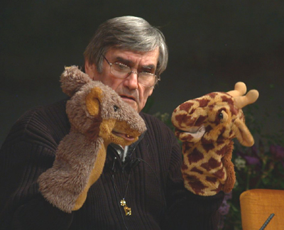
Marshall Rosenberg:
Non-Violent Communication

Slide 36
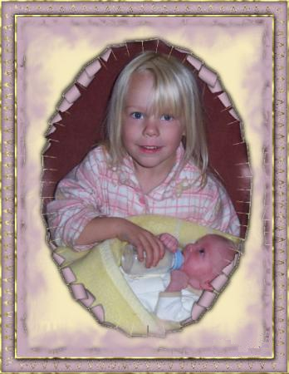
Reframing

Slide 37
What I asked life
I asked for strength...
And life gave me difficulties to make me strong.
I asked for wisdom...
And life gave me problems to resolve.
I asked for prosperity...
And life gave me brains and muscles to work with.
I asked to be able to fly ...
And life gave me obstacles to overcome.
I asked for love ...
And life gave me people who needed help.
I asked for favours ...
And life gave me possibilities
I did not receive anything of what I asked for...
And.......
I received everything I needed!

Slide 39
Reframing with
3 Perceptual positions
3
Third Position
Dissociated of yourself
and from the other
Also called: The meta position, the observer or helicopter view.
1
2
First Position
Associated in your self
Second Position Associated in the other

Slide 40
The gift of peace on earth lies in our hands.
What could be your first step?
Thank you for your important step
in improving your life with NLP !

