Slide 1

Welcome to the NLP-course “Achieve more success with
Your Unlimited Powers”
"حقق نجاحا أكثر مع طاقاتك اللامحدودة"
دورة البرمجة اللغوية العصبية التابعة
ترحيب
مرحبا
Success!
3rd day Ramallah, October 26, 2017

Slide 2
Program for today
Good and New
Open Frame
Mapping across using submodalities
  From dislike to like
  From like to dislike
  Work on identity level
  The doggy
  Living from your heart
  Voice expression of your identity, body, dynamics, personality
NLP conflict Resolution
  Conflict and the world model
  Presuppositions which you can apply
Reflection

Slide 3


Good and New
In pairs 2 minutes each.
Focus at a recent situation which has given you a good/or new feeling. In which you felt energy, happiness or joy.
Share in the whole group the title of your experience and show your feelings at your face.

Slide 4

Open Frame
Questions
Experiences
Short stories
Share a real life-experience to reflect on what NLP can mean to it.
Goal: apply NLP in your own reality.

Slide 5

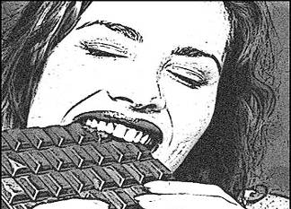

Mapping across
From like to dislike
Make this resource available in another context
Make the picture of chocolate eating smelling, colorful and small
Resource: the aversion for dog shit
Take the resource to another context: getting aversion to chocolate addiction

Slide 6



From dislike to liking (1)
Aversion to dog shit
Transfer aversion to chocolate addiction
2
1
Small
Black-and-white
Stationary
Large
Colour
Moving

Slide 7

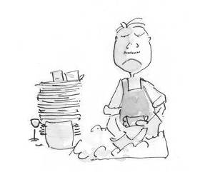
From dislike to like
Make this resource available in another context
Resource: the pleasure you have when you are dancing.
Take the resource to another context: getting pleasure in washing dishes

Slide 8
Exercise(26): From dislike to liking
Think of something you dislike and that you would like to change in liking.
Make an image of the situation you do dislike, look for the submodalities in the image.
Then look for something you really like very much, it is not necessary that the topic should be connected to the first image.
Make an image of this situation. Look for the sub-modalities in this image.
Look for the drivers (the submodalities which are different.
Then bring the submodalities of the image / situation you like to the situation you don’t like.
Test: Think of the task you first disliked. How do you feel about it?

Slide 9
Submodalities
V = Visual
Is there an image?
Associated / Disassociated
Black & White or Color
Bright or Dim
Size of Picture
Near or Far
Moving or Still
A = Auditive
Is there a sound?
Loud or Soft
Fast or Slow
Direction
Internal or External
Verbal or Tonal
Near or Far
K = Kinesthetic
Is there a feeling?
Temperature: Hot or Cold
Texture: Smooth or Rough
Intensity, Strong or Weak
Weight: Heavy or Light

Slide 10
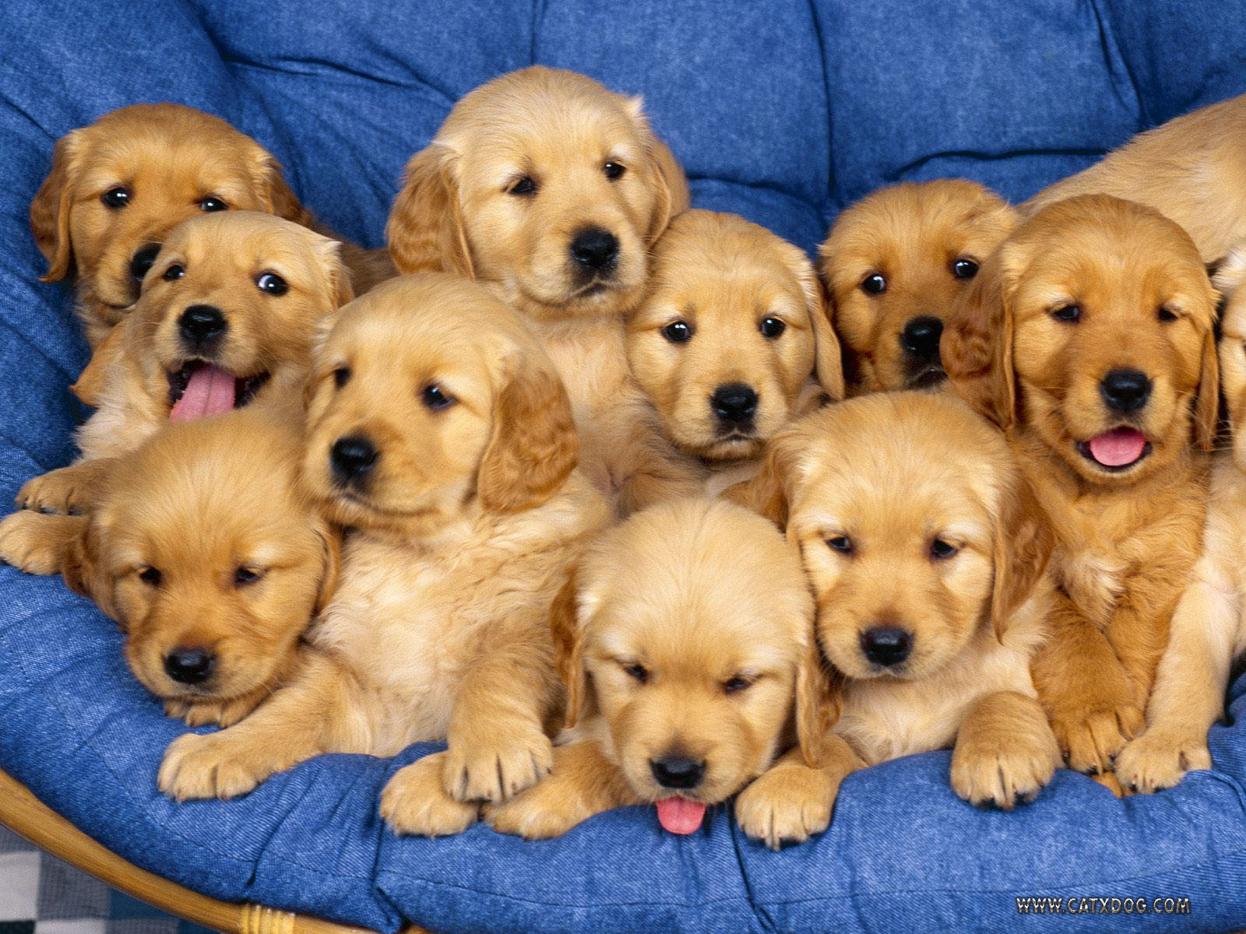
The puppy

Slide 11
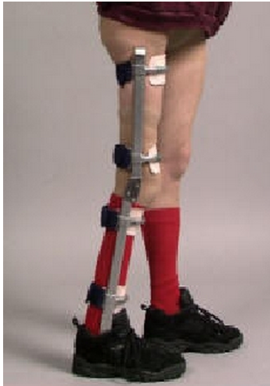
The world is full with people who need somebody who understands them

Slide 12
Exercise Giving from your heart
Supporting exercise for strengthening your self on identity level
Think of the story about the puppy, in which the farmer wholeheartedly gives this puppy to the boy who opened his heart to the puppy.
See if you remember from your own life an incident that illustrates the joy of giving from the heart or that illustrates the joy of receiving something which was given from the heart.

Slide 13
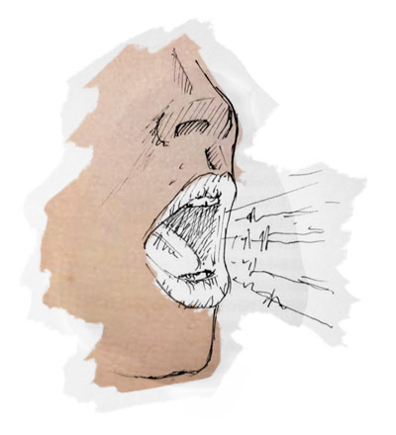

Your voice is the soul of your identity

Slide 14
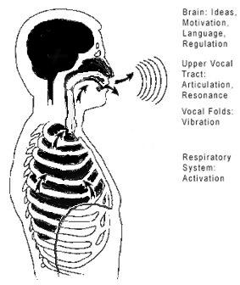
Your voice sounds only when you exhale

Slide 15


Experience your voice on identity level

Slide 16

A hollow bamboo
I am a hollow bamboo
Open up and let the love come through
You are a hollow bamboo
We are a hollow bamboo

Slide 17
Identity and voice
Don’t make your voice loud
to make others listen to you……
Make your personality so loud
that others beg to listen to you.

Slide 18
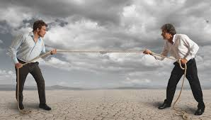
NLP and Success in conflicts
How can you reframe a conflict as a challenge that offers you a possibility to learn something?
Write 5 words down, which come to your mind, when you hear the word “conflict”

Slide 19
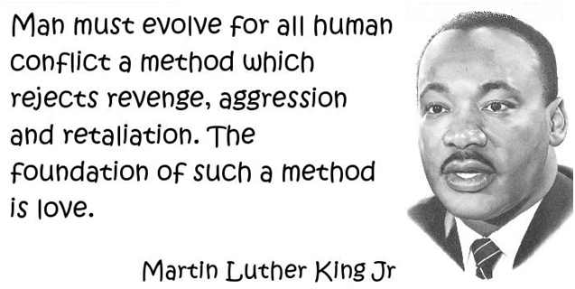

Slide 20
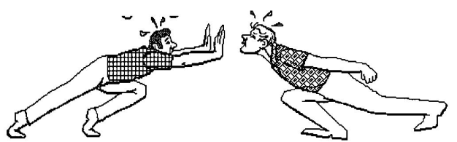
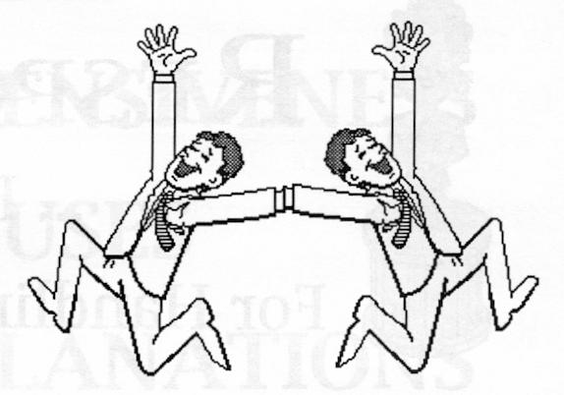
What is a Conflict?

Slide 21
Conflict and the model of the world
A
B
Neurological levels:
World model of A
World model of B
Mission
Identity
Values/beliefs
Skills
Behavior
Environment

Slide 22
NLP-Methods to deal with conflicts
Cross 3 out of the methods, which you find most useful for yourself to resolve conflicts.
The map is not the territory.
Respect for other people’s model of the world.
Making a difference between behavior and person.
I-messages.
Choose happiness instead of wanting to be right.
Make Rapport.
Three observational positions
Pacing and Leading.
Chunking up to a mutual value or mission.
Acknowledging the needs of the other person (and your own).
Getting out of the box .
Reframing, give it another meaning
“A street with a dead end”.
The steps of the giraffe, nonviolent communication.

Slide 23
I- and you- messages

Slide 24
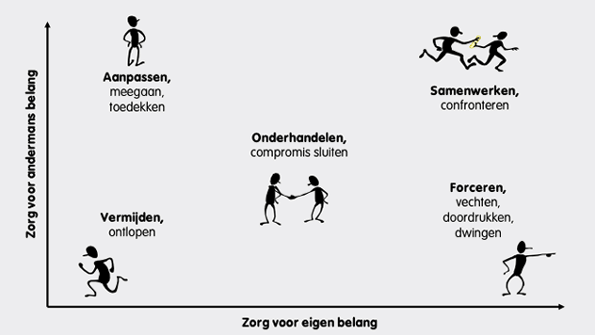
Conflict styles
assertivity: Caring for own interst
Force
Co-operate and confront
Negotiate
Avoid
Accommodate
Co-operate: Caring for other people’s interests

Slide 25
Exercise: Recognize the conflict style
A tells B about a conflict he/she had.
Together they decide which conflict style A used.
Is A satisfied with this conflict style? Or would you rather chose an other style?
What could you do in this conflict according to this style?
A and B swap.

Slide 26
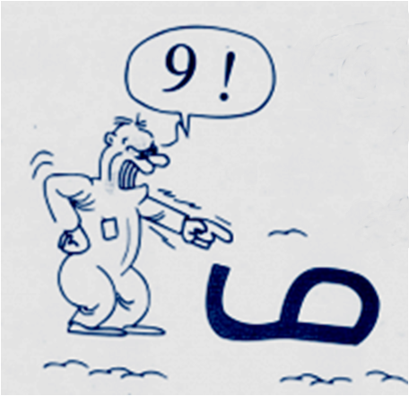
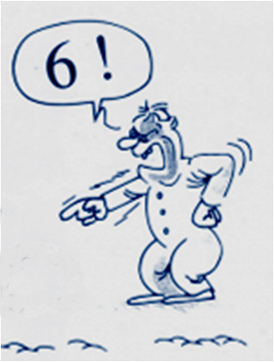
Perception
=
Projection
Take an other perspective

Slide 27



In the box with Negative Emotions
Fear
Angry
Sadness

Slide 28
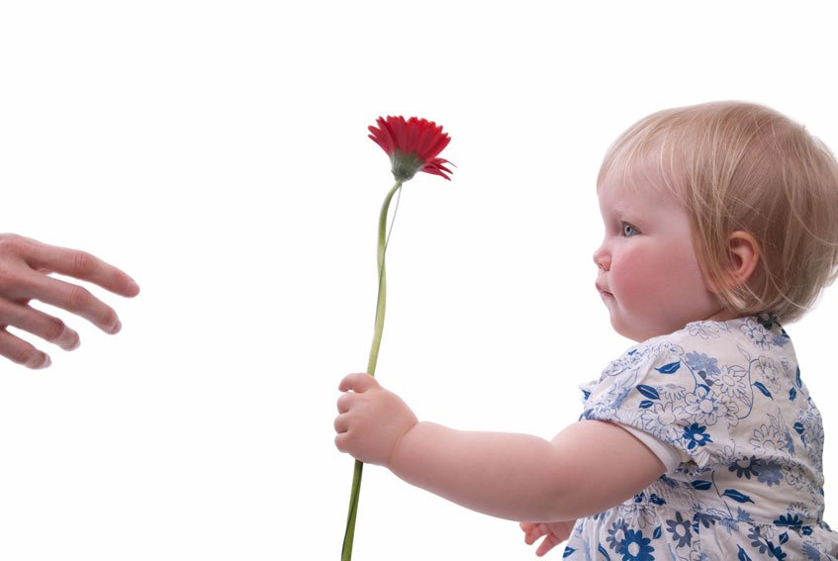
NLP Presupposition 7:
Every behavior has a positive intention
Look at behavior of yourself which you don’t like so much.
What would be the positive intention of it?

Slide 29
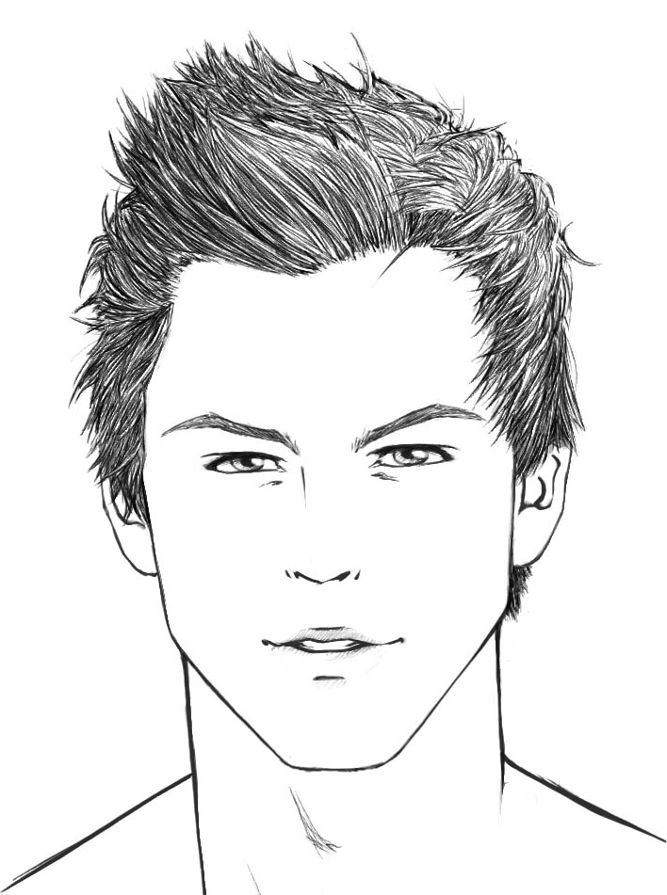
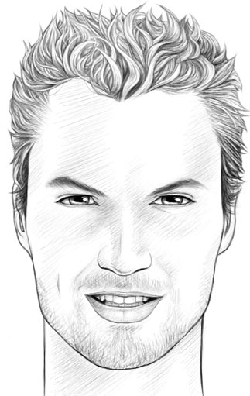
A story of violence
0 many divorced couples, joblessness,
from villages all over Palestine
1 discussions, insulting,
beating, physical violence,
between boys of two neighbors
2 Omar put on Twitter
‘Ali’s sister is a whore’
Ali
Omar

Slide 30
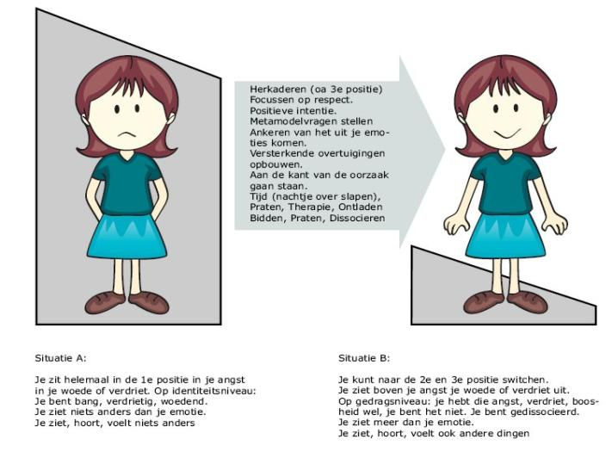
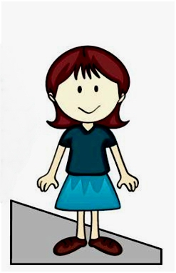
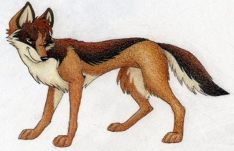
Intensity of the emotion
Jackal language

Slide 31
A story of violence
0 many divorced couples, joblessness,
from villages all over Palestine
1 discussions, insulting,
beating, physical violence,
between boys of two neighbors
2 Omar put ‘on Twitter
Ali’s sister is a whore’
3 Ali went to Omar
and stabbed him
What could you do to stop the violence?
Ali
Omar

Slide 32
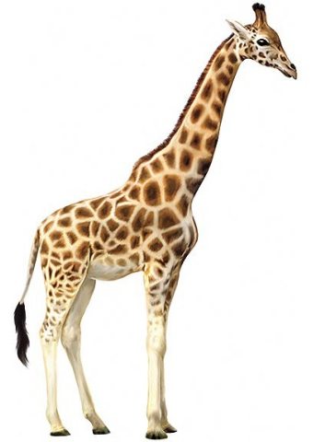
In the box
Out the box
Intensity of the emotion
Giraffe - language
Time
Discharge
Speaking
Therapy
Praying
Reframing
Meditating
Sleeping
Forgiving
Understanding
Walking
Washing hands
Focusing on positive things
Going in 2nd position

Slide 33

Street with dead end
Separate behavior and intention

Slide 34


Dead-end street conflict-resolution with NLP
Walking to the dead-end
Escalating:
Negative judgments
attacking

Slide 35

The dead-end
Changing the direction, because there is no way to continue.
A: So if I understand it correctly, you think/say ………
(using the same words),
B: Yes!

Slide 36

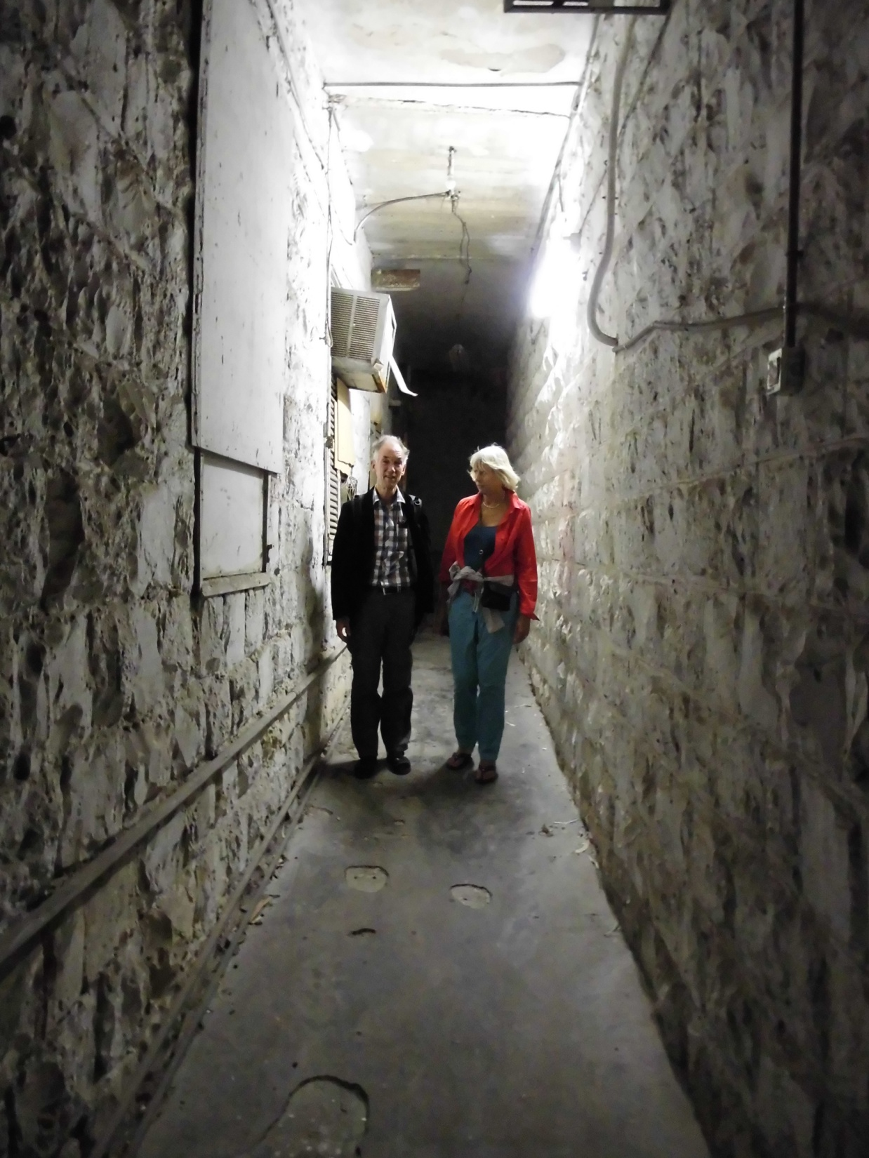

Coming out of the dead-end
Walking the way out: de-escalating
I know you have a positive intention tell me about it….
So this is very important to you….
Negotiate

Slide 37
Reflection of the day
Look back on what we did today.
Where and how can you use the different exercises?
Write it down for yourself.

