Slide 1
Welcome to the NLP-course “Your Unlimited Powers”
Welcome!
مرحبا
Ministry of social affairs, Ramallah, Palestine
3rd day Monday 2 May 2016
Trainers: Sytse and Marlies Tjallingii

Slide 2
Program of today
9.00 – 10.30 Welcome
Good and New
Open Frame
The unconscious mind
10.45 – 12.00 How big is your conscious mind?
4 Steps learning process
Your most important teachers
12.15 – 13.15 On the side of the cause
Empowering beliefs
13.30 – 14.30 The central nervous system is not able to store a denial
Sandwich feedback
Rapport
Pacing and Leading
Rapport with yourself

Slide 3
Good and new
Joy
Energy
In two's 2 minutes each.
Focus at a recent situation which had given you a good/or new feeling. In which you felt energy, happiness or joy.
Share in the whole group the title of your experience and show your feelings at your face.

Slide 4
Open Frame
Questions
Experiences
Short stories
Share a real life-experience to reflect on what NLP can mean to it.
Goal: apply NLP in your own reality.

Slide 5
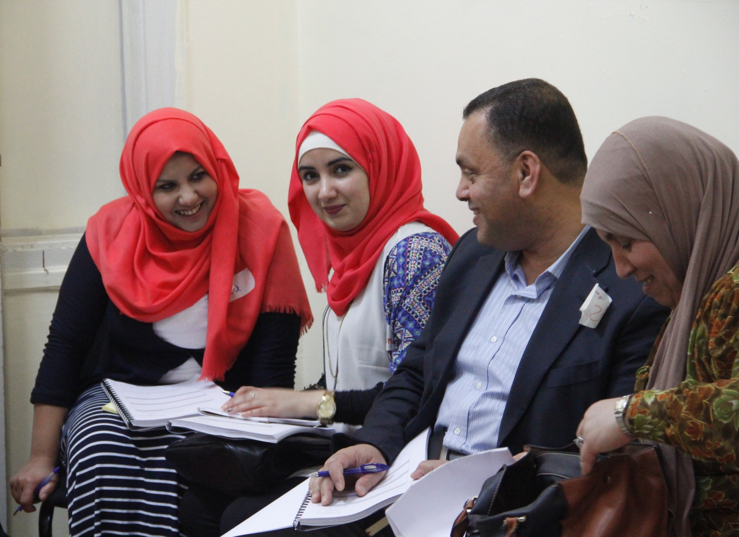

Slide 6
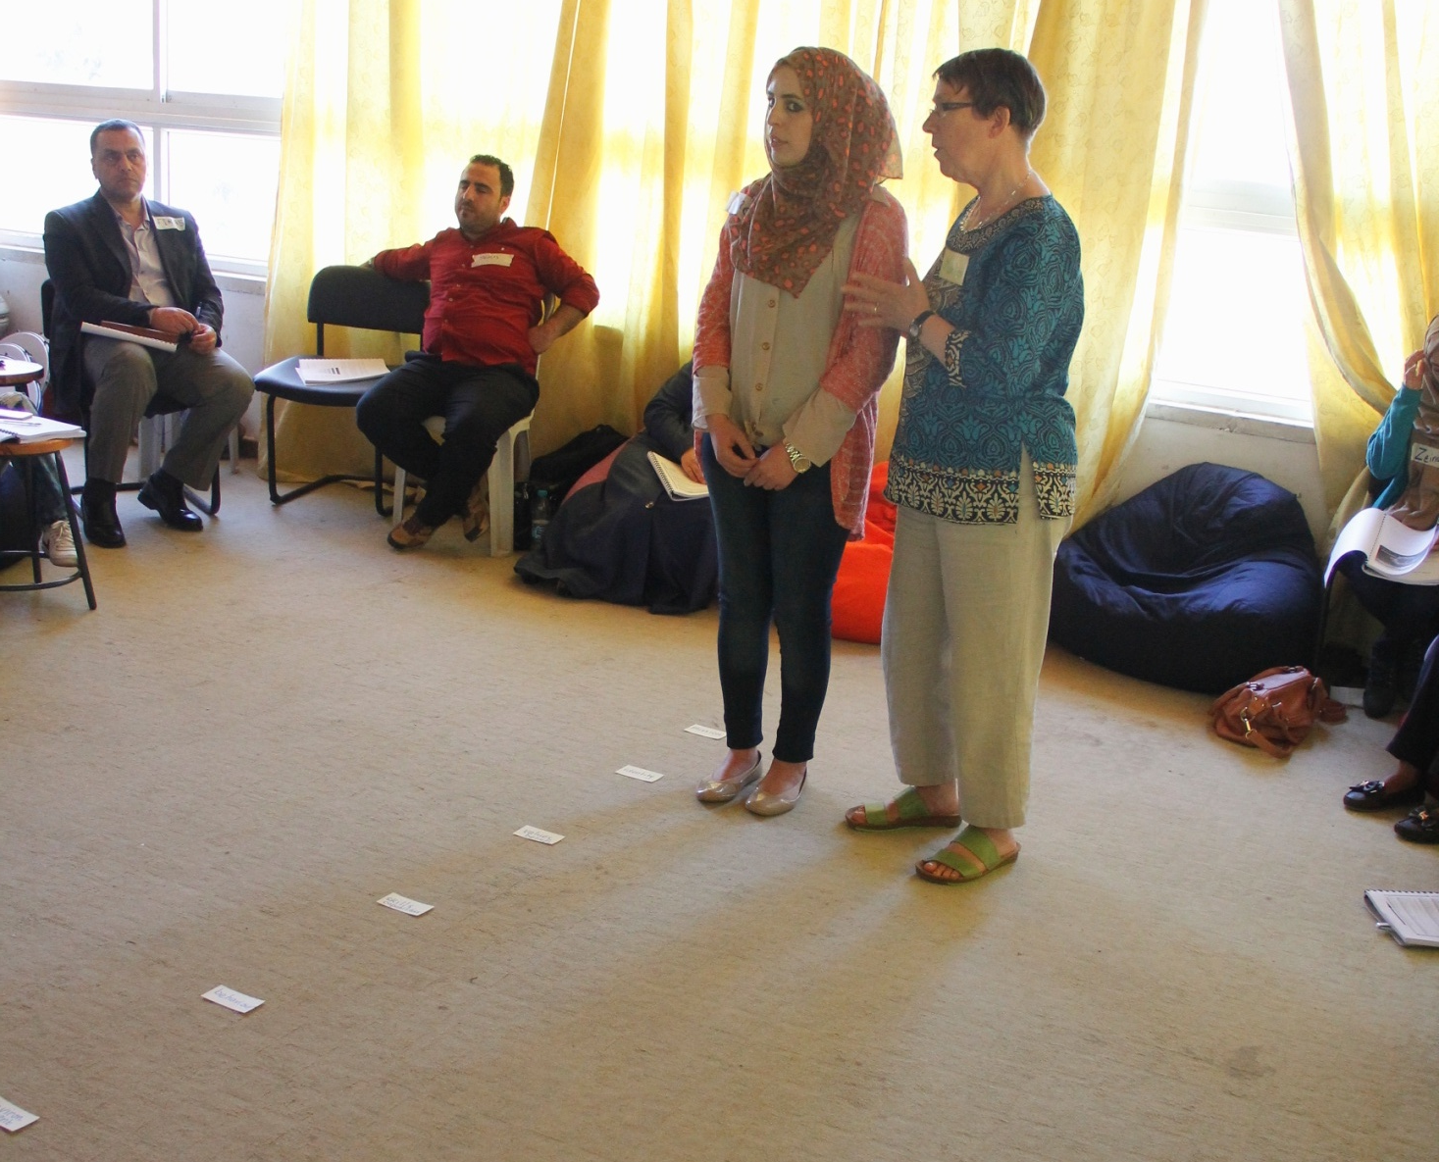

Slide 7
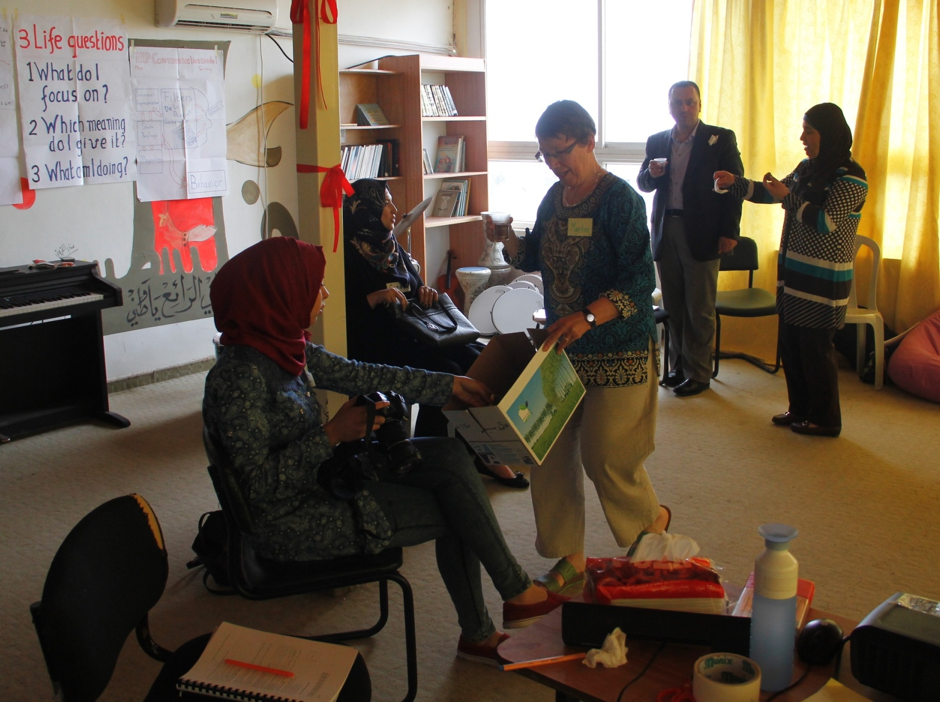

Slide 8
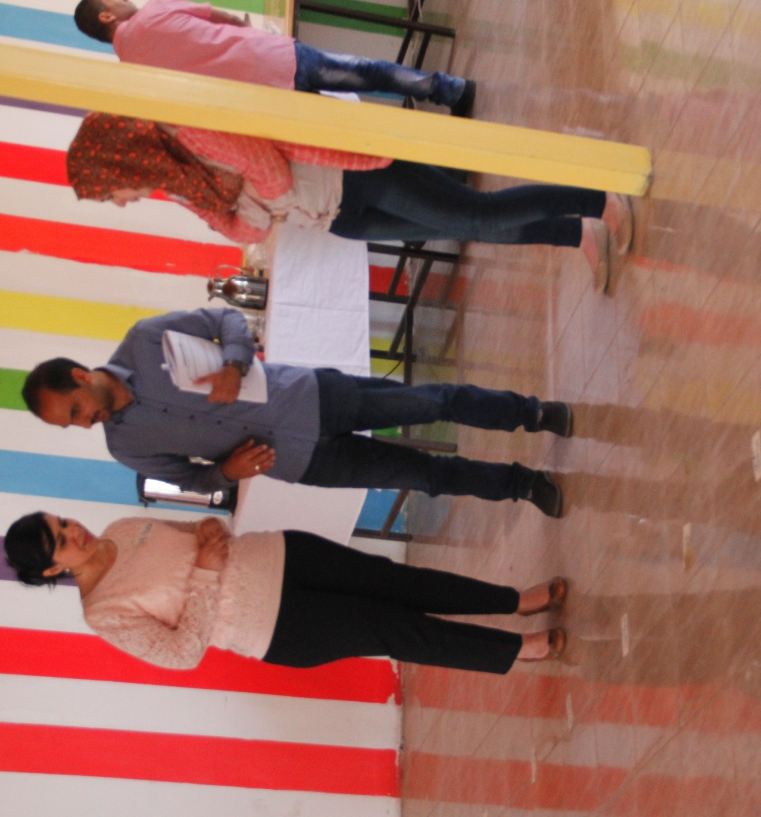

Slide 9
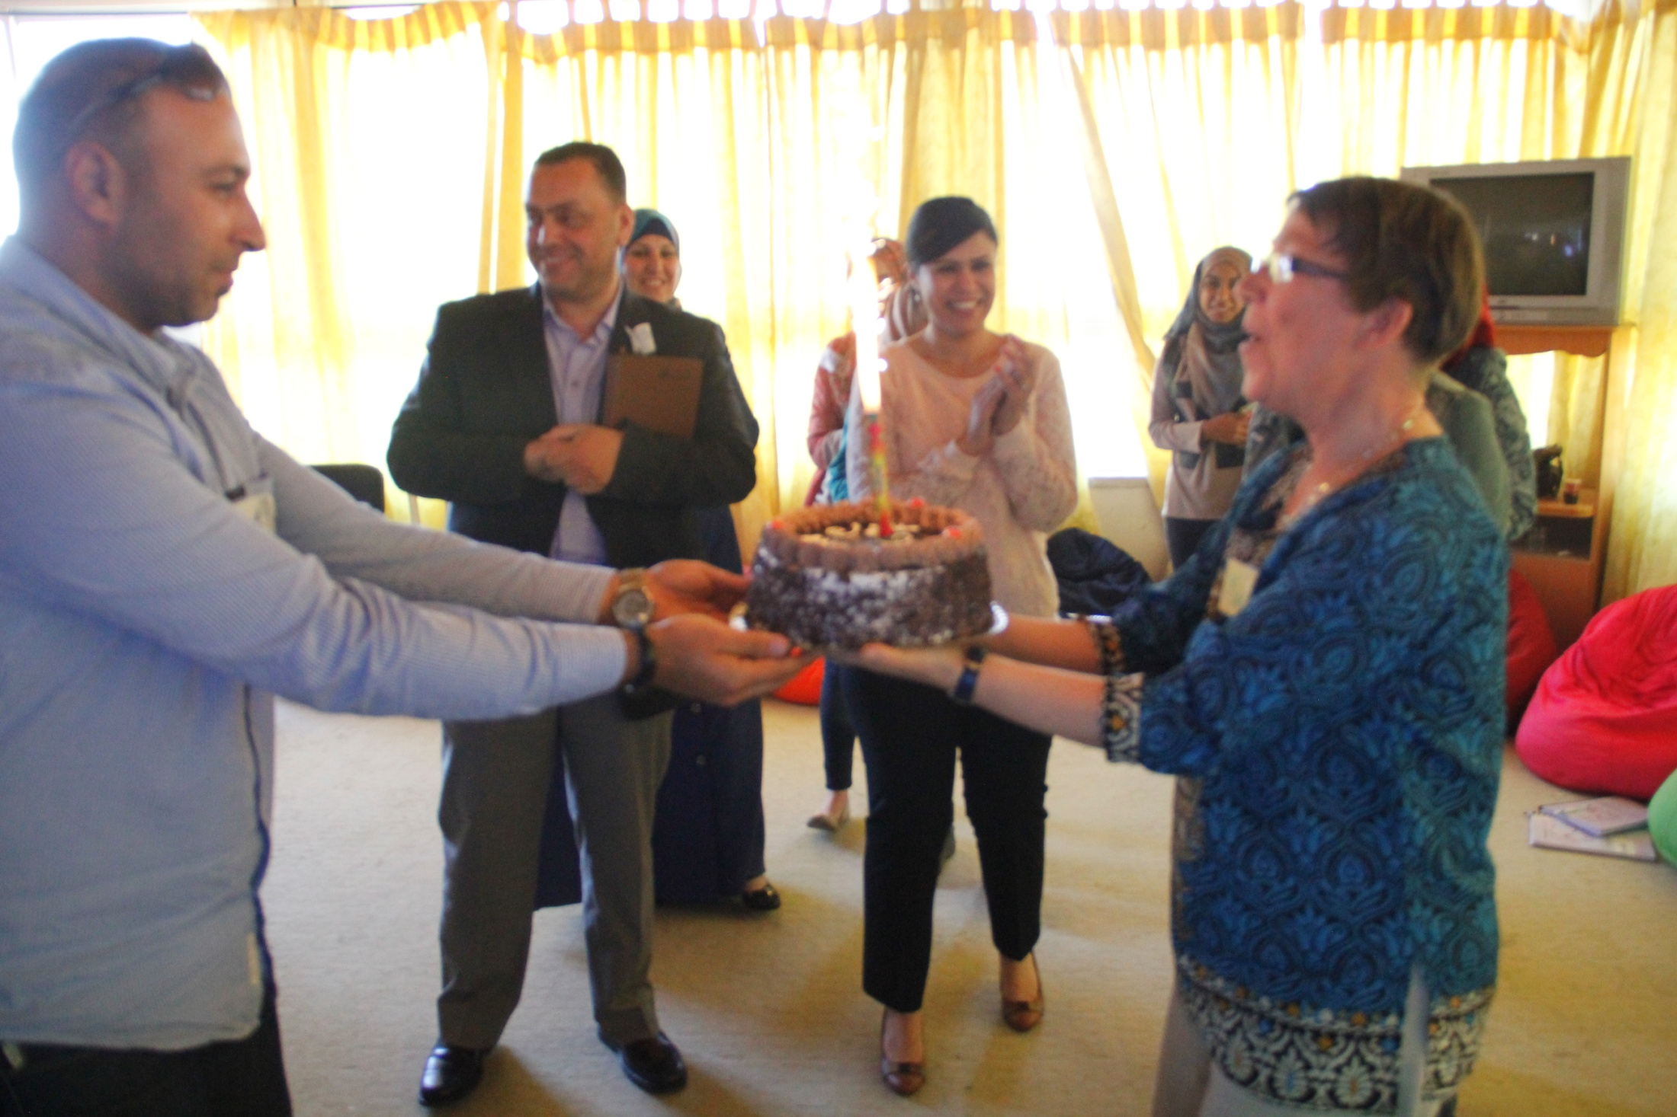

Slide 12
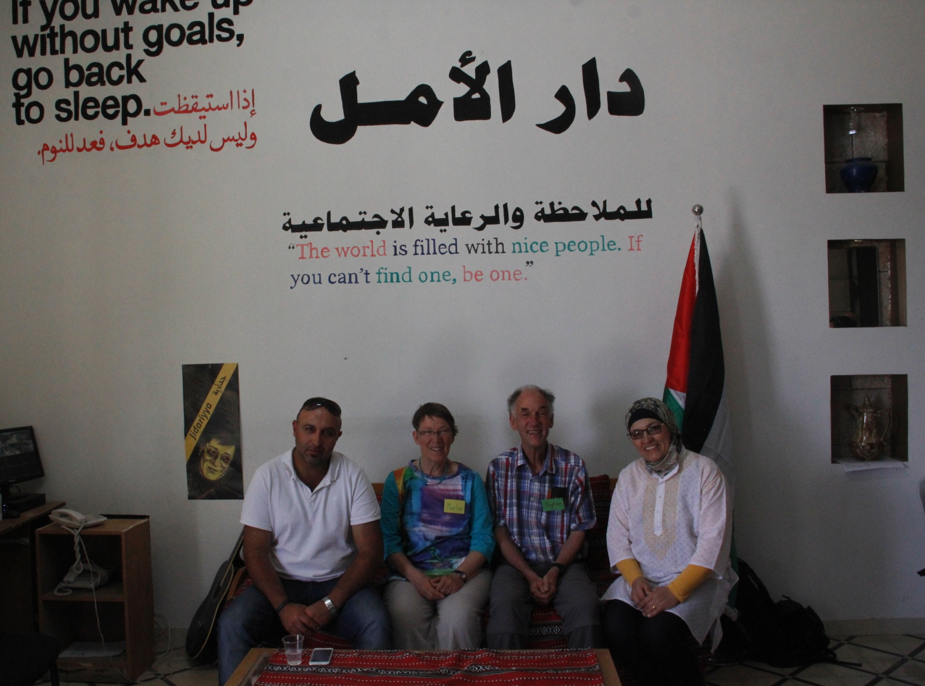

Slide 13
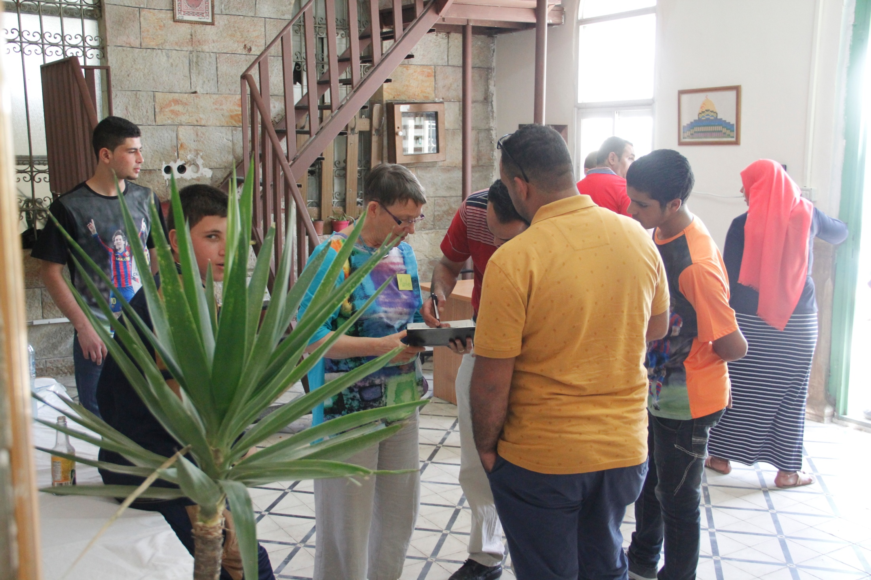

Slide 14
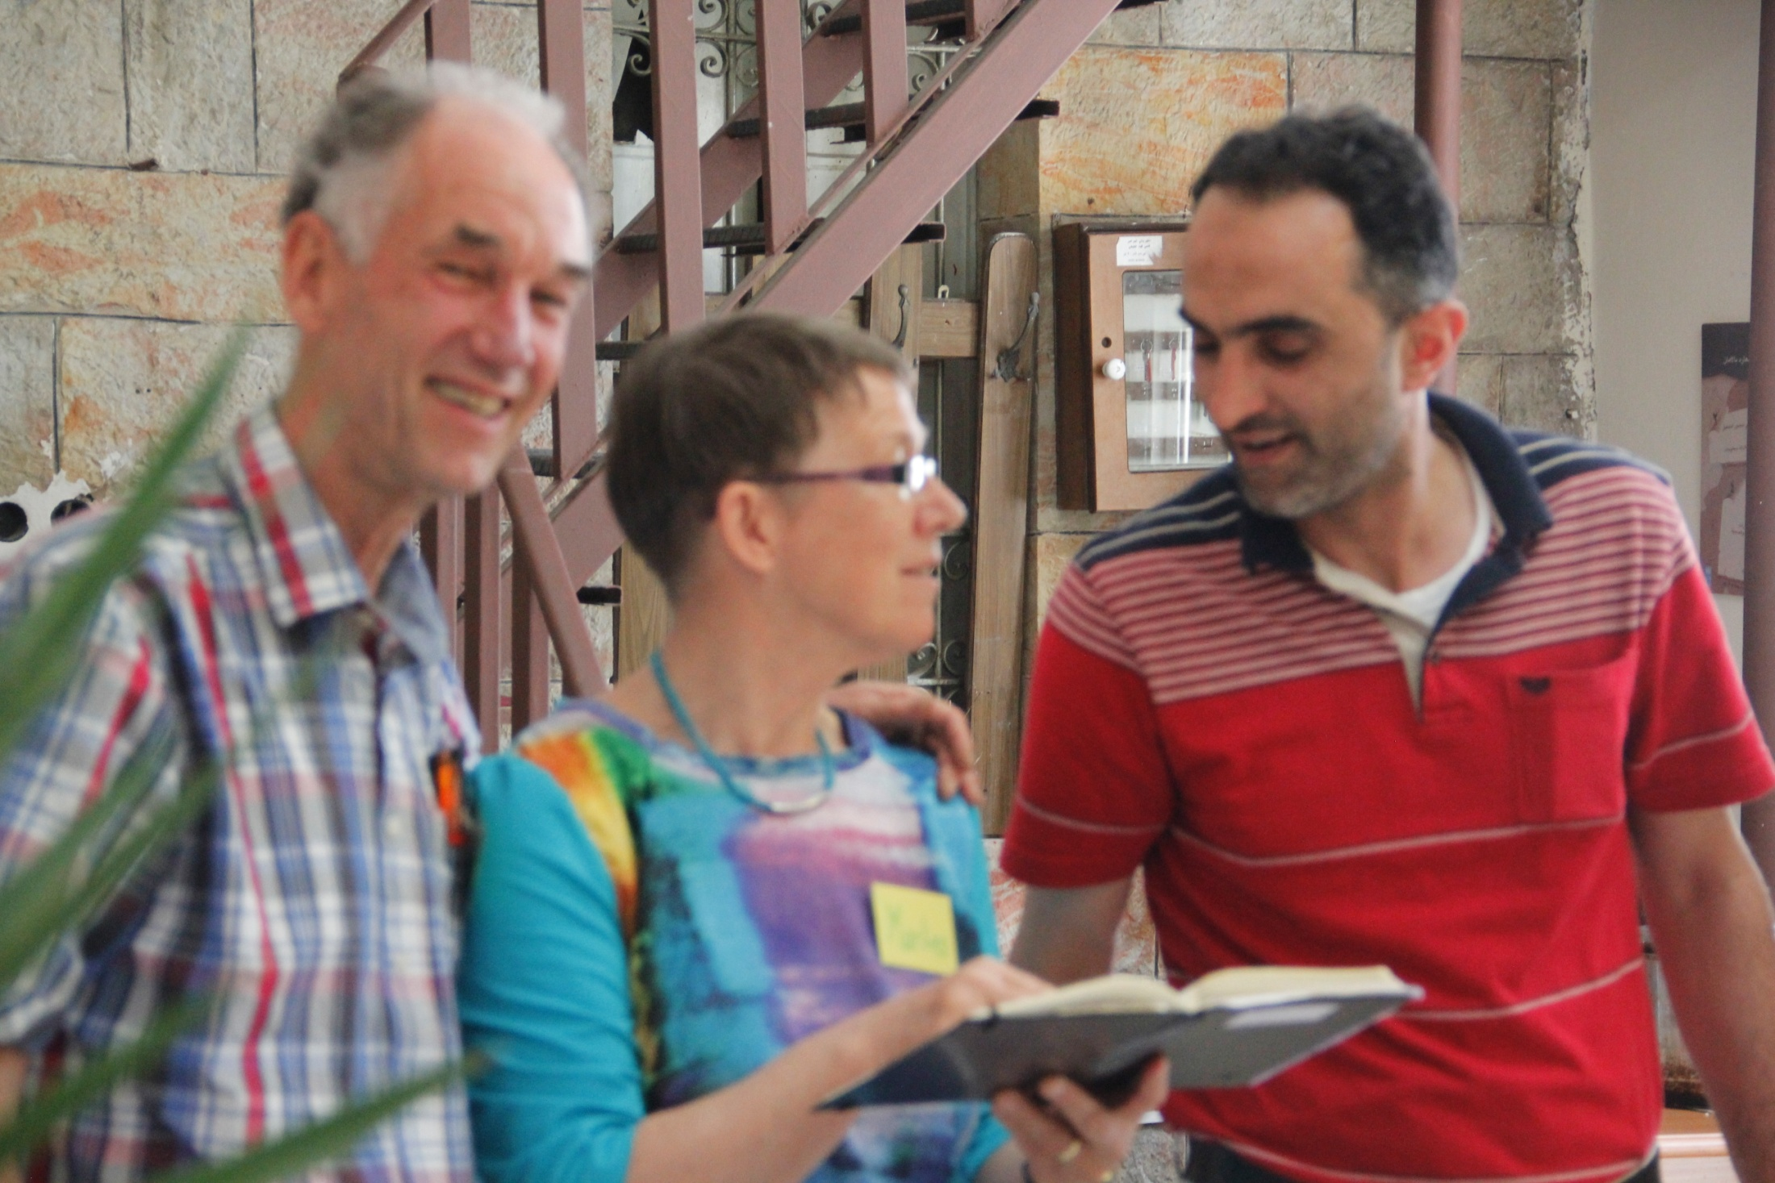

Slide 15
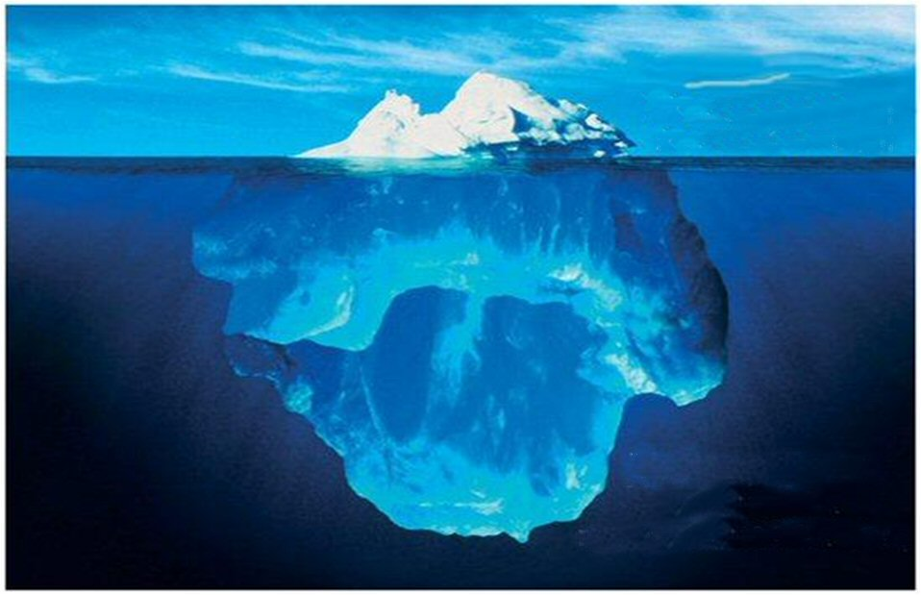
Conscious/Unconscious mind
Conscious mind
Processes 60 bits/sec
Unconscious mind
processes 11.200.000 bits/sec

Slide 16
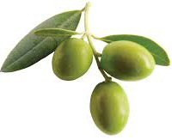
Your unconscious mind goes on, even when you sleep
Conscious Mind:
Processes 60 bits /sec
Olives
Unconscious Mind:
Processes 11.200.000bits /sec
Tree with branches
and roots

Slide 17
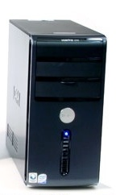
conscious
What is on the screen,
stays in the computer
All learning, behavior
and change is
Unconscious
And ……
Sometimes
Also Conscious
unconscious

Slide 18
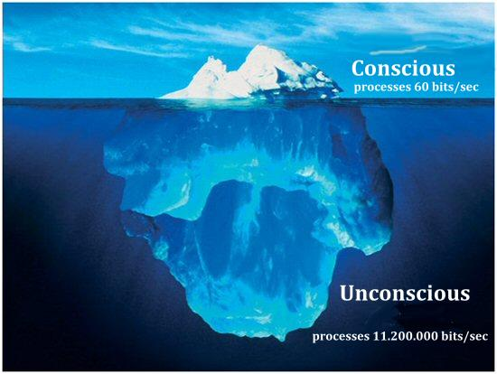
The most important functions of the unconscious mind
Stores memories
Is the domain of emotions
Maintains and protects the body
Works as a servant and follows the instructions of the conscious mind
Generates habits, automates, (4 steps learning process)
Takes everything personally (Perception is Projection)
Processes no denials

Slide 19
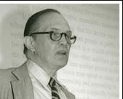
How big is your
counscious mind?
Read the following numbers in 15 seconds.
7 3 2 7 5 1 9
Write down all the numbers in the right order
7 3 2 7 5 1 9
George Miller
”The Magical Number Seven, Plus or Minus Two
How many did you write correct?
Read the following numbers in 25 seconds.
2 5 7 1 8 2 4 6 3 2 7 5
Your Conscious mind
can contain only
7 + 2
Write them down.
2 5 7 1 8 2 4 6 3 2 7 5
How many did you write correct?

Slide 20
The 4-Step Learning Process
1. Unconscious incompetent
Becoming conscious
2. Conscious incompetent
Exercise
3. Conscious competent
Getting routine
4. Unconscious competent
Unlearn: from step 4 to 2 and again to 4
Once more learn: from 2 to 4.

Slide 21
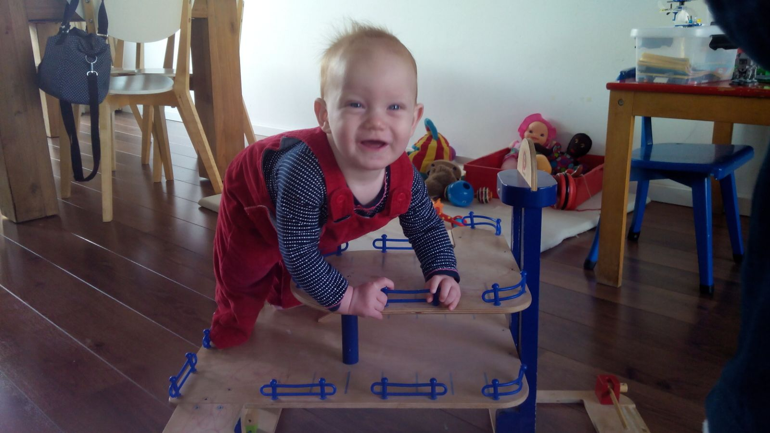

Slide 22
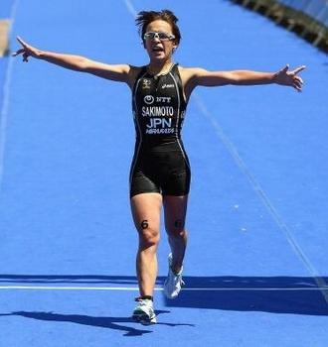
Feelings in the 4 steps learning process
4 succes experience
4
3 feeling better
1 neutral
2b challenge
feelings
1
2b
3
2a fear
2a
Stop disappointed
time

Slide 23
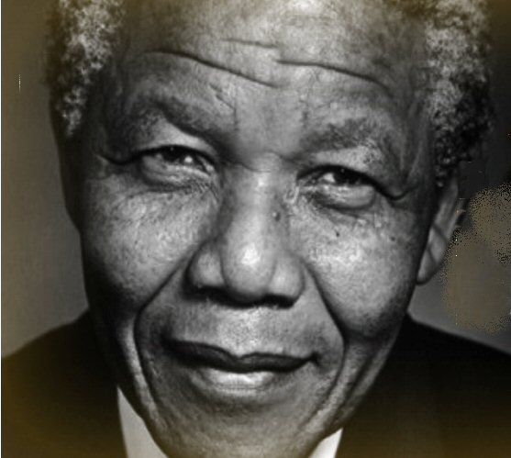
Most important teachers:
“It always seems impossible,
until it’s done.
Nelson Mandela

Slide 24
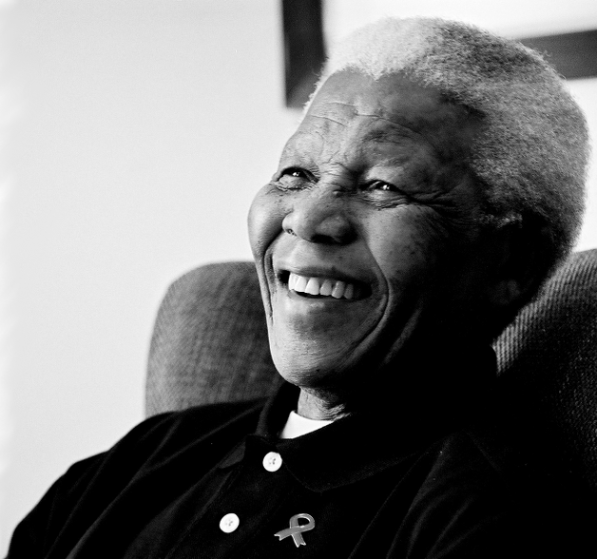
Most important teachers:
If you want to make peace
with your enemy,
you have to work with your enemy.
Then he becomes your partner.
Nelson Mandela

Slide 25
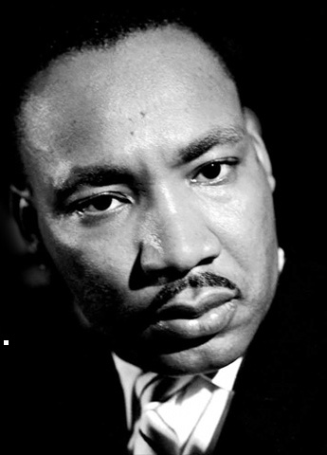
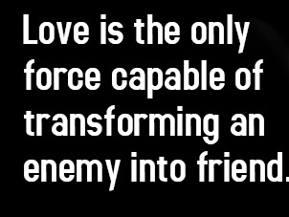

Slide 26
William Glasser:
“We remember . . .
10% of what we read
20% of what we hear
30% of what we see
50% of what we see and hear
70% of what we discuss
80% of what we experience
95% of what we teach others.”

Slide 27
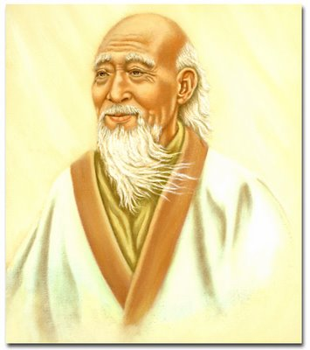
Tell me and I listen,
show me and I look,
let me experience and I learn.
Lao Tzu (604 BC. - 507 BC).

Slide 28
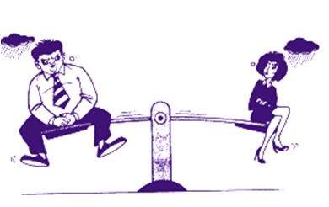
Cause and Result
C
R
Do you stay at the side of the result ,
or do you step at the side of the cause?
I feel powerless
because she ….
He does it again!
What could I do?
What could I do?

Slide 29
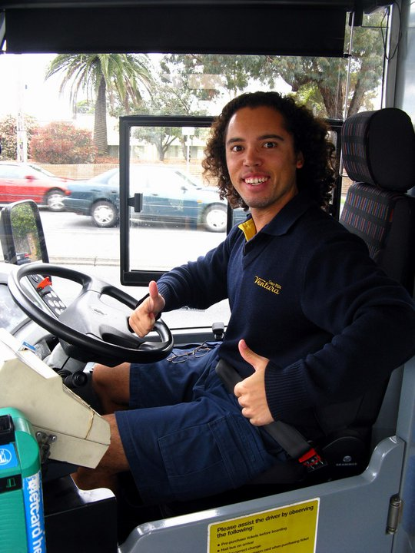
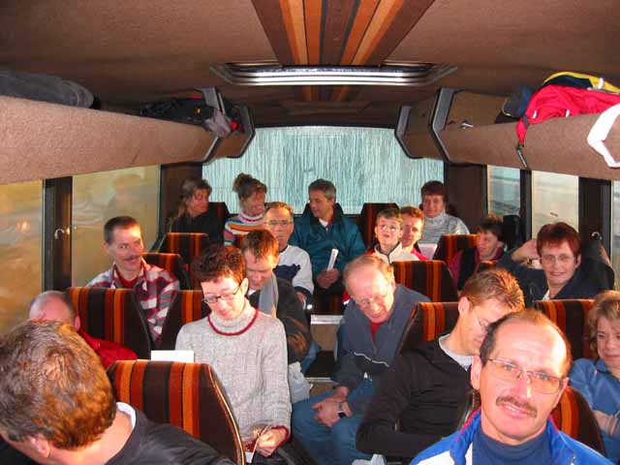
Cause → Result
Take responsibility of your life → Victim
Where do you want
to sit in the bus?
In the back of the bus?
Or ….
At the steering wheel?

Slide 30
Practice Cause or Result?
What would you chose?
What do I focus on?
Usually I am more focused on approaching.’
I often want to avoid problems.
1A
1B
What do you think of? | First I think of the solution of a problem. First I think of the cause of a problem. | 2A 2B
Against or together? | I feel the other is against me and I think ‘they, you and everyone takes care of him/herself. ’ I think in ‘we and together.’ | 3A 3B

Slide 31
Un-Limiting Convictions
(Empowering Beliefs)

Slide 32
This is difficult!
M
This is not
yet
so easy

Slide 33
The central nervous system is
not able to store a denial
Do not think of a pink elephant
Do not think of how you came
to the course today
Do not think of how you are going
home after the course
Do think of a blue elephant!

Slide 34
Beliefs / Convictions
Which limiting beliefs do you have?
Or your neighbour, colleague, friend…?

Slide 35
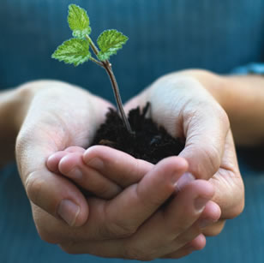
From weakening to empowering belief
Negative Weakening
Thought
What do I specific want? (small, close)
Strengthening conviction you eager wanted to have
My new boss will not like me.
I want to feel well, independent from my boss
I chose how I feel

Slide 36
I cannot learn English
I can study my English NLP manual every day
I can learn to speak and understand English fluently

Slide 37
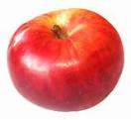
fruits
Empowering belief
…………………………….
Building your empowering belief
trunk
Experience 3 . . . . . . . . . . . . . . . . . .
Experience1 . . . . . . . . . . . . . . . . . . . . . . . . . . . . .
Experience 2 . . . . . . . . . . . . . . . . . . . . . . . .
Experience 3 . . . . . . . . . . . . . . . . . . . . .
Experience 5 . . . . . . . . . . . . . . . . . . . . . . .
roots

Slide 38
fruits
Example of building your empowering belief
Empowering belief
I can be empathetic
trunk
Experience1
e
Experience 1: I felt her pain yesterday
Experience 2
Experience 3
Experience 5
roots
Experience 4
Exp 2: I heard her voice going down, so I guessed she was sad
Exp 3: I followed her on Facebook
Exp 4: My friend said that she felt supported
Exp. 5: I looked in her eyes and felt very connected last week

Slide 39
Learn to give compliments
with the sandwich feedback model
What I specific like of what you deed ….(about the behavior)
What you probably could still do better in the future is ……
What I like, is your effort, motivation.

Slide 40
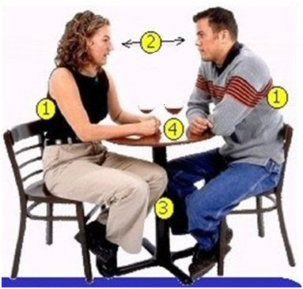
Rapport
1 = back in same position
2 = eye contact
3 = legs and feet in same position
4 = arms and hands slightly different.
Being on the same wavelength,
Feeling contact,
Synchronic
Feeling that you both are willing to listen and willing to accept suggestions
Example of unconscious human interaction.

Slide 41
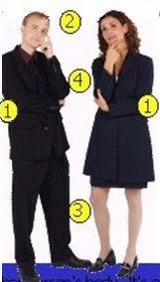
Rapport
1 = back in same position
2 = eye contact
3 = legs and feet in same position
4 = arms and hands slightly different.

Slide 42
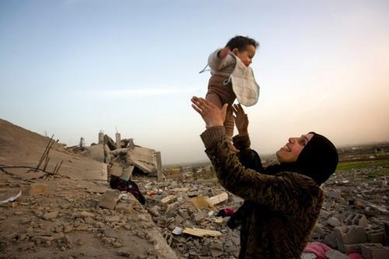
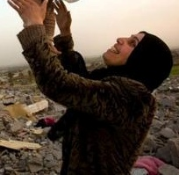
Rapport
Palestinian woman in rapport with her child
near their destroyed house
show respect for the other’s model of the world
eye contact
matching
adjust to each other
give attention to each other
willingness to follow
build trust
create emotional connection
use the same representation system

Slide 43
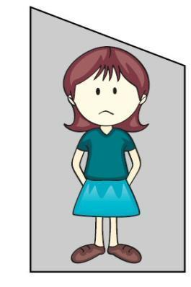
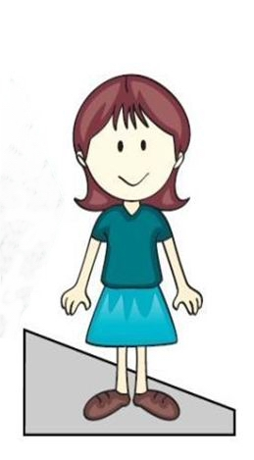
Coming out of the box
Take time
Reframe
Discharge
Pray
Talk
Anchor
Respect
Consider positive intention
Walk
Listen to music
Intensity of emotion
In the box
Out of the box

Slide 44
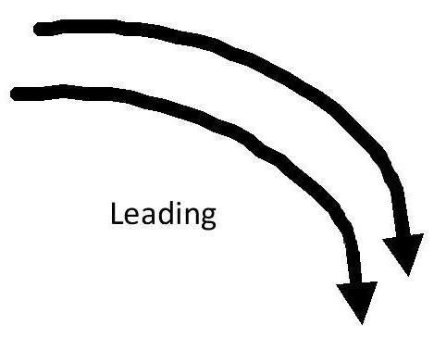
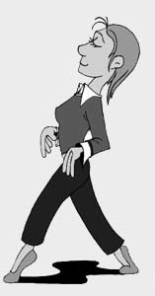
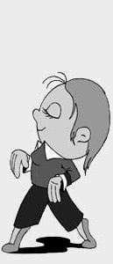
Pacing and Leading
Building up Rapport

Slide 45
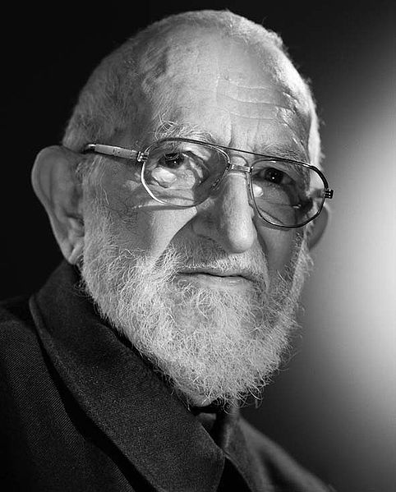
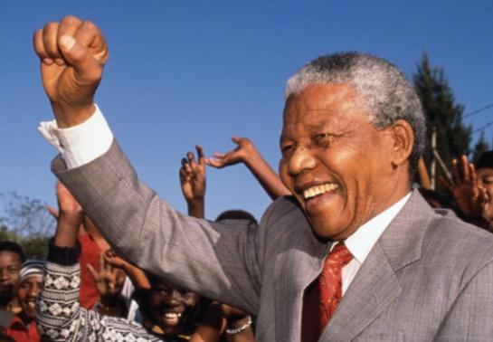
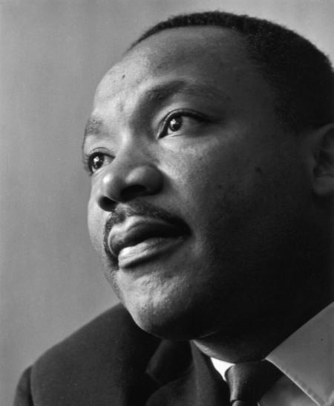
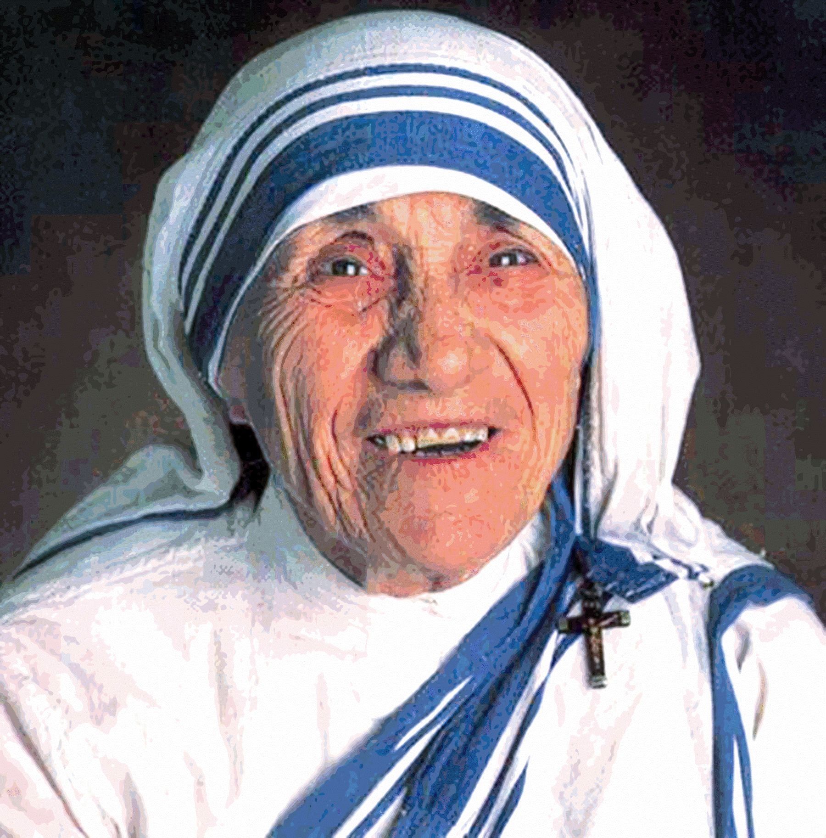
Rapport with your self
Charismatic leaders
Nelson Mandela
Gandhi
Abbé Pierre
Martin Luther King
Mother Theresa

Slide 46
The three houses

Slide 47
Representation systems test
4 most close to your own description
3 next best to your own description
2 next best to your own description
1 the least suited description
Example:
1. I take important decisions based on:
….. my intuitive feelings
….. what sounds best for me
….. what looks the best for me
….. exact research and study of the subject
2
3
1
4

Slide 48
Representation systems
primary
V | Visual
At | Auditive tonal
K | Kinesthetic
O | Olfactory
G | Gustative
Secondary Ad | Auditive digital
Seeing
Hearing
Feeling
Smelling
Tasting
Thinking
V
A
K
O
G
sec
Auditive-digital
insight
conscious
analyse
thought
understand
know
decide
Visual
look
picture
bright
outlook
focus
vision
perspective
Auditive-tonal
say
accent
question
click
rhythm
language
speech
Kinaesthetic
touch
move
pressure
handle
loose
insensitive
rough
Olfactory
scent
stink
whiff
reek
fishy
air
nostril
Gustatory
flavour
sweet
appetite
sour
feed
juicy
spicy

Slide 49
Practice Predicates 2
Indicate with V = visual, At = Auditive tonal, K = Kinesthetic, Ad = Auditive digital
1 I see your point
V
2 I want you to get a grasp on this
K
3 It appears rather clear to me
V
4 I ask myself
At
5 I saw a twinkling in your eyes
V
6 Are you able to get a handle on this?
K
7 I understand you
Ad
8 That doesn’t realy ring a bell
At
9 I want you to take a look at it
V
10 What you are doing doesn’t feel right to me
K
11 I hear what you are saying
At
12 Life feels warm and wonderful
K
13 I think you will understand me
Ad
14 Am I painting a clear picture?
V
15 That information is solid as a rock
K

Slide 50
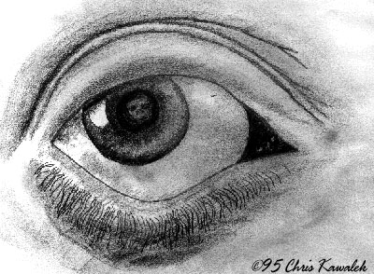
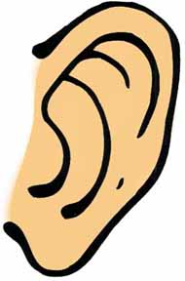
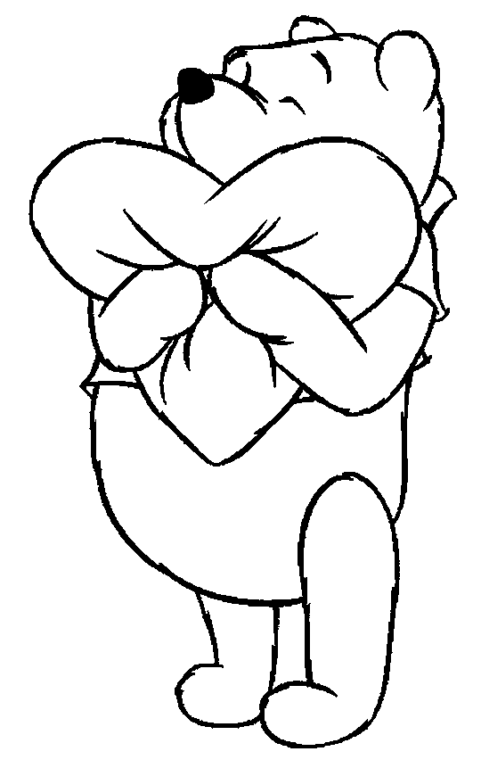
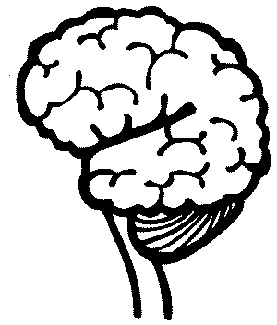
Representation system typology
V: Visual
with their eyes upward. They breath from the top of their lungs, often sitting forward in their seats.
At: Auditive
They breath from the middle of the chest. they are talking to themselves .
They love music and talking on the phone. They remember by using steps, procedures and sequences.
K: Kinaesthetic
Breathing from the bottom of their lungs. They often move slowly. They may speak slowly and with a low tune. They are standing close to people, touch the other person.
Ad: Auditive digital
They love ANALYZING the worlds around them. Thinking in themselves and becoming conscious about something

Slide 51
Anchoring
Anchor: Any stimulus that is associated with a specific response.
The short way to your resources
MOTIVATION
HUMOUR / LAUGHING
ENERGY
LOVE
POWER
SELFCONFEDENCE

Slide 52
To set an anchor
Anchoring
start
end
intensity
feelings
The four keys to anchoring
The make anchors working properly, they have to meet four criteria. We call these the four keys to anchoring:
The intensity of the experience - must be totally associated; see, hear, feel it as it was;
The timing of the anchor (see graphic above);
The unique properties of the stimulus (don’t take the inside of your hand, but take the touch of a knuckle or step in a circle);
Repeating of the stimulus (the incentive must be able to be repeated).
time

Slide 53
Anchoring
start
end
intensity
feelings
time
The four steps to anchoring
Remember a vivid positive experience from the past with one valuable resource as: Motivation; humour / laughing; energy; love; power; self confidence.
Step in the circle of excellence at the highest point (see graphic below). Repeat this several times.
Change your state (break state).
3 Repeat with the same or different resources with different memories.
4 Set the anchor in action to perform the test.

Slide 54
Language
Hierarchy
Meta-Model
Milton-Model
Non-violent communication

Slide 55
More general
More general
chunking
More specific
More examples at the samen level
down-chunking
lateraal
chunken
up-chunking
More specific

Slide 56
Video mother and child:
..\video's\NVC\Compassionate Communication with Kids.flv

Slide 57
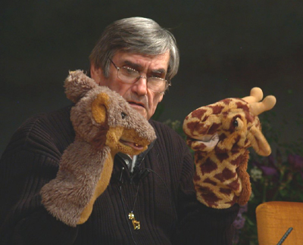
Marshall Rosenberg:
Non-Violent Communication

Slide 58
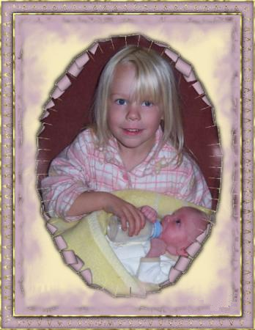
Reframing

Slide 59
What I asked life
I asked for strength...
And life gave me difficulties to make me strong.
I asked for wisdom...
And life gave me problems to resolve.
I asked for prosperity...
And life gave me brains and muscles to work with.
I asked to be able to fly ...
And life gave me obstacles to overcome.
I asked for love ...
And life gave me people who needed help.
I asked for favours ...
And life gave me possibilities
I did not receive anything of what I asked for...
And.......
I received everything I needed!

Slide 61
Reframing with
3 Perceptual positions
3
Third Position
Dissociated of yourself
and from the other
Also called: The meta position, the observer or helicopter view.
1
2
First Position
Associated in your self
Second Position Associated in the other

Slide 62
The gift of peace on earth lies in our hands.
What could be your first step?
Thank you for your important step
in improving your life with NLP !

