Slide 1
Welcome to the NLP-course “Achieve more success with Your Unlimited Powers”
"حقق نجاحا أكثر مع طاقاتك اللامحدودة"
دورة البرمجة اللغوية العصبية التابعة
ترحيب
مرحبا
Success!
2nd day Ramallah, October 25, 2017

Slide 2
Program for today
Good and New
Open Frame
Pacing and leading
Frame of Reference
Your key relations
Rapport with yourself
Synaesthesia in rapport with yourself
Mapping across using submodalities
From dislike to like
From like to dislike
Reflection

Slide 3
Good and New
In pairs 2 minutes each.
Focus at a recent situation which has given you a good/or new feeling. In which you felt energy, happiness or joy.
Share in the whole group the title of your experience and show your feelings at your face.

Slide 4
Open Frame
Questions
Experiences
Short stories
Share a real life-experience to reflect on what NLP can mean to it.
Goal: apply NLP in your own reality.

Slide 5
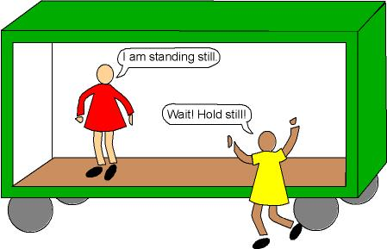
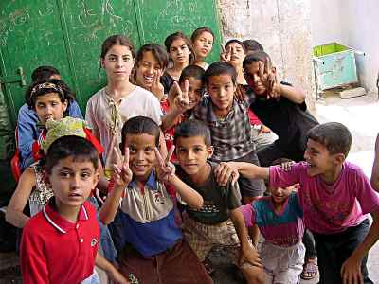
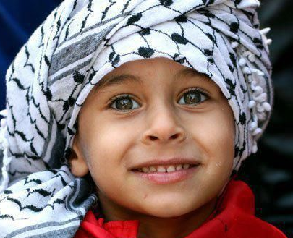
Frame of reference
Both external but different?
Internal or external?

Slide 6
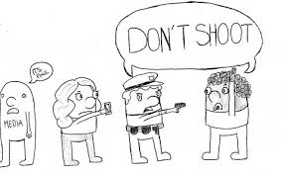
Who has an internal reference?
Policeman or the man who the gun appointing to?

Slide 7
Key relations
Partner
Family
Relatives
Close friend/friends
Other friends
Colleagues
Neighbours
Members of the same club, mosque
4. In which relations do you have already easily rapport?
5. In which relations do you want to make more rapport?
6. How are you going to make more rapport?
7. Make plans!

Slide 8
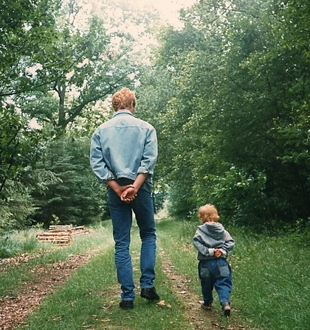
Pacing and leading

Slide 9
Pacing
and Leading
Pacing 1:
approaching
listening
Summarising and
Deepening questions
following,
open questioning
Pacing 2:
keeping rapport and deepening
Leading:
Proposeing kchoices
Building in presuppositions
How did you manage to continue for such a long time?
What would help you to feel better?

Slide 10
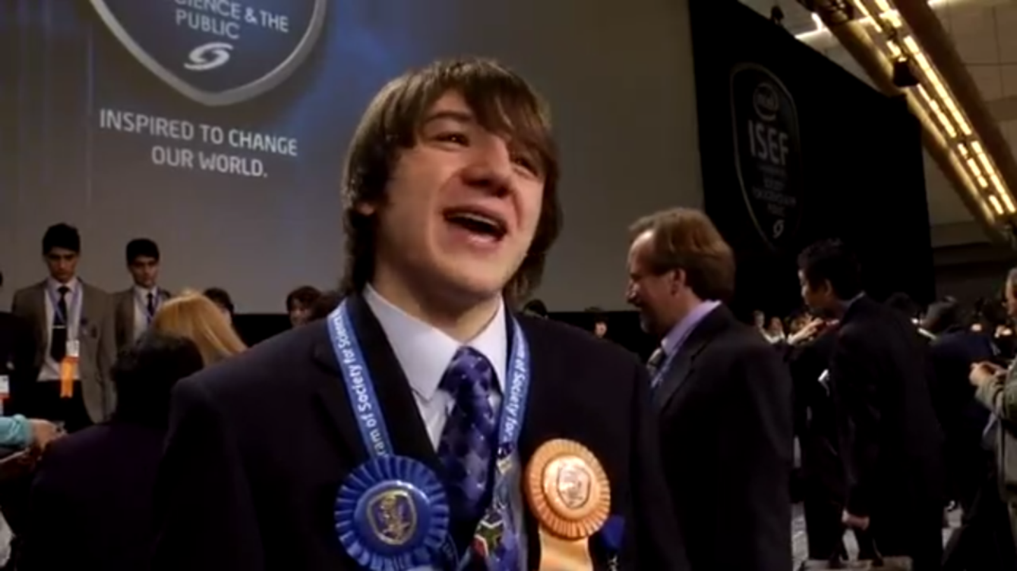
Success with rapport
Video of Jack Andraka
At the ISEF (International Science and Engineering Fair)

Slide 11
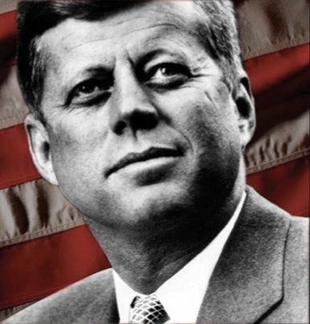
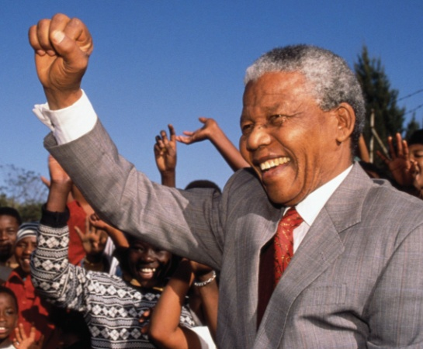
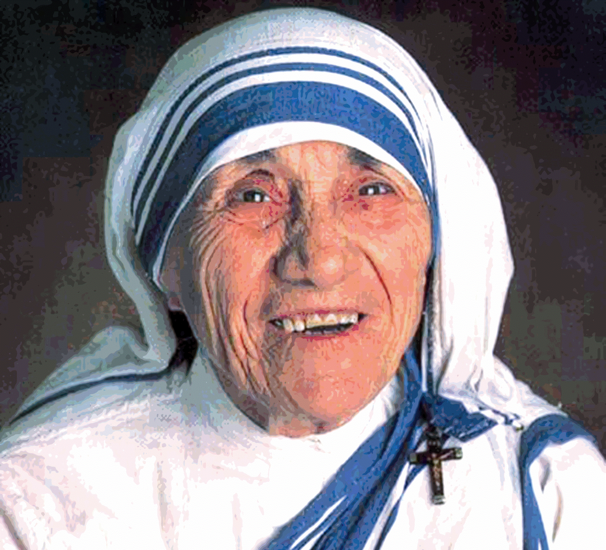
Rapport with your self
J.F.Kennedy
Mother Theresa
Nelson Mandela

Slide 12
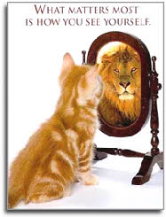
Rapport with your self?
What matters most is how you see yourself?

Slide 13
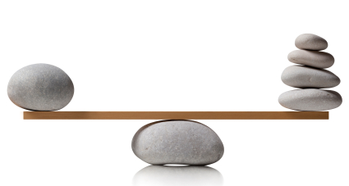
Balance between you and me
(trance)
A good balance in your being you can reach by:
Letting flow love through your body.
Respecting all your thoughts.
The way you look, sound and act.
The values that you choose consciously and which you apply in your behaviour.
Having balance between
Your convictions about yourself and about others.
Your goal in life and your perception of your identity.
The extent to which you are egocentric or rather empathic.
The focus on your big or rather small ego.
Your bright and dark side.
The appreciation you give yourself and which you get from others.

Slide 14
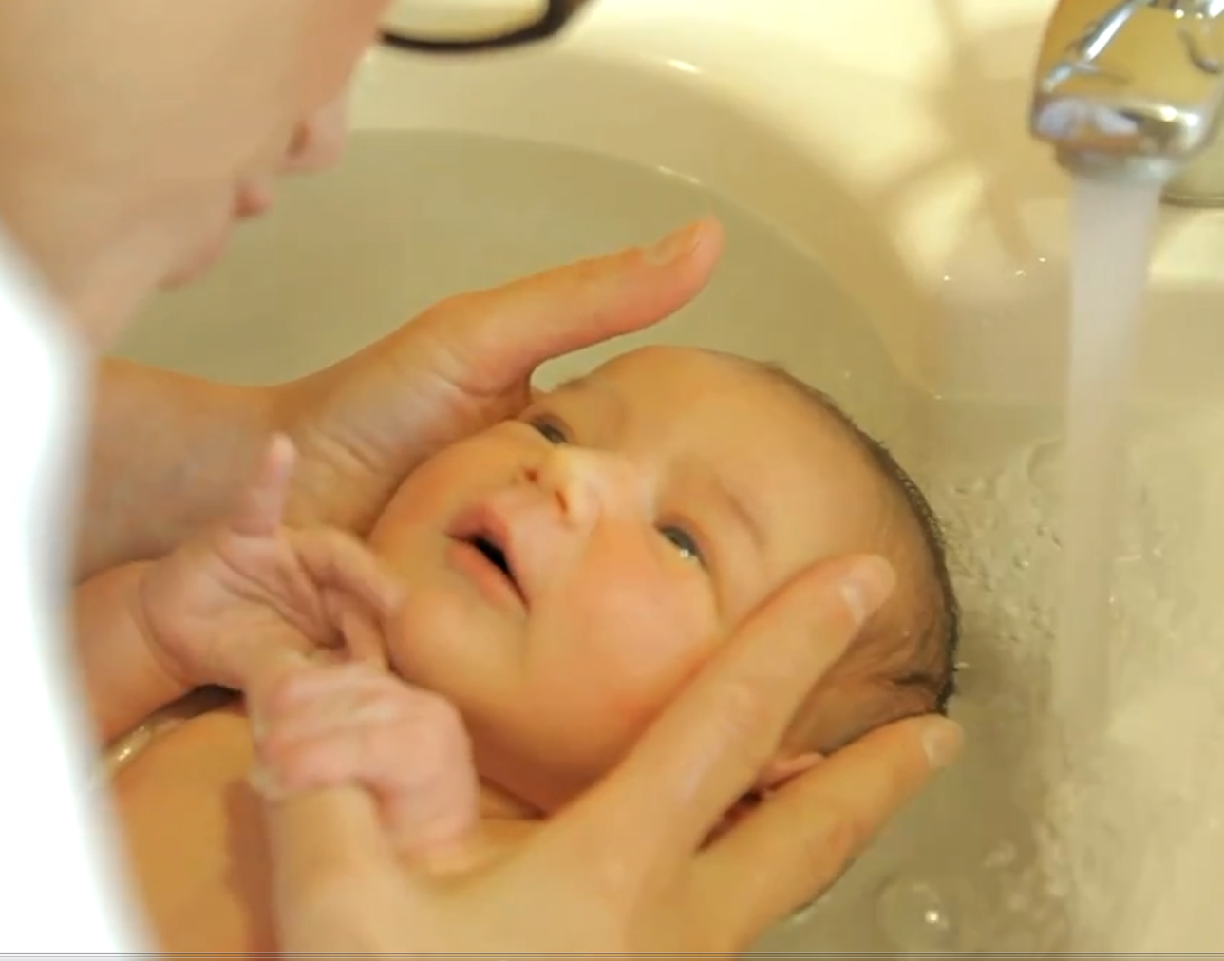
Love your ego!
Look with attention at the video.
Identify yourself with the baby.
Thalasso Bain baby by Sonia

Slide 15
Breathe and establish rapport with yourself
Gather energy with each new inhale.
With each exhale place yourself completely new into the world.
Do this while you are going through all neurological levels:
Environment
Behaviour
Skills
Values and beliefs
Identity
Mission

Slide 16
Synesthesia
Which representation systems are linked?
‘Hear then with your hands’
(Lucebert)
Gratitude is a way of looking at the world
(David DeWulf)
At → K
K → V
‘Emotions are cheering
Feelings whisper
(Olaf Hoensen )
K →A → K →A

Slide 17
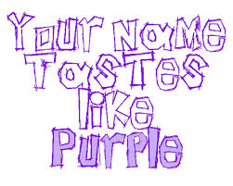
Which representationsystems?
Synaesthesia is a form of expressing in which the sensory effects of the representation system are exchanged or mixed.

Slide 18
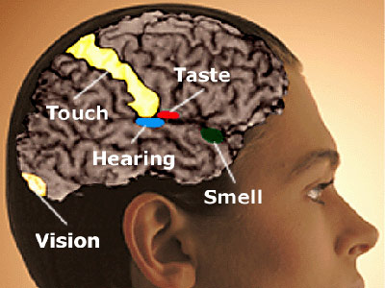
Synesthesia 1
K
V

Slide 19
Synesthesia 2
A
V

Slide 20
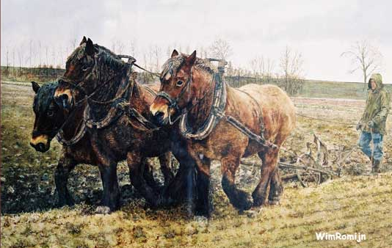
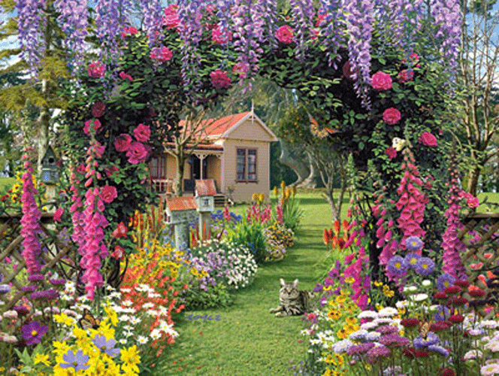
Rapport with your voice
AAAAAAAAaaaa : The sun emerging from the clouds.
OOOOOooooo: Big strong horses pulling a plough
MMMMmmmm: A beautiful flower garden in which all the colours are in harmony with each other.

Slide 21
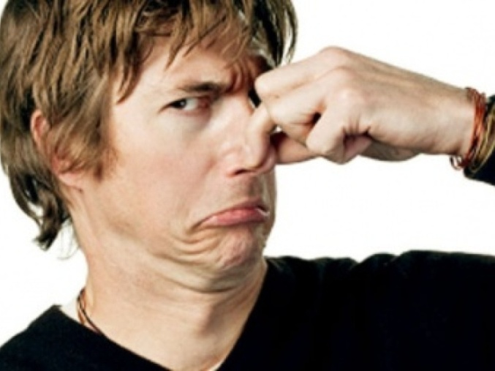
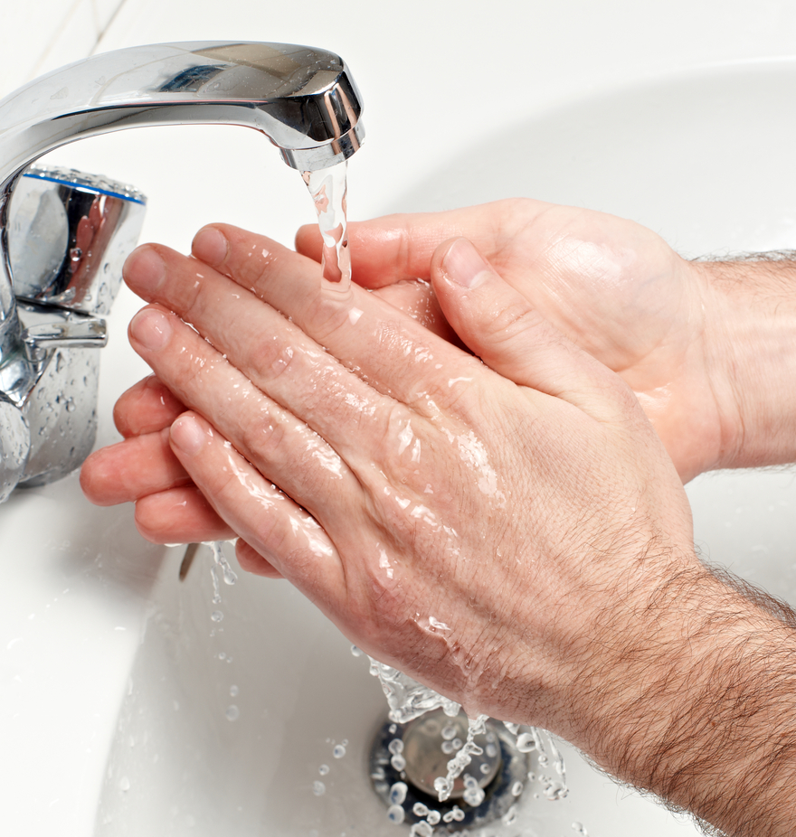
About rotten eggs
Think about a difficult time you had. Give it a number on a scale of one to ten, being one terribly difficult and ten as a beautiful learning moment.
2. Take the move to drink some water, wash your hands and face.
3. Think again about the same memory and give it a number on the same scale.

Slide 22
Becoming more mild about yourself
Make an internal representation of a joyful and pleasant occurrence,
Include bright colours, and let it move and position yourself in it. Just enjoy it a bit longer.
Think of less empowering thoughts you have had about yourself. Also create a matching image. Think about the exceptions, think about what these thoughts have brought you, and reflect to yourself that this was your best decision. Thank the thought and say goodbye to it.
Decide which milder or more empowering thought you could use to think instead. Then for a moment think back of the internal representation of the pleasant occurrence and enjoy it.
Notice how your mood has changed.

Slide 23
Love your ego
Exercise:
What is the difference between the first half (in Italic) and the second half (underlined) of the same sentences bellow.
What is the difference between an intelligent participant in a conversation, experienced by most participants, and someone who has the impression that he sounds intelligent?
What is the difference between someone who is liked by others and some who thinks that he is being nice?
What is the difference between a person who is considered brilliant by many and someone who considers himself to be brilliant?

Slide 24
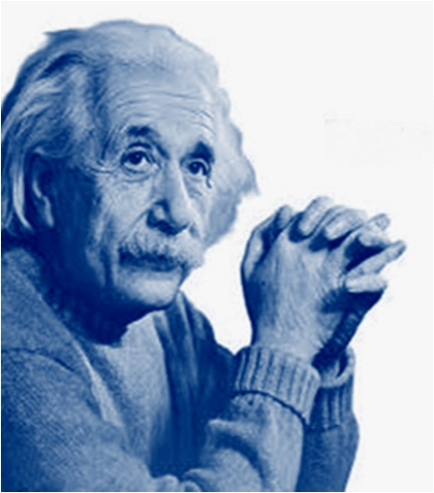
Ego and Knowledge

Slide 25
How is your vision to men?

Slide 26
Cut your ego or your relationship?

Slide 27
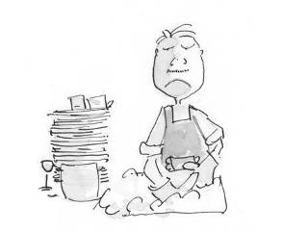
Mapping across
From dislike to like
Make this resource available in another context
Resource: the pleasure you have when you are dancing.
Take the resource to another context: getting pleasure in washing dishes

Slide 28
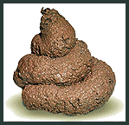
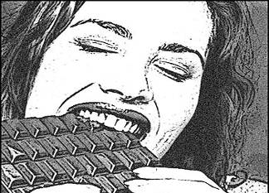
Mapping across
From like to dislike
Make this resource available in another context
Make the picture of chocolate eating smelling, colorful and small
Resource: the aversion for dog shit
Take the resource to another context: getting aversion to chocolate addiction

Slide 29
From dislike to liking (1)
Aversion to dog shit
Transfer aversion to chocolate addiction
2
1
Small
Black-and-white
Stationary
Large
Colour
Moving

Slide 30
From dislike to liking (1)
Think of something you dislike and that you would change this in liking.
Make an image of the situation you do dislike, look for the submodalities in the image.
Then look for something you really like very much, it is not necessary that the topic should be connected to the first image.
Make an image of this situation. Look for the sub-modalities in this image.
Look for the drivers (the submodalities which are different.
Then bring the submodalities of the image / situation you like to the situation you don’t like.
Test: Think of the task you first disliked. How do you feel about it?

Slide 31
Submodalities
Is there an image? V = Visual
Associated / Disassociated
Framed or Unbounded
Black & White or Color
Bright or Dim
Size of Picture
Near or Far
Location
Moving or Still
If a Movie-Fast/Normal/Slow
Focused or Defocused
From beneath of above, from the left or from the right side seen
3-Dimensional or Flat
Is there a sound? A = Auditive
Loud or Soft
Rhythm
Emphasis on specific words
Fast or Slow
Pauses
High or Low Pitch
Timbre
Location
Direction
Duration
Internal or External
Verbal or Tonal
Stereo or Mono
Near or Far
Clarity
Is there a feeling? K = Kinesthetic
Temperature: Hot or Cold
Texture: Smooth or Rough
Vibration
Pressure
Movement
Duration
Intensity, Strong or Weak
Size
Shape
Weight: Heavy or Light
Internal or external
Constant or Intermittent
Location
Large Area or Small Area

Slide 32
Reflection of the day
Look back on what we did today.
Where and how can you use the different exercises?
Write it down for yourself.

