Slide 1
“Develop your unlimited powers even better”
Respect for the model of the world of the other and of myself
Solution focused work
Ho’oponopono
Dar Al Amal
Day 5, 2018

Slide 2
Good and New
In pairs, 2 minutes each.
Focus on a recent event, which was good and new, in which you felt energy, happiness of joy.
Share the title of your experience and show the emotion on your face or in a movement.

Slide 3
Open Frame
Questions
Events
Short stories
Share a real life experience to reflect at it from the point of view of different NLP models and techniques.
Purpose: apply NLP in your own reality.

Slide 4
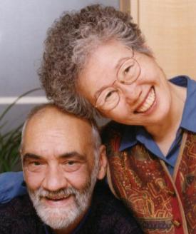
Solution focused work
P - Problems are acknowledged but NOT analyzed
O - Outcomes are specified
W - Where are you now on the scale?
E - Exceptions to the problem are keys to solutions
R - Relationships are enhanced and made productive
S - Small steps forward lead to larger change
Powers

Slide 5
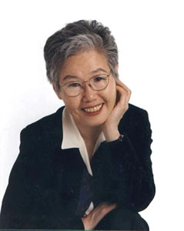
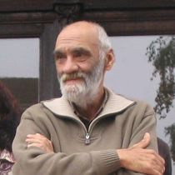
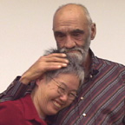
Van focussen op het probleem
naar focussen op de oplossing
Oplossingsgericht werken,
door Steve de Shazer en
Kim Insoo Berger

Slide 6
What do you do with a problem?
Throw it away
Where are you going to direct your attention?
Solution!

Slide 7
Assumptions of SFW
The assumptions of the techniques of Solution Focused Work are simple.
When something is not broken, don’t repair it.
Stop doing what does not work, do something different
Do more of what works well
Learn from others what works and teach others what you know is working.
Goals:
Generate hope for change
Respectful and authentic attention
Give the other the feeling that he or she is understood.

Slide 8
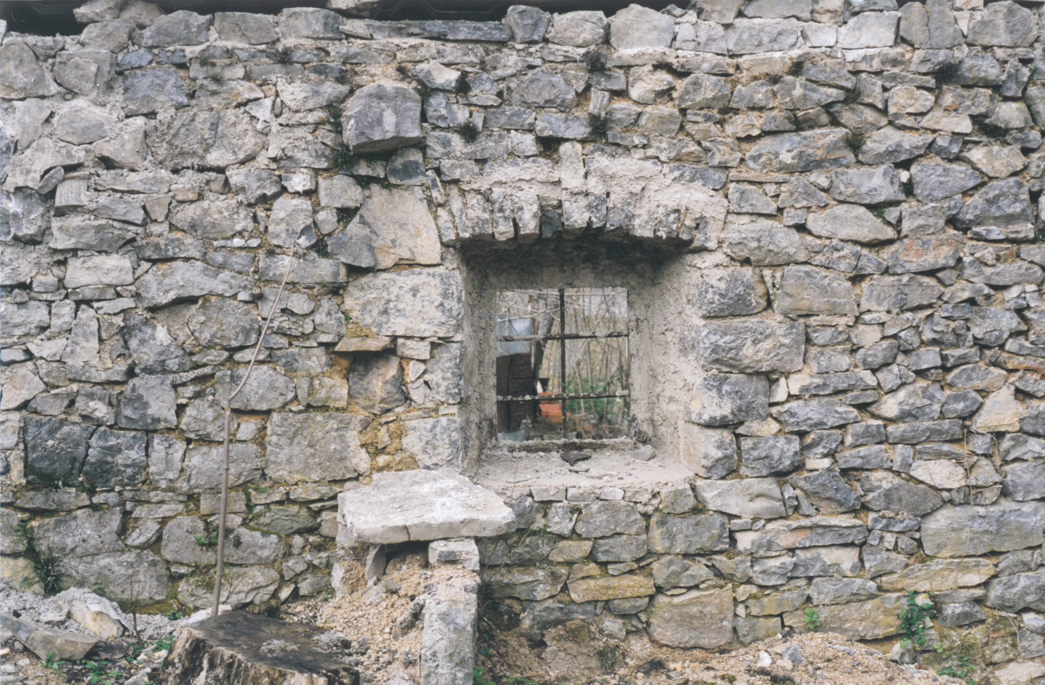
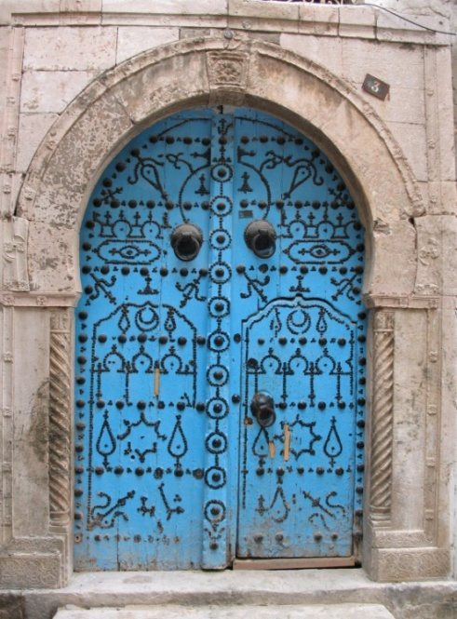
“Do you focus on the walls?
………….or on the door?”

Slide 9
Walking the scale
Everyone thinks of something which you would like to do better
Imagine a scale from 0 to 10 in this room.
Find a place in the room indicating the position where you are now in relation to your goal.
What did you do get on the place where you are now?
Stand on 10.
How do you know that you achieved your goal?
Stand again on the Now position.
Did you ever stand on a higher position than where you are now? (Very often we have had better results than where we are now: earlier successes, which we tend to forget). How was that? What did you do at that time?
What do you need to reach a step higher on the scale?
Visualize for yourself how you are going to do that.

Slide 10
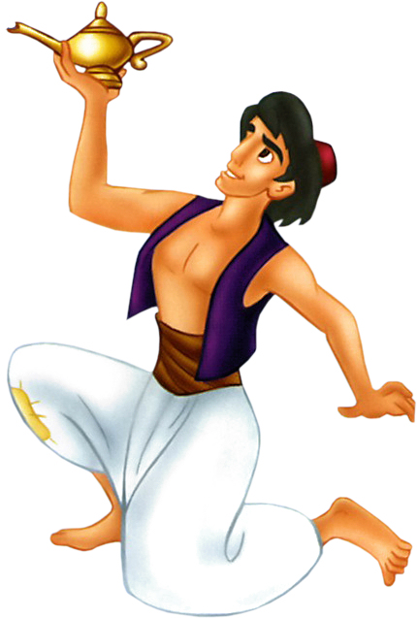
The Miracle Question
Imagine that a miracle has happened ………

Slide 11
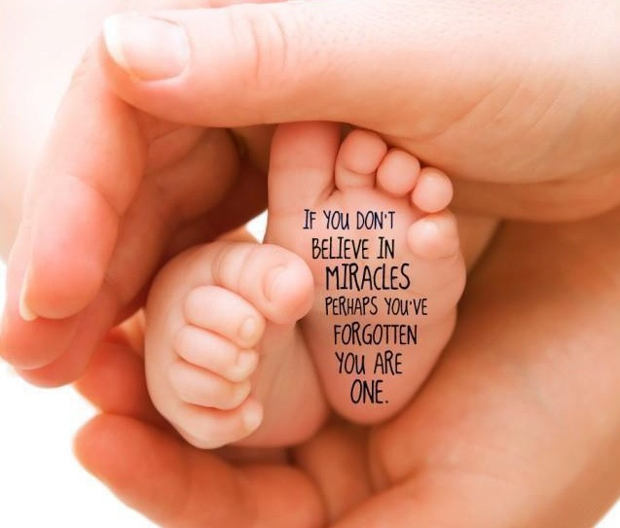
A miracle

Slide 12
Major ideas of SFW

Slide 13
Ho’o Pono pono
Doctor Stanley Ihaleakala Hew Len

Slide 14
How it works
Higher Self Zelf
Higher Self seen as the father
Conscious Mind seen as the mother, taking care of her child
Unconscious Mind, seen as the child that communicates with the father
Conscious Mind
Unconscious
Higher Self
Life energy coming from Mission /Spirituality /your Source/ your Higher Self
Conscious Mind
Contact with your Higher Self (mission/spirituality/Source) is impossible because of a blockade of the connection between the conscious and the unconscious mind. (This blockade comes from negative emotions and limiting decisions)
Sub-conscious

Slide 15
Ho’o Pono pono
Ho’o pono pono
All problems begin as thought
All thoughts are imbued with memories,
memories of persons, places or things.
When you do Ho’o po pono
Divinity takes the painful thought
and neutralizes it
You don’t have to know
what the problem is
just notice any problem you are
experiencing mentally, physically,
emotionally or whatever.
Once you notice, your responsibility is
to immediately begin to clean your memories
by saying:
“I’m sorry.
Please forgive me.
I love you.
Thank you.
Repeat
until the energy is clean.

Slide 16
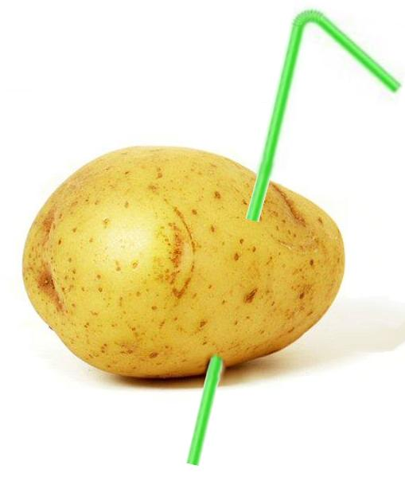
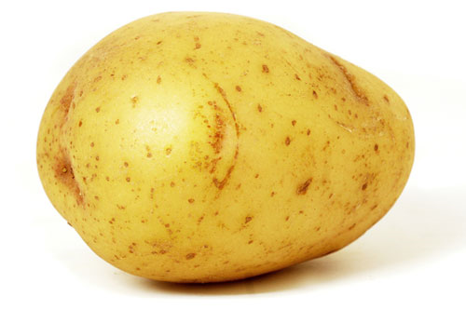
Mental power

Slide 17
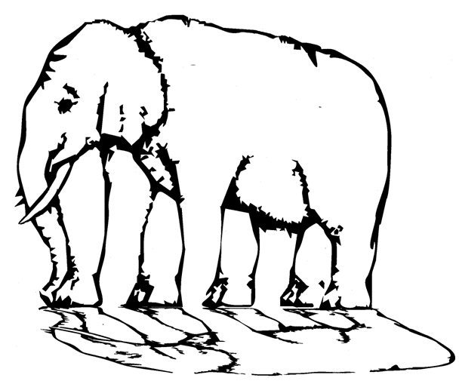
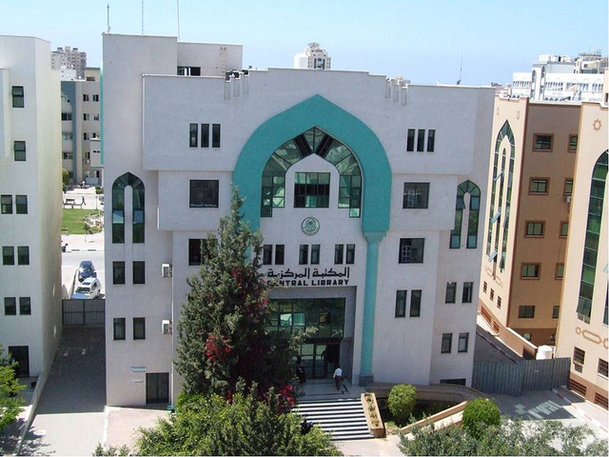
‘Develop your unlimited powers even better every day after the course’
End of the NLP course,
Start of realization and integration
From imagination to realization

Slide 18
Dare to jump to the solution

