Slide 1
“Develop your unlimited powers even better”
Respect for the model of the world of the other and of myself
Changing sub modalities
Strategies
Dar Al Amal
Day 4, 2017

Slide 2
Good and New
In pairs, 2 minutes each.
Focus on a recent event, which was good and new, in which you felt energy, happiness of joy.
Share the title of your experience and show the emotion on your face or in a movement.

Slide 3
Open Frame
Questions
Events
Short stories
Share a real life experience to reflect at it from the point of view of different NLP models and techniques.
Purpose: apply NLP in your own reality.

Slide 4
Changing sub-modalities
Which the submodalities did we change here?
Visual submodalities:
Size
Contrast,
Brightness

Slide 5
How do we code memories? How do we order the memories? And How do we give meaning to them?
Sub modalities

Slide 6
How do we Communicate?
Change the
Sub modalities
of your internal representation
FILTERS
Internal
Representaion
Delete
Deform
Generalise
External
signal
State, emotions
Other emotional state
time/space matter/energy
time/space matter/energy
language
memories
decisions
metaprograms
values
and beliefs
attitudes
Physiology
Different physiology
Behaviour
Other behaviour

Slide 7
Strengthen your beliefs
Working with changing sub modalities of your internal representations
Visual sub modalities
Location
Size of the image
Colour or black and white. Intensity of the colour
Contrast, right or faint
3-Dimensional or flat
Associated or dissociated
With a frame of panoramic
Distance to the image
Still or moving. Movement quick or slowly
The corner from which you look at the image

Slide 8
Which visual sub modalities do you notice?

Slide 9
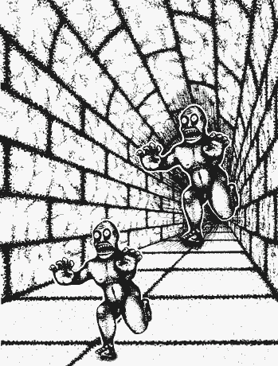
Visual sub modalities
Changing sub modalities changes the internal representation
Location
1. Changing the location

Slide 10
Visual sub modalities
Changing sub modalities changes the internal representation
2. Size of the picture
2. Smaller

Slide 11
Visual sub modalities
Changing sub modalities changes the internal representation
3. Clour or black and white
3. From colour to black and white

Slide 12
Visual sub modalities
Changing sub modalities changes the internal representation
4. Contrast
4. Diminishing contrast

Slide 13
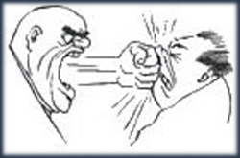
Weakening your disempowering beliefs
Changing sub modalities changes the internal representation
Exercise 35
smaller
contrast
S W I S H

Slide 14
Examples of disempowering visual memories
You witnessed an accident
You saw violence
You saw someone who
suffered pain
was sad or afraid
Stay in a hospital
A bad dream
Ghosts
A nasty film

Slide 15
Blow away a negative memory
Exercise 35

Slide 16
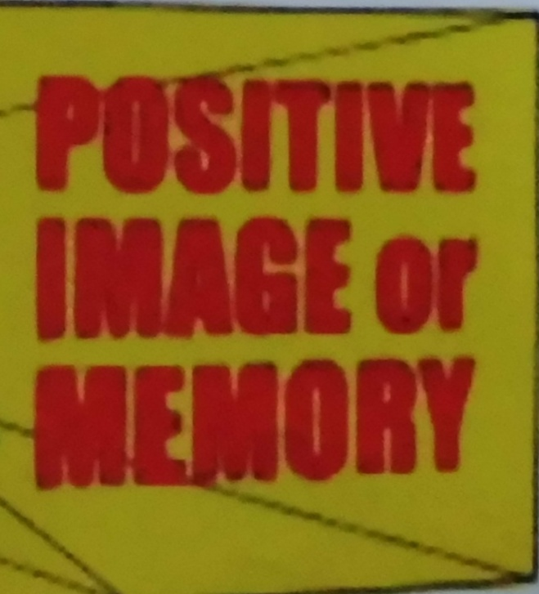
Strengthening a positive visual memory
Size
bigger

Slide 17
Strengthening a positive visual memory
2. contrast
more contrast

Slide 18
Strengthening a positive visual memory
3. colour
More colour

Slide 19
Strengthening a positive visual memory
Bigger and more contrast
bigger
S W I S H

Slide 20
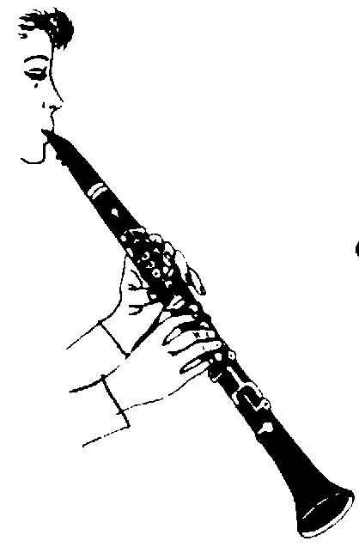
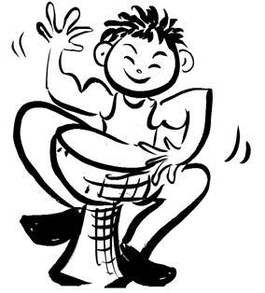
Auditive submodalities
Volume
Height
Internal or external
Timbre (quality)
Cadence (interruptions)
Rhythm
Tempo
Silence
Tonality
Location
Unicity of sound
Length
In music: p for soft and f for strong

Slide 21
Examples of negative auditive memories
A shout
A cry
A scream
Scolding
Roaring
Cursing
Breaking of glass

Slide 22
Weakening auditive memories
Lowering the tune
Diminished volume
Further away
Shorter
Locate the sound externally
Timbre for example from a male voice to a children's voice

Slide 23
Strengthening positive auditive memories
A higher tune
Greater volume
Closer
Longer
Internally

Slide 24
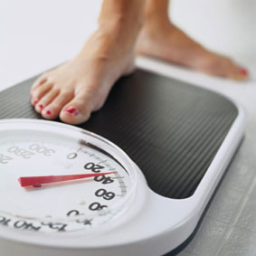
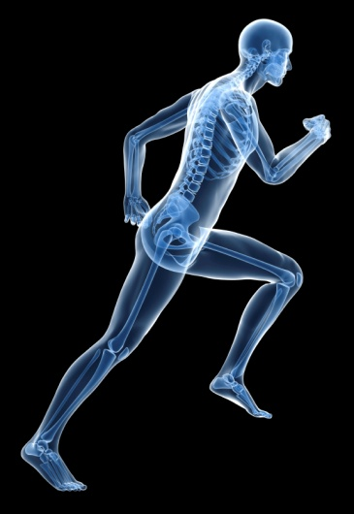
Kinaesthetic sub modalities
Temperature
Texture
Vibration
Pressure
Movement
Duration
Continuous -variably
Intensity
Size
Shape
Weight
Internal or external

Slide 25
Examples of negative kinaesthetic memories
Pain
Cold
Fear
Anger
Sadness
Depressive
Exhausted
Heavy
Paralysed

Slide 26
Weakening negative kinaesthetic memories
Less intense
Shorter
Softer
Warmer
Make it external
Lighter, less weight
Less energy
Movement
Courage

Slide 27
Strengthen positive kinaesthetic memories
More intense
Make touch more pleasant
Shorter
Warmer
Place it inside
Lighter, less weight
Feel the energy
Move with the memory
Feel the courage of the good memory

Slide 28
Weakening a negative memories
Think of a negative memory or a negative belief.
Make a picture of it, look at the colour and see how far it is away from you.
Make the picture less colourful, diminish the contrast, put it further away.
Blow the picture in the air.

Slide 29
Strengthening a positive belief
Take a belief which you would like to strengthen.
Make a picture of the belief, make it colourful, add movement and sound.
Move the picture nearer to you till it is in your heart or another place in your body which feel good for you.

Slide 30
Changing your reaction to a word
Choose a word which gives you a negative feeling, for example: relationship, colleague, neighbour.
Choose a moment from the past where you had a good feeling when hearing the word relation, you felt nourished, understood.
Make the memory stronger and see what you saw, hear what you heard, feel what you felt.
Let someone say the word relation, or colleague or neighbour
Test what you feel at that moment
You can set an anchor, connecting your thumb and forefinger.

Slide 31
Laughing at your fears
Exercise 37
Think of a moment where you had to laugh and you hardly could stop
Start to laugh and continue with it
Think of something which gives you fear and continue to laugh
Notice how the fear in your head is diminishing

Slide 32
Butterfly Chi-gong
Bow your arms palms up.
Close your fingers carefully, as if you hold a butterfly in your hands.
Open your left-hand slowly and turn the palm forward, sinking a bit through your knees.
Turn your hand and pull it back, while you stretch your legs
Close your fingers carefully.
Do the same with your right-hand and then with both hands together
* Notice how your feet are grounded!

Slide 33
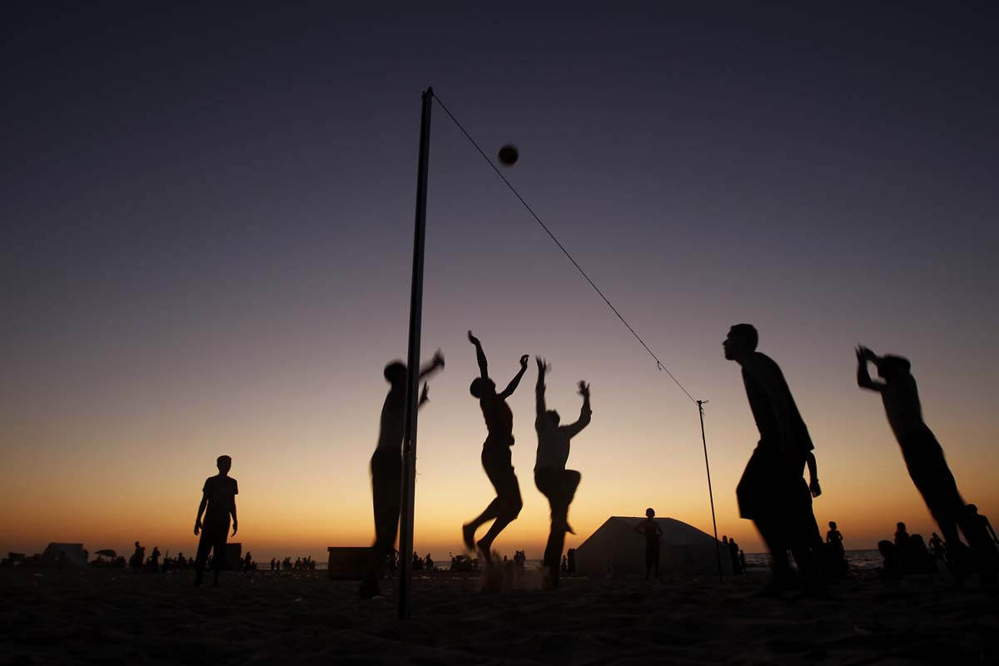
A strategy in NLP is a sequential series of representation systems one follows to achieve a specific goal.

Slide 34
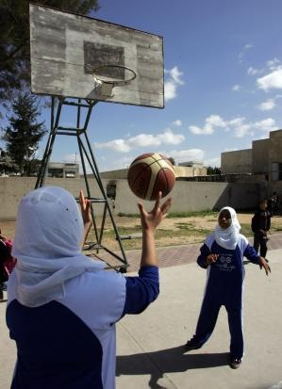
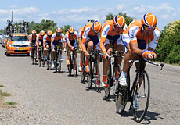
What are their strategies?
Wild geese flying thousands kilometers
Palestinian girls in Gaza playing basket ball
Cyclists in the Tour de France Team Time Race

Slide 35
A strategy is like a number lock
Every time when you use the right number code the lock opens.
If you don’t use the right number code the result will be differently.
You applied the “not opening strategy”.

Slide 36
The ‘TOTE’ model for human behaviour
‘TOTE’ means:
Bijvoorbeeld Koopstrategie:
Input: red shoes
1. (Input)
Test: need, status, convience?
Operate:
2. Test
Ask for the price,
Look at the model,
Listen at the saleswoman,
Talking to one self,
Good Feeling
3. Operate
4. Test
Test: does it meet my criteria criteriavoldoet deze aan de drie criteria?
5. Exit
Exit: yes I buy the shoes
1. Input
+
2. Test
3. Operate
4. Test
5. Exit
-

Slide 37
Sleeping strategy: Sawasana

Slide 38
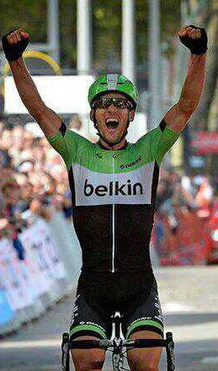
A success strategy
World Ports Classic September 2013
At the start: I feel ill Ki
180 km to go Ad
Last 20 km alone Ki,
Very unlikely to have success Ad
Physically very strong Ki
Look behind Ve
Video

Slide 39
Possible strategies for:
Eating Sports Health Wealth Poverty Peace War | Loving Decisions Relaxation Motivation Tension | Diseases Depression Sales Giving Receiving | Pleasure Forget Sex Boredom Food Marketing | Communication Good Luck Cycling upwind Creativity

Slide 40
A Shopping strategy
To discover a Strategy
Discovering a strategy, we use the term ‘to elicit’; we need to ask some questions:
Example of a purchase strategy:
I saw (in the shop) some shiny red shoes (= Visual-external, Ve).
I asked the price (Auditory-external, A^{e}).
I said to myself: "Yes this is it" (Auditory-internal, A^{i}).
Then I was entirely sure (Kinesthetic-internal, K^{i}) that I wanted to buy these shoes.

Slide 41
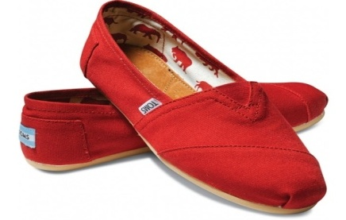
Elicit a shopping strategy
K⁺
It feels good
Ve
Visual
external
A^{e}
Auditive external
A^{i}
Auditive internal
K^{i}
Kinesthetic internal

Slide 42
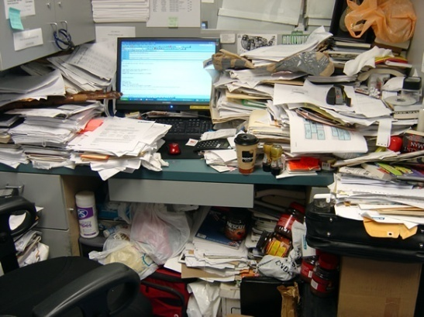
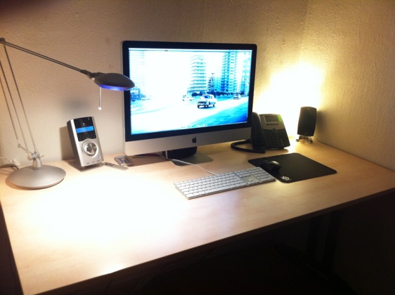
How do you motivate yourself?
Cleaning up your
desk, a big job?
Not if you imagine
a clean desk!

Slide 43
Cleaning Strategy
Un- successful cleaning strategy
Successful cleaning strategy
1. I see chaos on my desk
1. I see chaos on my desk
2. I get a bad feeling
2. I imagine what it looks like if it is cleaned
3. I say to myself ‘ I will tidy at another moment’
3. I get a good feeling
4. I say to myself ‘ I can start with a part of it Now’
Ve
Visual
external
K^{i} Kinesthetic internal
At^{i}
Auditive internal
Ve
Visuel
external
V^{i}
Visueal
internal
K^{i} Kinesthetic internal
At^{i}
Auditive internal

Slide 44
Effective Strategies
Ineffective motivation strategies:
Disaster scenario: imagine if I don’t do it or if I postpone it even longer;
"Imagine that I do it" instead of "imagine that it is finished";
Dictator style: voices in my head with must, have to, need to, should
Thinking the 'big picture': seeing the entire job.
Successful motivation strategies:
Imagine that it is already ' finished '. V^{i}
Speak to yourself in a motivating manner. At^{i}
Feel what you feel when the job is 'finished' and enjoy it. K^{i}
Take a small part to start with Ki+
A journey of a thousand miles begins with the first step
Chinese Philosopher: Laozi, 604 – 531 before Chr.
Discover your unknown powers by taking the first step.

Slide 45
Elicit and install a success strategy
Look for a task which you tend to postpone always, a task with an unsuccessful strategy.
Look for a task in which you were successful.
Elicit the steps in this successful task (VAKOG specific, internal or external).
Make a picture of the negative consequences of not doing the unpleasant task (in 1, with the unsuccessful strategy).
Add motivating views, sounds, and feelings (VAKOG) to the image, taken from the successful strategy from step 2.
Add what is so attractive in finishing the job or the task.
Make this image very clear.
What is the next step?
Mention all the steps several times, imagining doing the task in the new success strategy

