Slide 1
“Develop your unlimited powers even better”
Respect for the model of the world of the other and of myself
Speaking as a jackal or as a giraffe
Video Technique
Dar Al Amal
Day 3, 2017

Slide 2
Good and New
In pairs, 2 minutes each.
Focus on a recent event, which was good and new, in which you felt energy, happiness of joy.
Share the title of your experience and show the emotion on your face or in a movement.

Slide 3
Open Frame
Questions
Events
Short stories
Share a real life experience to reflect at it from the point of view of different NLP models and techniques.
Purpose: apply NLP in your own reality.

Slide 5
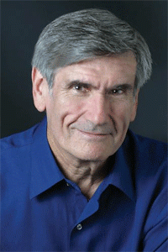
Nonviolent Communication
Marshall Rosenberg
Psychologist, (1934 – 2015)
Initiator of Non Violent Communication (NVC),
Since 1960 in 60 countries.
The objective is living and communicating peacefully and compassionately.

Slide 7
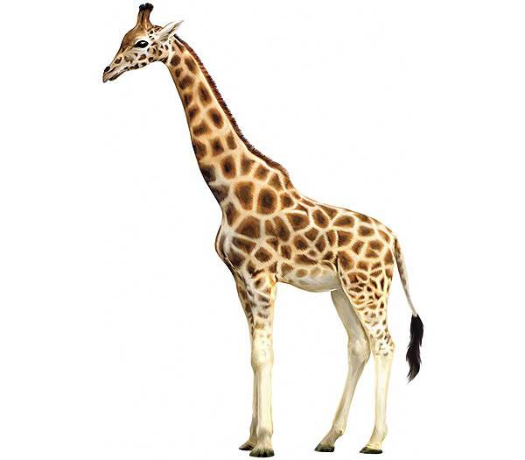
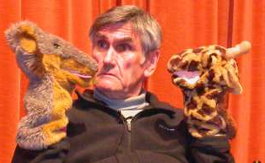
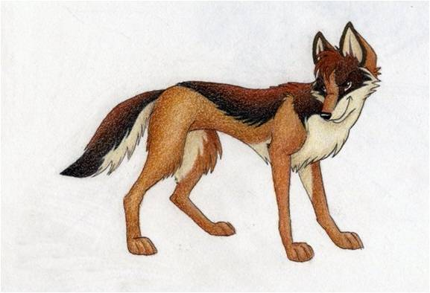
Non Violent Communication
´You messages´
´I´ messages
Giraffe
Jackal

Slide 8
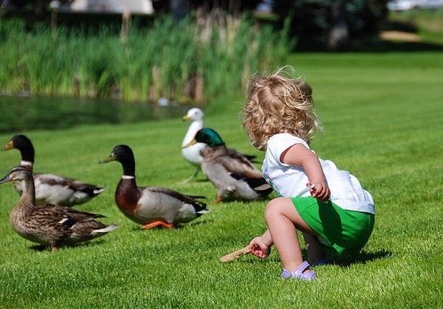
The core of Non-Violent Communication
While I was waiting……….
Do only those things which can do with the joy of a child who is feeding ducks.

Slide 9
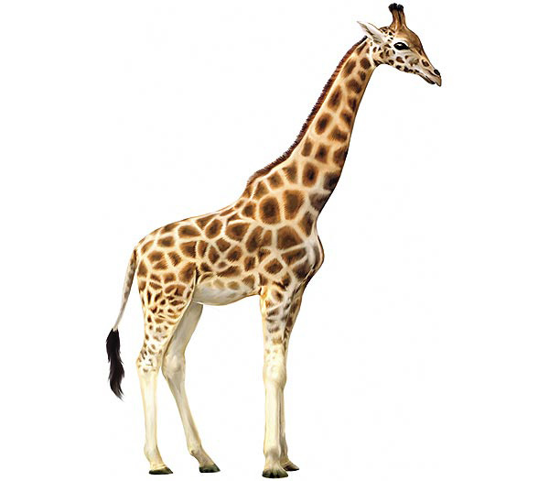
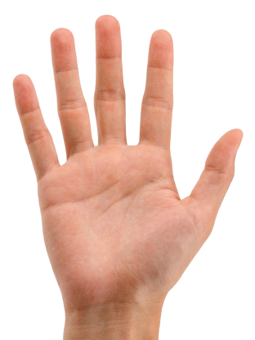
The steps of the Giraffe
Non-Violent Communication
Observing
Without judging or interpreting
“I see …… “
“I hear ……”
2. Feeling
Recognise your feelings
Acknowledge your feelings
“I am feeling …………. “
Acknowledge needs
Connect your feelings with your needs
“I feel …… because I need ………“
4. Options
Which options do I have to fulfil my needs?
2
3
4
1
5
5. Make a request or do something myself
“Are you willing to do ….?“
“I am going to do ……!”

Slide 10
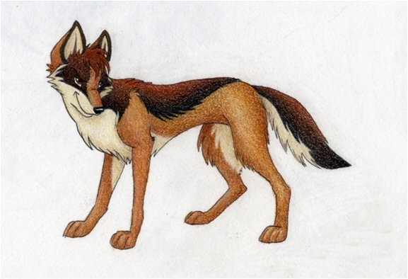
Communicating with judgments
The pitfalls of the jackal
1. Observing with judgments
“ I see that you never do the right thing!”
2. Mix feelings with thinking
Mind reading: “I see that you don’t like to do it.”
3. The other is responsible for my needs
“I want that you don’t make me angry.”
4. There is only one option
“Only you can do it ........................, I am not able to do it.”
5. A demand not a request
“I want that you do it immediately and in my way!

Slide 11
Giving from your heart
Exercise 22
Which examples do you have that you were living from your heart?

Slide 12
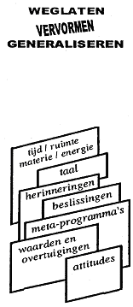
Map
NVC and the NLP Communication model
Territory
FILTERS
Internal
Representaion
Delete
Deform
Generalise
External
signal
State, emotions
time/space matter/energy
language
memories
decisions
metaprograms
values
and beliefs
attitudes
Physiology
Behaviour

Slide 13
NLP-communication model and NVC
Filters:
Delete
Distort (deform)
Generalize
In and out of the box
Three observational positions

Slide 14
26. Exercise: Observe your thoughts
Step 1.
A closes her or his eyes and tells B what thoughts come up. Mention all the thoughts which come up. B writes A’s thoughts in A’s notebook. After 3 minutes change roles
For step 1 you take 3 minutes each way.
Step 2
A and B look at the thoughts and see which of the thoughts are giving energy and which thoughts are taking energy.
+ gives energy
+ neutral
- takes energy

Slide 15
Observe your own thoughts
What did this exercise for you?

Slide 16
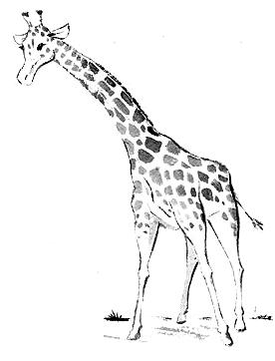
Own feelings
I take the responsibility for my own feelings
I feel joyful
I am angry

Slide 17
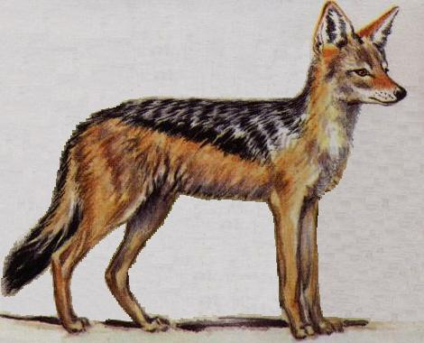
Thought feelings
I feel that you do me wrong
I feel that you make me angry
I feel that you don’t give me enough attention.

Slide 18
Needs
I have needs and I take responsibility to fulfill my needs.
Authenticity
Emotional freedom
Physical safety and protection
To play
Spiritual connection
Celebrating
Mourning

Slide 19
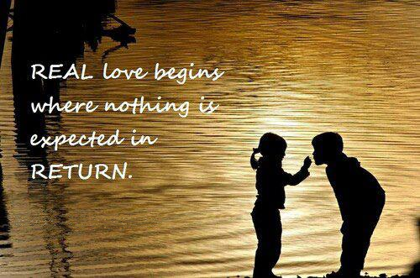
Basic Needs (Avi Butavia)
1 Love
2 Safety
3 Acknowledgement

Slide 20
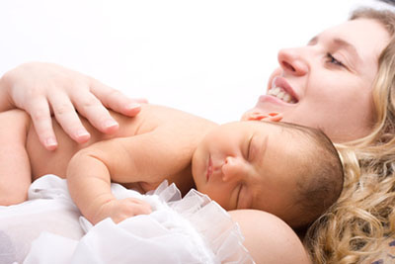
Basic Needs
(Avi Butavia)
1 Love
2 Safety
3 Acknowledgment

Slide 21
Basic Needs (Avi Butavia)
1 Love
2 Safety
3 Acknowledgement

Slide 22
……Yes, but….
Make it:
………Yes, and ……….
Never say a ‘but’ in an angry face.
“Do not think of a blue elephant”
Think of purple hat.

Slide 23
What does NLP tell us?
Choose the side of the cause, take responsibility for your own feelings
At the side of the result: You choose for being the victim of the situation.
You are not able to change it, the other needs to do it. You feel powerless.
Standing at the side of the cause means: you can change yourself.
In the language of the giraffe: I am responsible for my own feelings..
The other may be involved, but is not responsible for my feelings.
For example: You say “He ruins my whole day.” You feel the victim and you are at the side of the result.
When you say “I am choosing to be in a good mood.” You stand at the side of the cause. You determine how you feel.

Slide 24
The giraffe as a metaphor
Head
Observation
Heart
Feeling
Belly
Needs
Legs
Options

Slide 25
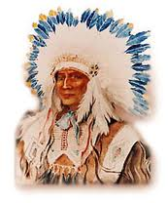
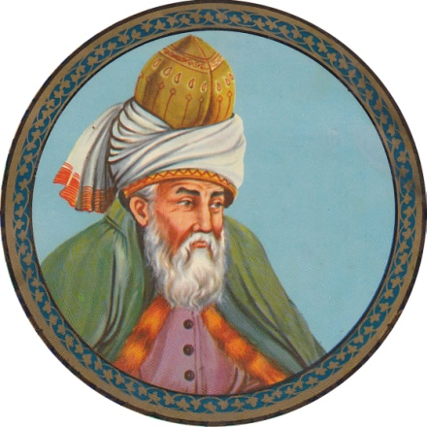
White Eagle and Rumi
24. Exercise: Inhale the Light…..
Out beyond ideas of wrongdoing, and right doing, there is a field. I will meet you there.
-- Jalāl ad-Dīn Muhammad Rūmī (1207–1273) (جلال الدین محمد رومی),

Slide 26
NVC → NLP
Jackal:
1e observation position,
strongly associated: in the box
Giraffe:
3e + 2e +1e
dissociated: out of the box

Slide 27
Exercise 30
Clear request 10, 7, 1, 6, 2
Clear demand 4, 5
Unclear request 6, 9
Tonality is important!

Slide 28
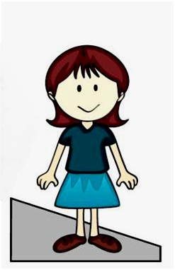
In the box -→ out the box
Intensity from the emotion
Time
Discharge
Speaking Therapy
Praying
Reframing
Meditating
Sleeping
etc.
In the box
Out the box
Situation A: You are entirely in the 1st position (the “ I” position).
You are angry, sad, afraid, etc. you see just your own emotion, there is nothing else.
Situation B: You are able to look above your emotion, your are able to switch from the 1st position (the “ I” position), to the 2nd (the You position) and 3rd position (the helicopter view).
You are not your anger, sadness, fear, etc. you see your own emotion, and a lot of other things, you overlook the situation.

Slide 29
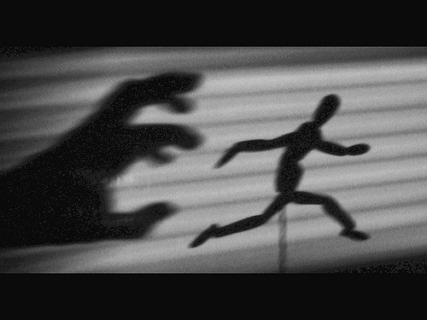

Slide 30
3
Third Position
Dissociated of yourself and from the other
Also called: The meta position, the observer or helicopter view.
المركز الثالث :
اعزل نفسك عن الأخرين
ويسمى أيضا :
موقف الفوقية .
المراقب .
1
2
First Position
Associated in your self
المركز الأول :
مرتبط مع نفسك
Second Position Associated in the other
المركز الثاني
مرتبط مع الآخر

Slide 31
Exercises 28, 29, 30, 31
28. Exercise: Observation or an Interpretation.
29. Exercise: Which phrase is a feeling or a non-feeling.
30. Exercise: clear request or a demand / unclear request
31. Exercise: Taking responsibility

Slide 32
Video technique

Slide 33
How can you process a traumatic experience?
When you did experience a bad situation you have three choices:
1. Either it determines your own future
2. Or it destroys
3. Or you draw strength from it and it makes you stronger

Slide 34
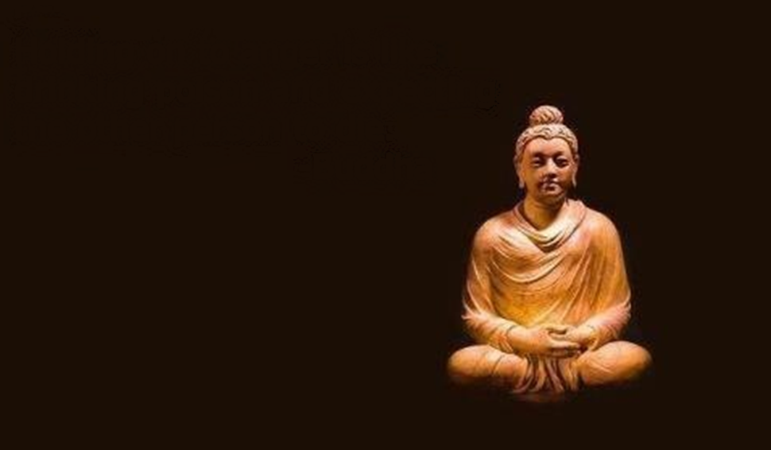
A traumatic experience with anger

Slide 35
Video technique
wall
Screen
memory
Project an internal representation of the past on a wall = ‘video’
To take away the negative energy of this memory
When you speak about yourself in the video use the third person: s/he is doing and s/he feeels like ….

Slide 36
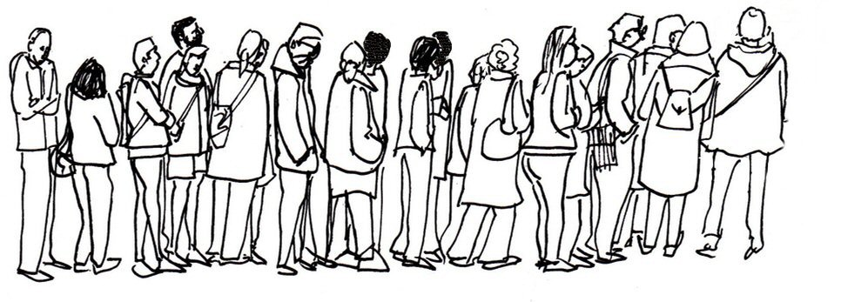
Exercise 33: Associating and Dissociating
Sreen far away
Screen close
What does happen with your feelings?

Slide 37
When do you apply the ‘video technique’?
1. If you have a negative unprocessed experience.
2. If you experienced something and you cannot speak about it.
3. If something happens and it brings you back in the past, and you don’t know what it is about. (trigger or restimulation).
4. If you worry about something in future.

Slide 38
What is a Significant Emotional Event?
SEE
A small or a big event in the past which comes up in your thoughts and ……
You feel emotional, or
You feel paralysed, or
you are not able to think clearly, or
You wake up and you think about it, or
You go to a survival strategy.

Slide 39
Make a video of your internal representation with 5 images
1
2
3
4
5
Before the SEE
Everything was OK
The start of the SEE
The worst part of the SEE
The end of the SEE
After the SEE when it is OK again

Slide 40
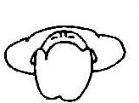
Video techniqu: dissociated projection
1
Before the SEE, everything is OK
2
The start of the SEE
3
The moment of the SEE
4
The end of the SEE
5
After the SEE, when everything is OK.
s/he in the video on the screen
Say something lovingly to s/he on the screen

Slide 41
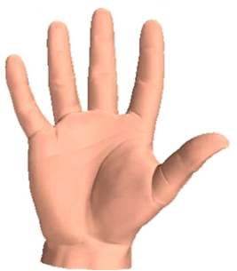
Video technique use your fingers
1. Before the SEE, when everything was still OK
Titles
3
2
4
1
2. The start of the SEE
5
3. The most emotional moment of the SEE
4. The end of the SEE
Mention the five images on each finger of your hand.
Start with 1 to 5, then 5 tot 1.
Take the colour way.
Diminish the contrast.
Take away the movement.
Repeat the pictures 1 to 5 quicker and quicker.
The other way round.
5. After the SEE when everything was OK again

Slide 42
The happiness of feeling free after
processing a trauma

Slide 43
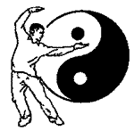
Butterfly-Qigong

