Slide 1
NLP-follow-up course “Develop your unlimited powers even better”
Respect for the model of the world of the other and of myself
Welcome!
Ramallah, Dar Al Amal
Day 1, April 2017

Slide 2
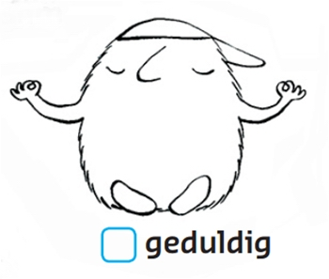
Present yourself …
honest
serious
Present yourself to the group with your most important positive characteristic(s)
smart
sportive
positive
cheerful
modest
spontaneous
sensitive
patient
helpful
social
funny

Slide 3
Which NLP techniques you used most?
Apply presuppositions
Anchoring
Focussing
Becoming wiser
Give a meaning
Letting go
Doing
Accepting
How to change the structure?
Respecting
Reframing
Change your internal representation
3 Observational positions
Choosing for higher neurological levels
Building Rapport
Milton language
Building empowering beliefs
Meta model
Accessing inner resources

Slide 4
What are your goals with this NLP course?
Use positive words (avoid using not and no)

Slide 5
Three life questions
What do I focus on?
Which meaning do I give it?
What do I do with it?
You can use the scheme in your book to work on different topics.
Subject 1 | 2 | 3
What do I focus on? | What do I focus on? | What do I focus on?
Which meaning do I give it? | Which meaning do I give it? | Which meaning do I give it?
What do I do with it? | What do I do with it? | What do I do with it?

Slide 6
What do people indicate as factors for success?
Indicate your own factors for success.
Give the different factors 1, 2, 3, 4, 5 in order of importance.
Authenticity
Mission, goal
Perseverance
Honesty, openness
Courage, boldness, guts
Passion, enthusiasm, drive
Acceptance, respect
Pleasure, humor, enjoying
1 2 3 4 5 6 7 8 9 10
Wisdom, knowledge, insight
(Self)trust, belief, conviction
4 Perseverance
8 Authenticity
3 Mission, goal
9 Acceptance, respect
2 Pleasure, humor, enjoying
7 Honesty, openness
1 (Self)trust, belief, conviction
5 Wisdom, knowledge, insight
10 Courage, boldness, guts
6 Passion, enthusiasm, drive

Slide 7
How to advance in NLP?
Possible solution
(f)
(h)
(e)
(c)
(i)
(b)
(j)
(d)
(a)
(g)
Understanding the results of your communication
Consistent and congruent behavior
Predictable performance
Eliminating negative emotions
Ability to work with people and inspire them
Accepting the present as it is
Completeness as a person
Ability to reach the desired goals
Determination to achieve personal growth
Ability to create a strong connection with others

Slide 8
NLP Presuppositions
Respect for somebody else’s model of the world and that of yourself.
Exercise:
Analyze the differences between the models of the world of the people involved in a conflict situation.
See how much you can respect these differences.

Slide 9
Three important NLP presuppositions
The meaning of your communication is the response that you get.
Your mind and your body are parts of the same system, you cannot separate them.
The map is not the territory. Every person has their own individual map of the world.
There is no single correct map of the world.

Slide 10
NLP Presupposition 17:
It is as it is,
Accept the situation as it is.
(Text adapted from Luise Hay)

Slide 11
Exercise: Using pre-suppositions for a case
Step into the inner circle of the case
Associate with the case and the context in which it occurs to create an anchor.
Step into pre-supposition circle 1.
Look at yourself in the problem context (dissociated), through the filters of the pre-supposition.
Step into presupposition 4, apply the presupposition.
Do the same with 6, 7 and 8.
Access all the pre-suppositions fully, and then step into the inner circle, integrating the pre-supposition.
Continue so that you have accessed and integrated all circles with the pre-suppositions useful in this case.
4 The map is not the territory
1 Respect for the model of the world
6 Best choice in that moment and in that situation
Circle for the case
8 Differentiate between behavior and person
7 Positive intention

Slide 12
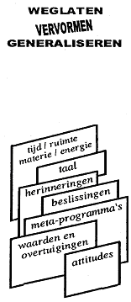
Map
How do we Communicate?
Territory
FILTERS
Internal
Representaion
Delete
Deform
Generalise
External
signal
State, emotions
time/space matter/energy
language
memories
decisions
metaprograms
values
and beliefs
attitudes
Physiology
Behaviour

Slide 13
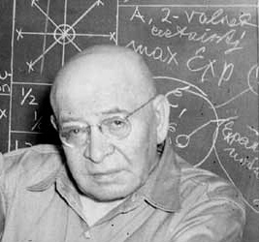
The map is not the territory
Map
Territory
Alfred Korzybski:
We can built bridges and beautiful buildings….
And we make war and we don’t have possibilities to make peace.
The map is not the territory (reality).
We make the map.
We make images and ideas about our enemies, and our enemies do the same!

Slide 14
Alfred Korzybski
What ever you say it is,
…………….. it is not.

Slide 15
Neurological levels
6 Mission
That what gives direction to our life: Mission, objective, goal
5 Identity
Personality: ‘I am’. At this level emotions play a role, your feeling about yourself..
4 Values and beliefs
4a Norms and Values. Everything which is not factual. Nominalisations.
4b Beliefs. What is important for you and what you take as true.
3 Skills
skills, resources, qualities, what you are able to do.
2 Behaviour
All actions of people which you can see and hear, that what you can show on video.
1 Environment
Everything around you, the place, the time, the people with whom you are.

Slide 16
9. Recognising the Neurological Levels
Exercise
Indicate the neurological levels of the following expressions.
You could indicate for some of the expressions several levels.
1. In another company I would never manage to reach the top so quickly.
Belief related to the environment
2. For his work he is some days in Aman, after that he flies to Cairo.
Environment
3. She is a person who wants to take care of others.
Identity
4. Who is looking at this film, will quickly start to laugh.
Behaviour
5. Girls don’t have aptitude for mathematics.
Belief about identity
6. Where is the bathroom?
Environment
8. In top sport mentality is important.
Belief about values
9. I would like to do this, however I am sure that I will never succeed.
Belief about skills
10. Is the door locked and did we switch of the electricity?
Environment

Slide 17
10. Exercise ‘Distinguish Neurological Levels’
Easily we mix skills and behaviour with Identity.
we do say sometimes: “You are crazy“, while we mean to sau: “What you do is crazy”
Examples
1 “You are a fool “, (identity level)
“You behave like a fool “
“Yesterday wile drinking coffee, your behaviour was not very clever”
2 “ You are unmotivated “,
“Your behaviour is unmotivated “
“This morning you could use some motivation”
3 “ She is a weak in orthography“,
“You made five errors in this tekst. You could inmprove your spelling.”
Confusing behaviour and Skills with identity can be harmful for the self image of the addressed person.
Exercise in pairs:
A: Says one example of a negative judgement on identity level, which you have heard from others or which you say to others yourself.
Say the same on behaviour level
B: Listens and writes them down. Then B reads the sentences out loud to A.
A: Tells how s/he feels while listening to the different sentences on identity level or on behaviour level.

Slide 18
Compliment on behaviour level
And of course…….
To strengthen the self image of someone else, it is positive to say: “You are OK!” or
“You are wonderful!”
You could try the effect of staying close to the facts, chunking down, being more specific.
The person might belief you more easily:
“What you did yesterday was very adequate, because …………..“.

Slide 19
Neurological Levels as a model for analysis
At what level does your problem exist?
Which of the levels is neglected?
At which level(s) is change desirable?
Gregory Bateson:
1. A higher neurological level organizes the information on underlying levels.
2. Change at a lower level can bring change to a higher level
3. Change at a higher level will certainly bring change at all lower levels.

Slide 20
Neurological levels
Mission | What is my goal in my life?
More unconscious
Identity | My self-esteem, my sense of self.
Beliefs & Values | Whether I believe something is possible or impossible. Love, respect, honesty, freedom. Nominalizations.
Capability & Skills | Which capabilities and/or skills do I have for dealing appropriately with an issue?
Behavior | What I do.
Environment | People, places, and time.

Slide 21
Exercise on p.17: Communication at one of the Neurological levels
MISSION: | To what purpose? | I don’t have a anything useful to do with my life!
IDENTITY | Who? | I am worthless
BELIEFS | Why? | Because I retired too early
CAPABILITIES | How? | I have no possibilities to get out of this situation.
BEHAVIOUR | What? | There is nothing I can do about it.
ENVIRONMENT | Where, when? | My house is too small for me, I feel imprisoned.

Slide 22
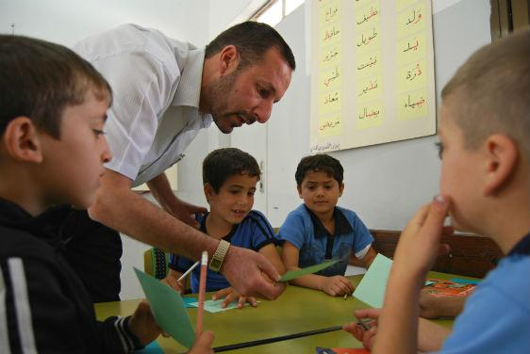
Neurological Levels in Education

Slide 23
A student performed badly on a test………..
At which level does the teacher react?
1. Teacher: "Was there too much noise in the classroom?“
2. Teacher: “How would it have been if you would work more slowly when making the test next time?“
3. Teacher: "Do you want to have more insight into those exercises?“
4. Teacher: "Don’t bother too much about it. Many girls drop out at math anyway.”
5. Teacher: "Are you weak in math?“
6. Teacher: “I know you are a go-getter, next time you will do better.”
What is the effect on the student?

Slide 24
Confusing Neurological Levels
We confuse easily Abilities and Behavior with Identity.
"You're crazy“
More specific description:
"Your behavior is crazy.“
Experience the difference between:
"You're an idiot" (Identity) and "You're acting like a fool“ (Behavior)

Slide 25
A wonderful resource:

Slide 26
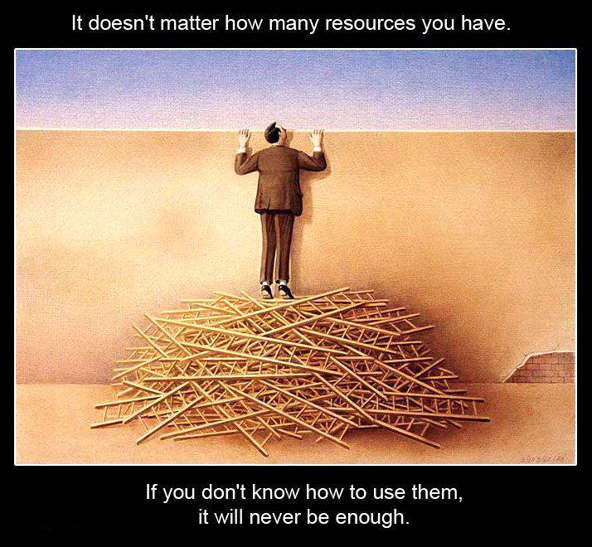
Resources, how to use them?
There are no people without resources.
Only people who don’t use their resources adequately.
What would you think of this use of resources?
What about this use of resources?

Slide 27
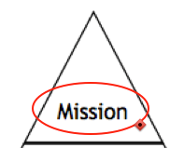
Resources, like:
Mother Earth
Allah/God
Self trust
Breathing/ Breath
Love
Humour
Motivation
Power
Sport
Family
Neurological levels
Mission
Identity
Beliefs,
Values
Skills
Behaviour
Environment

Slide 28
What are resources?
Trust
Happiness
Courage
Humor /laughing
Motivation
Self confidence
Energy
Love
Quietness
Power

Slide 29
Exercise: Aligning your Neurological Levels using your resources
Choose a resource, which may help you to be more in tune with all your values, beliefs, your identity and your mission in your life
What could make your life even more meaningful and hopeful?
Use the cards with the levels, take time to go inward and to feel the power of the resource on each level and experience how the resource may contribute to enriching your life.

Slide 30
Values on identity level
Peace Like a River
I’ve got peace like a river (2x) I’ve got peace like a river in my soul.
2 x
I’ve got love like an ocean (2x) I’ve got love like an ocean in my soul .
2 x
I’ve got joy like a fountain, I’ve got joy like a fountain, in my soul
2 x
I’ve got strength like a mountain I’ve got strength like a mountain in my soul
2 x

