Slide 1
Welcome to the NLP-course “Your Unlimited Powers”
Welcome!
مرحبا
Ministry of social affairs, Ramallah, Palestine
1st day Wednesday 27 April 2016
Trainers: Sytse and Marlies Tjallingii

Slide 2
Good and new
Joy
Energy
In two's 2 minutes each.
Focus at a recent situation which had given you a good/or new feeling. In which you felt energy, happiness or joy.
Share in the whole group the title of your experience and show your feelings at your face.

Slide 3
Open Frame
Questions
Experiences
Short stories
Share a real life-experience to reflect on what NLP can mean to it.
Goal: apply NLP in your own reality.

Slide 4
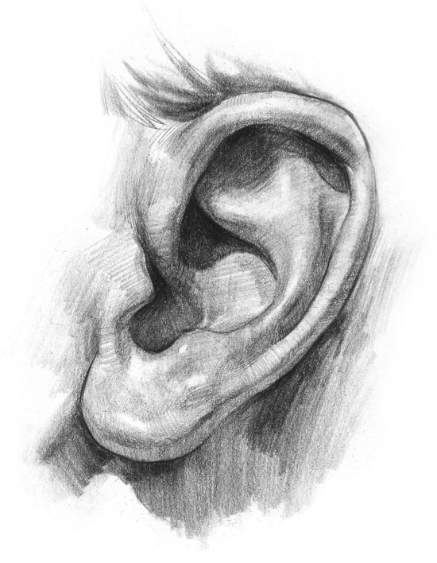
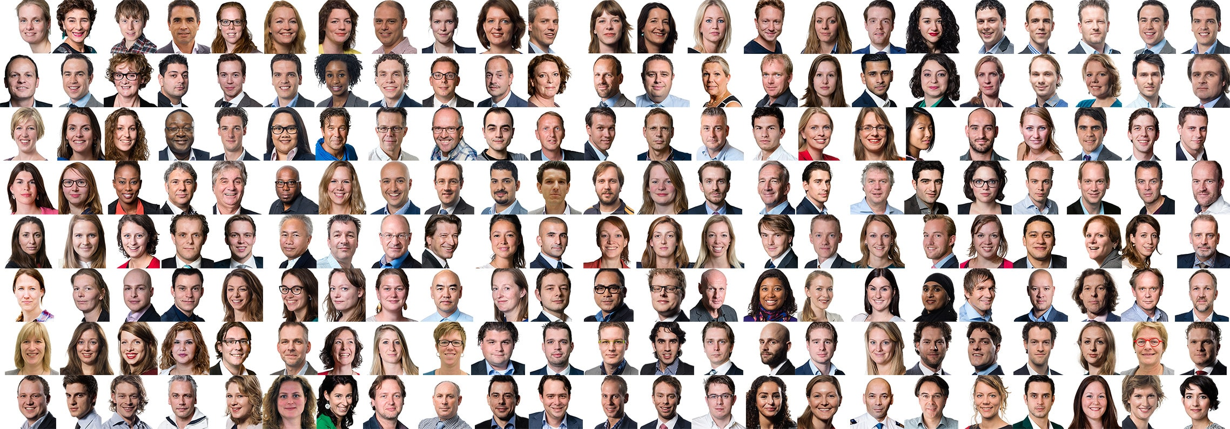
Tonality
How many people can you recognize
just hearing their voice?

Slide 5
Tonality
Give it a value between 1 and 5 | 1st half | 2nd half
Volume (soft/hard)
Rhythm (regular/irregular)
Inflections of the voice and stress on certain words or syllables (they can be interpreted as questioning or stating)
Tempo (slow/fast)
Pauses between words and/or sentences (short/long).
Sound height (expressed in Hertz, low/high).
Timbre (the nature of the sound, for example, with few or many overtones)

Slide 6
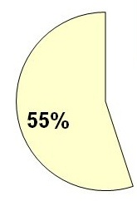
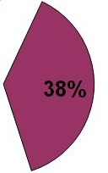
What is communication about?
words
physiology
Professor
Albert Mehrabian
tonality

Slide 7
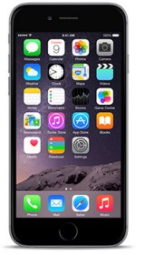
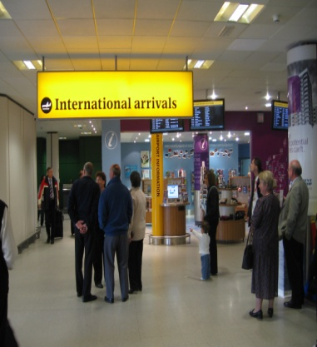
Modern Communication
What is the percentage of the
whole Communication ?
Telephone call
Email
At the airport when there is glass between you and the person who is picking you up. (no hearing only seeing)

Slide 8
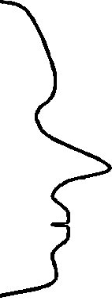
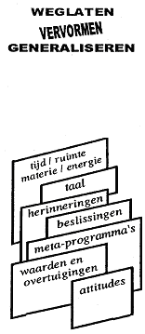
Map
How do we Communicate?
Territory
FILTERS
Internal
Representation
Delete
Deform
Generalise
External
signal
State, emotions
time/space matter/energy
language
memories
decisions
metaprograms
values
and beliefs
attitudes
Physiology
Behaviour

Slide 9
Internal
Representation
What are the individual differences in the internal representations?
Practice
Write down at least 5 words which come up when you hear the word “Bethlehem”.
What do you think?
How many of these words, which you wrote down are written by everybody?

Slide 10
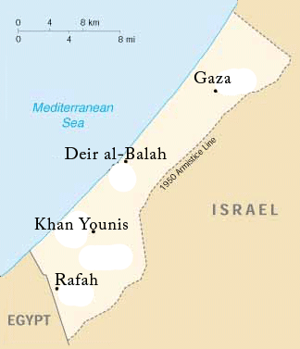
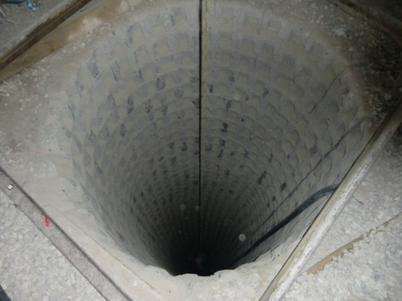
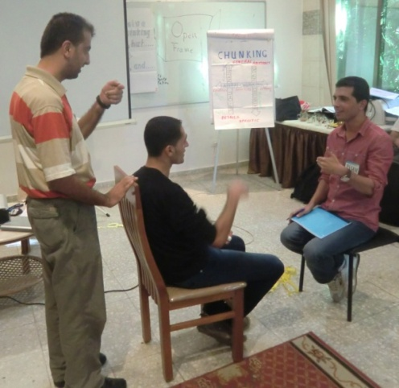
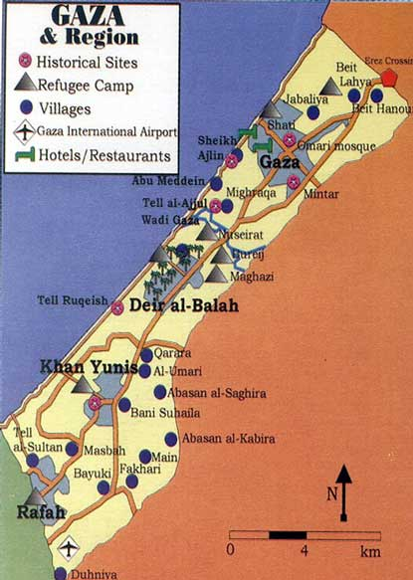
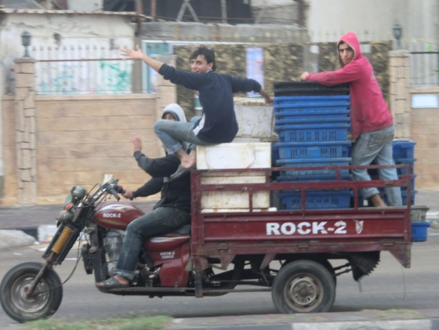
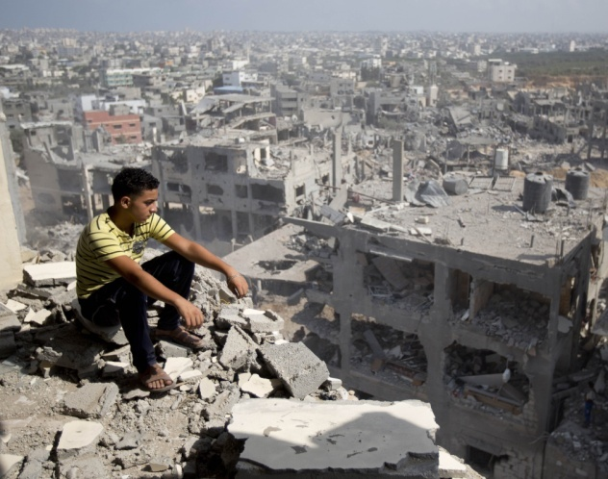
What is the difference between the map and the territory?
Map of Gaza
‘Territory’ of Gaza

Slide 11
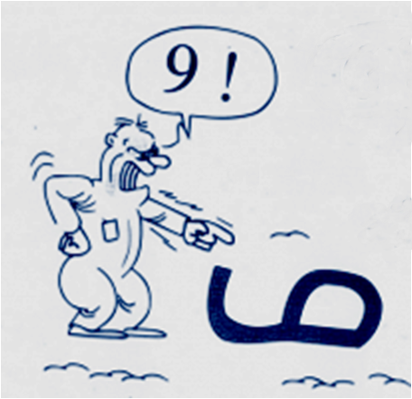
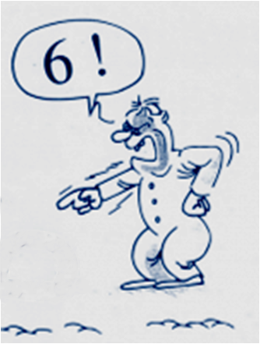
Perception
=
Projection
Look from a different perspective

Slide 12
Communication in strip
“I bought a dog”
“Oh yes? A big dog?”
“No not so big”
“With long hair?”
“No with short hair”
“Which colour?”
“Spotted black and white”
“What a nice dog!”
“Yes indeed it is!”

Slide 13
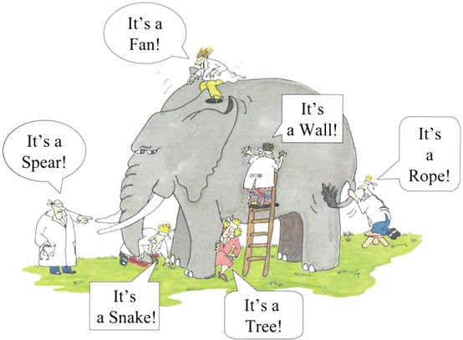
The six blinds: The map is not the territory

Slide 14
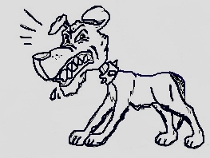
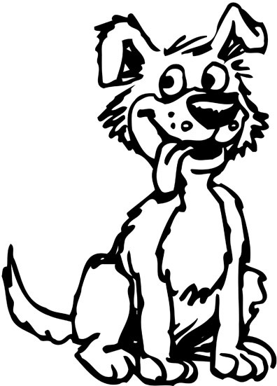
The temple with the thousand mirrors

Slide 15
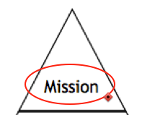
What is most important in your life?
Who are you?
Why?
How? Which skills?
What do you do?
Where? When?

Slide 16
Neurological levels
6 Mission
What orients you in your life, what is most important in your entire life
5 Identiteit
Personality: ‘I am’. Your self esteem.
4 Values and Beliefs/Convictions:
4a Values an norms: thoughts and ideas.
4b beliefs. What you think about your self and others and what you belief that is true for you.
3 Skills, Capacities
Powers, resources, qualitities, what you are able to do.
2 Behavior
Everything you can see and hear of the other, what you video.
1 Environment
Everything what is surrounding you, context, people, things time.

Slide 17
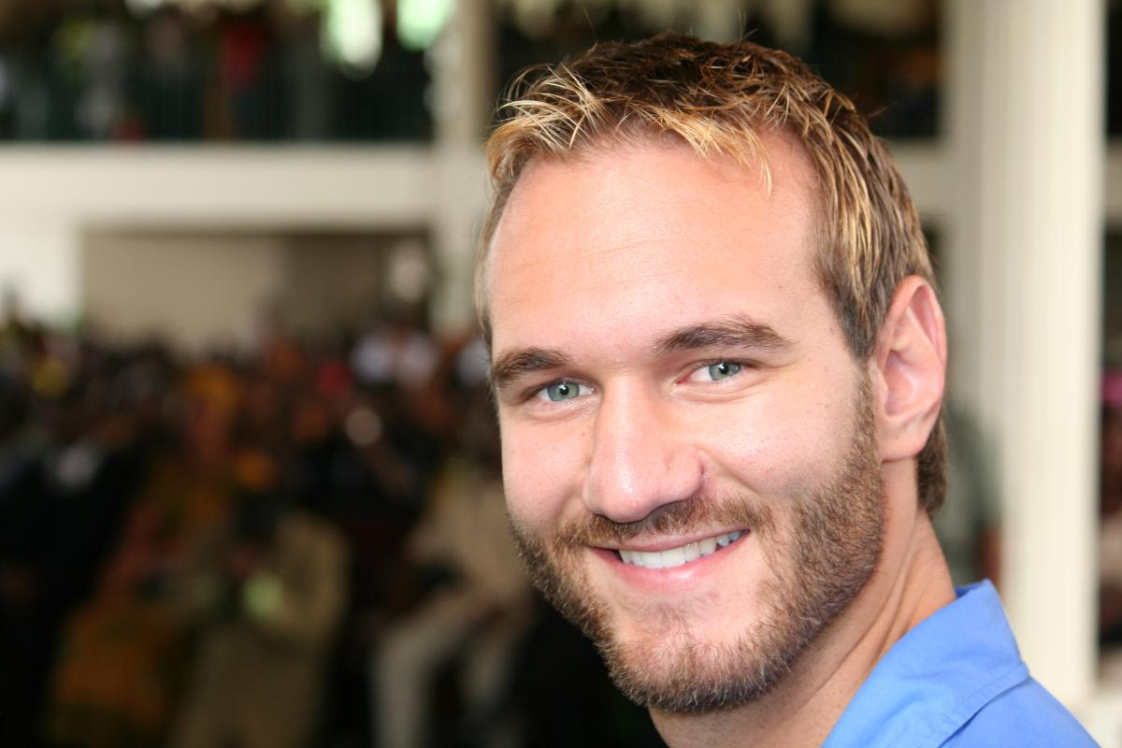
What do you communicate with yourself?
How much can you focus at what you have?
Instead of focussing at what you miss?
Heb jij beperkingen?
Kijk naar Nick Vujicic

Slide 18
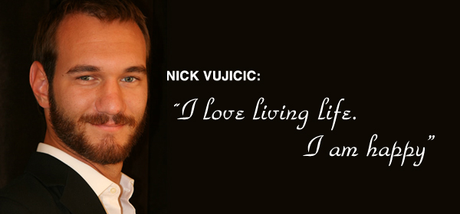
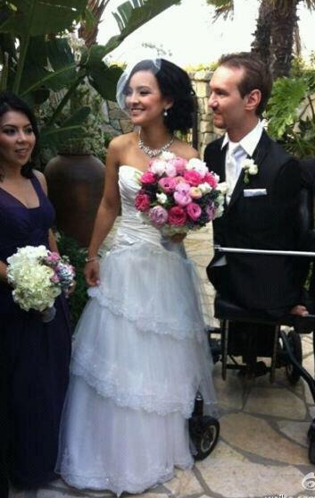
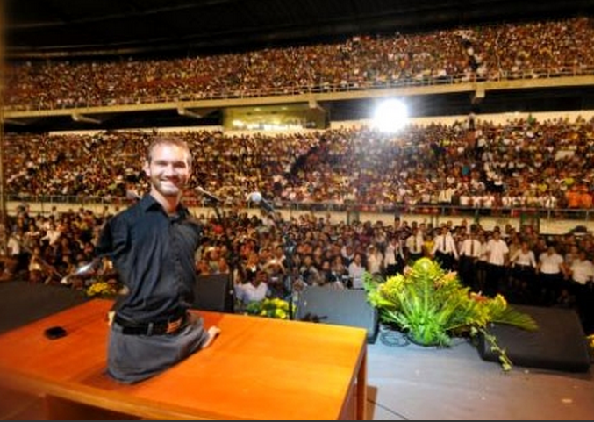
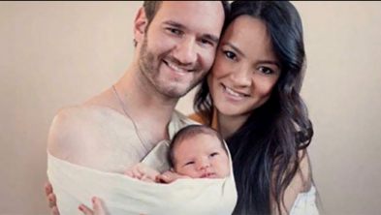
What are his neurological levels?

