Slide 1

Welcome to the NLP-course “Achieve more success with
Your Unlimited Powers”
"حقق نجاحا أكثر مع طاقاتك اللامحدودة"
دورة البرمجة اللغوية العصبية التابعة
ترحيب
مرحبا
Success!
Ramallah, October 24, 2017

Slide 2
Program October 2017
Time schedule | Time
Tuesday 24 | 9.00 - 15.15
Wednesday 25 | 9.00 - 15.15
Thursday 26 | 9.00 - 15.15
Friday 27 | 9.00 - 15.15
Saturday 28 | 9.00 - 15.15
 | Total 30 hours of training level 4
Practitioner Examination after 130 hours training
Support for Theory Wednesday - Saturday (support is optional) | 16.00 – 17.00
Practical Examination Sunday 29 | 13.00-18.00

Slide 3
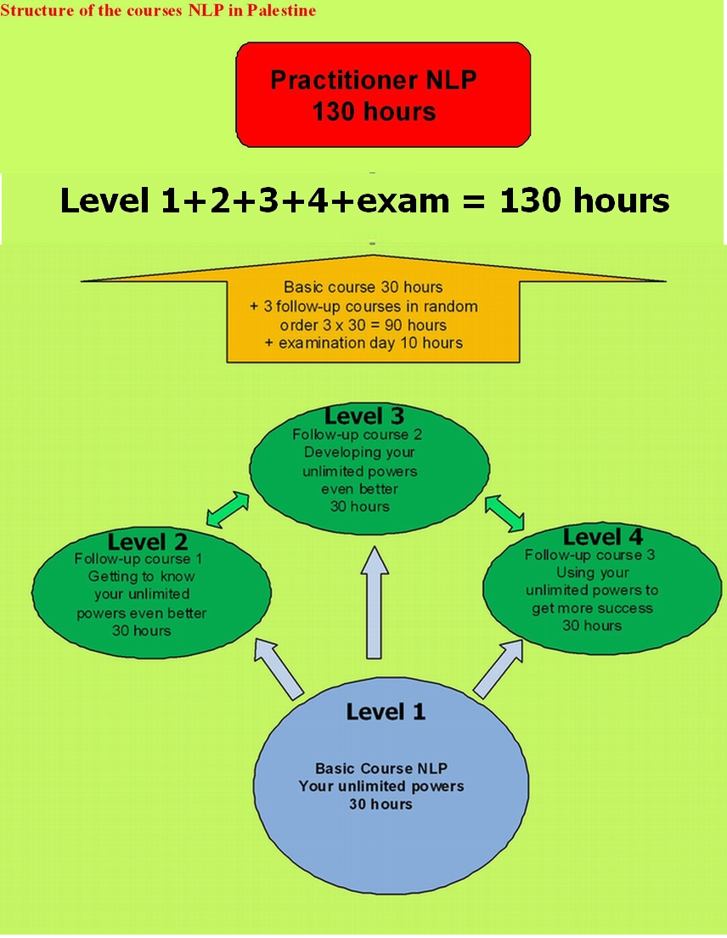
The structure of NLP courses
NLP Master Practitioner = 130 life training + modelling thesis
NLP Trainer/coach = 130 life training + assistance 130 hours + 3 days of examination

Slide 4


Slide 5
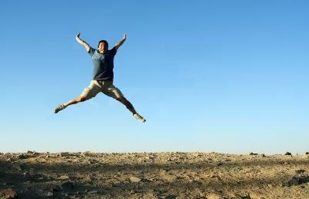
NLP and Success
Make a jump to your next success moment!

Slide 6
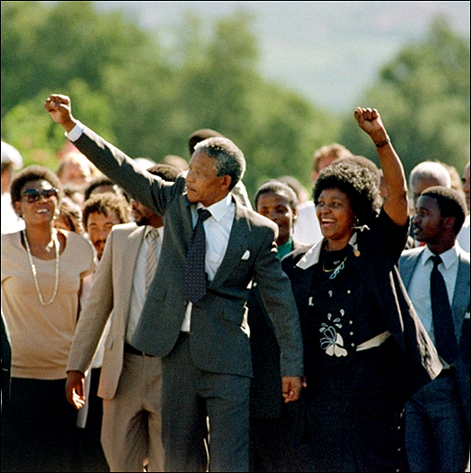
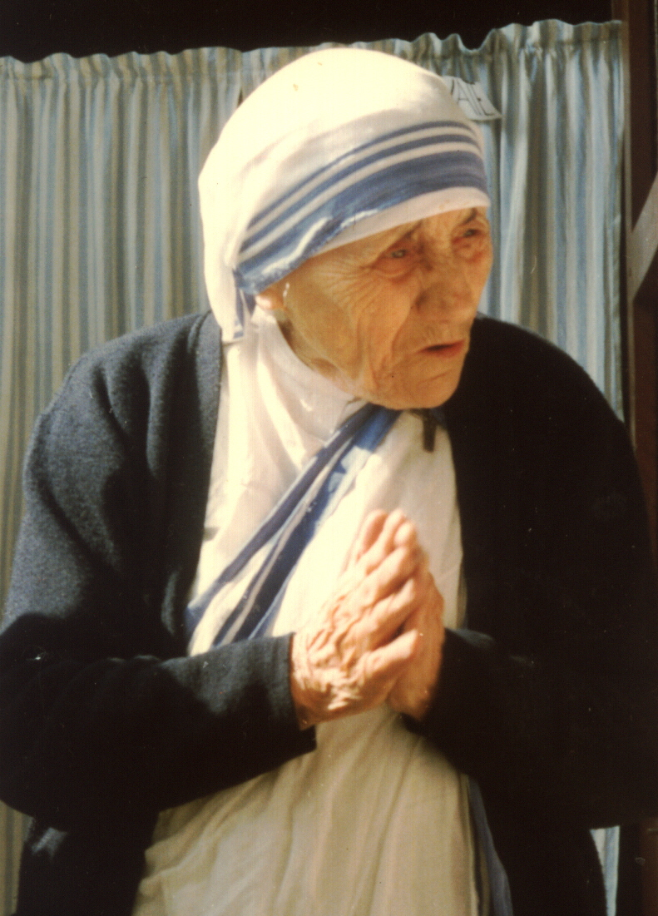
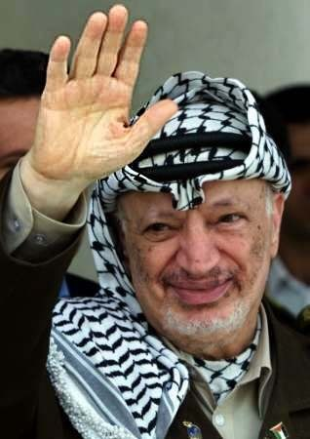
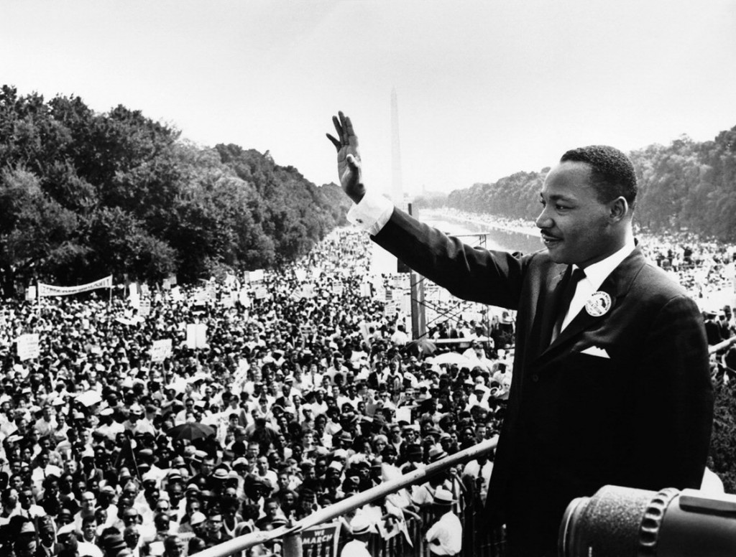
Success
Applying feedback
Failure doesn’t exist, only feedback
Every ‘failure’ is a learning moment
Follow your own process.
Y o u !
Nelson Mandela
Yasser Arafat
Mother Theresa
Martin Luther King

Slide 7
What kind of success do you want?
The success of Nelson Mandela is:
Respect of the model of the world of yourself and the other

Slide 8
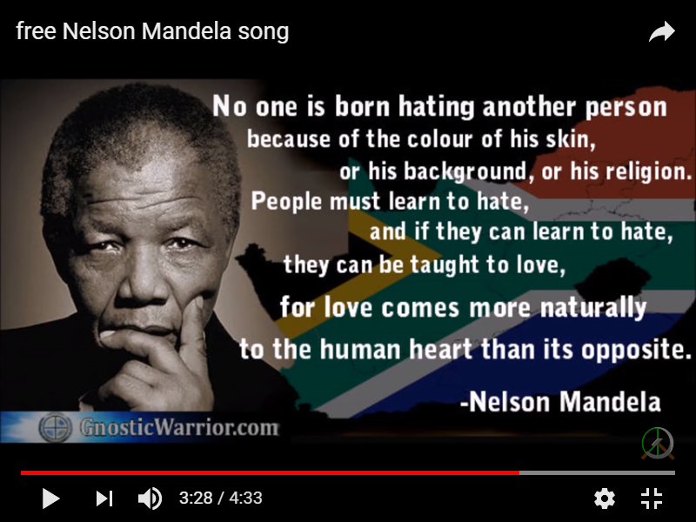
Success of Nelson Mandela

Slide 9
Success by connecting
Getting to know each other,
Work in pairs two minutes each way, A interviews B, after 2 minutes B interviews A also in 2 minutes:
Where do you live?
What are you doing, most of the time?
What kind of skills do you have already?
What skills did you improve in the last course?
How did you do that?
What do you want to reach in this course?
Present the model of the world of the person whom you interviewed (max. 0,5 min).

Slide 10
A little letter to our friends and family in the Netherlands
Success by connecting with the people who are supporting this course
Write a short notice of appreciation:
In English, Palestine, Ramallah, 23-10-2017
Dear friend
I’m ……..
I learned …..
My job/volunteer work/study is/will be……………
I want to use this communication skills for private/work ………
A specific example is…………………….
I want to express my feeling to you …..
With kind regards
Name
Email address

Slide 11
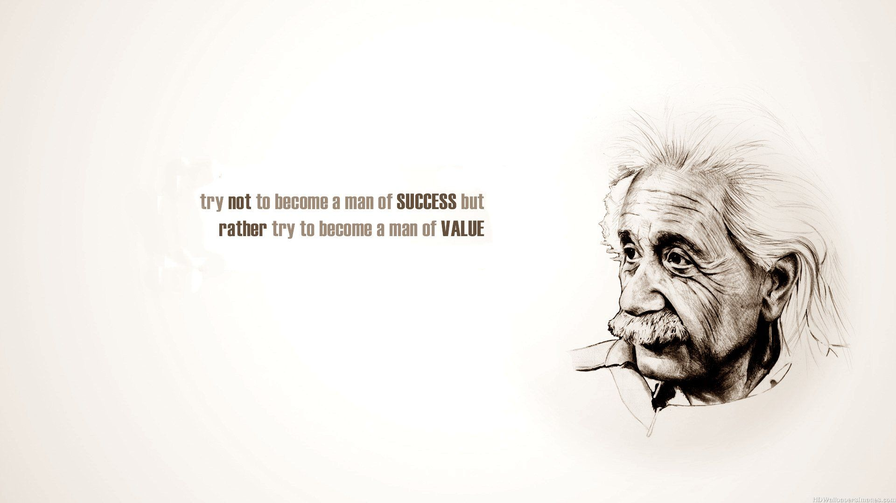
Success or Value?
“Try not to become a man of
SUCCESS,
but rather try to become a man of
VALUE”
Albert Einstein

Slide 12
Goals for this course: Recent situation
3 minutes
Write down something that happened not long ago and in which you whish you would have communicated better.
On a scale of 0 – 10, how badly or how well did you do it?
What would you like to improve in your own behavior.?
To what number on the scale do you want to improve?
What would you like to learn in order to be more successful in your life?

Slide 13
What do people indicate as their success factors?
1. Self confidence, faith, belief 39%
2. Fun, humor, joy 30%
3. Mission, target 28%
4. Perseverance 27%
5. Wisdom, knowledge, insight, understanding,
learning, growing, developing 25%
6. Passion, drive, being driven, enthusiasm 23%
7. Honesty, openness 22%
8. Authenticity 16%
9. Acceptance, respect 16%
10. Boldness, being brave, courage 15%
What are your success factors?

Slide 14
Which techniques were most useful for you?
Describe the technique you have used to make a situation successful.
Three life questions
Sensory acuity
NLP-Communication-model
Neurological Levels
Presuppositions
4 steps learning model
Step to the side of the cause
The central nervous system can not store a denial
Representation systems
Anchoring
Chunking
Meta-model
Milton model
Nonviolent communication
Reframing
Three observational positions
Solution focused work
………………………………….

Slide 15



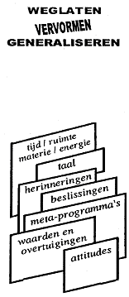



Map
How do we Communicate?
Territory
is not
Internal
Representation
FILTERS
Delete
Deform
Generalise
External
signal
State, emotions
time/space matter/energy
language
memories
decisions
metaprograms
values
and beliefs
attitudes
Physiology
Behaviour

Slide 16
Internal
Representation
What are the individual differences in the internal representations?
Practice
Write down at least 5 words which come up when you hear the word “Success”.
What do you think?
How many of these words, which you wrote down are written by everybody?

Slide 17

Success by being grateful (1)
Practicing gratefulness can make us healthier, happier and more sociable.
The road to success in your life.
What do you focus on?
It grows.
If you give it the meaning of gratefulness,
it makes you feel successful
3. What do you do with it?
Write 3 things which make you feel grateful

Slide 18

Exercise in Gratefulness (2)

Slide 19
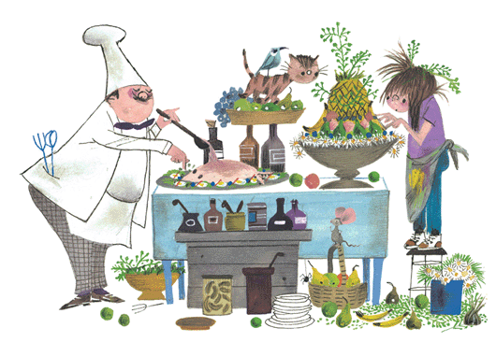


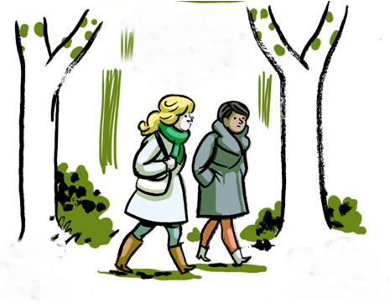
Exercise in thankfulness (3)
Think on all what you do with joy.
Do you like sports, cooking or delicious eating, or walk in a park or outside the town?
Are you touched by your favorite music?
Does reading give you joy and wisdom?
Say thank you.

Slide 20
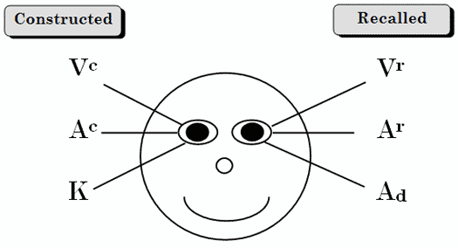
Eye patterns
William James, Richard Bandler + John Grinder, Robert Dilts
Useful to reach better rapport in order to use the same representation system
creative
memory
Visual
Visual
Auditive
tonal
Auditive
tonal
Auditive
digital
Kinesthetic

Slide 21
Definitions
Preferred Representation System
Is the system to bring the internally stored information (internal representation) to the outside world.
Lead System
This is the system that is needed to reach the internally stored information.
Lead system you can compare with windows on your PC, to put your PC at work. The Preferred Repr.Sytsem with Word, Excel, Explorer etc.

Slide 22
How do we Communicate?
FILTERS
Internal
Representation
Delete
Deform
Leadsystem
External
signal
Generalise
State, emotions
time/space matter/energy
time/space matter/energy
language
memories
decisions
metaprograms
values
and beliefs
Preferred Repr. Sytsem
attitudes
Physiology
Behaviour

Slide 23
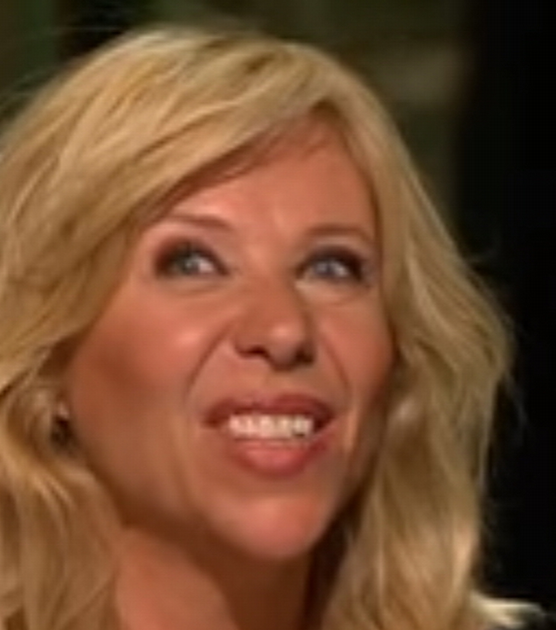
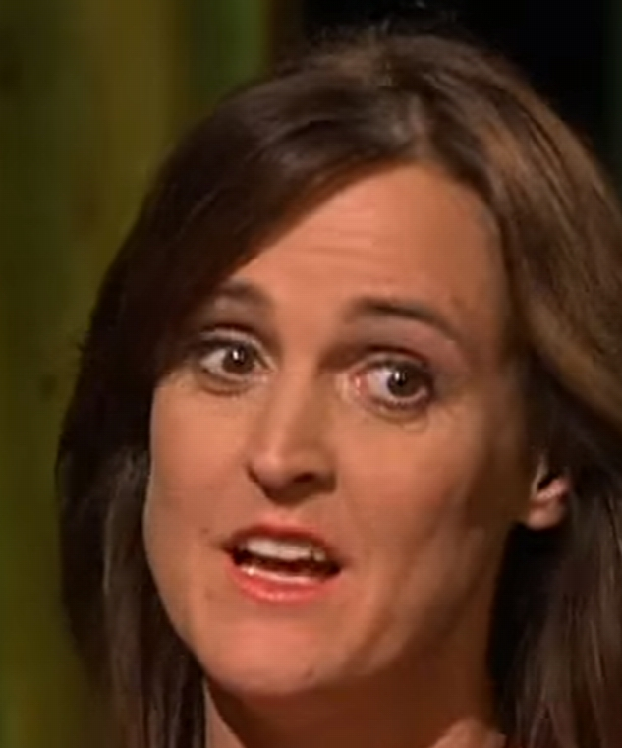
Eye patterns are telling about VAKOG
On Dutch TV
Claudia de Breij
Janine Abbring
Video

Slide 24
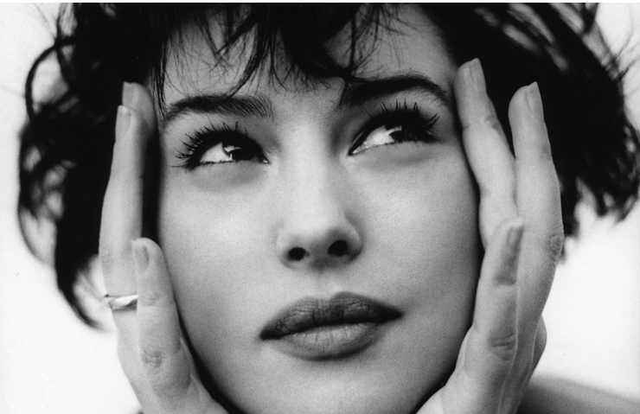


Which Preferred Representation System have these persons? (1)
Visual Construction V^{c}
Visual Memory V^{r}
Auditive Construction A^{c}
Auditive Memory A^{m}
Kinesthetic K
Auditive digital Ad
1
V^{r}
3
A^{c}
2
K

Slide 25
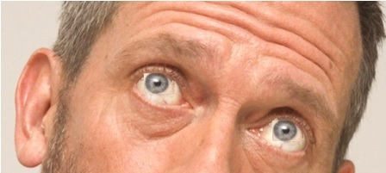
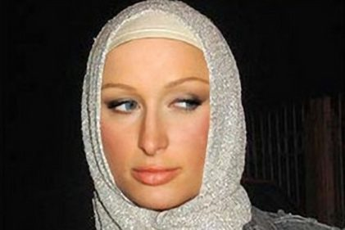
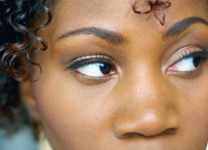
Which Preferred Representation System has this person? (2)
Visual Construction
Visual Memory
Auditive Construction
Auditive Memory
Kinesthetic
Auditive digital
5
V^{c}
4
Ad
6
Ar

Slide 26
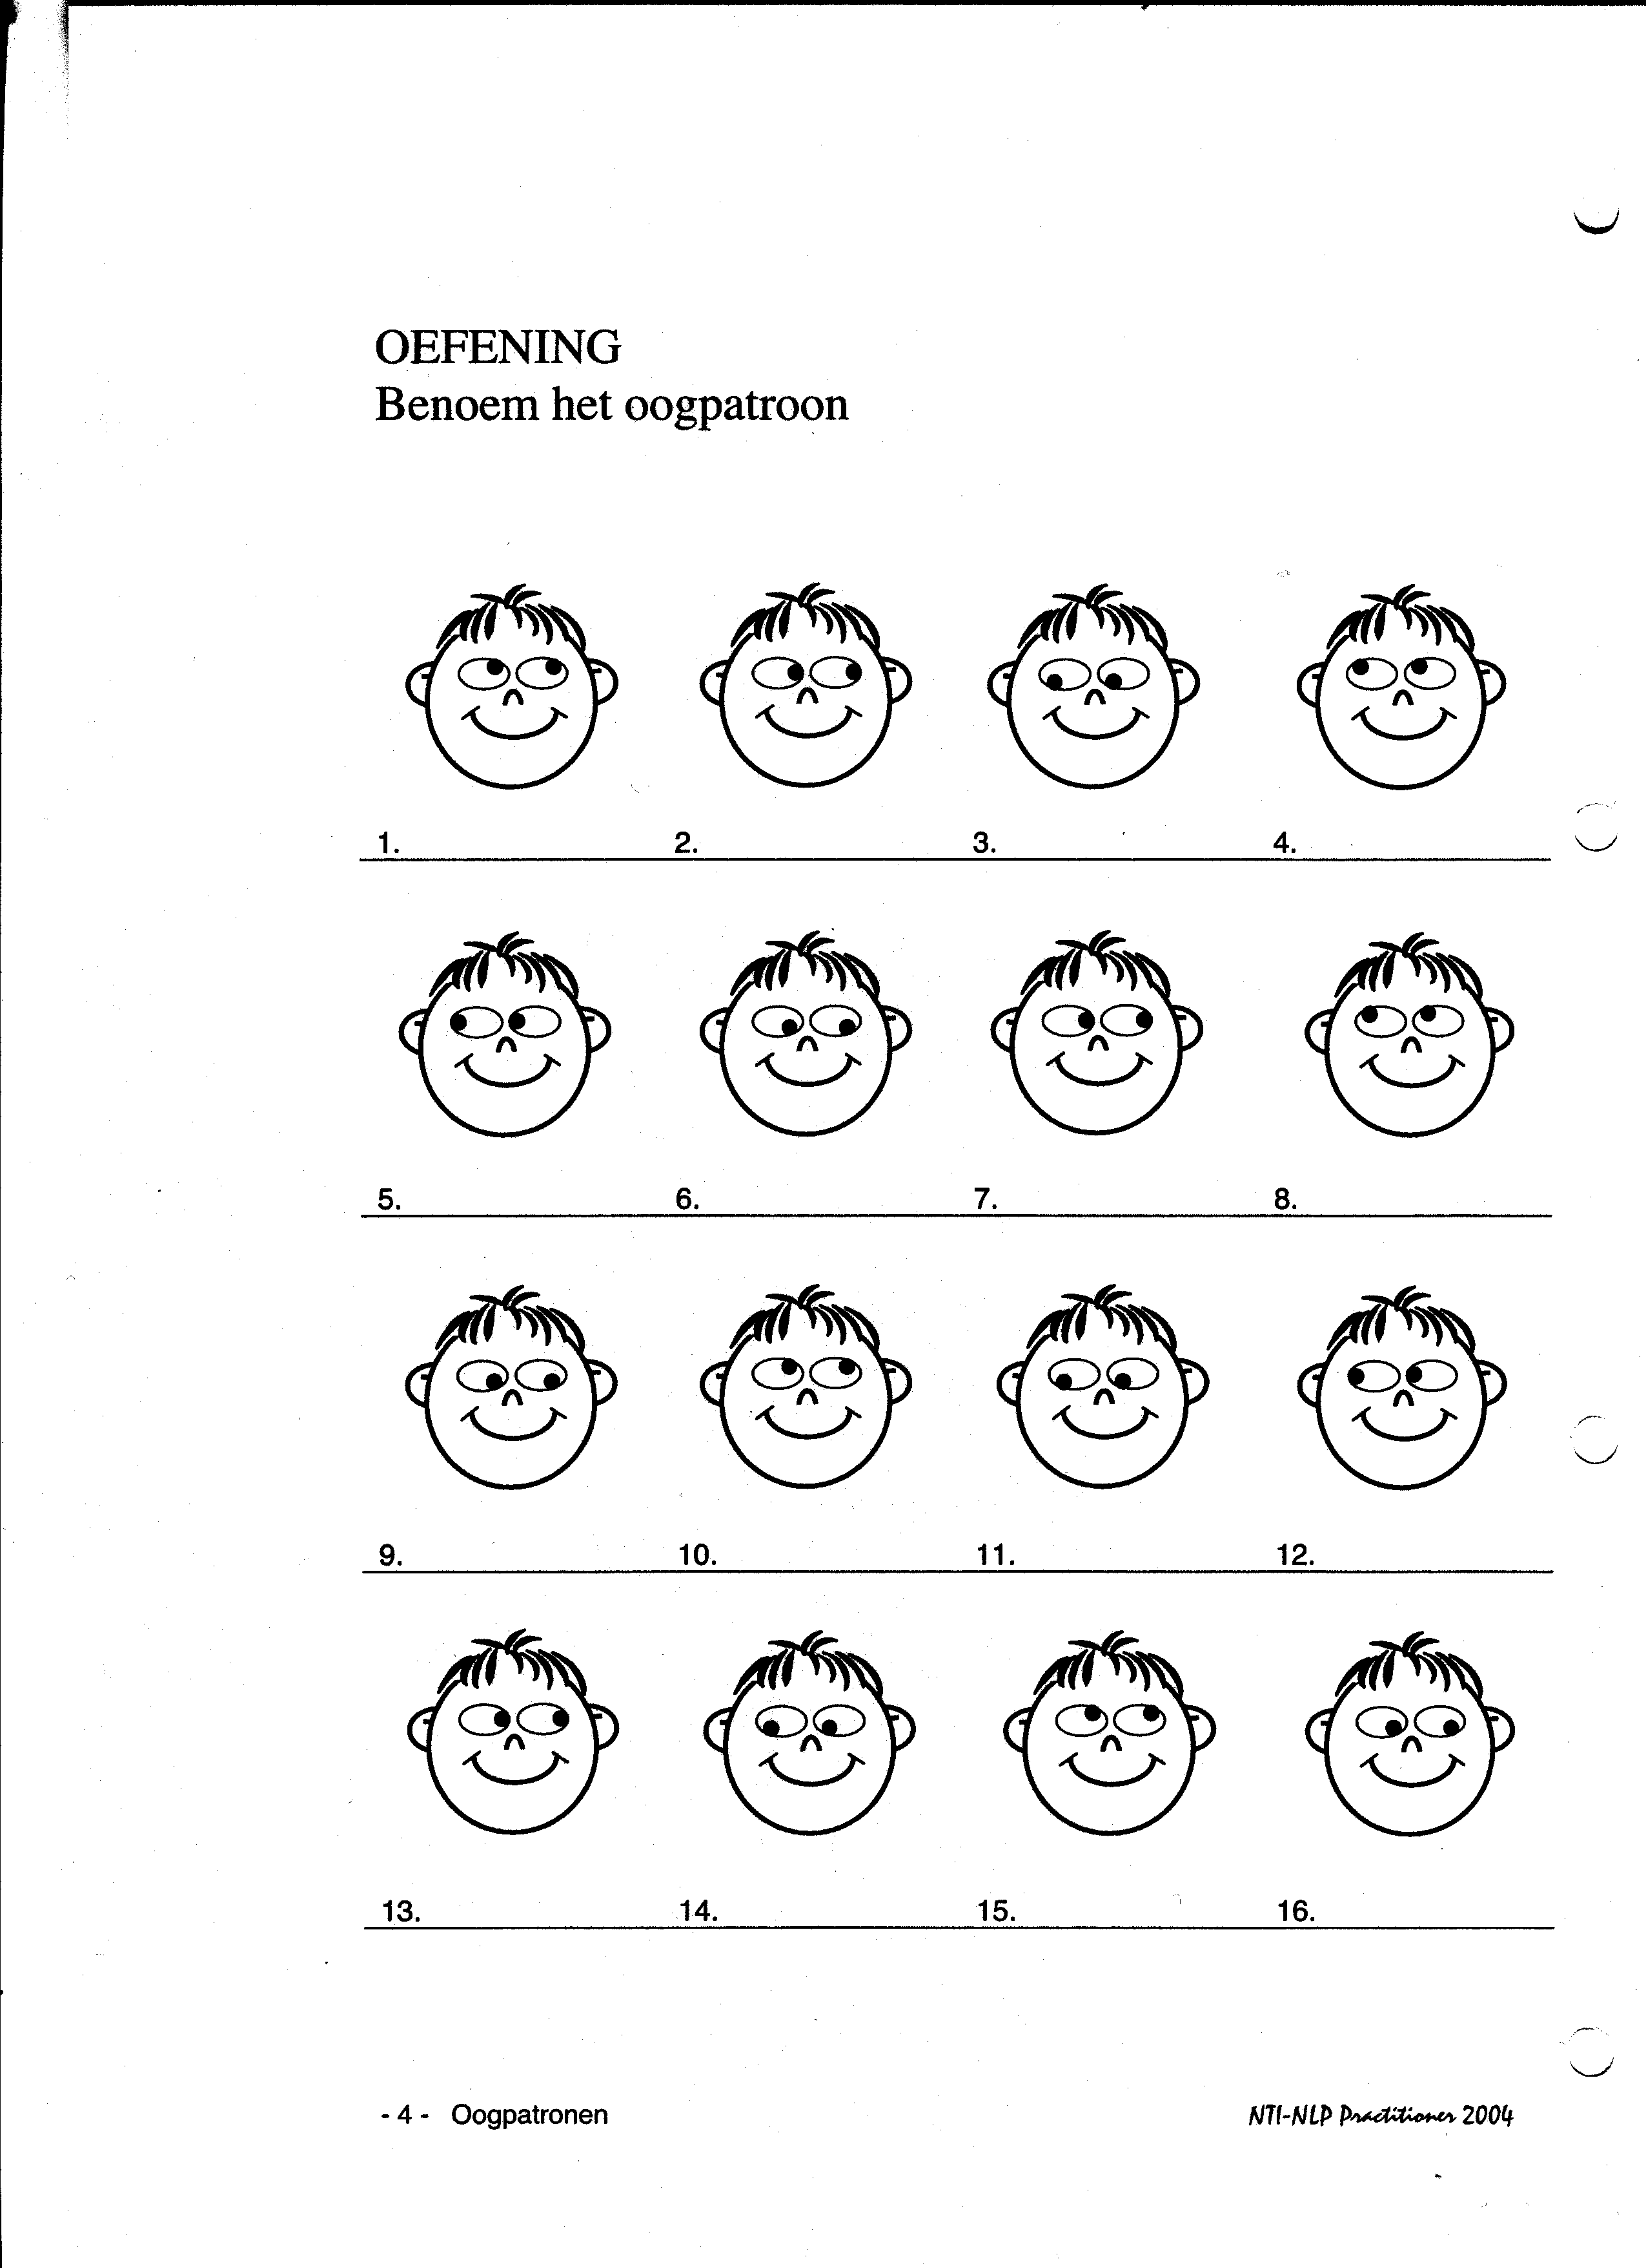
Label the eye pattern (3)
V^{r}
A^{r}
K
V^{c}
A^{c}
Ad

Slide 27
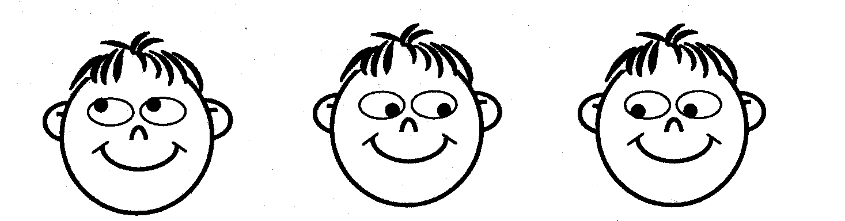

Link eye patterns and predicates (4)
a = V^{c}
a “it is going to look bright”
e = V^{c}
b “something is holding me back”
c “I don’t know what to decide”
b = K
e “I see a good opportunity”
c = Ad
d “I think I have to reflect about it”
d = Ad

Slide 28
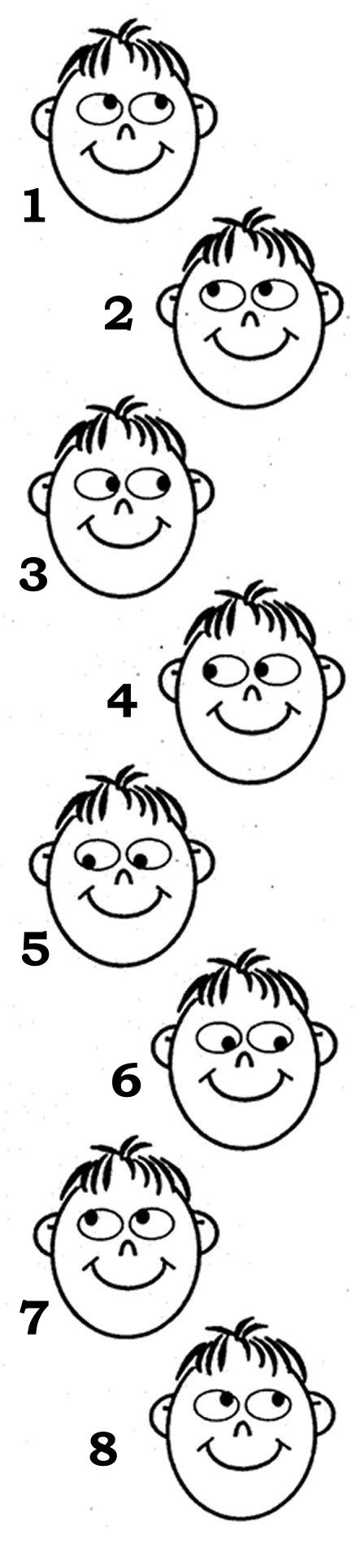
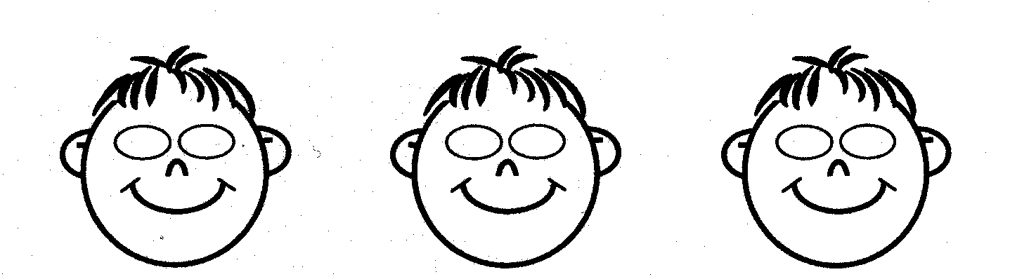
The test to elicit the preferred representation system (5)
Expected Observed
  What was the color of your mother’s hair when you saw her for the last time?
  2 What would your mother look like if she would have green hair?
  3 Can you remember the melody of your favorite song?
  4 How would this song sound with the sounds of a mosque at the background?

Slide 29
The test to elicit the preferred representation system (5 cont)
Expected Observed
  5 How would it feel if you have melting ice in your hands?
  6 What do you say to yourself at this moment?
  Can you see yourself with hair of gold?
  How many windows does your house have?

Slide 30
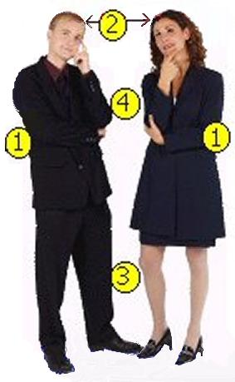
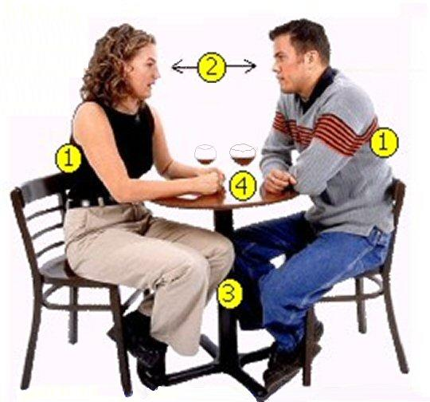
Rapport

Slide 31
Auditive digital
Predicates
Visual
Auditory
Kinesthetic
thinking
analyzing
calculating
understanding
reflecting
consciously
planning
to order
See handbook

Slide 32

Needs and whishes
If you from your heart you get easily rapport with yourself and others

Slide 33
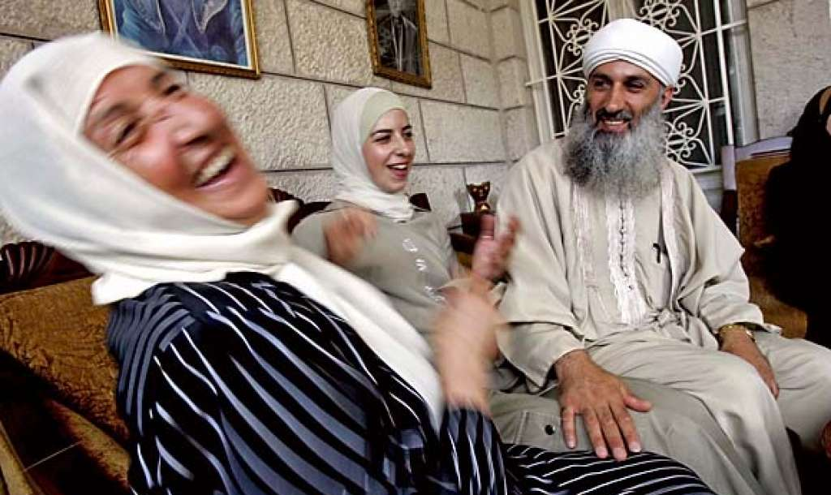
Laughing is the shortest distance between two people

Slide 34
Exercise: Laughing to get rapport
Together laughing about something is making a direct connection.
Explanation or words are superfluous.
If you laugh at the same moment, you are together, connected.
Laughing liberate, connect and disarmed.
Who stimulates the group to laugh?
What are the movements of the eyes, mouth edges, breathing?
What changes to your body?

Slide 35
Chunking to get rapport
If somebody uses many details, than answer also with details, or ask questions about details.
If somebody speaks mainly about the big lines , than use yourself also more abstract language.

Slide 36
Reference frames
External: open for other opinions.
“Somebody has to say me”
“I was valued”.
Internal: “I have my own opinion”
“I know if I did something good”
“I trust upon my own impression”

Slide 37
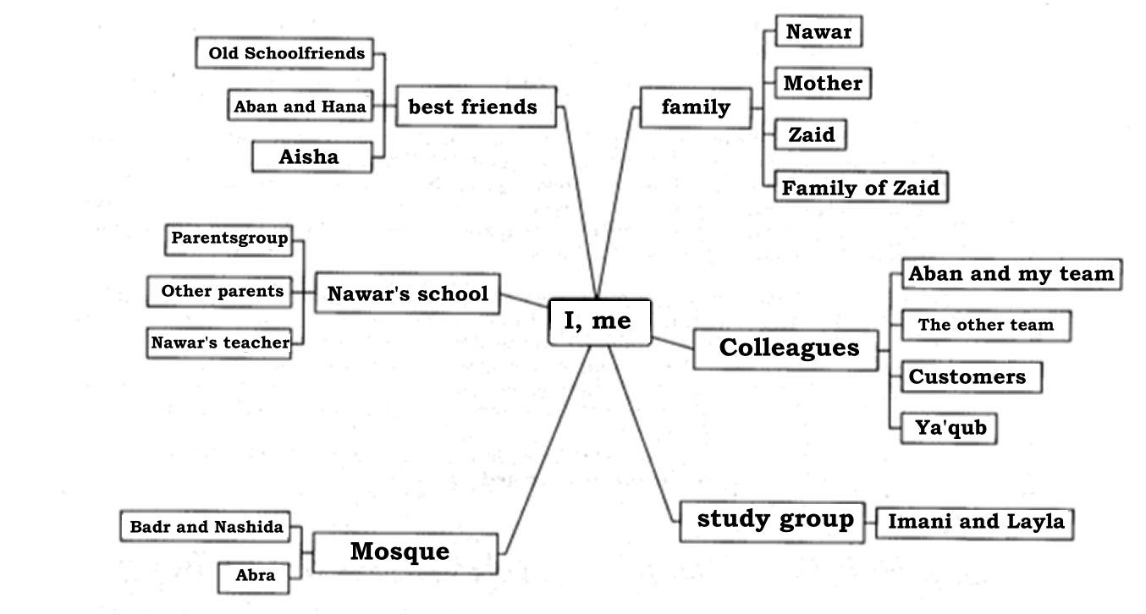
My relations
I, me

Slide 38
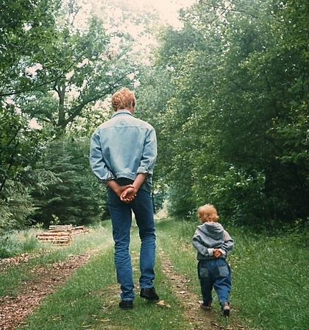
Pacing and leading

Slide 39
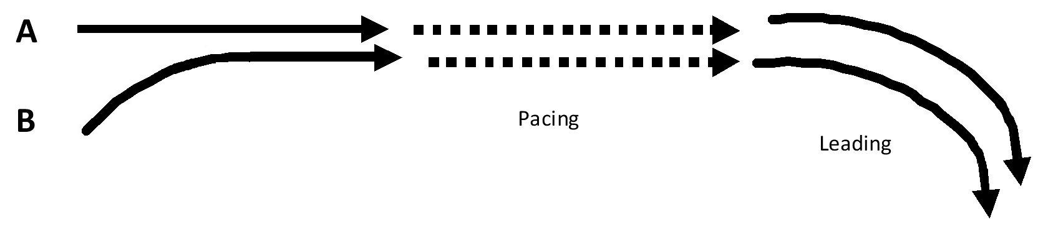

Pacing
and Leading
Pacing 1:
approaching
listening
Summarising and
Deepening questions
following,
open questioning
Pacing 2:
keeping rapport and deepening
Leading:
Proposeing kchoices
Building in presuppositions
How did you manage to continue for such a long time?
What would help you to feel better?

Slide 40
Reflection of the day
Look back on what we did today.
Where and how can you use the different exercises?
Write it down for yourself.

