Slide 1
Welcome to the NLP-course “Your Unlimited Powers”
Welcome!
مرحبا
Ministry of social affairs, Ramallah, Palestine
1st day Wednesday 27 April 2016
Trainers: Sytse and Marlies Tjallingii

Slide 2
Program of today
8.30 – 10.00 Welcome
Getting to know each other
Recent situation
10.15 – 11.45 Goals
3 Life questions
Presuppositions
12.00 – 13.30 Sensory acuity
Observation or Interpretation ?
13.45 – 15.15 Observation or Interpretation
Visual calibration

Slide 3
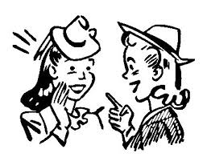
Getting to know each other
Make a small paper about yourself
With your name
Age
Family
Daily activity
Present it to the group

Slide 4
Group support
K+
Confidentiality
Respect for the model of the world of the other and of yourself

Slide 5
Recent Situation
Describe a situation of today, yesterday or last week in which you had the idea that you rather would like to have communicated in a better way.
Write it in Arabic or English on page 5

Slide 6
Goal(s) for this course
Be positive
Ecology

Slide 7
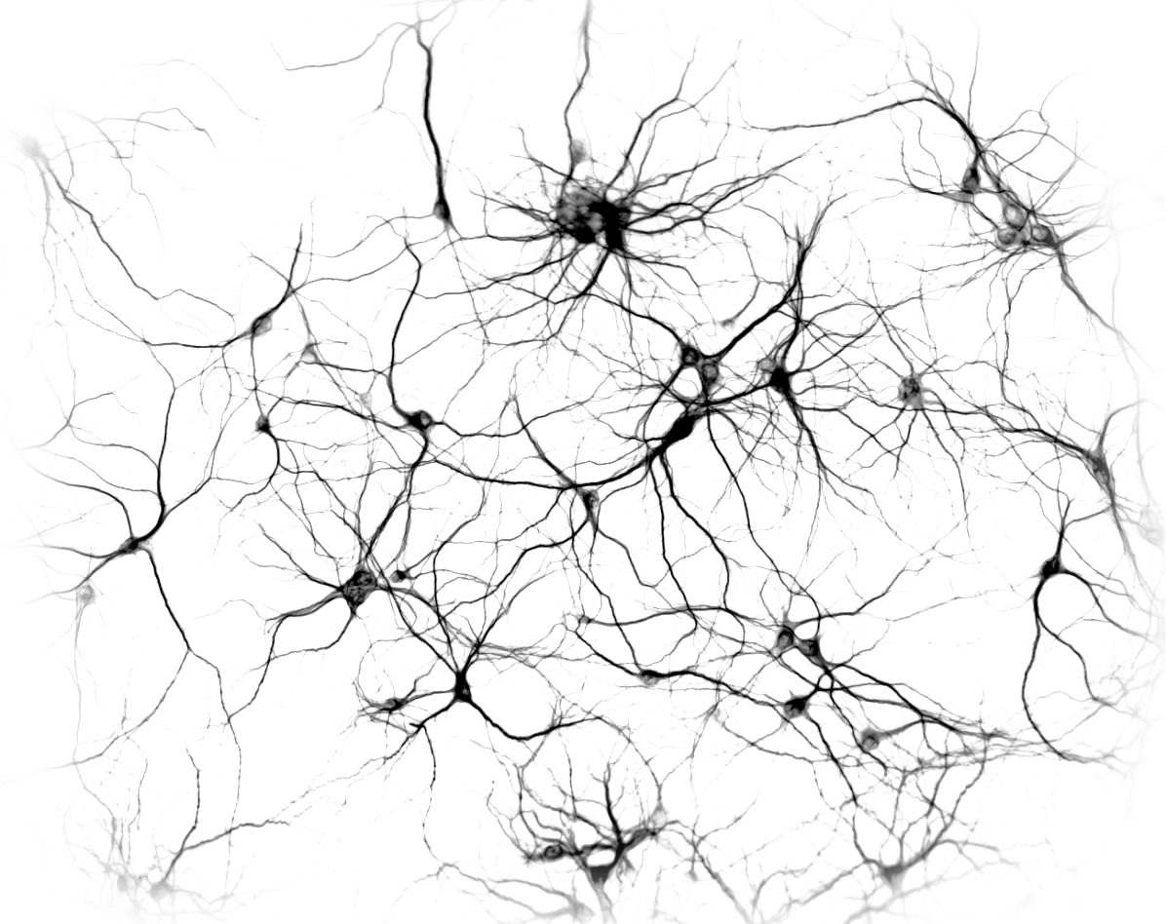
What is NLP?
100 billion neurons
Each 30.000 connections
Neurologic
Linguistic
Programming

Slide 8
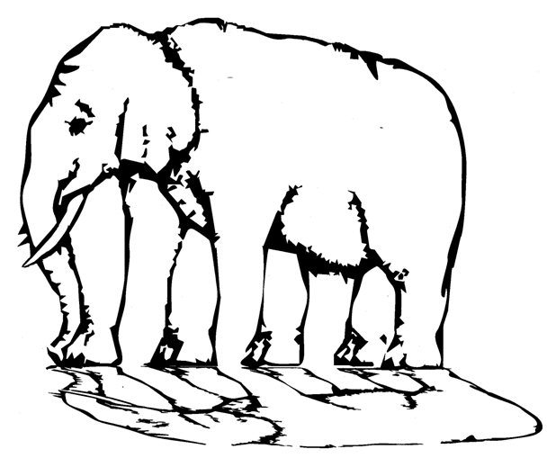
The toolkit of NLP:Neuro Linguistic Programming
Non Violent Communication
3 Life questions:
Anchoring
1 Focus
Hierarchy in language: chunking
2 Give meaning
Positive language: Milton
3 Doing
Language: Metamodel
Step to side of the cause
4 step learning proces motivating in 2nd step
Integrate presuppositions
Neurological levels
Respect
Mission building
Accept
Changes on identity level
The map is not the territory
Building empowering beliefs
toolkit
Sensory acuity
Reframing
Internal representation
3 Perceptual positions
Using your inner resources

Slide 9
The three life questions
1 What do I focus on?
2 What meaning do I give it?
3 What do I do?

Slide 10
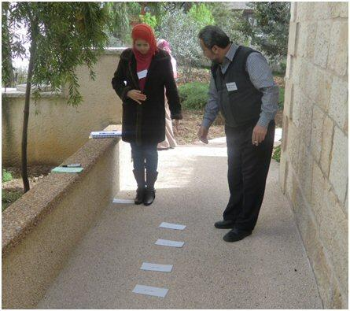
1. What are they focusing on?
2. What meaning do they give it?
3. What are they going to do?

Slide 11
Exercise 3 life questions
1 My focus in my personal life
2 The meaning I give it
3 The action I want to take

Slide 12
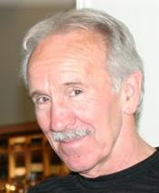
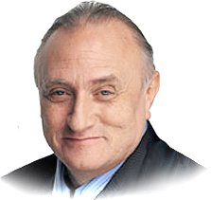
NLP founders
Richard Bandler
John Grinder

Slide 13
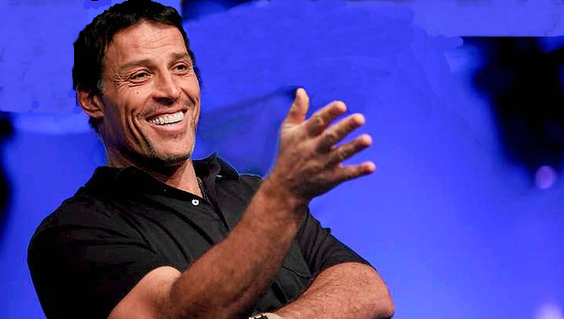
Tony Robins

Slide 14
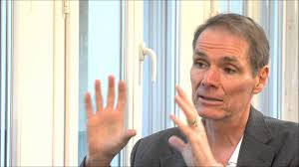
Robert Dilts

Slide 15
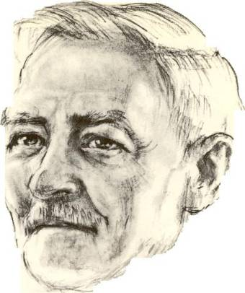
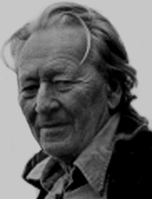
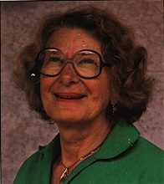
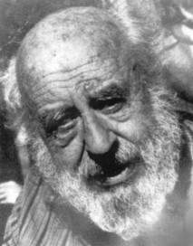
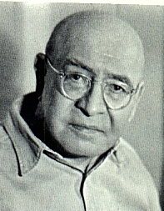
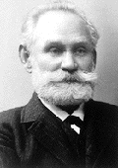
Who is who in NLP?
Milton Erickson, successful psychiatrist, hypnotherapist
Virginia Satir, a famous
family therapist
Gregory Bateson, biologist, psychiatrist, anthropologist and cybernitist
Fritz Perls, the ‘father’ of the Gestalt therapy
Alfred Korzibsky, Professor of linguistics and semantics
Ivan Petrovich Pavlov, founder of the idea of the reflex

Slide 16
Presuppositions of NLP
A presupposition is working for you, if you believe it,
they are not true or false.
Respect for somebody else’s model of the world and of yourself.
4. The map is not is not the territory
17. Accept the reality as it is. It is as it is.

Slide 17
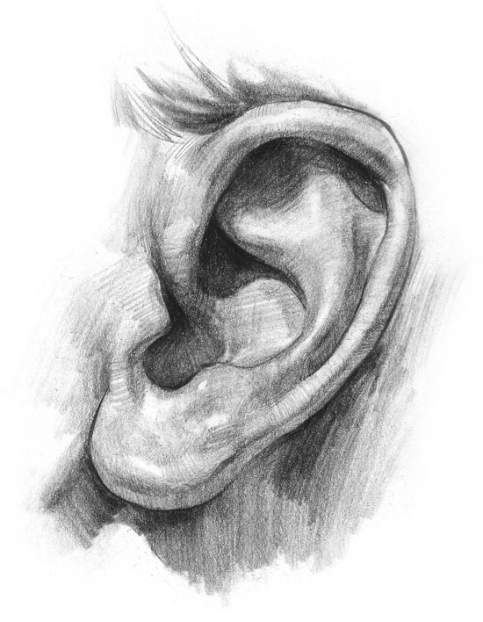
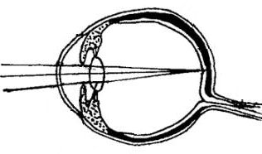
Sensory Acuity
How to become more sharp in your observations?
How to differentiate between observation and interpretation?

Slide 18
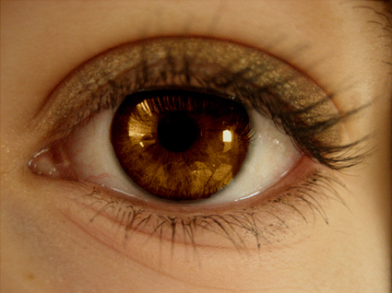
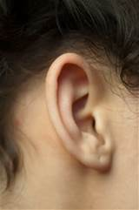
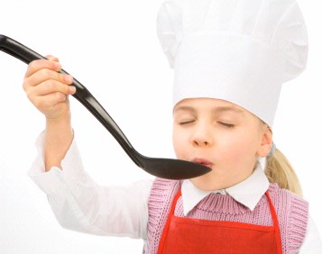
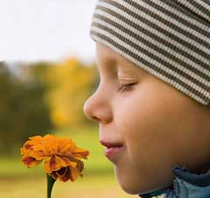
Sensory Acuity
Seeing
Which senses do you have?
Feeling
Hearing
Tasting
Smelling

Slide 19
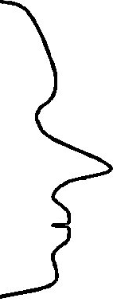
How do we Communicate?
FILTERS
Internal
Representation
Delete
External
signal
State, emotions
Deform
Generalise
Physiology
Behaviour

Slide 20
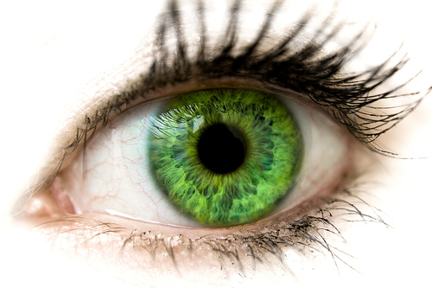
Sensory acuity, What do we observe?
Exercise: What do our senses delete?
Read the following text once carefully and
count how many times the letter F exists in this text.
FINISHED FILES ARE THE RESULTS OF YEARS OF SCIENTIFIC STUDY COMBINED WITH EXPERIENCE OF YEARS OF TRUTHFULL WORK AND OF INTENSIVE REFLECTION IF THEY ARE FILLED WITH FAITHFUL FACTS ABOUT EFFECTIVE SAFETY PERSONS OR FALSE OFFENDERS OF FOUR FANTASTIC AND BEAUTIFUL PEOPLE.

Slide 21
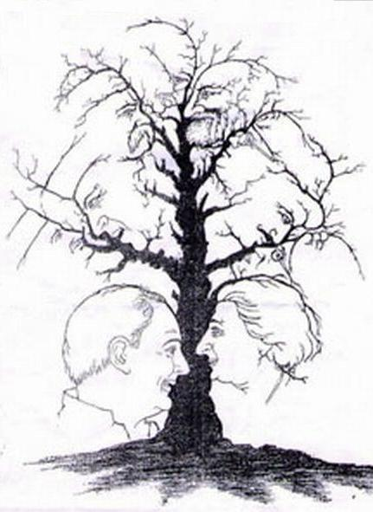
The Head Tree

Slide 22
How sharp are your senses?
Take more time to focus!

Slide 23
Focus with Sensory Acuity!
What did you see?
How many?
Notice how many different observations there are done!

Slide 24
Very much Sensory Acuit!
The answer is 10 group of lines wich you can imagine as heads
Do you want to check once more?
What kind of persons were represented?
Or do you see only what you know?

Slide 25
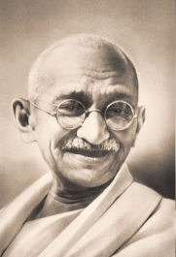
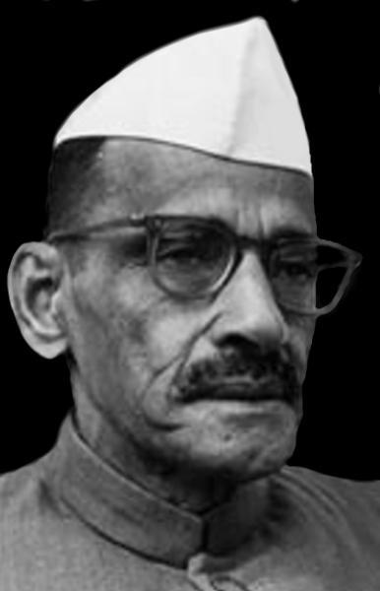
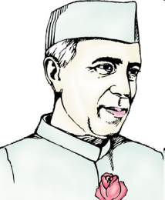
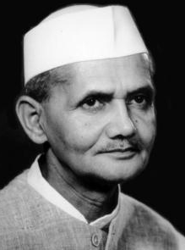
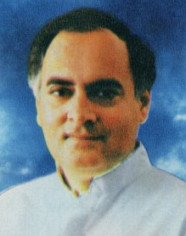
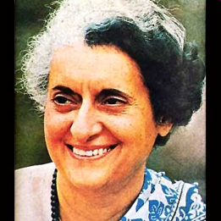
1
2
MahatmaGandhi
1
Gulzarilal Nanda
2
MahatmaGandhi
Nehru
Gulzarilal Nanda
3
3
4
4
Lal Bahadur Shastri
Rajiv Gandhi
5
6
Indira Gandhi
Nehru
Lal Bahadur Shastri
5
6
Rajiv Gandhi
Indira Gandhi

Slide 26
What do we need to get a complete picture?
Attention
Focus on the detail
Focus on the overview
Knowledge about what we can expect
Interest
………

Slide 27
Sometimes it works differently ……..
What do we really need?
Acrocidng to sinefitc rsaerceh at an Eglnhis Uvirntsiey it dseson’t mkae any defenrifce in wchih suqenece the ltreets of a wrod are psiotienod, the olny tnihg whcih is intamropt is taht the fsrit and the lsat lteetr are at the rhgit palce.
The oehetr lttrees may be pealcd on any pacle. You are albe to raed eislaiy waht is wttrien. The rosean is taht we are redinang erevy lteetr saetperlaly but ervey wrod as a wolhe.

Slide 28
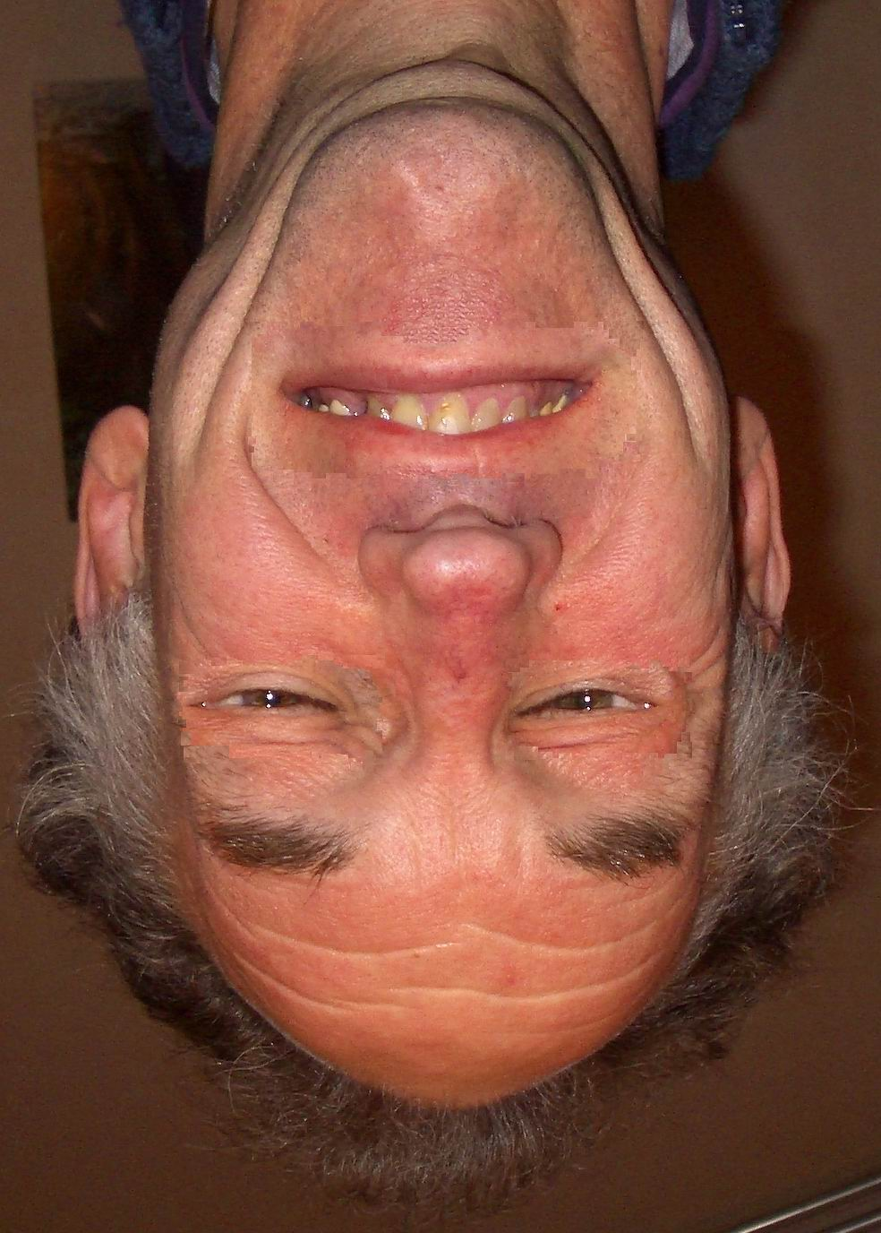
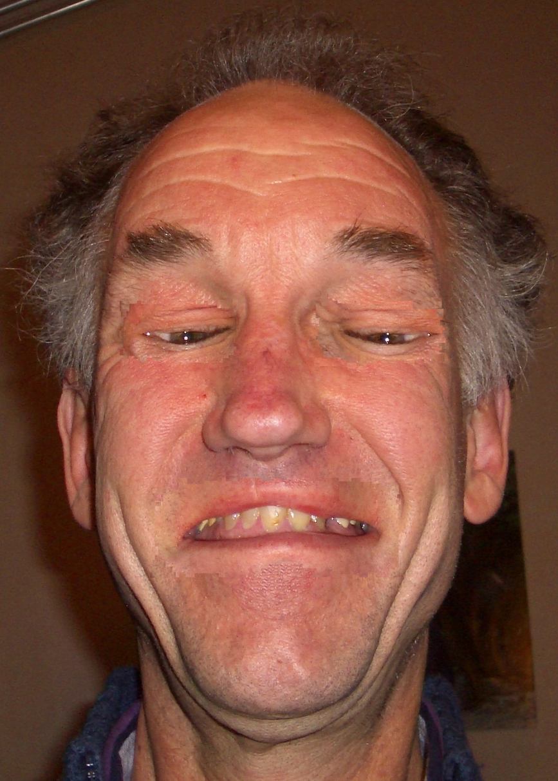
Misleading?
Which emotions following your inerpretations with this person?
What is your interpretation if you turn this photo 180

Slide 29
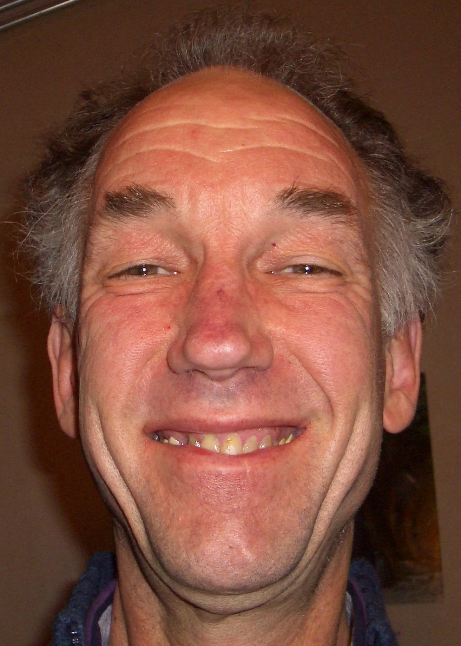
As it was in the original photo

Slide 30
What are the lines doing, you think?

Slide 31
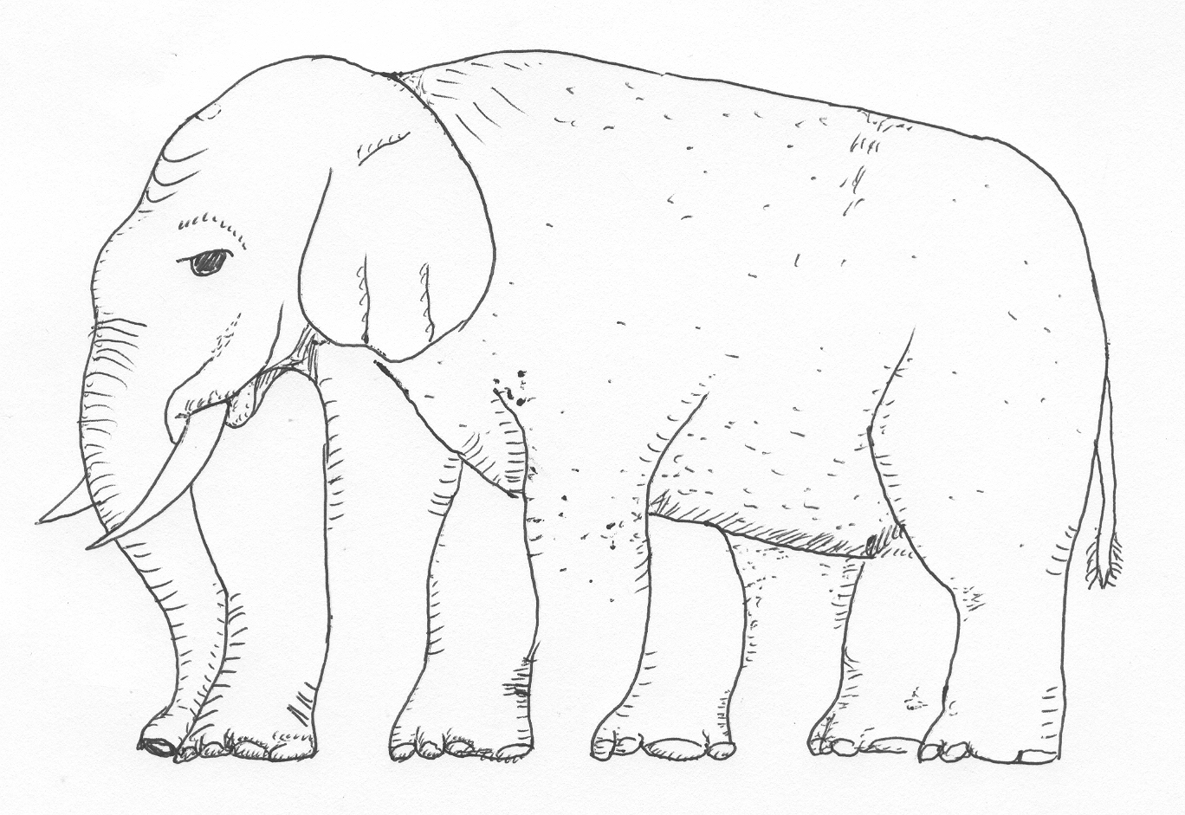
How many legs has this elephant?
And if you cover the lower part?

Slide 32
How many legs has this elephant?
And if you cover the upper part?

Slide 33
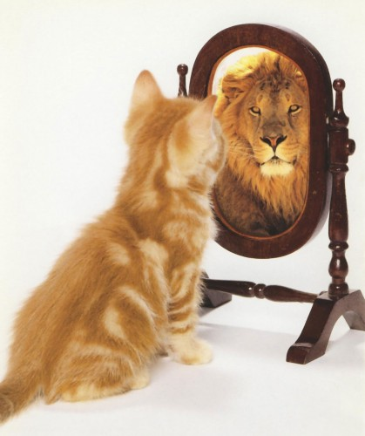
Perception
= Projection

Slide 34
Observation or Interpretation?
Her lips were more narrow and the muscles in her face were strained.
…O.
There was a warm expression on his face.
….I…
It was clear that he felt relieved.
…I…..
I guess that his heart beats at 180 beats per minute.
…I. (O)
Because of the responsibilities of her job she was under heavy pressure.
…I…..
His speaking tempo went faster and the sound of his voice went up.
…O….
When you touched him I could see the curiosity on his face.
…I..
Suddenly her breathing slowed down and her chest hardly moved.
…O..
The color of her face became darker when she looked downward to the right.
….O..

Slide 35
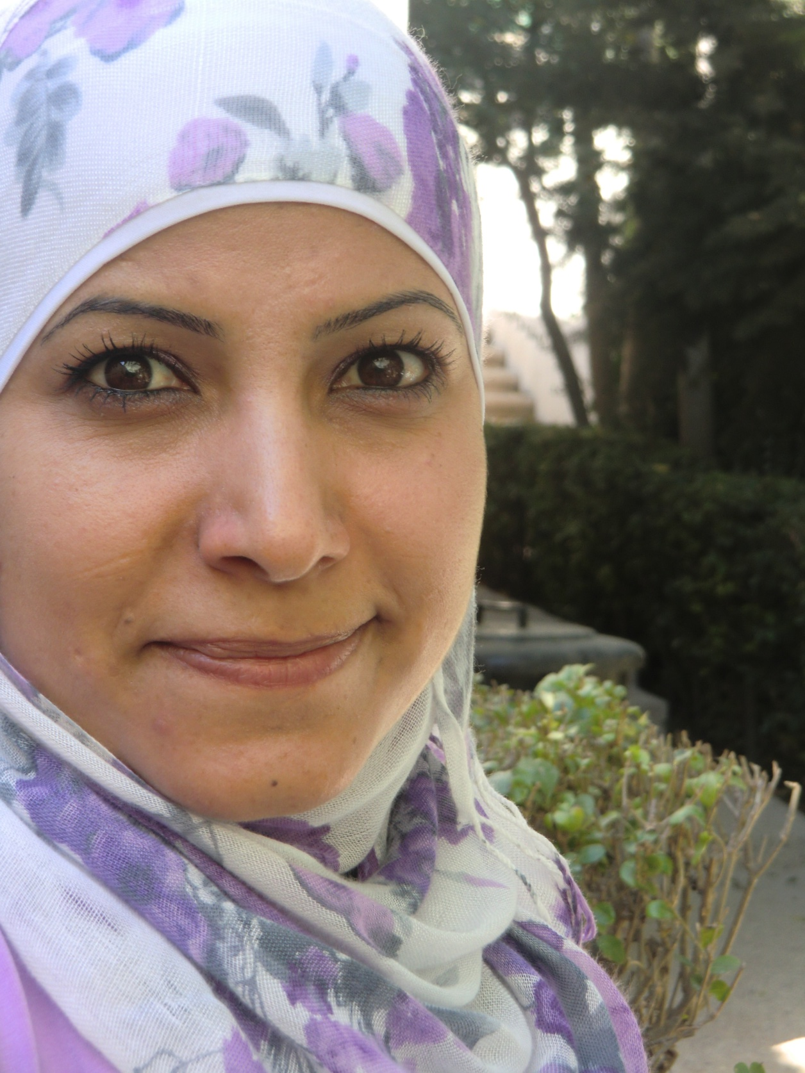
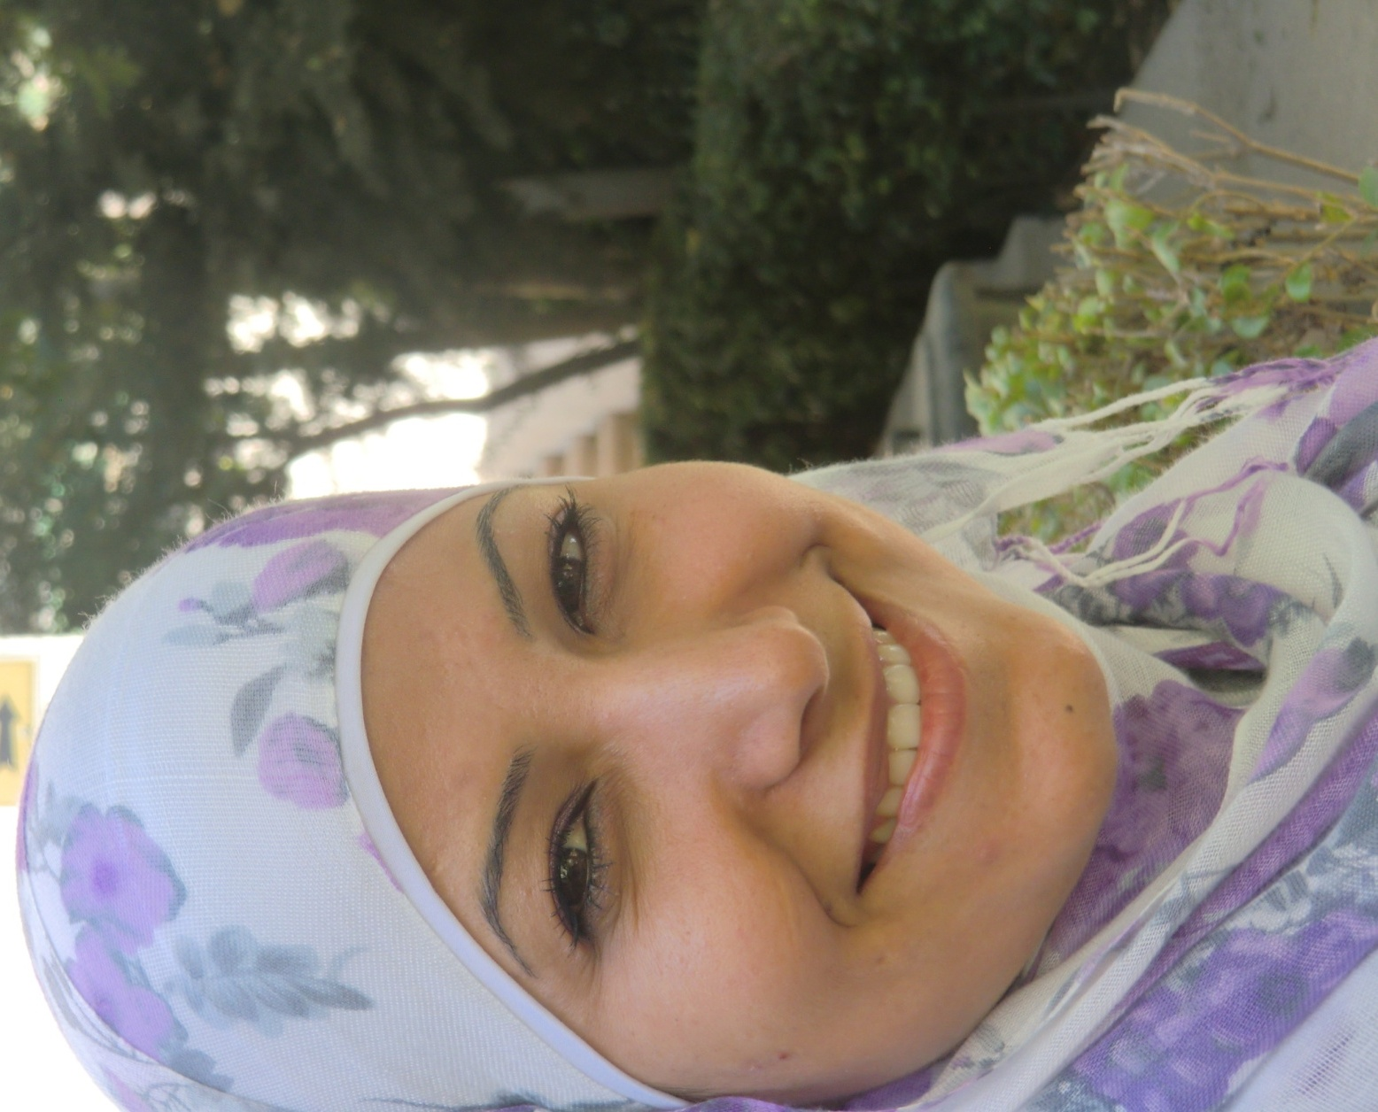
Which caracteristics are changing?
Color of the skin:
Light ………………………………….. Dark
2. Tension of the skin:
Shiny …………………………………. Not shiny
Symmetric ………………………… Asymmetric
Wrinckles in forehead
Flat ……………………………………. Deep
Wrinckles between eyes
Flat ……………………………………..Deep
Wrinckles between eye and ear
Flat ……………………………………..Deep
Wrinckles around the mouth
Flat …………………………………… Deep
3. Breathing
Fast …………………………………….Slow
High …………………………………….Low
4. Size of the underlip, and
position of the mouth corner
Lines …………………………………..No lines
Mouth corner up ……………….Down
5. Eyes
Focus sharp …………………………Not sharp
Pupils …………..…………………… Not enlarged

Slide 36
Exercise Visual Calibration
Think of a not nice person
Look what you see, what you hear, what you feel
Fill in the body language signs with a X
Brake state (eg how many feet are there on the ground
Think of a nice person
Look what you see, what you hear, what you feel
Fill in the body language signs with a O
Brake state
Test: think of that person who you met most recently
Look to the body language and compare it with the first
or the second person

