Slide 1
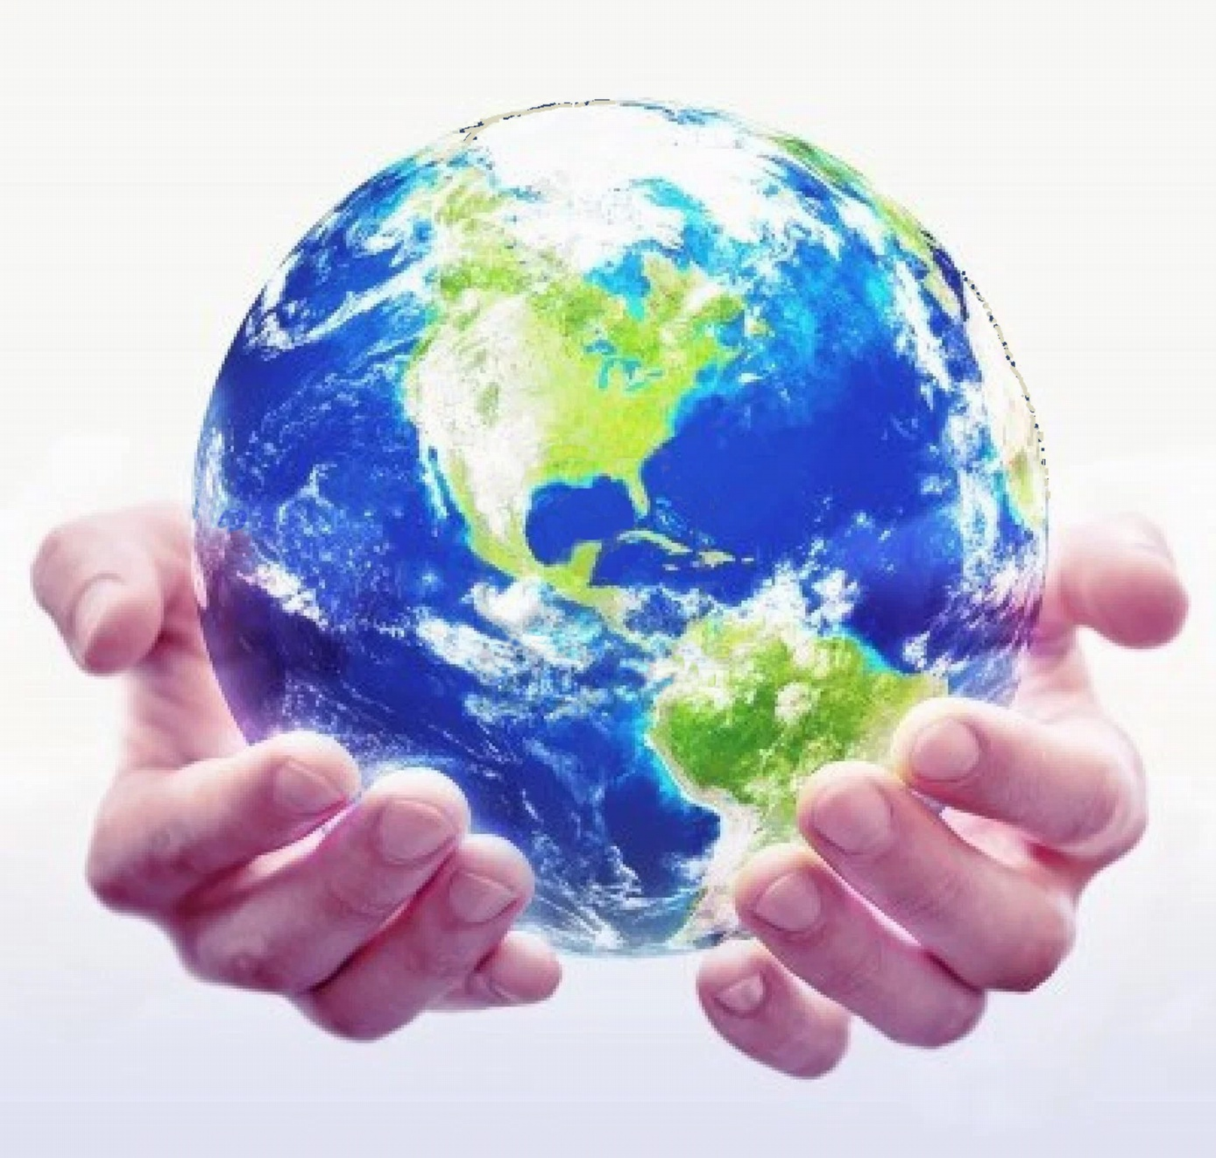
Trust!
Respect for the model of the world of the other and of myself
Enlarging trust in your model of the world
Online workshop for NLP participants in Ramallah November 28 2020

Slide 2
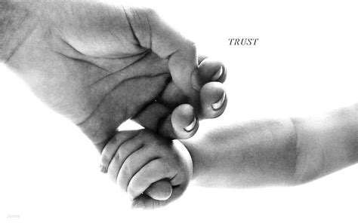
Trust

Slide 3
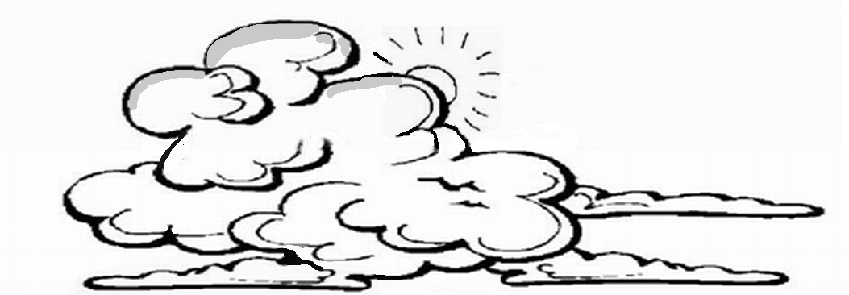
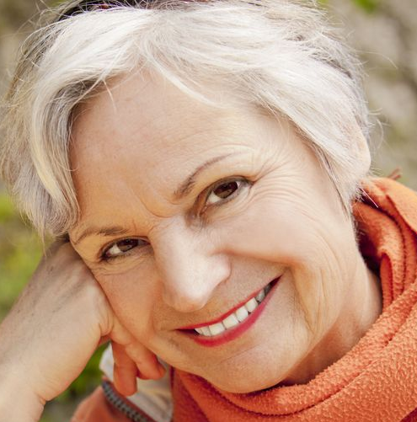
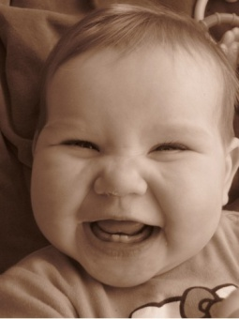
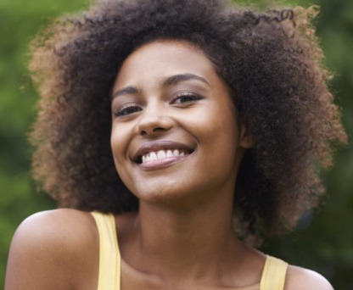
See the sun shining behind the clouds
Focus on a moment in which you felt trust, energy or balance, despite of fear, uncertainty.
Write the title of your experience in the chat.

Slide 4
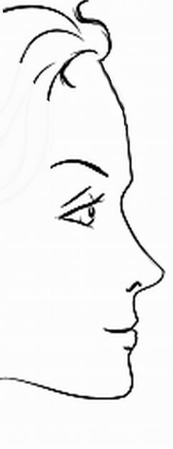
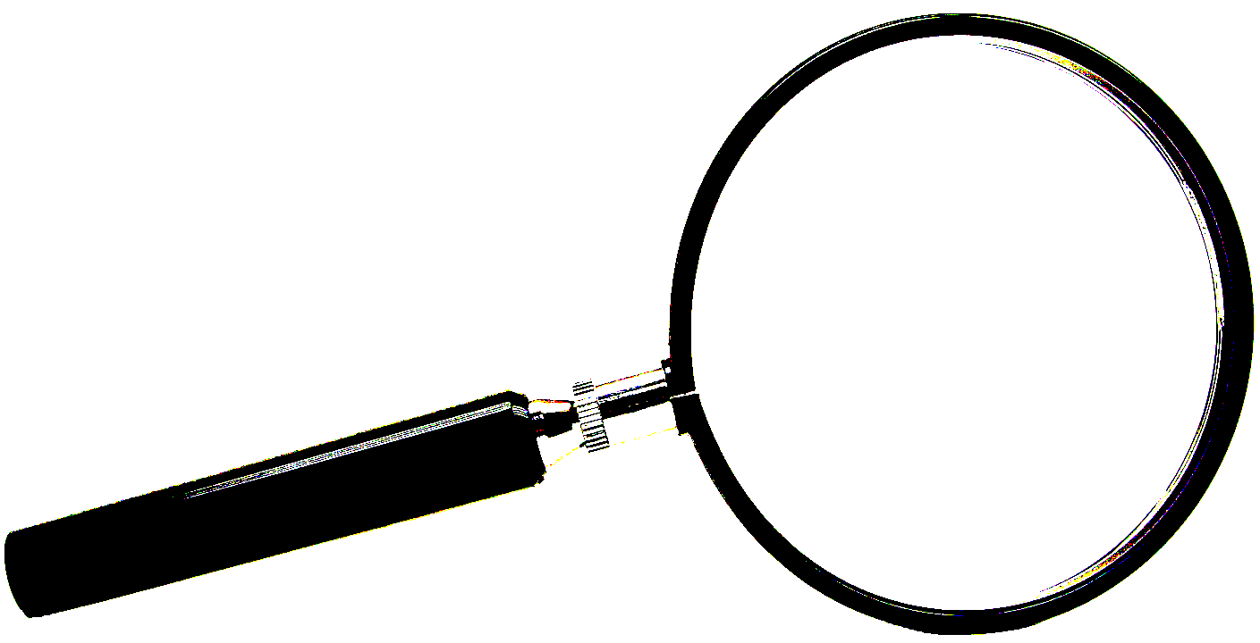
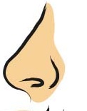
How do you built up trust?
T e r - r i t o r y
Internal
Representation
FILTERS
Delete
External
Stimulus
M a p
Trust
(State, Feelings)
Deform
Generalize
Physiology
Behaviour

Slide 5
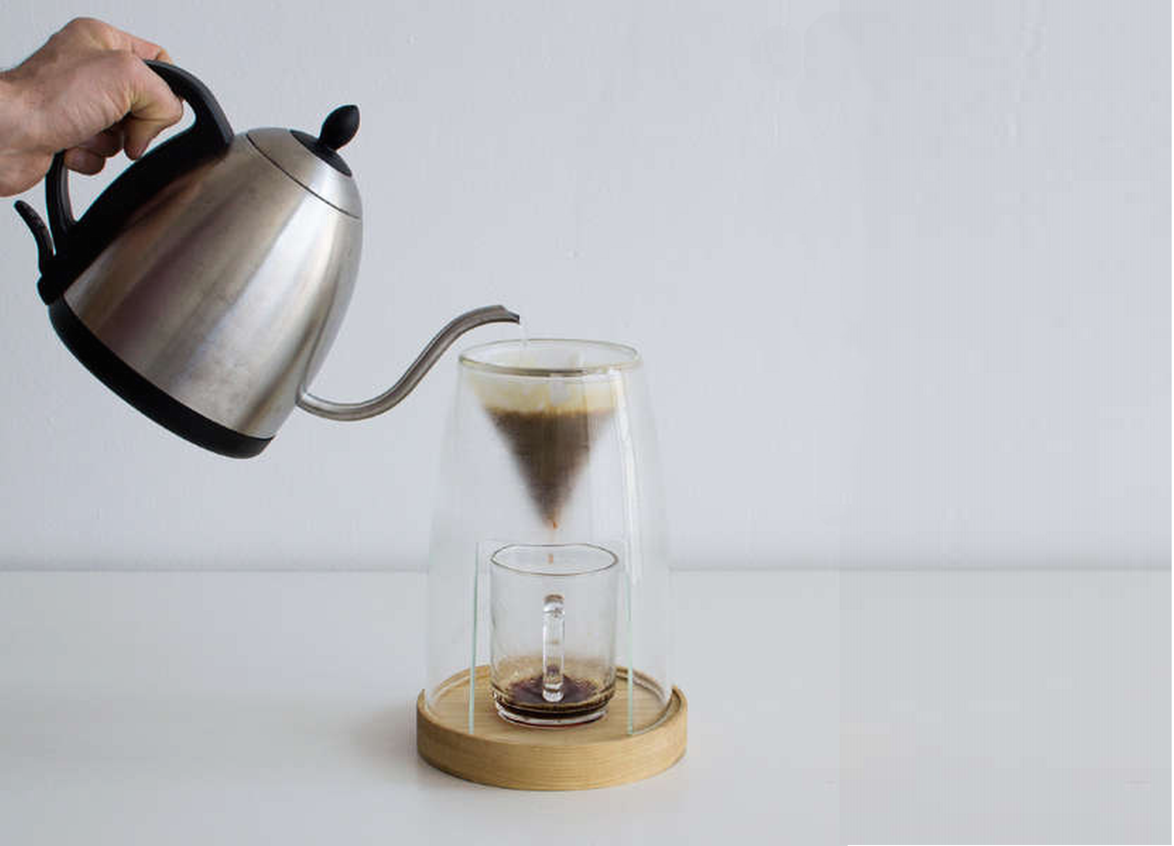
How do I create coffee in my head?
Water
Reality = Territory
My own filters:
delete,
distort and
generalize
give
taste and colour
Ground coffee
+ filter
Coffee to drink
Map =
Internal
representation

Slide 6
Once upon a time ………
Two leaning stones or ………

Slide 7
Focus more on the positive side to create respect and trust.
Often we pay more attention to the negative information about someone else.
Diminish your negative beliefs.
Choose to increase your attention on the positive aspects.
Focus on respect for the fact that others are different.
Recognize the positive values of other persons.
Create trust!
The power of positive thinking

Slide 8
What is my Model of the World?
Do you recognize your negative judgements?
Oh see him/her doing it again!!!
How stupid …
You can’t mean this?
We did not agree to …?
The other does not what you did expect him or her to do!
This very annoying!
The other should change!
I do make my personal picture of the reality.
My filters determine the shapes and the colors of reality.

Slide 9
Respect for my own model of the world
negative
Respect
FILTERS
Delete
Deform
Generalize
and
time/space matter/energy
language
memories
decisions
metaprograms
values and beliefs
attitudes
positive

Slide 10
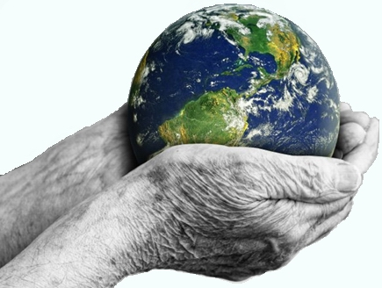
Respect the model of the world of the other
How do you change the other? That is not easy!
Bett is to change yourself first……. This will help:
“I respect the model of the world of the other (and of myself)."
The other does act from the own internal picture.
The own model of the world.
Connect to that model of the world.
In this way you can start building trust in the other.

Slide 11
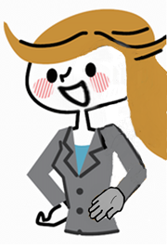
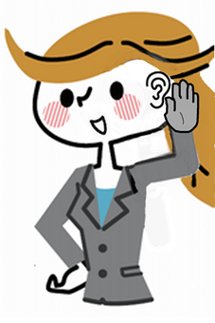
Circle of trust
Observe
with attention
Respect
Ask questions with respect
Listen carefully
Create respect for the model of the world of the other
From respect you develop trust

Slide 12
Exercise
Go to a situation in which you had a lot of selftrust.
Now go to a situation in which you had trust in another person.
Share your situations in groups of two or three.
How did you get this trust?
Click on ‘join’ to enter, we will call you back in 10 min.

Slide 13
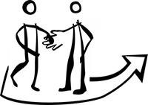
How do you develop trust?
Rapport
Mutual deep trust
Create an emphatic relationship
Respect the others model of
the world
Respect your own model of the world
Understand the others model of the world
Understand your own model of the world
Trust the other
Self trust

Slide 14
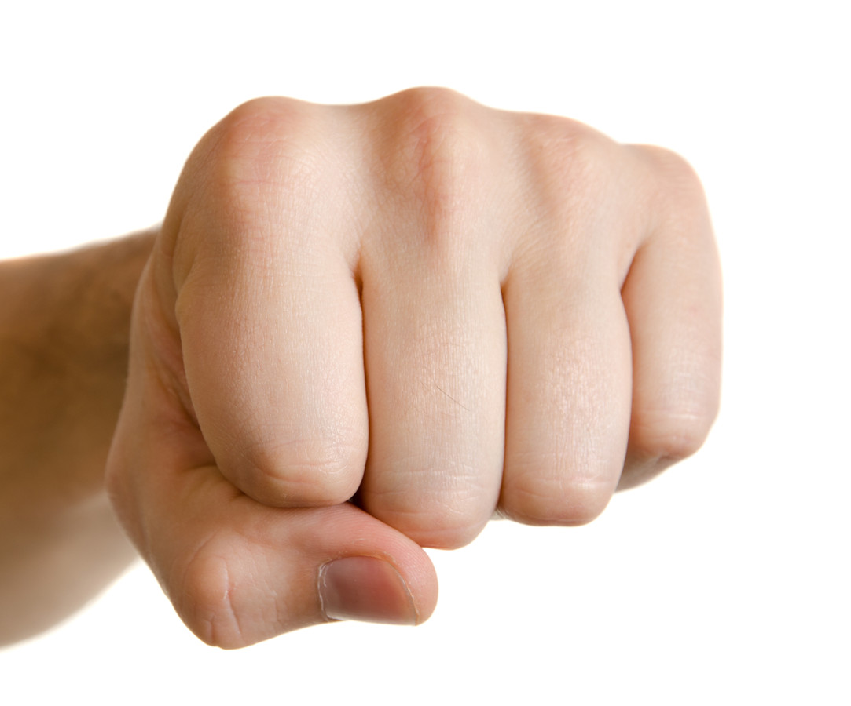
Anchor trust on your knuckles.
self-trust
acceptation
respect
Trust in others
Trust in the model
of the world of others

Slide 15
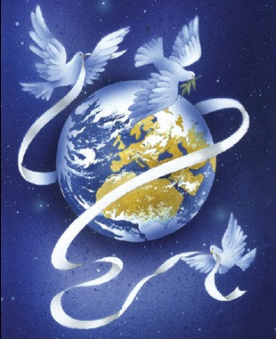
With self trust I fully connect myself with …….
visualisation
Peace in the world
Health and balance of the earth
Trust in change in a positive direction
Respect and love for each other
Sustainability for everyone
The will to create balance
Grandparents, parents, children and grandchildren
Mother Earth
My inner truth
Gratitude
Trust in myself
Trust in the people around me.

Slide 16
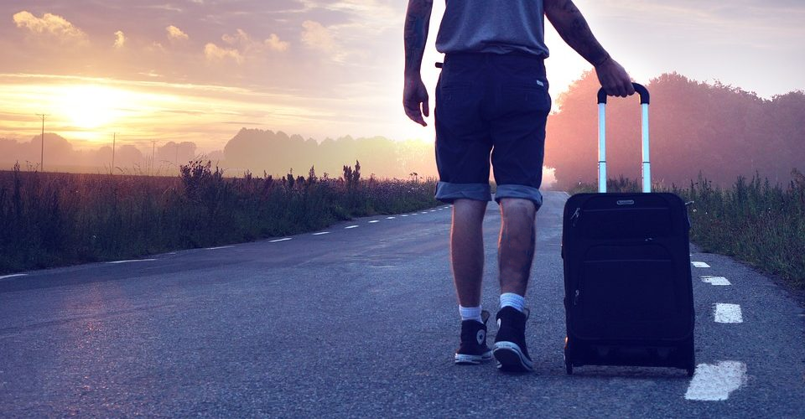
Write in the chat what you take with you from this workshop.

