Slide 1
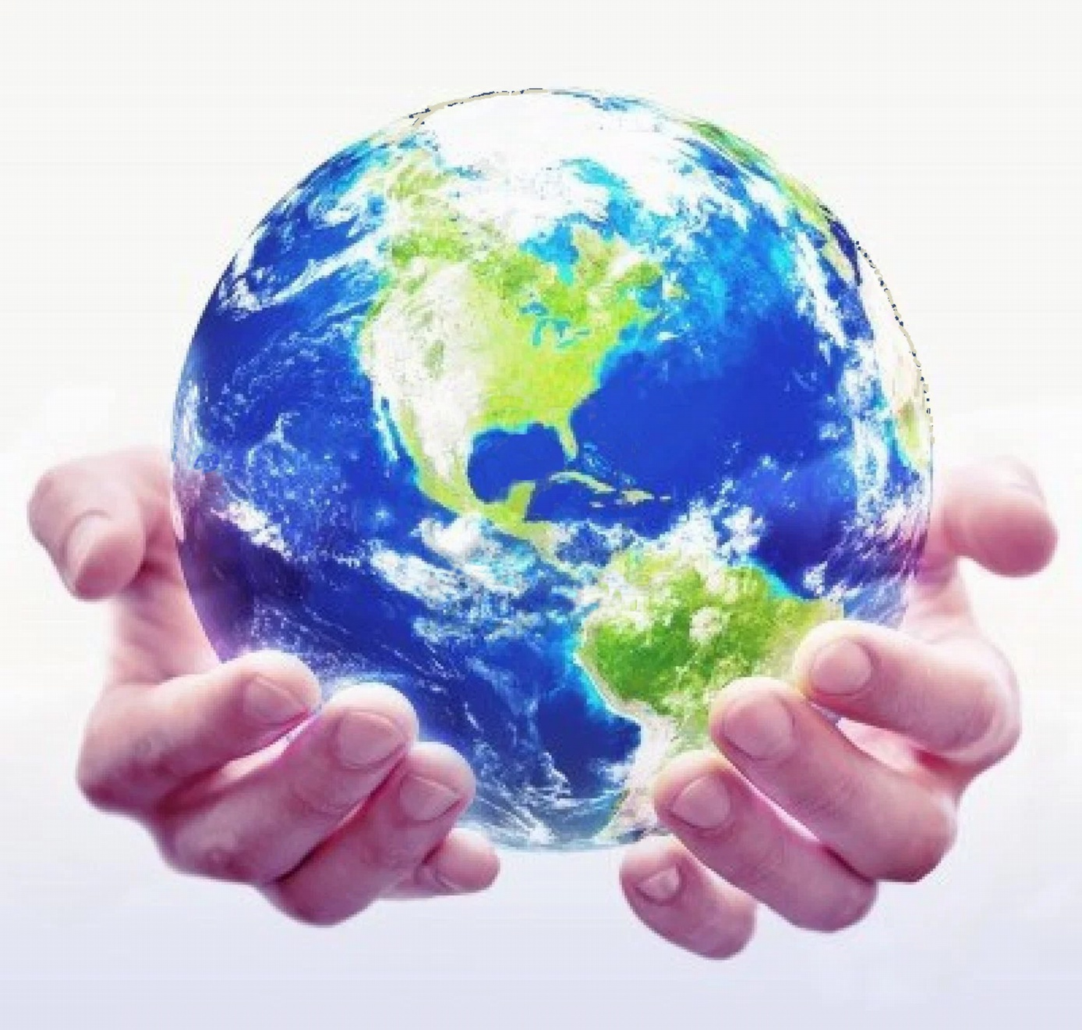
“Develop your unlimited powers even better”
Respect for the model of the world of the other and of myself
Values and Timeline
Dar Al Amal
Day 2, 2017

Slide 2
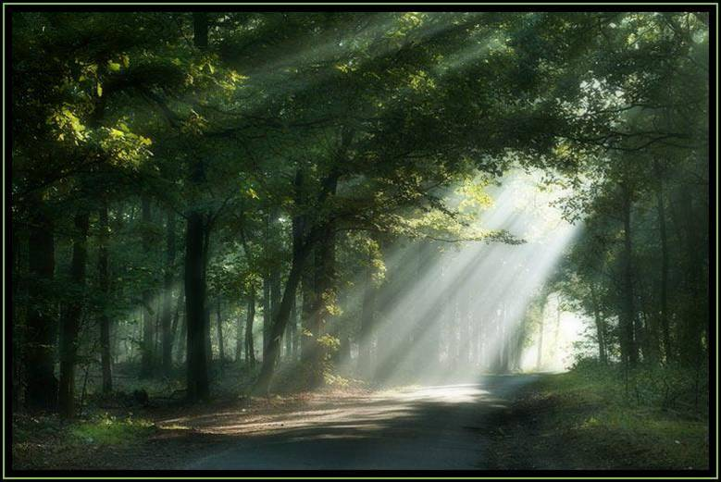
Good and New
In pairs, 2 minutes each.
Focus on a recent event, which was good and new, in which you felt energy, happiness of joy.
Share the title of your experience and show the emotion on your face or in a movement.

Slide 3
Open Frame
Questions
Events
Short stories
Share a real life experience to reflect at it from the point of view of different NLP models and techniques.
Purpose: apply NLP in your own reality.

Slide 4
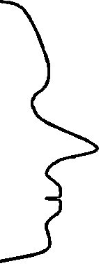
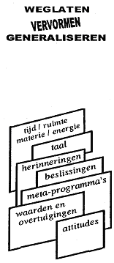
Map
How do we Communicate?
Territory
FILTERS
Internal
Representaion
Delete
Deform
Generalise
External
signal
State, emotions
time/space matter/energy
language
memories
decisions
metaprograms
values
and beliefs
attitudes
Physiology
Behaviour

Slide 5
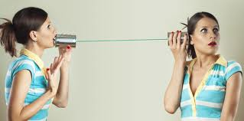
One speaks……. the other listens only.

Slide 6
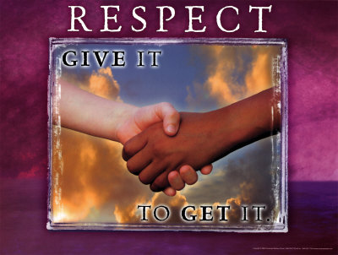
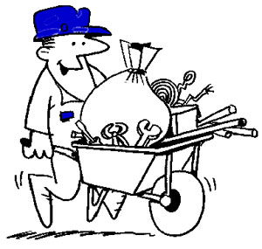
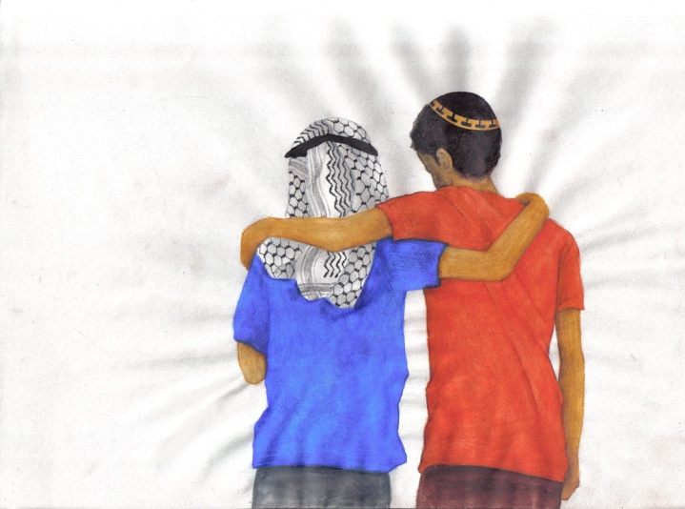
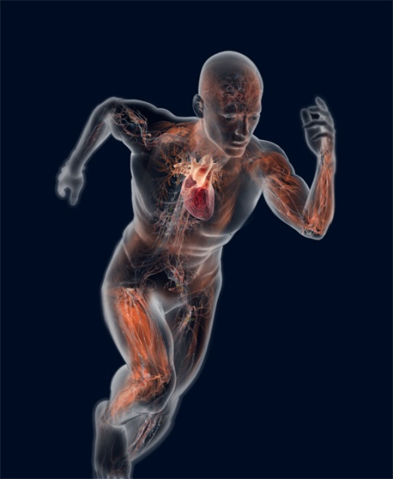
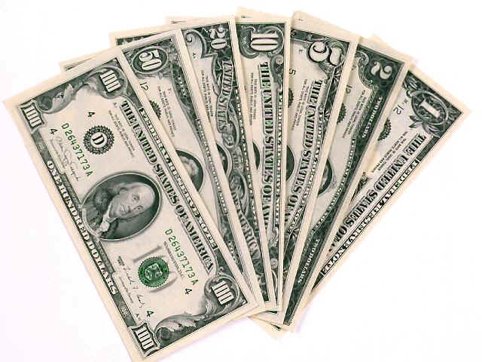
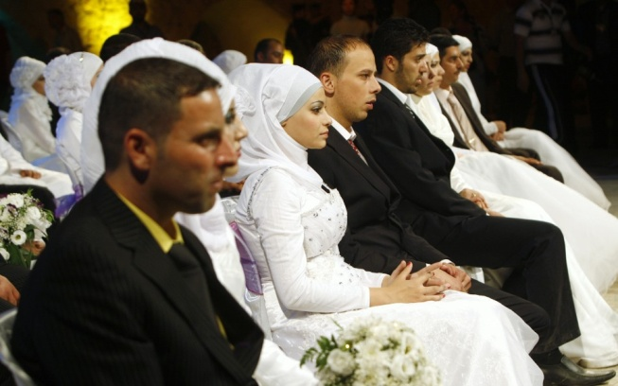
Values
Values don’t fit in a wheelbarrow.
Is money a value?

Slide 7
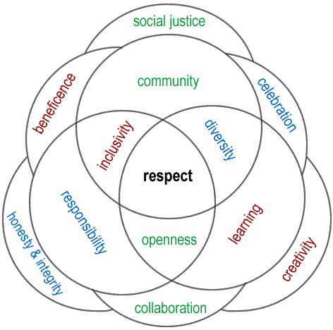
What are your most important Values?
Culture
Religion
Environment
Values, where do they come from?
Sports
Family
Media
Relatives
Economy
School
Ancestors
Work
Friends

Slide 8
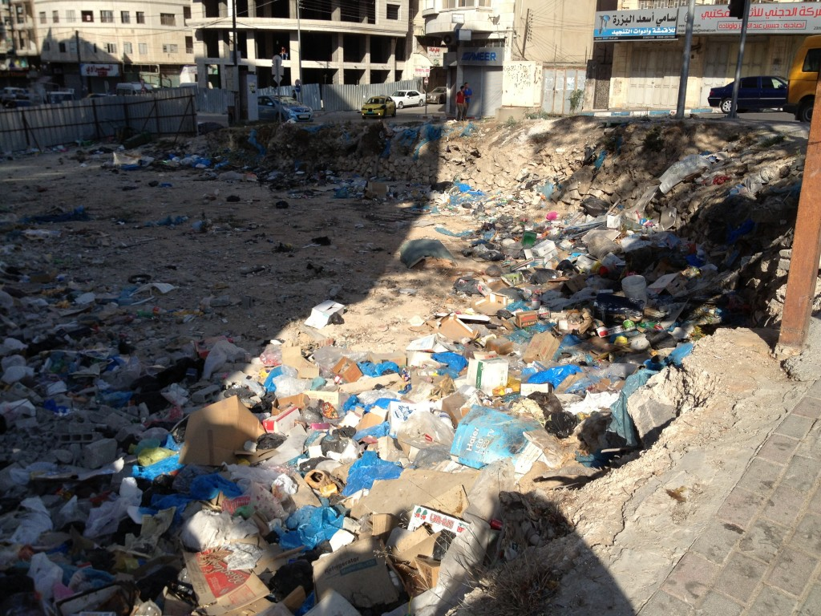
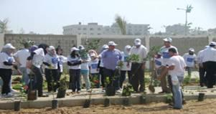
Value: Cleanliness in practice
As part of a project “Environmental Awareness Month,” and in celebration of the 40th anniversary of Earth Day, there was organized a planting and clean-up campaign at Al-Azhar University. More than fifteen faculty and administrative staff members joined approximately 80 volunteers in clearing litter from the garden of the University’s Agriculture College.

Slide 9
The most effective message?

Slide 10
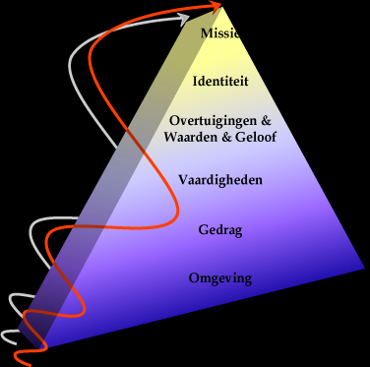
Values on different neurological levels
Exercise:
In pairs 5 minutes each way.
Look at the values you wrote down, from the list on page 30.
Look for which level the values are applicable.

Slide 11
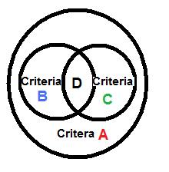
Highly appreciated values
Eour values are also criteria, with which we assess to test if something is in agreement with this value or not.
Which value rates the highest criterion? A, B, C of D?
What could be an example of A, B, C en D?
Eg.. A = Respect, B = Politeness, C = Acceptation and D = Tolerance

Slide 12
An example of a value-belief flower
Example:
I respect people from another culture.
My respect for someone is independent of his or her position in society.
I am able to respect myself just like I respect the people around me.
I respect animals.
I respect nature.
I respect people with other religions.
I respect people of all ages.
3
4
B
B
B
V
2
B
5
B
Respect
B
1
B
6
7

Slide 13
Make your own “value-belief flower”
3
4
Choose a value
Choose beliefs which are connected to and may empower this value.
B
B
B
V
2
B
5
B
B
1
B
6
7

Slide 14
Values as Nominalizations
Values are nominalizations; for example you can think of Satisfaction. Security, Joy, Challenge, Honesty.
Satisfaction is the nominalization of: ……………………………
Security is the nominalization of:……………………………….
Joy is the nominalization of: …………..
Challenge is the nominalization of:………………………………..
Honesty is the nominalization of: ……………………………….
1 to satisfy
2 to assure
3 to enjoy
4 to challenge
5 to be honest

Slide 15
Belief system
3
4
A belief system is:
a series of beliefs organized around a highly appreciated value.
B
B
B
V
2
B
5
B
B
1
B
6
7

Slide 16
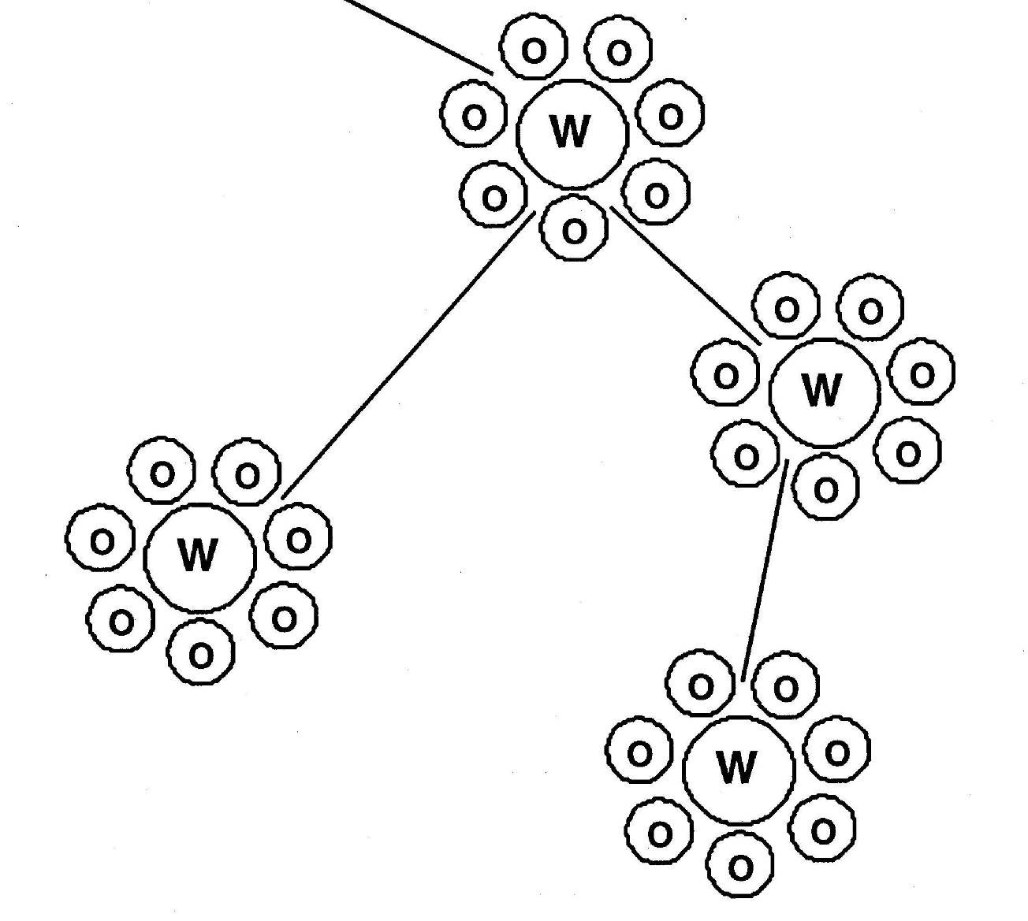
Attitudes / Habits
Are based on groups of values and beliefs.
They are the total of values and beliefs one has related to a certain topic.

Slide 17
How conscious are we in relation to our values?
Fully conscious
Beliefs
Values
Core values
Attitudes
Meta Programs
The greater the influence of our values, the less conscious we are of their function
Fully unconscious

Slide 18
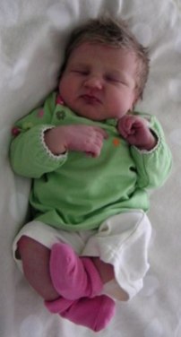
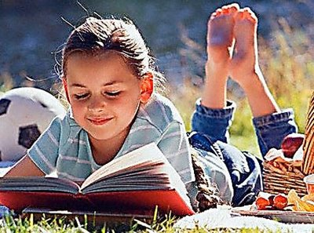
When did you develop your values?
0 year imprinting period 7 year
In this time learning from your parents is mostly unconsciously.
Which values did you learn in this period?

Slide 19
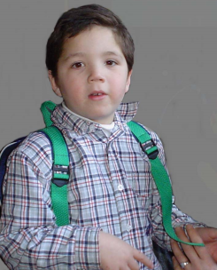
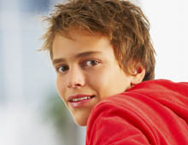
When did you develop your values?
8 years old period of modelling 13 years old
Learning by copying from friends consciously and unconsciously. Some of your most important values you learn around your tenth anniversary.
Which values did you learn in this period?

Slide 20
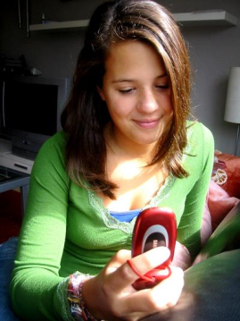
When did you develop your values?
14 years Socialization period 21 years
In this period you learn the values which have influence on your relations.
Which values did you develop in this period?

Slide 21
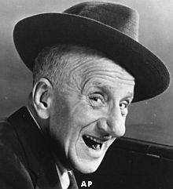
Jimmy Durante
"I thought you would only be with us for some minutes, what did happen?".
His answer was: “did you see those two men at the front row? The first one only had his left arm and the second the right arm.
Together they could applaud. That is what they did all the time, loudly and joyfully."

Slide 22
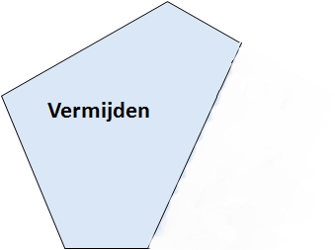
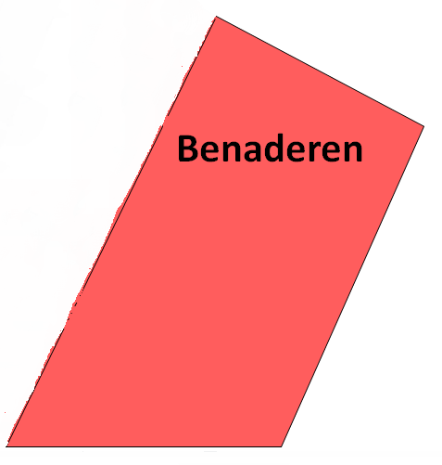
Exercise: How to become even more conscious of your values?
Discover how values are being guided.
Ask yourself: how much (what percentage) do I want to approach that value?
And how much (what percentage) do I want to avoid the opposite? (how much emotions do I feel with this value?)
You may indicate this with percentages, like %80/%20 or %40/%60- etc.
What would you like to reach more?

Slide 23
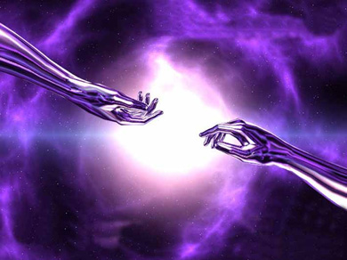

Slide 24
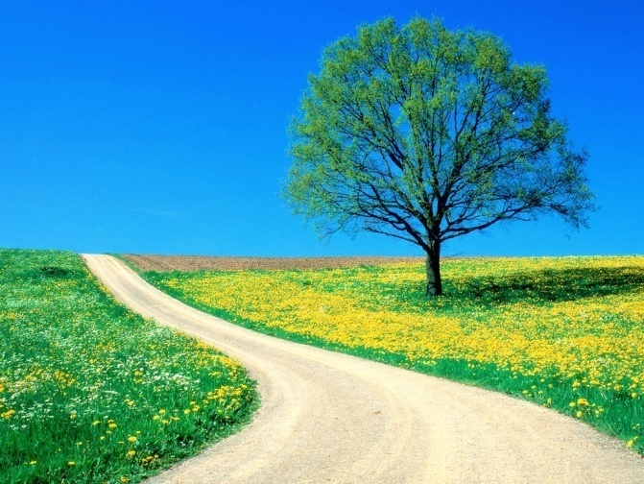
The Timeline
Future
Now
Past
T i m e l i n e

Slide 25
Timeline of humanity
Stone age
Now
Middle Old Stone Age
Late Old Stone Age
Middle-Stone Age
New Stone Age
Future ??????

Slide 26
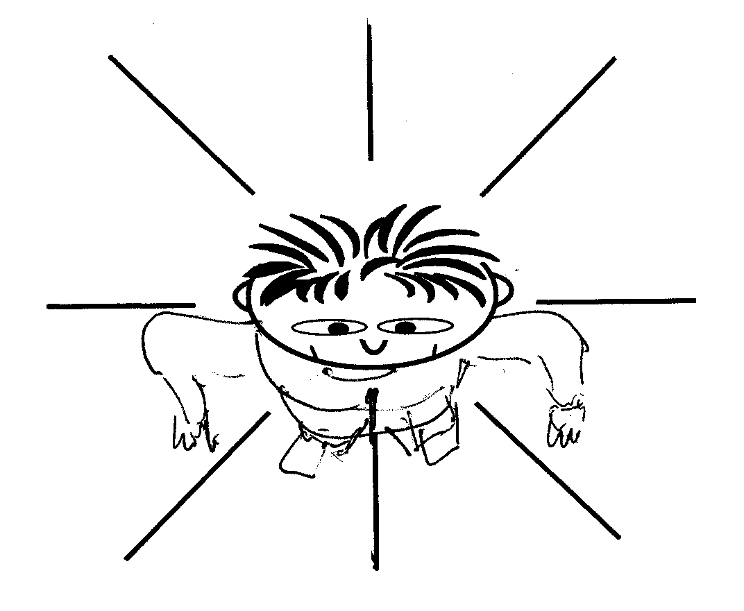
What does your timeline look like?
Stay in touch with your unconscious.
In which way does your unconscious mind
organise and store your memories?
Remember something what happened last week
Notice where it comes from
Repeat step 1. and 2. with memories of 1 month, 1 year, 5 years and 10 years ago
Then repeat step 1. and 2. with something you imagine in future 1 week, 1 month, 1 year.
Do you notice that there is a certain order in the memories and in the future events?
Test: Are you able to imagine that your memories are located in one line?

Slide 27
Timeline
3
2
1
Test 4
‘S.E.E.’
Past
Now
Future

Slide 28
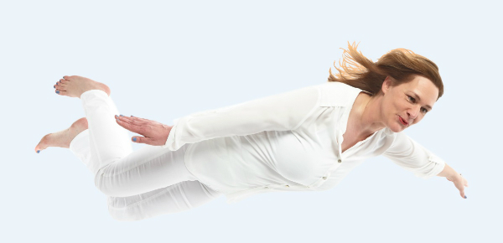
Floating above the timeline
Listen to the wind
Experience how it feel to float above the timeline
Higher up
Past
Now
Future
timeline

Slide 29
Discover the first Significant Emotional Event
Exercise 20
What would you like to improve in your life at this moment?
What does hold you back?
Where in the past did you experience the same feeling? (only mention the title)
With this feeling you walk back on the timeline, mentioning the moments, places, times..
When did you experience this for the first time?
This is your first Significant Emotional Event (SEE).
Gestalt = series of events with the same pattern, beliefs and emotions
1e
SEE
2e
3e
4e
Now
Past
SEE = Significant Emotional Event

Slide 30
Positions above the Timeline
3
2
1
Test 4
SEE
Past
Now
Future
SEE = Significant Emotional Event

Slide 31
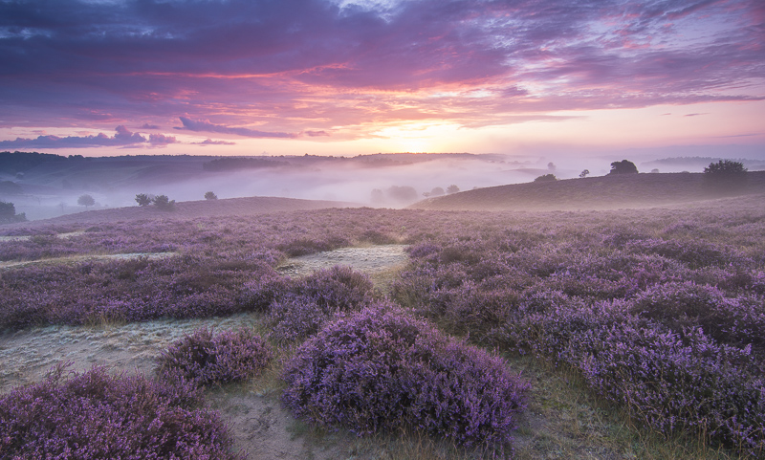
Take your time!
To get wisdom
From the ‘errors’
Which you made yesterday
To remind the good things
Which may give you joy
In length of time
To clean the road behind you
From that what gives you
Needless worries today
To enjoy the rare moments freely
And keep these moments a bit longer
To do exactly what you like to do
And from time to time
Blissful doing nothing
Never missing a single change
Of being happy
And to start with this today
Translated from Valeer Deschacht

